Slide 1
Picfinity
Image Sharing Platform

Slide 2
Architecture Constraints
Type | Constraints | Background and/or motivation
technical | Implementation in Flutter | App should be programmed in Flutter to cover iOS and Android all at once
technical | Third party software/filters must be available under compatible open-source license & installable via a package manager | Developer/architect should be able to check out the sources, compile and run the application without problems external dependencies should be available via package manager/installer
operating system | Mobile OS independent development | application should run on both iOS and Android
organisational | Configuration and version control / management | private git repository to manage commits

Slide 3
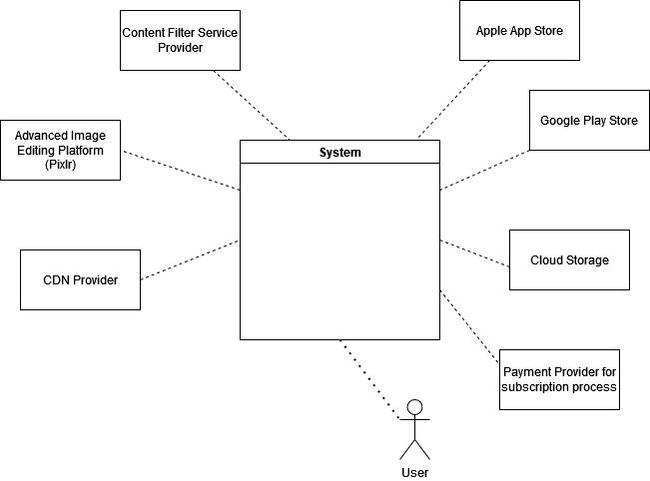
Business Context

