Slide 1


Exploratory Data Analysis for Cars Price Prediction
Eng. Fahad Abdullah AlOmran

Slide 2

3. Tools
1. Methodology
2. Introduction
Outline
4. Workflow
5. Conclusion

Slide 3







METHODOLOGY
Findings and Insights
Exploratory Data
Data Preparation
Problem Understanding

Slide 4

Introduction :
Car price prediction is somehow interesting and popular problem. As per information that was gotten from the Agency for Statistics of BiH, 921.456 vehicles were registered in 2014 from which 84% of them are cars for personal usage. This number is increased by 2.7% since 2013 and it is likely that this trend will continue, and the number of cars will.

Slide 5







Tools
Numpy Library
Python
Jupyter Notebook
PowerPoint
Matplotlib Library
Word
Pandas Library

Slide 6
Dataset
Data provided by Kaggle has been used in this project website: ( https://www.kaggle.com/hashroo t97/carpriceprediction )
8,084
Rows
11
Columns

Slide 7


Workflow:
Drop null values
Update inconsistent data
Drop duplicates
Drop rows / columns
Answer questions

Slide 8
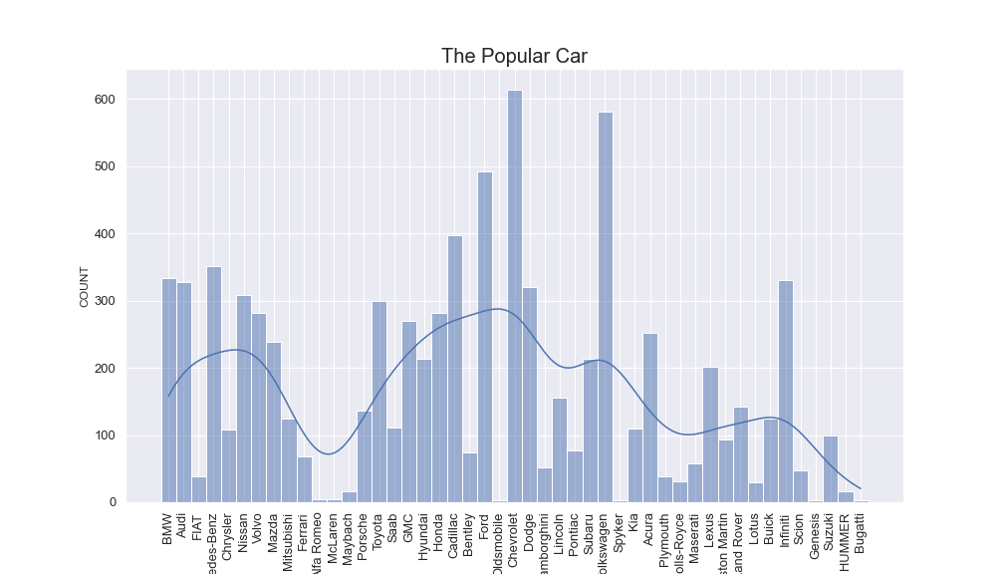

Results :
Which type of car is more popular?

Slide 9
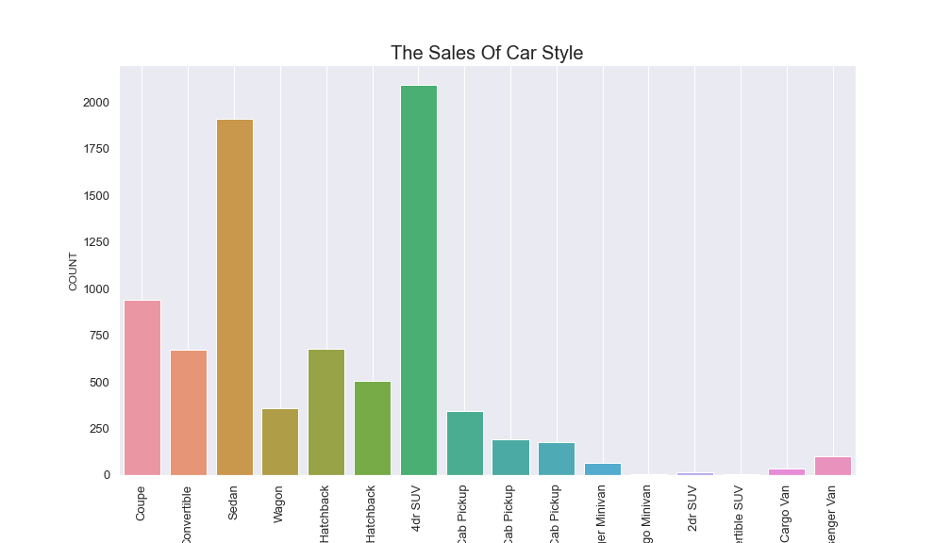
Results :
What is more selling of car style?

Slide 10
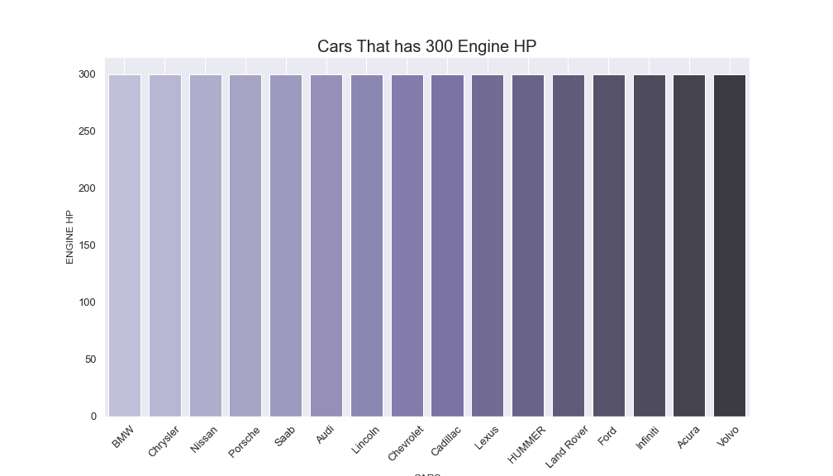
Results :
Which cars that has the 300 of engine horsepower?

Slide 11
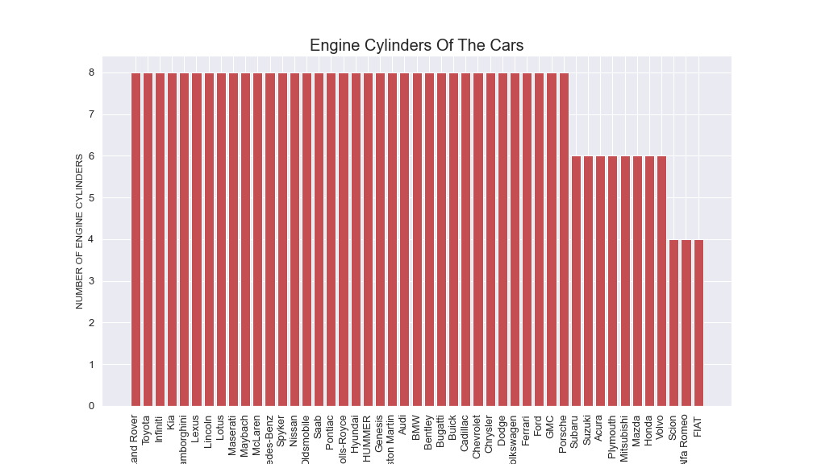
Results :
How many cars that has 4 engine cylinders and cars that has 6 engine cylinders?

Slide 12

Challenges
Google many times to get some codes we need to it
Remove Outliers

Slide 13
Conclusion :
I learned how to write the codes through which the most popular car was known.
We saw which the more sales of car style, which cars that has 300 Engine HP and we was show cylinders of each car.
I have practice google searching for codes and how to get to the right way.
I concluded the exploratory data analysis is an approach of analyzing data sets to summarize their main characteristics.

Slide 14
Thank you

