Slide 1

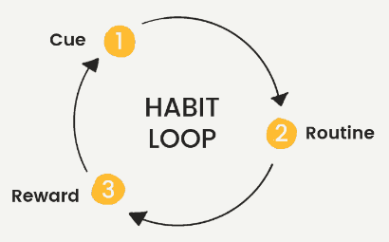
RENEW
Allie Offer

Slide 2
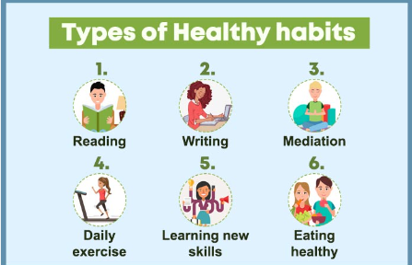
WHAT CAN
RENEW DO?
Makes tracking your habits simple
Easily create new habits and implement them into your daily routine

Slide 3
WHY HABITS?
5 CATEGORIES FOR HABITS
EXERCISE
FINANCIAL
HEALTH
WELLBEING
AROUND THE HOUSE
Habits are essential to many aspects of life
Creating new healthy habits and breaking old bad habits create efficient routines
Tracking habits makes this cycle easier

Slide 4
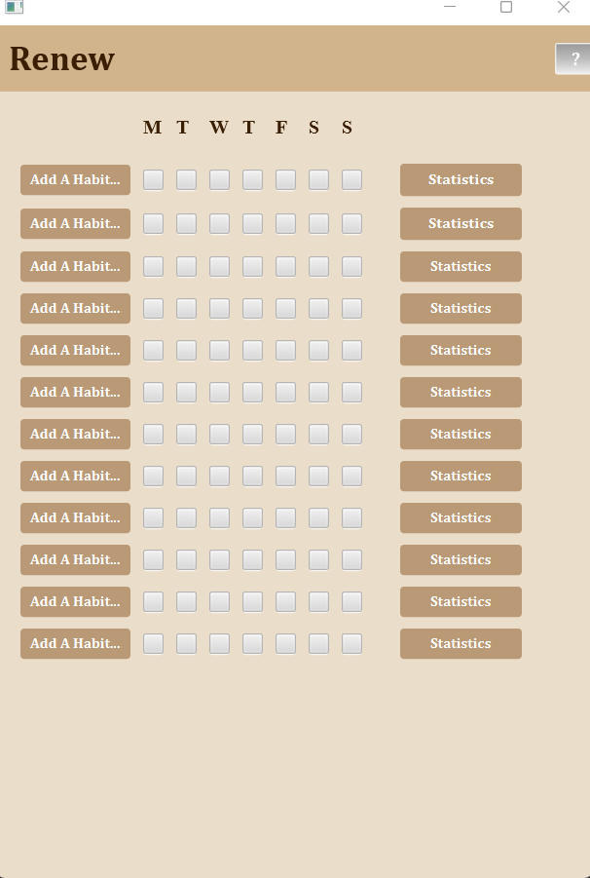
DESIGN PROCESS
Created my classes
Each class inherited the main class Habit
Each subclass had its own unique subcategory combo box
Created the home scene
Created each add a habit scene
Created each statistics scene
Used the checkboxes to determine the statistics calculations
Checked for where I needed error messages, clear buttons and home buttons
Created the error class

Slide 5
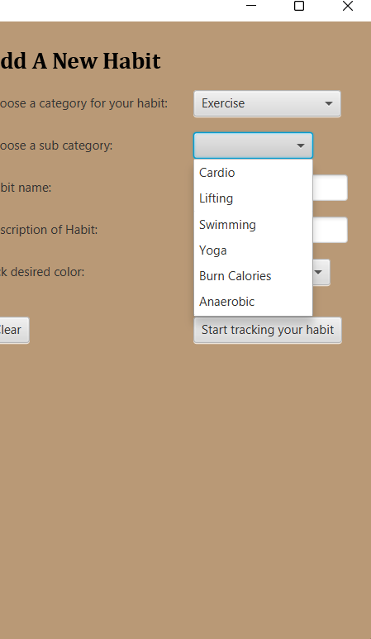
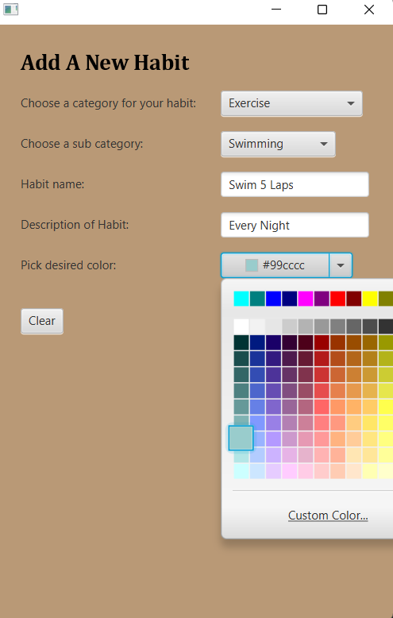
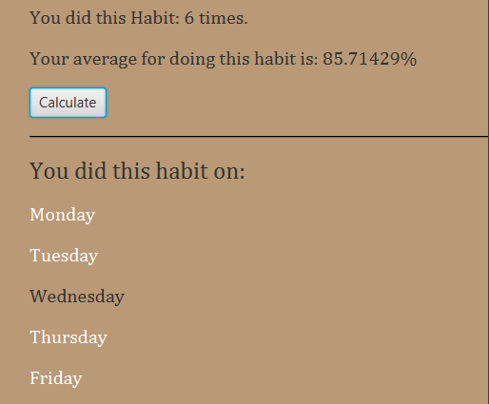
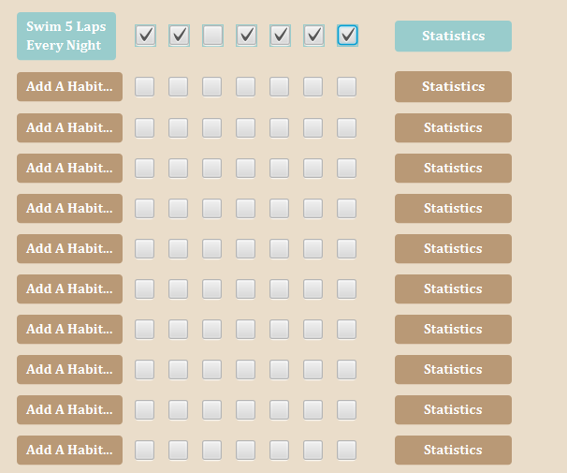

Slide 6
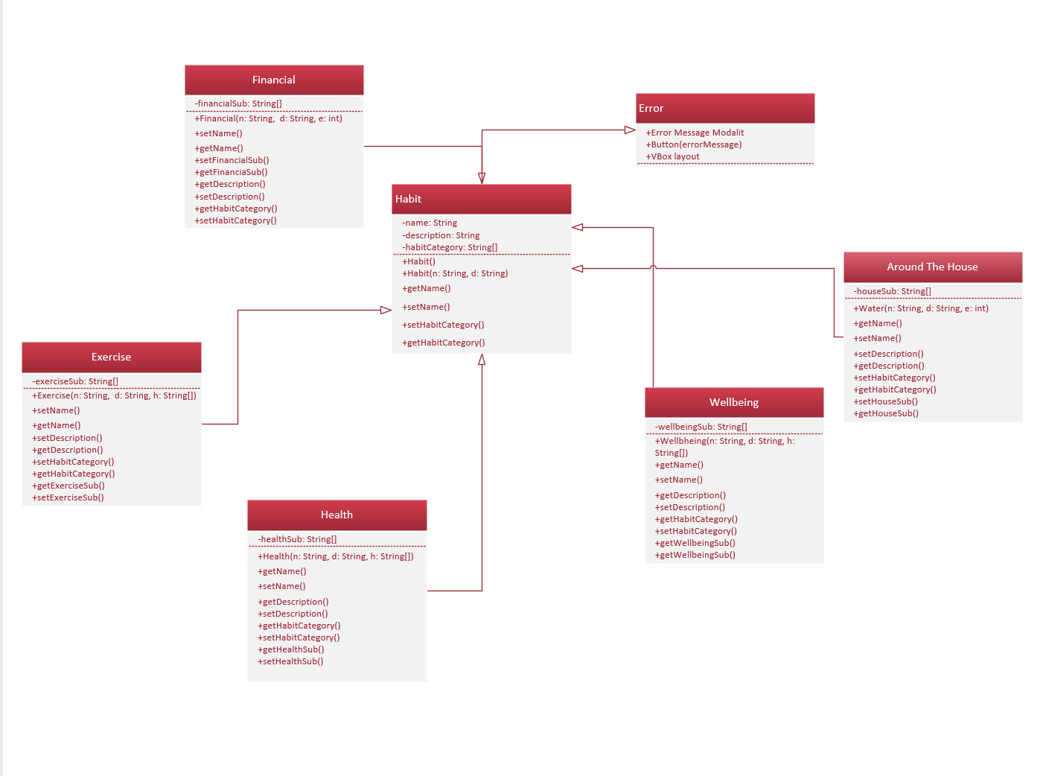
UML

Slide 7
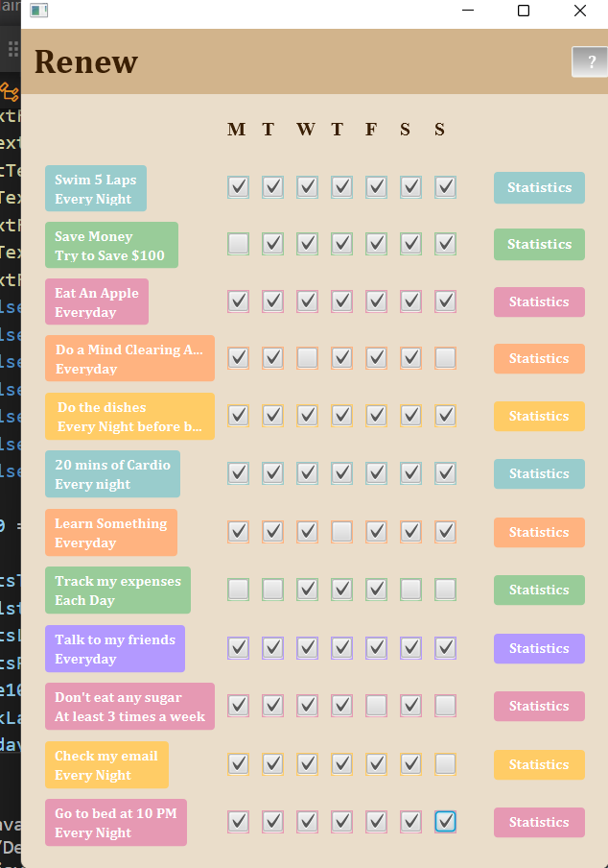
WHAT DID I LEARN?
The original idea I had needed many improvisions
Constant process of revising
The code can be simplified in many ways
It is easy to do more work than needed

