Slide 1
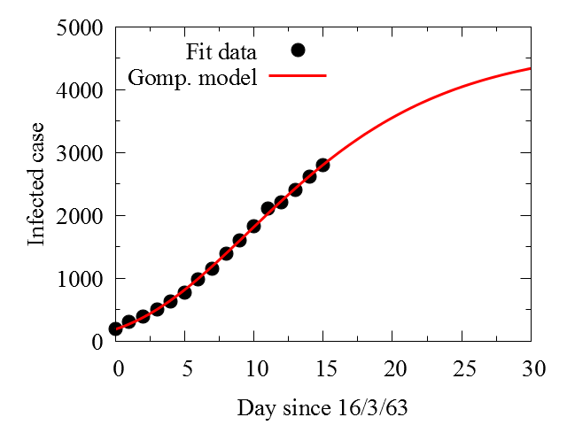

t=0 at 16/3/2563
$$f\left(t\right)=ae^{−be^{−t/c}}$$
Model :
Fit parameters :
a=4712.08
b = 3.22738
c = 8.21227
degrees of freedom (FIT_NDF) : 13
rms of residuals (FIT_STDFIT) = sqrt(WSSR/ndf) : 31.6067
variance of residuals (reduced chisquare) = WSSR/ndf : 998.984
Final set of parameters Asymptotic Standard Error
======================= ==========================
a = 4712.08 +/- 251 (5.328%)
b = 3.22738 +/- 0.04515 (1.399%)
c = 8.21227 +/- 0.4203 (5.118%)

