Slide 1



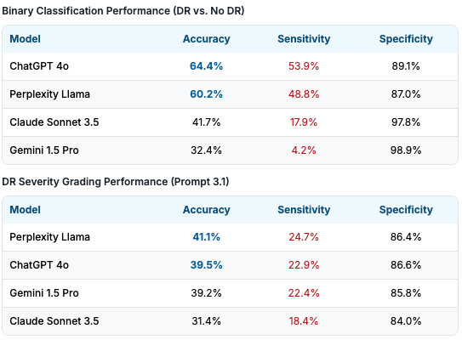
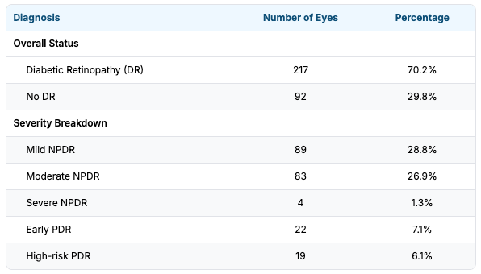
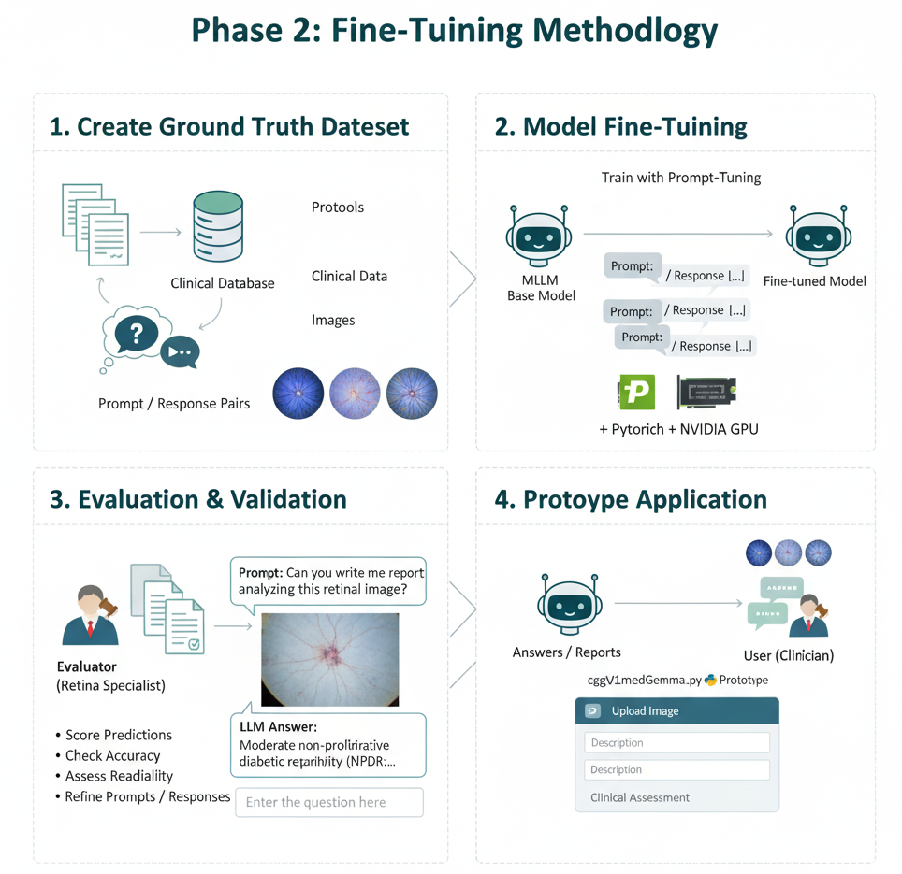
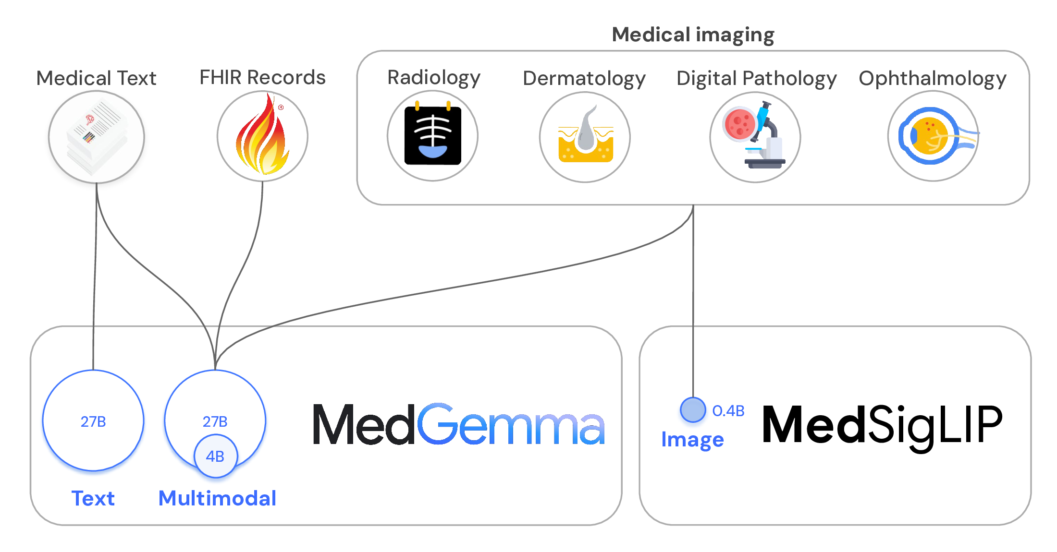


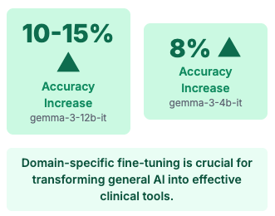
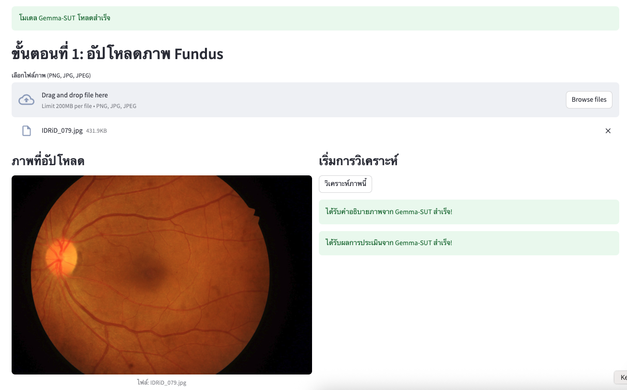
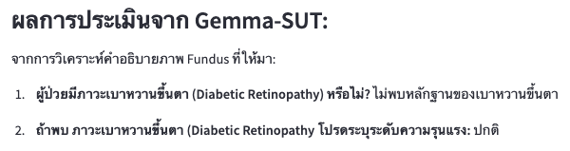
Development of Fine-tuning Multimodal Large Language Models for Diabetic Retinopathy Analysis
Authors: Asst. Prof. Dr. Ittipon Fongkaew¹*, Dr. Panithan Sriboriboon¹, Assoc. Prof. Dr. Panomsak Meemon¹, Dr. Juthaporn Assawachananont, M.D.²
¹Suranaree University of Technology, ²Suranaree University of Technology Hospital
Introduction
Diabetic Retinopathy (DR) is a leading cause of blindness, affecting over 103 million people globally. In Thailand, only about 45.5% of the 3.6 million diabetic patients receive the necessary annual eye screenings, largely due to a shortage of ophthalmologists. While general-purpose Multimodal Large Language Models (MLLMs) like GPT-4o and Gemini show promise for image analysis, their reliability for clinical diagnosis is still uncertain. This research aims to first quantify the baseline performance of these general MLLMs and then develop a specialized, fine-tuned model using MED-Gemma to significantly improve diagnostic accuracy for DR, creating a reliable tool to support clinicians and expand screening accessibility.
Phase I : Baseline Evaluation of General MLLMs
This initial phase evaluated the out-of-the-box performance of leading MLLMs on DR diagnosis, based on the a quantitative evaluation study "Can Multimodal Large Language Models Diagnose Diabetic Retinopathy from Fundus images? ".
Methods
Ultra-widefield fundus images from patients seen at the University of California, San Diego data base, were graded for DR severity by 3 retina specialists using the ETDRS classification system to establish ground truth. Four MLLMs (ChatGPT-4o, Claude 3.5 Sonnet, Google Gemini 1.5 Pro, and Perplexity Llama 3.1 Sonar/Default) were tested using 4 distinct prompts. These assessed multiple-choice disease diagnosis, binary disease classification, and disease severity.
Results: Highly Variable & Unreliable
Cohort Ground Truth Disease Status & Severity (n=309 Eyes)
Conclusion (Phase 1)
Results Summary: From 309 eyes, 70.2% had DR. For binary classification, ChatGPT had the highest accuracy (64.4%), but sensitivity was highly variable and low across models (4.2% to 53.9%), while specificity was high (87.0%-98.9%). For severity grading, accuracy was poor (highest 41.1% by Perplexity) with very low sensitivity. While MLLMs show potential, their current diagnostic performance falls short of clinical standards for safe implementation in DR screening due to variability and low sensitivity.
Phase 2: Fine-Tuning with MED-Gemma model
To address the limitations identified in Phase 1, we fine-tuned Gemma, a state-of-the-art open model, using MED-Gemma, a version specialized for the medical domain.
Application Prototype:
Results & Improvement
Overall Conclusion & Future Work
Specialized fine-tuning significantly improves MLLM performance, creating a path towards reliable AI-powered tools to assist in the fight against diabetic blindness.
Next Steps:
Conduct larger-scale clinical validation and Integrate into telemedicine platforms for remote deployment.

