Slide 1
Classifier evaluation
How can we measure the performance of different classifiers

Slide 2
Introduction
Performance: assessing how well a classifier classifies new cases
Explanatory: interpretability
Decision tree, rule sets vs logistic regression, artificial neural nerworks

Slide 3
Partitioning the Examples
Constructing a classifier
Full set
Training set & Test set
Trainting set, Test set & Hold-Out-set

Slide 4
Systematic Partitioning Methods
Lucky or unlucky splits
Cross Validation
Bootstrapping

Slide 5
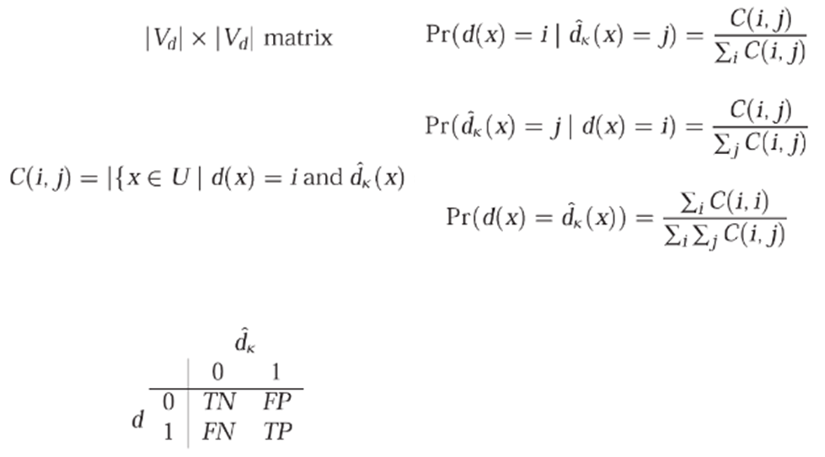
Confusion Matrices
Sensitivity
Specificity
2 x 2 matrices

Slide 6
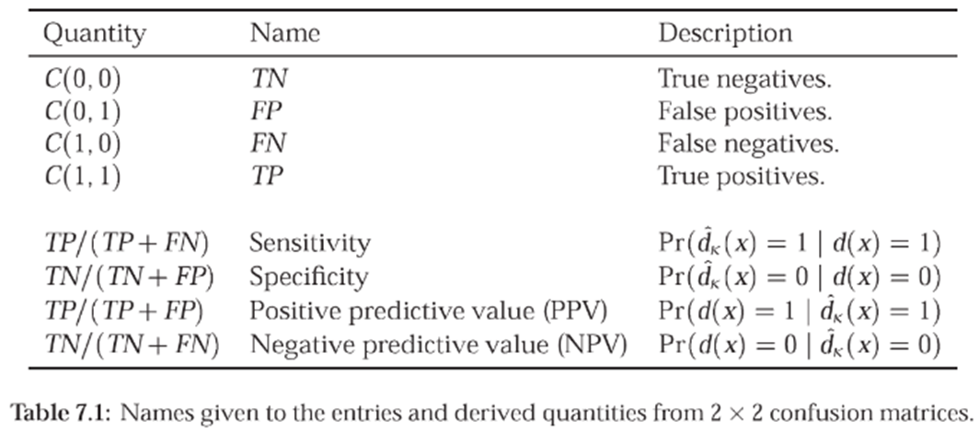
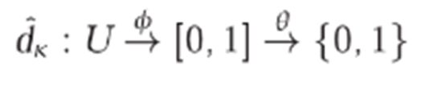

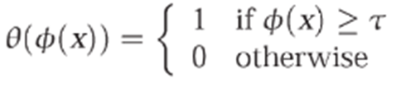
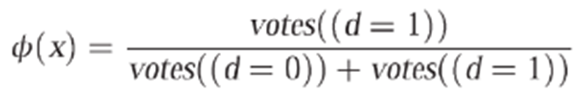
Binary Classifiers
•Realizing

Slide 7
Discrimination and Calibration
Discrimination:
  Guessing the correct class when given an object
  Measure of performance
    Accuracy, Area under ROC-curves
Calibration
  Calibrated-in-the-small
  Well separated certainty values

Slide 8
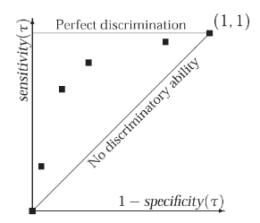
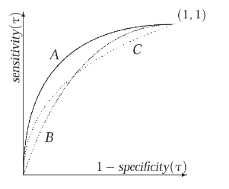
ROC Curves
Representation of discrimination
  Independent of class distributions and error cost
A function of the threshold value t
Uses sensitivity and specificity
Comparing ROC curves
Notes:
ROC kurver som dominerer en annen er en bedre calssifier. Det betyr ikke nødvendigvis at den er best I praksis, fordi den ikke tar med kosten ved å gjøre feil.
Sensitivitet = TP/(TP+FN), Sier noe om hvor mange positive cases som blir misset
Spesifisitet = TN/(TN+FP), Sier noe om hvor mange negative cases som blir miseet.
Hvis du er veldig sensitiv for at noe som er positiv klasse blir feilklassifisert, så vil du ha høy sensitivitet (høyt på grafen)
Hvis du er veldig sensitiv for at noe som er negativ klasse blir feilklassifisert, så vil du mot venstre.
Ideelt sett venstre og opp.

Slide 9
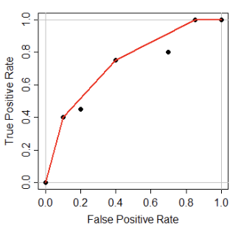
ROC Convex Hull Method
Usually, the curves cross at some point
Which ROC curve is optimal for certain class and cost distributions?
1) Compute convex hull of all the points on the ROC. If a classifier does not contribute to a point on hull, it can never be optimal
Encode class/cost distribution, superimpose this as tangent on hull. Classifier that contributed to the tangent/hull point is the best classifier under these conditions
Tabulate under which class/cos contributions that the hull-contributing classifiers are optimal
Notes:
Convex hull = pareto front
Superimpose = legge over

Slide 10
Interpreting the ROC curve
Slope:
  Likelihood ratio
Integral:
  Area-Under-Curve
  Performance measure
  Ideal: 1
Notes:
AUC: 0.5 random classification

Slide 11
Selecting a threshold
The ROC plots multiple thresholds, but we need to choose one
False positives vs false negatives
  Equal: Northwest point
  Where
    πi = a priori probability of Xi
    Ci = cost of misclassification for Xi

