Slide 1
Retrieval Based NLP

Slide 2
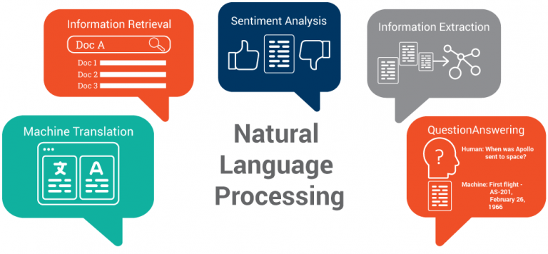

Slide 3
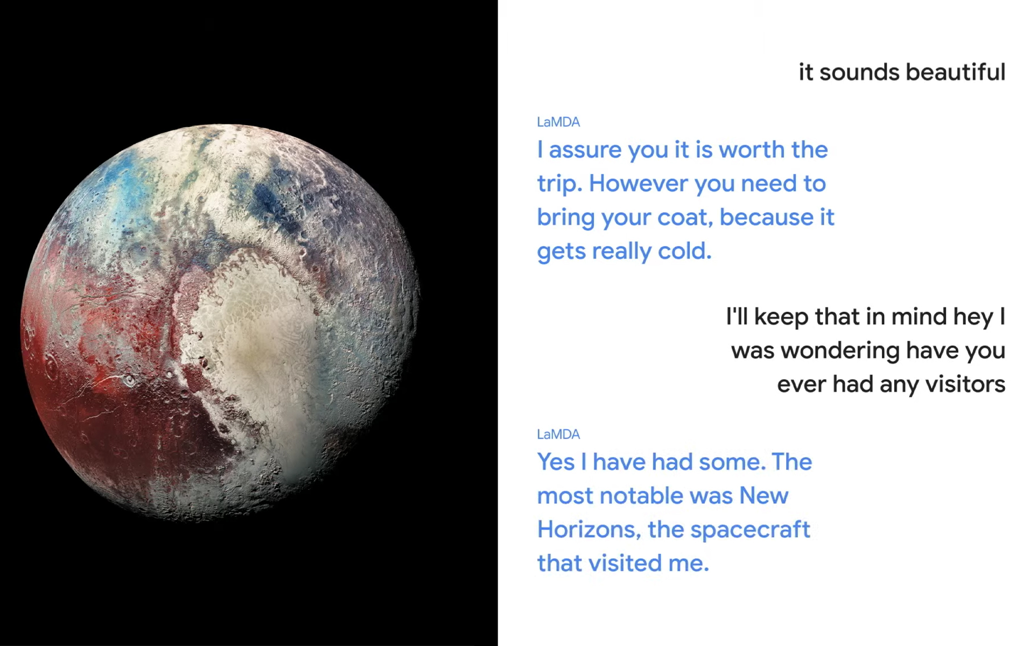

Slide 4
Key disadvantages of large language models
Inefficient (billions of parameters)
Opaque (serving as black-box models)
Static (expensive to retrain)

Slide 5
Retrieval-based NLP models
“Search” for relevant passages in the text
Existing models: REALM, RAG, ColBERT-QA, Baleen
Include checkable sources
Are 100-1000 times smaller
Cheaper

Slide 6
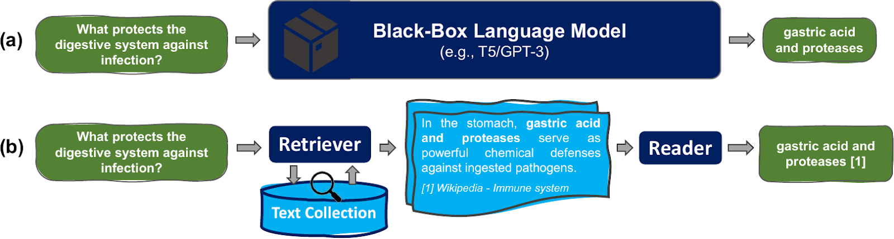

Slide 7
Key advantages of retrieval-based NLP models
They are smaller and faster, the knowledge is stored seperately from the capacity to understand the text itself
They are transparent: it is easy to track the sources the model used to produce the output
They tackle static knowledge - the knowledge is stored as a seperate block of text, which can be easily extended

Slide 8
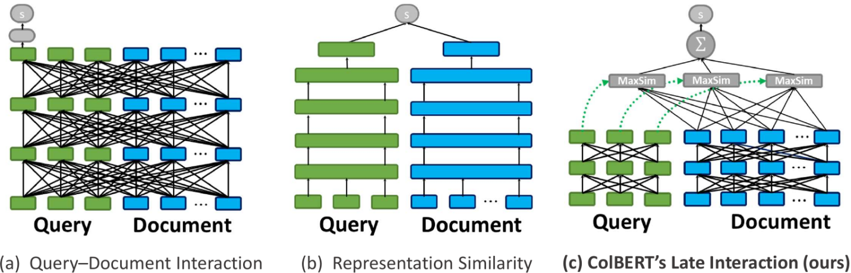

Slide 9
Domain updates can get easier
Since the knowledge and facts are stored seperately as text, it is easy to pick a certain domain and just extend the original text with text from the domain

Slide 10
Summary
Is retrieval all we need?
Could be, since it produces promising results
Research continues
Worth to take a look at

Slide 11
Materials used
Article “Building Scalable, Explainable, and Adaptive NLP Models with Retrieval”: http://ai.stanford.edu/blog/retrieval-based-NLP/
Google LaMDA: https://www.engadget.com/google-lamda-ai-180253539.html?guccounter=1&guce_referrer=aHR0cHM6Ly93d3cuZ29vZ2xlLm5vLw&guce_referrer_sig=AQAAAHlbPmmaxyRw5az1NzQm1ni2yTuuhzuU3o0a8LCbeQ8hyVCp2ZVVlfGIFSnZ3TYdQJ0EMmhkbtG86QLvDSuouSQW8IWc9z1rsUrb96DAzcrvm3eXPGHWeuvp654xnUO4EK0gbLkFwcMf1_oa4jRQ0DtbMZu-x-4mYQvx3fiwtl2o

