Slide 1
CS276
Information Retrieval and Web Search
Chris Manning, Pandu Nayak and Prabhakar Raghavan
Efficient scoring

Slide 2
Today’s focus
Retrieval – get docs matching query from inverted index
Scoring+ranking
  Assign a score to each doc
  Pick K highest scoring docs
Our emphasis today will be on doing each of these efficiently, rather than on the quality of the ranking
  We’ll consider the impact of the scoring function – whether it’s simple, complicated etc.
  In turn, some “efficiency tricks” will impact the ranking quality

Slide 3
Background
Score computation is a large (10s of %) fraction of the CPU work on a query
  Generally, we have a tight budget on latency (say, 250ms)
  CPU provisioning doesn’t permit exhaustively scoring every document on every query
Today we’ll look at ways of cutting CPU usage for scoring, without compromising the quality of results (much)
Basic idea: avoid scoring docs that won’t make it into the top K

Slide 4
Recap: Queries as vectors
Ch. 6
We have a weight for each term in each doc
Key idea 1: Do the same for queries: represent them as vectors in the space
Key idea 2: Rank documents according to their cosine similarity to the query in this space
Vector space scoring is
  Entirely query dependent
  Additive on term contributions – no conditionals etc.
  Context insensitive (no interactions between query terms)
We’ll later look at scoring that’s not as simple …

Slide 5
TAAT vs DAAT techniques
TAAT = “Term At A Time”
  Scores for all docs computed concurrently, one query term at a time
DAAT = “Document At A Time”
  Total score for each doc (incl all query terms) computed, before proceeding to the next
Each has implications for how the retrieval index is structured and stored

Slide 6
Efficient cosine ranking
Sec. 7.1
Find the K docs in the collection “nearest” to the query ⇒ K largest query-doc cosines.
Efficient ranking:
  Computing a single cosine efficiently.
  Choosing the K largest cosine values efficiently.
    Can we do this without computing all N cosines?

Slide 7
Safe vs non-safe ranking
The terminology “safe ranking” is used for methods that guarantee that the K docs returned are the K absolute highest scoring documents
  (Not necessarily just under cosine similarity)
Is it ok to be non-safe?
If it is – then how do we ensure we don’t get too far from the safe solution?
  How do we measure if we are far?

Slide 8
SAFE RANKING

Slide 9
We first focus on safe ranking
Thus when we output the top K docs, we have a proof that these are indeed the top K
Does this imply we always have to compute all N cosines?
  We’ll look at pruning methods
Do we have to sort the resulting cosine scores? (No)

Slide 10
Computing the K largest cosines: selection vs. sorting
Sec. 7.1
Typically we want to retrieve the top K docs (in the cosine ranking for the query)
  not to totally order all docs in the collection
Can we pick off docs with K highest cosines?
Let J = number of docs with nonzero cosines
  We seek the K best of these J

Slide 11
Use heap for selecting top K
Sec. 7.1
Binary tree in which each node’s value > the values of children
Takes 2J operations to construct, then each of K “winners” read off in 2log J steps.
For J=1M, K=100, this is about 10% of the cost of sorting.
1
.9
.3
.3
.8
.1
.1

Slide 12
WAND scoring
An instance of DAAT scoring
Basic idea reminiscent of branch and bound
  We maintain a running threshold score – e.g., the K^{th} highest score computed so far
  We prune away all docs whose cosine scores are guaranteed to be below the threshold
  We compute exact cosine scores for only the un-pruned docs
Broder et al. Efﬁcient Query Evaluation using a Two-Level Retrieval Process.

Slide 13
Index structure for WAND
Postings ordered by docID
Assume a special iterator on the postings of the form “go to the first docID greater than X”
Typical state: we have a “finger” at some docID in the postings of each query term
  Each finger moves only to the right, to larger docIDs
Invariant – all docIDs lower than any finger have already been processed, meaning
  These docIDs are either pruned away or
  Their cosine scores have been computed

Slide 14
Upper bounds
At all times for each query term t, we maintain an upper bound UB_{t} on the score contribution of any doc to the right of the finger
  Max (over docs remaining in t’s postings) of w_{t}(doc)
finger
t
3
7
11
17
29
38
57
79
UB_{t} = w_{t}(38)
As finger moves right, UB drops

Slide 15
Pivoting
Query: catcher in the rye
Let’s say the current finger positions are as below
Threshold = 6.8
catcher
273
UB_{catcher} = 2.3
rye
304
UB_{rye} = 1.8
in
589
UB_{in} = 3.3
the
762
UB_{the} = 4.3
Pivot

Slide 16
Prune docs that have no hope
Terms sorted in order of finger positions
Move fingers to 589 or right
Threshold = 6.8
catcher
273
Hopeless docs
UB_{catcher} = 2.3
rye
304
Hopeless docs
UB_{rye} = 1.8
in
589
UB_{in} = 3.3
the
762
UB_{the} = 4.3
Update UB’s
Pivot

Slide 17
Compute 589’s score if need be
If 589 is present in enough postings, compute its full cosine score – else some fingers to right of 589
Pivot again …
catcher
589
rye
589
in
589
the
762

Slide 18
WAND summary
In tests, WAND leads to a 90+% reduction in score computation
  Better gains on longer queries
Nothing we did was specific to cosine ranking
  We need scoring to be additive by term
WAND and variants give us safe ranking
  Possible to devise “careless” variants that are a bit faster but not safe (see summary in Ding+Suel 2011)
  Ideas combine some of the non-safe scoring we consider next

Slide 19
NON SAFE RANKING
We’ll speak of cosine scores, but most of these ideas
are general and a recap of the Coursera video

Slide 20
Non-safe (cosine) ranking
Sec. 7.1
Return K docs whose cosine similarities to the query are high
  Relative to the safe top K
  Reminiscent of normalization in NDCG
Can we prune more aggressively?
Yes, but may sometimes get it wrong
  a doc not in the top K may creep into the list of K output docs
  Is this such a bad thing?

Slide 21
Cosine similarity is only a proxy
Sec. 7.1.1
User has a task and a query formulation
Cosine matches docs to query
Thus cosine is anyway a proxy for user happiness
If we get a list of K docs “close” to the top K by cosine measure, should be ok
All this is true for just about any scoring function

Slide 22
Generic approach
Sec. 7.1.1
Find a set A of contenders, with K < |A| << N
  A does not necessarily contain the top K, but has many docs from among the top K
  Return the top K docs in A
Think of A as pruning non-contenders
  Unlike WAND, pruning here can be lossy
The same approach is also used for other (non-cosine) scoring functions
Will look at several schemes following this approach
Often A may not be explicitly spelled out a priori

Slide 23
Index elimination
Sec. 7.1.2
Basic cosine computation algorithm only considers docs containing at least one query term
Take this further:
  Only consider high-idf query terms
  Only consider docs containing many query terms

Slide 24
High-idf query terms only
Sec. 7.1.2
For a query such as catcher in the rye
Only accumulate scores from catcher and rye
Intuition: in and the contribute little to the scores and so don’t alter rank-ordering much
Benefit:
  Postings of low-idf terms have many docs → these (many) docs get eliminated from set A of contenders

Slide 25
Docs containing many query terms (DAAT)
Sec. 7.1.2
Any doc with at least one query term is a candidate for the top K output list
For multi-term queries, only compute scores for docs containing several of the query terms
  Say, at least 3 out of 4
  Imposes a “soft conjunction” on queries seen on web search engines (early Google)
Easy to implement in postings traversal

Slide 26
Champion lists
Sec. 7.1.3
Precompute for each dictionary term t, the r docs of highest weight in t’s postings
  Call this the champion list for t
  (aka fancy list or top docs for t)
Note that r has to be chosen at index build time
  Thus, it’s possible that r < K
At query time, only compute scores for docs in the champion list of some query term
  Pick the K top-scoring docs from amongst these

Slide 27
High and low lists
Sec. 7.1.4
For each term, we maintain two postings lists called high and low
  Think of high as the champion list
When traversing postings on a query, only traverse high lists first
  If we get more than K docs, select the top K and stop
  Else proceed to get docs from the low lists
A means for segmenting index into two tiers

Slide 28
Tiered indexes
Sec. 7.2.1
Break postings up into a hierarchy of lists
  Most important
  …
  Least important
Inverted index thus broken up into tiers of decreasing importance
At query time use top tier unless it fails to yield K docs
  If so drop to lower tiers
  Common practice in web search engines

Slide 29
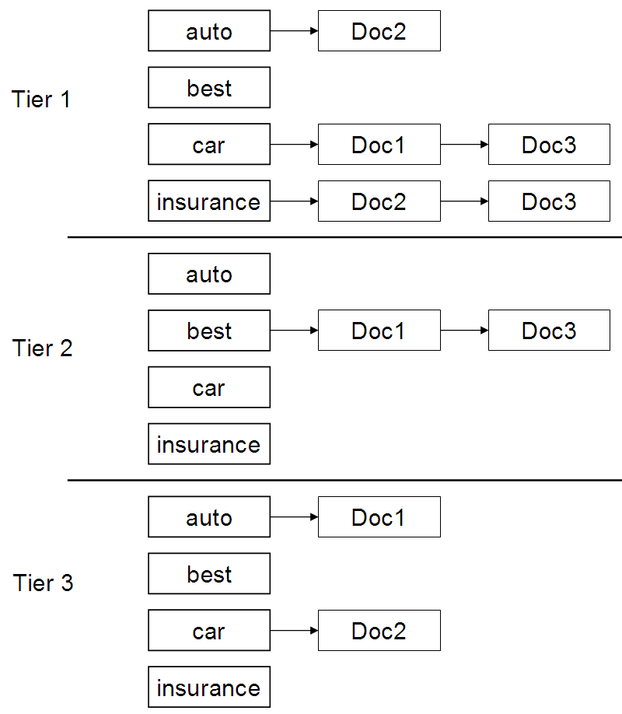
Example tiered index
Sec. 7.2.1

Slide 30
RECAP OF SOME FINAL SCORING IDEAS

Slide 31
Document dependent scoring
Sometimes we’ll have scoring functions that don’t add up term-wise scores
We’ll look at two instances here, but industry practice is rife with these
  Static document goodness measures
  Term proximity

Slide 32
Static quality scores
Sec. 7.1.4
We want top-ranking documents to be both relevant and authoritative
Relevance is being modeled by cosine scores
Authority is typically a query-independent property of a document
Examples of authority signals
  Wikipedia among websites
  Articles in certain newspapers
  A paper with many citations
  Many bitly’s, likes or social referrals marks
  (Pagerank)
Quantitative

Slide 33
Modeling authority
Sec. 7.1.4
Assign to each document a query-independent quality score in [0,1] to each document d
  Denote this by g(d)
Thus, a quantity like the number of citations is scaled into [0,1]

Slide 34
Net score
Sec. 7.1.4
Consider a simple total score combining cosine relevance and authority
net-score(q,d) = g(d) + cosine(q,d)
  Can use some other linear combination
  Indeed, any function of the two “signals” of user happiness – more later
Now we seek the top K docs by net score

Slide 35
Top K by net score – fast methods
Sec. 7.1.4
First idea: Order all postings by g(d)
Key: this is a common ordering for all postings
Thus, can concurrently traverse query terms’ postings for
  Postings intersection
  Cosine (or other) score computation

Slide 36
Why order postings by g(d)?
Sec. 7.1.4
Under g(d)-ordering, top-scoring docs likely to appear early in postings traversal
In time-bound applications (say, we have to return whatever search results we can in 50 ms), this allows us to stop postings traversal early
  Short of computing scores for all docs in postings

Slide 37
Champion lists in g(d)-ordering
Sec. 7.1.4
Can combine champion lists with g(d)-ordering
Maintain for each term a champion list of the r docs with highest g(d) + tf-idf_{td}
Seek top-K results from only the docs in these champion lists
Combine with other heuristics we’ve seen …

Slide 38
Different idea – Query term proximity
Sec. 7.2.2
Free text queries: just a set of terms typed into the query box – common on the web
Users prefer docs in which query terms occur within close proximity of each other
Let w be the smallest window in a doc containing all query terms, e.g.,
For the query strained mercy the smallest window in the doc The quality of mercy is not strained is 4 (words)
Would like scoring function to take this into account – how?

Slide 39
Scoring factors
The ideas we’ve seen are far from exhaustive
But they give some of the principal components in a typical scoring function
  They reflect some intuition of how users phrase queries, and what they expect in return
Scoring goes beyond adding up numbers
  E.g., if we get too few hits – how should we increase recall on the fly?
  If it’s an obvious “nav query” how do we cut recall?

Slide 40
Non-additive scoring
Sec. 7.2.3
Free text query from user may in fact spawn one or more queries to the indexes, e.g., query rising interest rates
  Run the query as a phrase query
  If <K docs contain the phrase rising interest rates, run the two phrase queries rising interest and interest rates
  If we still have <K docs, run the vector space query rising interest rates
  Rank matching docs by vector space scoring
This sequence is issued by a query handler

