Slide 1
CS276
Information Retrieval and Web Search
Chris Manning, Pandu Nayak and Prabhakar Raghavan
Evaluation

Slide 2
Situation
Thanks to your stellar performance in CS276, you quickly rise to VP of Search at internet retail giant nozama.com. Your boss brings in her nephew Sergey, who claims to have built a better search engine for nozama. Do you
  Laugh derisively and send him to rival Tramlaw Labs?
  Counsel Sergey to go to Stanford and take CS276?
  Try a few queries on his engine and say “Not bad”?
  … ?

Slide 3
What could you ask Sergey?
Sec. 8.6
How fast does it index?
  Number of documents/hour
  Incremental indexing – nozama adds 10K products/day
How fast does it search?
  Latency and CPU needs for nozama’s 5 million products
Does it recommend related products?
This is all good, but it says nothing about the quality of Sergey’s search
  You want nozama’s users to be happy with the search experience

Slide 4
How do you tell if users are happy?
Search returns products relevant to users
  How do you assess this at scale?
Search results get clicked a lot
  Misleading titles/summaries can cause users to click
Users buy after using the search engine
  Or, users spend a lot of $ after using the search engine
Repeat visitors/buyers
  Do users leave soon after searching?
  Do they come back within a week/month/… ?

Slide 5
Happiness: elusive to measure
Sec. 8.1
Most common proxy: relevance of search results
  But how do you measure relevance?
Three elements:
  A benchmark document collection
  A benchmark suite of queries
  An assessment of either Relevant or Nonrelevant for each query and each document

Slide 6
So you want to measure the quality of a new search algorithm
Benchmark documents – nozama’s products
Benchmark query suite – more on this
Judgments of document relevance for each query
  Do we really need every query-doc pair?
5 million nozama.com products
Relevance
judgement
50000
sample
queries

Slide 7
Relevance judgments
Binary (relevant vs. non-relevant) in the simplest case, more nuanced (0, 1, 2, 3 …) in others
What are some issues already?
5 million times 50K takes us into the range of a quarter trillion judgments
  If each judgment took a human 2.5 seconds, we’d still need 10¹¹ seconds, or nearly $300 million if you pay people $10 per hour to assess
  10K new products per day

Slide 8
Crowd source relevance judgments?
Present query-document pairs to low-cost labor on online crowd-sourcing platforms
  Hope that this is cheaper than hiring qualified assessors
Lots of literature on using crowd-sourcing for such tasks
Main takeaway – you get some signal, but the variance in the resulting judgments is very high

Slide 9
What else?
Sec. 8.5
Still need test queries
  Must be germane to docs available
  Must be representative of actual user needs
  Random query terms from the documents generally not a good idea
  Sample from query logs if available
Classically (non-Web)
  Low query rates – not enough query logs
  Experts hand-craft “user needs”

Slide 10
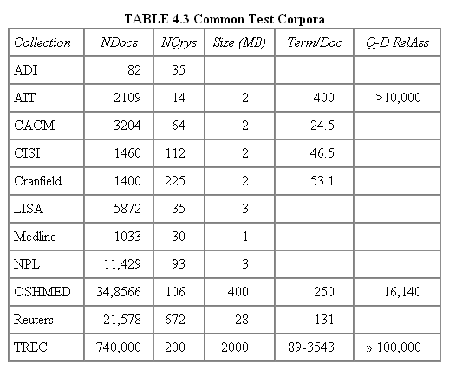
Some public test Collections
Sec. 8.5
Typical TREC

Slide 11
Now we have the basics of a benchmark
Let’s review some evaluation measures
  Precision
  Recall
  DCG
  …

Slide 12
Evaluating an IR system
Sec. 8.1
Note: user need is translated into a query
Relevance is assessed relative to the user need, not the query
E.g., Information need: My swimming pool bottom is becoming black and needs to be cleaned.
Query: pool cleaner
Assess whether the doc addresses the underlying need, not whether it has these words

Slide 13
Unranked retrieval evaluation:
Precision and Recall – recap from IIR 8/video
Sec. 8.3
Binary assessments
Precision: fraction of retrieved docs that are relevant = P(relevant|retrieved)
Recall: fraction of relevant docs that are retrieved
= P(retrieved|relevant)
Precision P = tp/(tp + fp)
Recall R = tp/(tp + fn)
 | Relevant | Nonrelevant
Retrieved | tp | fp
Not Retrieved | fn | tn

Slide 14
Rank-Based Measures
Binary relevance
  Precision@K (P@K)
  Mean Average Precision (MAP)
  Mean Reciprocal Rank (MRR)
Multiple levels of relevance
  Normalized Discounted Cumulative Gain (NDCG)

Slide 15

Precision@K
Set a rank threshold K
Compute % relevant in top K
Ignores documents ranked lower than K
Ex:
  Prec@3 of 2/3
  Prec@4 of 2/4
  Prec@5 of 3/5
In similar fashion we have Recall@K

Slide 16
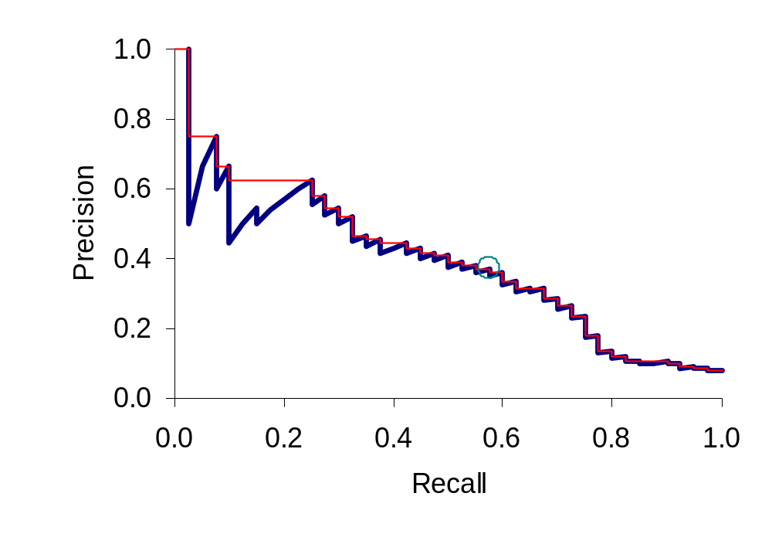
A precision-recall curve
Sec. 8.4
Lots more detail on this in the
Coursera video

Slide 17

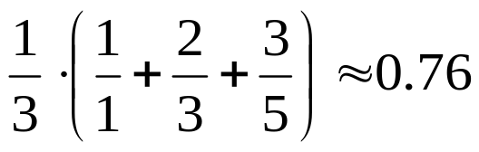
Mean Average Precision
Consider rank position of each relevant doc
  K₁, K₂, … K_{R}
Compute Precision@K for each K₁, K₂, … K_{R}
Average precision = average of P@K
Ex: has AvgPrec of
MAP is Average Precision across multiple queries/rankings

Slide 18
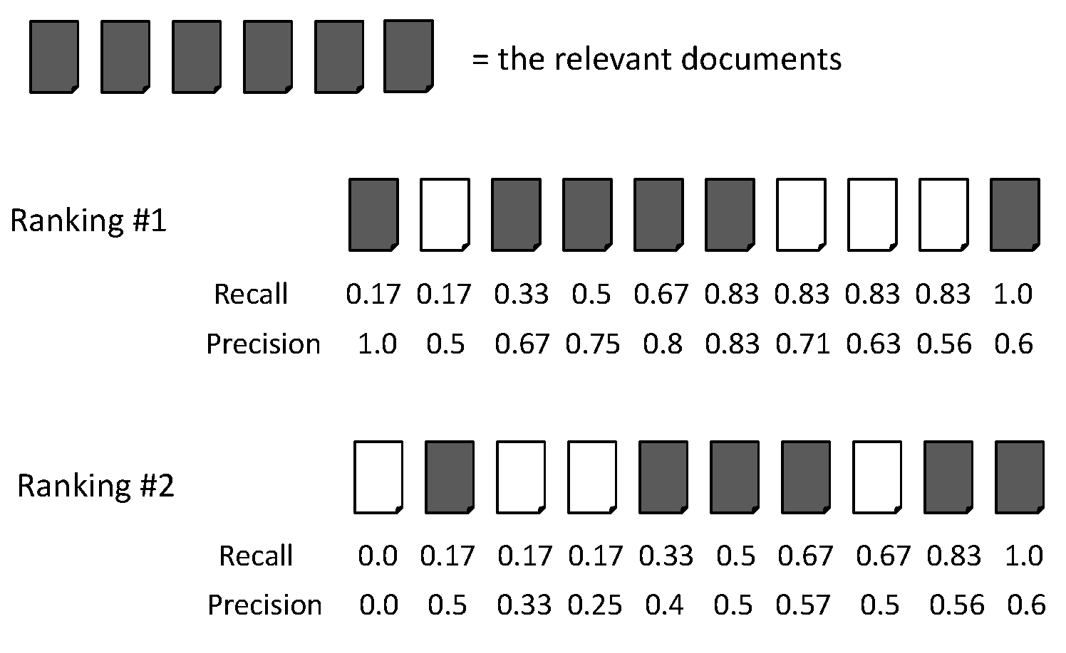
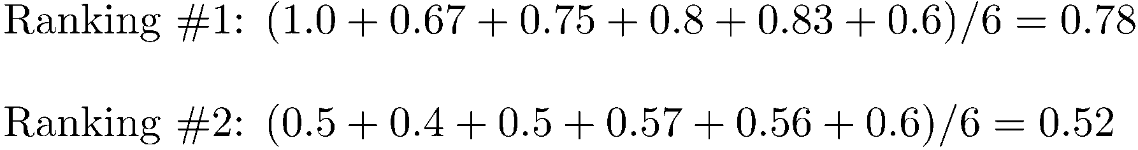
Average Precision

Slide 19
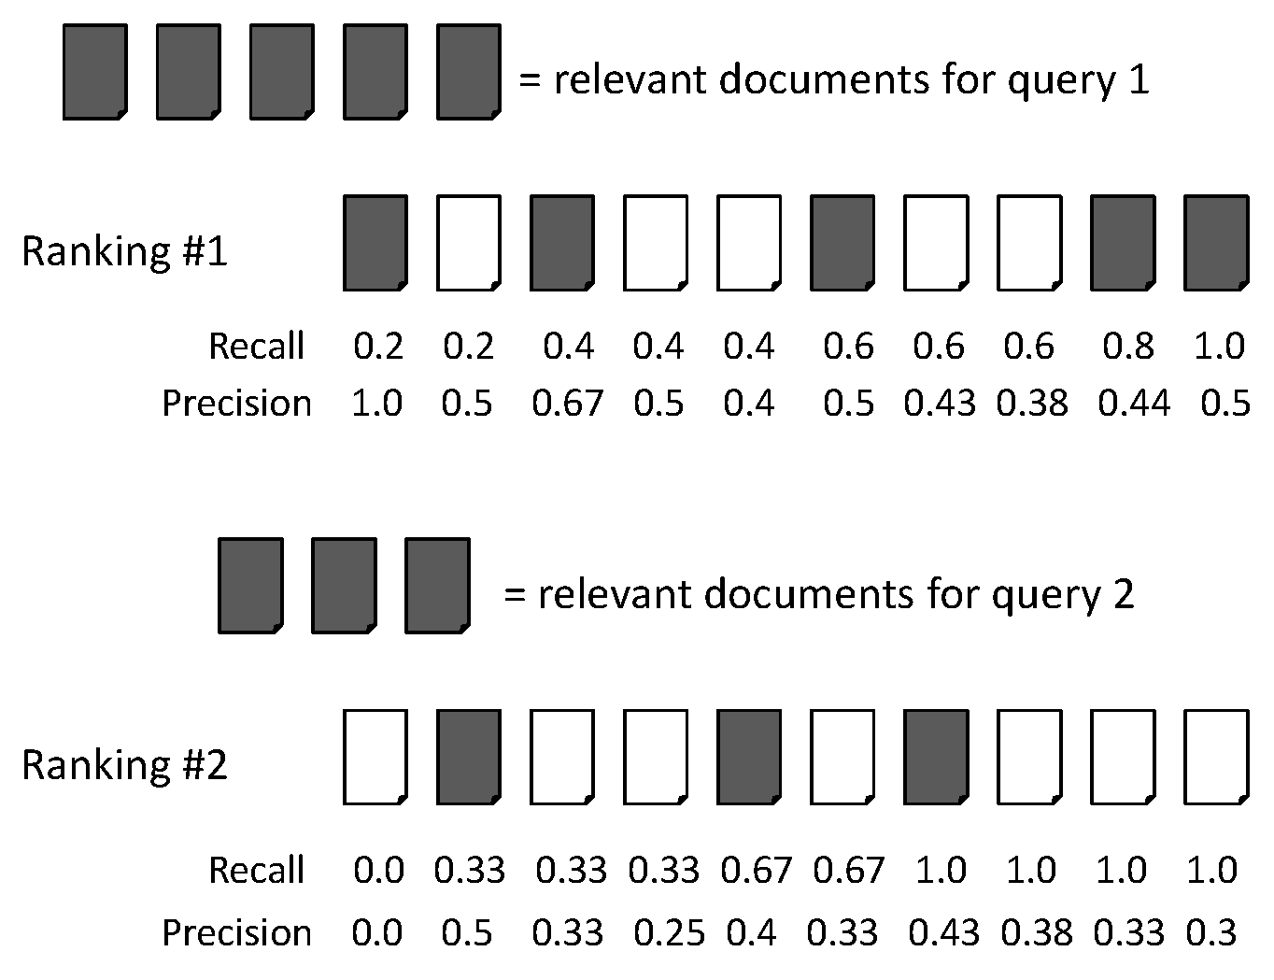
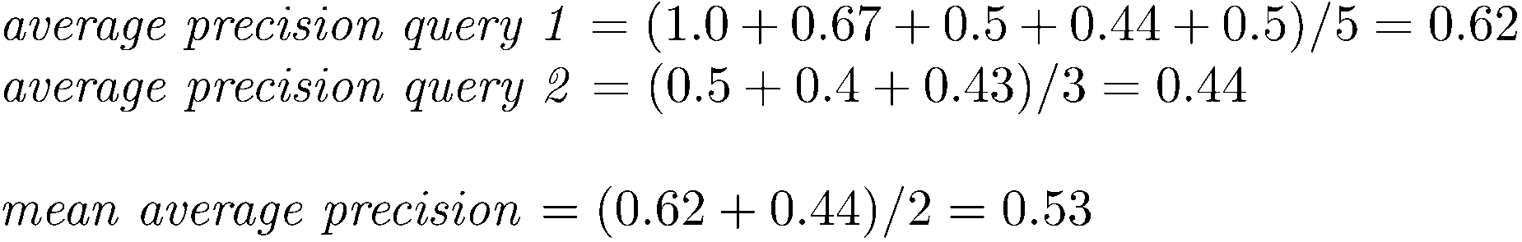
MAP

Slide 20
Mean average precision
  If a relevant document never gets retrieved, we assume the precision corresponding to that relevant doc to be zero
  MAP is macro-averaging: each query counts equally
  Now perhaps most commonly used measure in research papers
  Good for web search?
  MAP assumes user is interested in finding many relevant documents for each query
  MAP requires many relevance judgments in text collection

Slide 21
BEYOND BINARY RELEVANCE

Slide 22
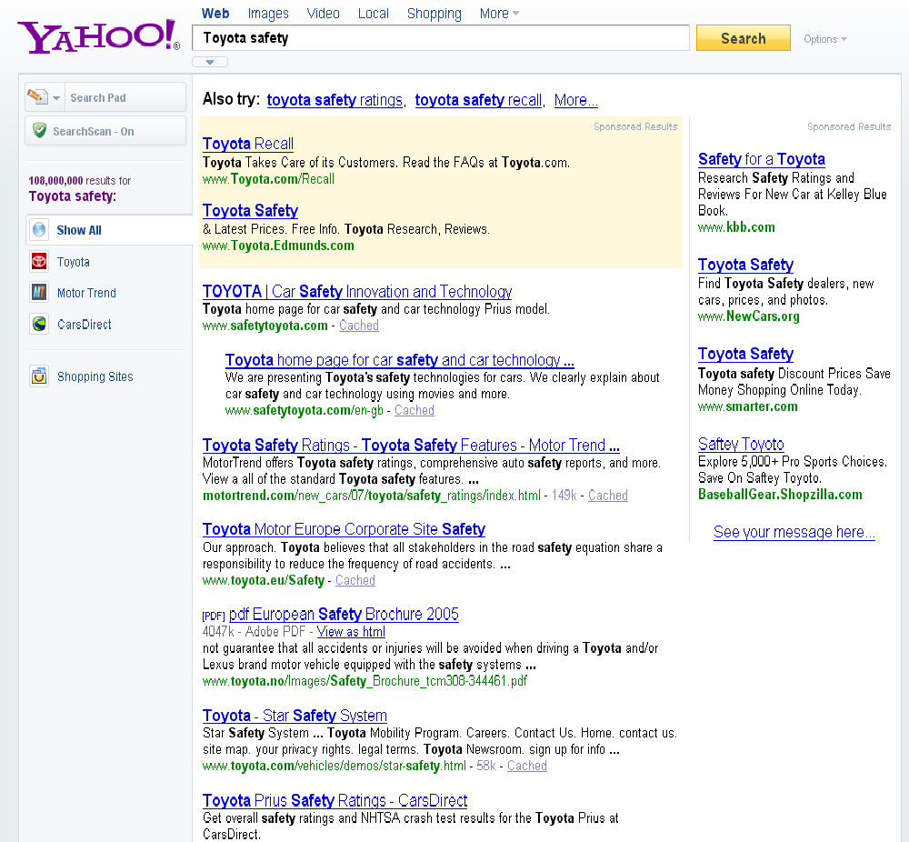
fair
fair
Good

Slide 23
Discounted Cumulative Gain
Popular measure for evaluating web search and related tasks
Two assumptions:
  Highly relevant documents are more useful than marginally relevant documents
  the lower the ranked position of a relevant document, the less useful it is for the user, since it is less likely to be examined

Slide 24
Discounted Cumulative Gain
Uses graded relevance as a measure of usefulness, or gain, from examining a document
Gain is accumulated starting at the top of the ranking and may be reduced, or discounted, at lower ranks
Typical discount is 1/log (rank)
  With base 2, the discount at rank 4 is 1/2, and at rank 8 it is 1/3

Slide 25
Summarize a Ranking: DCG
What if relevance judgments are in a scale of [0,r]? r>2
Cumulative Gain (CG) at rank n
  Let the ratings of the n documents be r₁, r₂, …r_{n} (in ranked order)
  CG = r₁+r₂+…r_{n}
Discounted Cumulative Gain (DCG) at rank n
  DCG = r₁ + r₂/log₂2 + r₃/log₂3 + … r_{n}/log₂n
    We may use any base for the logarithm
Notes:
For rank positions above b, do not discount

Slide 26
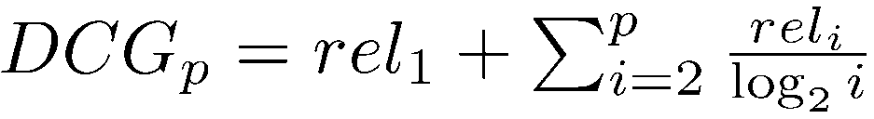
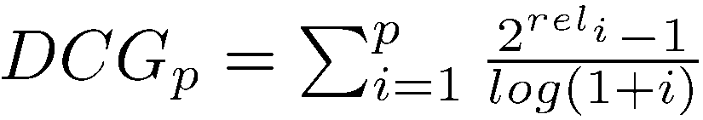
Discounted Cumulative Gain
DCG is the total gain accumulated at a particular rank p:
Alternative formulation:
  used by some web search companies
  emphasis on retrieving highly relevant documents

Slide 27
DCG Example
10 ranked documents judged on 0-3 relevance scale:
  3, 2, 3, 0, 0, 1, 2, 2, 3, 0
discounted gain:
  3, 2/1, 3/1.59, 0, 0, 1/2.59, 2/2.81, 2/3, 3/3.17, 0
  = 3, 2, 1.89, 0, 0, 0.39, 0.71, 0.67, 0.95, 0
DCG:
  3, 5, 6.89, 6.89, 6.89, 7.28, 7.99, 8.66, 9.61, 9.61
Notes:
Normalized DCG:
DCG values are often normalized by comparing the DCG at each rank with the DCG value for the perfect ranking
makes averaging easier for queries with different numbers of relevant documents

Slide 28
Summarize a Ranking: NDCG
Normalized Discounted Cumulative Gain (NDCG) at rank n
  Normalize DCG at rank n by the DCG value at rank n of the ideal ranking
  The ideal ranking would first return the documents with the highest relevance level, then the next highest relevance level, etc
Normalization useful for contrasting queries with varying numbers of relevant results
NDCG is now quite popular in evaluating Web search
Notes:
Perfect ranking:
3, 3, 3, 2, 2, 2, 1, 0, 0, 0
ideal DCG values:
3, 6, 7.89, 8.89, 9.75, 10.52, 10.88, 10.88, 10.88, 10
Actual DCG:
3, 5, 6.89, 6.89, 6.89, 7.28, 7.99, 8.66, 9.61, 9.61
NDCG values (divide actual by ideal):
1, 0.83, 0.87, 0.76, 0.71, 0.69, 0.73, 0.8, 0.88, 0.88
NDCG ≤ 1 at any rank position

Slide 29
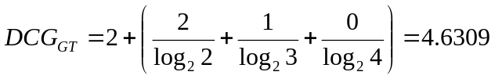
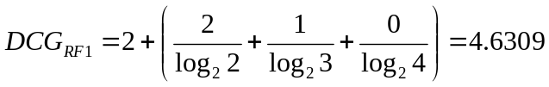
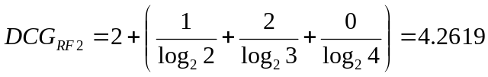

NDCG - Example
4 documents: d₁, d₂, d₃, d₄
i | Ground Truth |  | Ranking Function₁ |  | Ranking Function₂
 | Document Order | r_{i} | Document Order | r_{i} | Document Order | r_{i}
1 | d4 | 2 | d3 | 2 | d3 | 2
2 | d3 | 2 | d4 | 2 | d2 | 1
3 | d2 | 1 | d2 | 1 | d4 | 2
4 | d1 | 0 | d1 | 0 | d1 | 0
 | NDCG_{GT}=1.00 |  | NDCG_{RF1}=1.00 |  | NDCG_{RF2}=0.9203

Slide 30
What if the results are not in a list?
Suppose there’s only one Relevant Document
Scenarios:
  known-item search
  navigational queries
  looking for a fact
Search duration ~ Rank of the answer
  measures a user’s effort

Slide 31
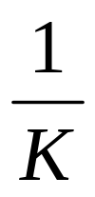
Mean Reciprocal Rank
Consider rank position, K, of first relevant doc
  Could be – only clicked doc
Reciprocal Rank score =
MRR is the mean RR across multiple queries

Slide 32
Human judgments are
Expensive
Inconsistent
  Between raters
  Over time
Decay in value as documents/query mix evolves
Not always representative of “real users”
  Rating vis-à-vis query, vs underlying need
So – what alternatives do we have?

Slide 33
USING USER CLICKS

Slide 34
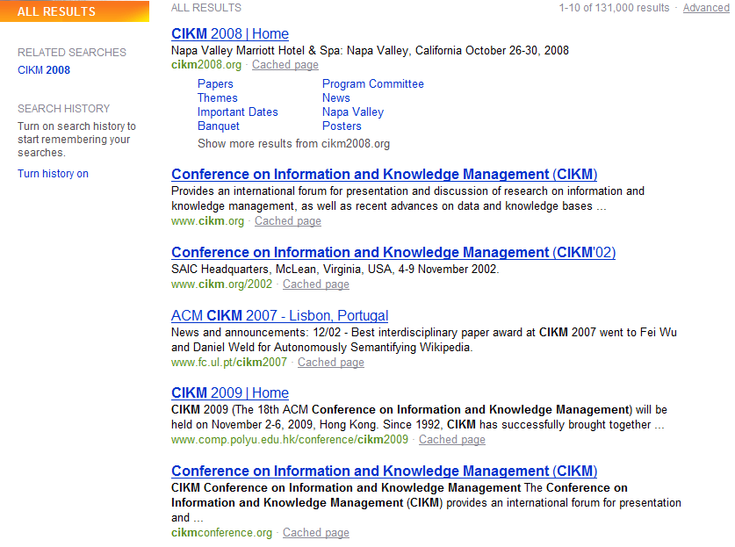
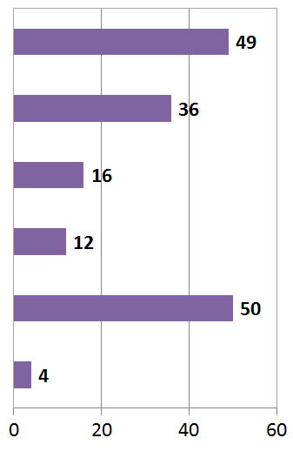
What do clicks tell us?
# of clicks received
Strong position bias, so absolute click rates unreliable

Slide 35
Relative vs absolute ratings
User’s click
sequence
Hard to conclude Result1 > Result3
Probably can conclude Result3 > Result2

Slide 36
Pairwise relative ratings
Pairs of the form: DocA better than DocB for a query
  Doesn’t mean that DocA relevant to query
Now, rather than assess a rank-ordering wrt per-doc relevance assessments
Assess in terms of conformance with historical pairwise preferences recorded from user clicks
BUT!
Don’t learn and test on the same ranking algorithm
  I.e., if you learn historical clicks from nozama and compare Sergey vs nozama on this history …

Slide 37
Interleaved docs (Joachims 2002)
One approach is to obtain pairwise orderings from results that interleave two ranking engines A and B
Top From A
Top From B
Top From B
Top From A
2nd From A
2nd From B
2nd From B
2nd From A
3rd From A
3rd From B
3rd From B
3rd From A

Slide 38
Comparing two rankings to a baseline ranking
Given a set of pairwise preferences P
We want to measure two rankings A and B
Define a proximity measure between A and P
  And likewise, between B and P
Want to declare the ranking with better proximity to be the winner
Proximity measure should reward agreements with P and penalize disagreements

Slide 39
Kendall tau distance
Let X be the number of agreements between a ranking (say A) and P
Let Y be the number of disagreements
Then the Kendall tau distance between A and P is
(X-Y)/(X+Y)
Say P = {(1,2), (1,3), (1,4), (2,3), (2,4), (3,4))} and A=(1,3,2,4)
Then X=5, Y=1 …
(What are the minimum and maximum possible values of the Kendall tau distance?)

Slide 40
Critique of additive relevance
Sec. 8.5.1
Relevance vs Marginal Relevance
  A document can be redundant even if it is highly relevant
    Duplicates
    The same information from different sources
  Marginal relevance is a better measure of utility for the user
    But harder to create evaluation set
    See Carbonell and Goldstein (1998)
  Pushes us to assess a slate of results, rather than to sum relevance over individually assessed results
    Raters shown two lists, and asked to pick the better one
    Reminiscent of interleaved doc idea we just saw

Slide 41
Beyond measuring lists
Results for a query don’t have to be presented as a list of docs
Using facts/entities as evaluation unit can more directly measure true recall
Also related is seeking diversity in first page results
  See Diversity in Document Retrieval workshops

Slide 42
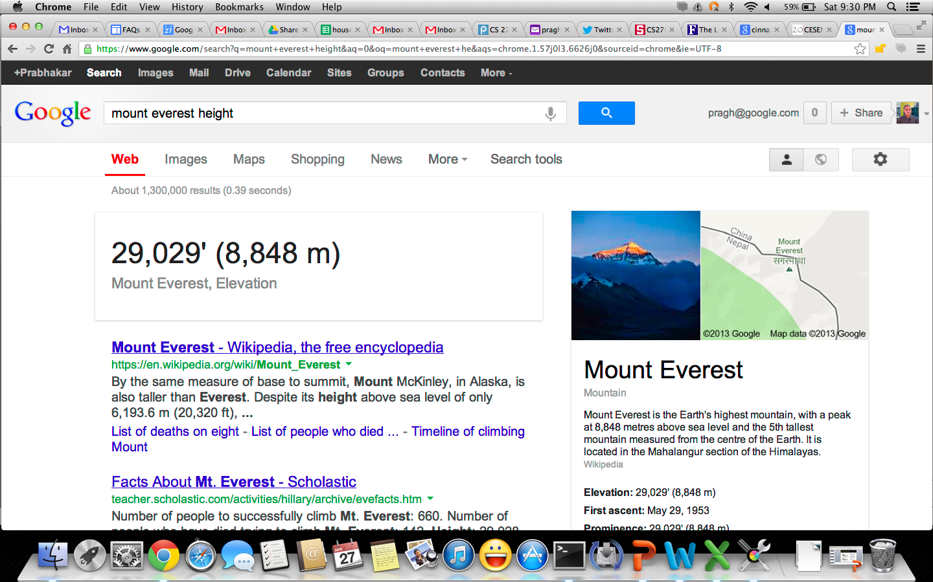
Facts/entities (what happens to clicks?)

Slide 43
A/B testing at web search engines
Sec. 8.6.3
Purpose: Test a single innovation
Prerequisite: You have a large search engine up and running.
Have most users use old system
Divert a small proportion of traffic (e.g., 1%) to the new system that includes the innovation
Evaluate with an “automatic” measure like clickthrough on first result
Now we can directly see if the innovation does improve user happiness.
Probably the evaluation methodology that large search engines trust most
In principle less powerful than doing a multivariate regression analysis, but easier to understand

Slide 44
Recap
Benchmarks consist of
  Document collection
  Query set
  Assessment methodology
Assessment methodology can use raters, user clicks, or a combination
  These get quantized into a goodness measure – Precision/NDCG etc.
  Different engines/algorithms compared on a benchmark together with a goodness measure

