Slide 1
CS276: Information Retrieval and Web Search
Christopher Manning and Prabhakar Raghavan
Lecture 10: Text Classification;
The Naive Bayes algorithm

Slide 2
Relevance feedback revisited
In relevance feedback, the user marks a few documents as relevant/nonrelevant
The choices can be viewed as classes or categories
For several documents, the user decides which of these two classes is correct
The IR system then uses these judgments to build a better model of the information need
So, relevance feedback can be viewed as a form of text classification (deciding between several classes)
The notion of classification is very general and has many applications within and beyond IR

Slide 3
Standing queries
Ch. 13
The path from IR to text classification:
  You have an information need to monitor, say:
    Unrest in the Niger delta region
  You want to rerun an appropriate query periodically to find new news items on this topic
  You will be sent new documents that are found
    I.e., it’s text classification not ranking
Such queries are called standing queries
  Long used by “information professionals”
  A modern mass instantiation is Google Alerts
Standing queries are (hand-written) text classifiers

Slide 4
Spam filtering: Another text classification task
Ch. 13
From: "" <takworlld@hotmail.com>
Subject: real estate is the only way... gem oalvgkay
Anyone can buy real estate with no money down
Stop paying rent TODAY !
There is no need to spend hundreds or even thousands for similar courses
I am 22 years old and I have already purchased 6 properties using the
methods outlined in this truly INCREDIBLE ebook.
Change your life NOW !
=================================================
Click Below to order:
http://www.wholesaledaily.com/sales/nmd.htm
=================================================

Slide 5
Text classification
Ch. 13
Today:
  Introduction to Text Classification
    Also widely known as “text categorization”. Same thing.
  Naïve Bayes text classification
    Including a little on Probabilistic Language Models

Slide 6
Categorization/Classification
Sec. 13.1
Given:
  A description of an instance, d ∈ X
    X is the instance language or instance space.
      Issue: how to represent text documents.
      Usually some type of high-dimensional space
  A fixed set of classes:
  C = {c₁, c₂,…, c_{J}}
Determine:
  The category of d: γ(d) ∈ C, where γ(d) is a classification function whose domain is X and whose range is C.
    We want to know how to build classification functions (“classifiers”).

Slide 7
Supervised Classification
Sec. 13.1
Given:
  A description of an instance, d ∈ X
    X is the instance language or instance space.
  A fixed set of classes:
  C = {c₁, c₂,…, c_{J}}
  A training set D of labeled documents with each labeled document ⟨d,c⟩∈X×C
Determine:
  A learning method or algorithm which will enable us to learn a classifier γ:X→C
  For a test document d, we assign it the class γ(d) ∈ C

Slide 8
Document Classification
Sec. 13.1
“planning
language
proof
intelligence”
Test
Data:
(AI)
(Programming)
(HCI)
Classes:
ML
Planning
Semantics
Garb.Coll.
Multimedia
GUI
Training
Data:
learning
intelligence
algorithm
reinforcement
network...
planning
temporal
reasoning
plan
language...
programming
semantics
language
proof...
garbage
collection
memory
optimization
region...
...
...
(Note: in real life there is often a hierarchy, not present in the above problem statement; and also, you get papers on ML approaches to Garb. Coll.)

Slide 9
More Text Classification Examples
Many search engine functionalities use classification
Ch. 13
Assigning labels to documents or web-pages:
Labels are most often topics such as Yahoo-categories
  "finance," "sports," "news>world>asia>business"
Labels may be genres
  "editorials" "movie-reviews" "news”
Labels may be opinion on a person/product
  “like”, “hate”, “neutral”
Labels may be domain-specific
  "interesting-to-me" : "not-interesting-to-me”
  “contains adult language” : “doesn’t”
  language identification: English, French, Chinese, …
  search vertical: about Linux versus not
  “link spam” : “not link spam”

Slide 10
Classification Methods (1)
Ch. 13
Manual classification
  Used by the original Yahoo! Directory
  Looksmart, about.com, ODP, PubMed
  Very accurate when job is done by experts
  Consistent when the problem size and team is small
  Difficult and expensive to scale
    Means we need automatic classification methods for big problems

Slide 11
Classification Methods (2)
Ch. 13
Automatic document classification
  Hand-coded rule-based systems
    One technique used by CS dept’s spam filter, Reuters, CIA, etc.
    It’s what Google Alerts is doing
      Widely deployed in government and enterprise
    Companies provide “IDE” for writing such rules
    E.g., assign category if document contains a given boolean combination of words
    Standing queries: Commercial systems have complex query languages (everything in IR query languages +score accumulators)
    Accuracy is often very high if a rule has been carefully refined over time by a subject expert
    Building and maintaining these rules is expensive

Slide 12
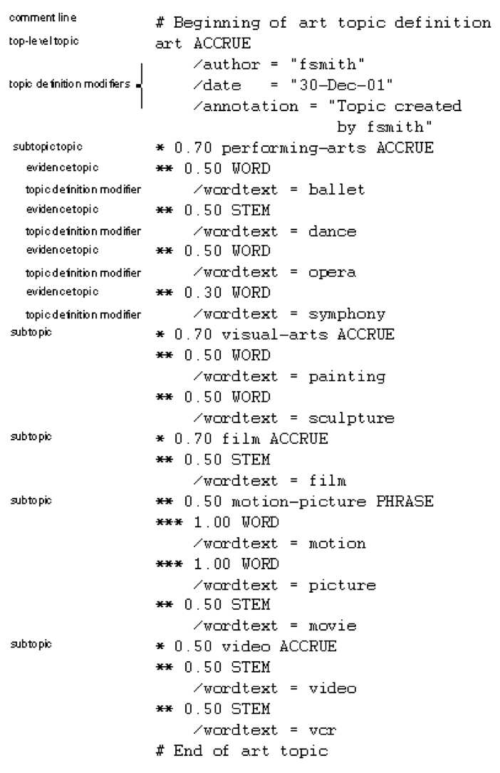
A Verity topic
A complex classification rule
Ch. 13
Note:
  maintenance issues (author, etc.)
  Hand-weighting of terms
  [Verity was bought by Autonomy.]

Slide 13
Classification Methods (3)
Ch. 13
Supervised learning of a document-label assignment function
  Many systems partly rely on machine learning (Autonomy, Microsoft, Enkata, Yahoo!, …)
    k-Nearest Neighbors (simple, powerful)
    Naive Bayes (simple, common method)
    Support-vector machines (new, more powerful)
    … plus many other methods
    No free lunch: requires hand-classified training data
    But data can be built up (and refined) by amateurs
Many commercial systems use a mixture of methods

Slide 14
Probabilistic relevance feedback
Sec. 9.1.2
Rather than reweighting in a vector space…
If user has told us some relevant and some irrelevant documents, then we can proceed to build a probabilistic classifier,
    such as the Naive Bayes model we will look at today:
  P(t_{k}|R) = |D_{rk}| / |D_{r}|
  P(t_{k}|NR) = |D_{nrk}| / |D_{nr}|
    t_{k} is a term; D_{r} is the set of known relevant documents; D_{rk} is the subset that contain t_{k}; D_{nr} is the set of known irrelevant documents; D_{nrk} is the subset that contain t_{k}.

Slide 15
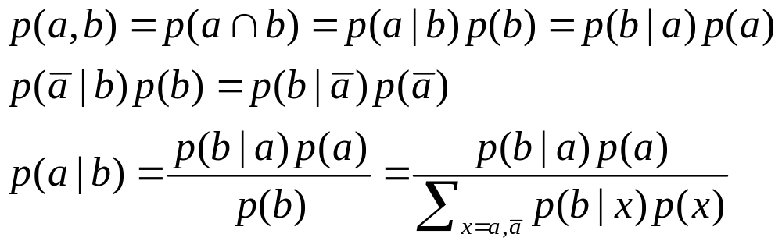
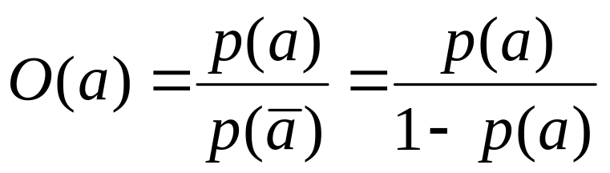
Recall a few probability basics
For events a and b:
Bayes’ Rule
Odds:
Prior
Posterior

Slide 16
Bayesian Methods
Sec.13.2
Our focus this lecture
Learning and classification methods based on probability theory.
Bayes theorem plays a critical role in probabilistic learning and classification.
Builds a generative model that approximates how data is produced
Uses prior probability of each category given no information about an item.
Categorization produces a posterior probability distribution over the possible categories given a description of an item.

Slide 17
Bayes’ Rule for text classification
Sec.13.2
For a document d and a class c

Slide 18
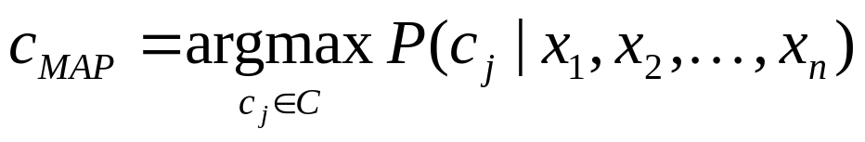
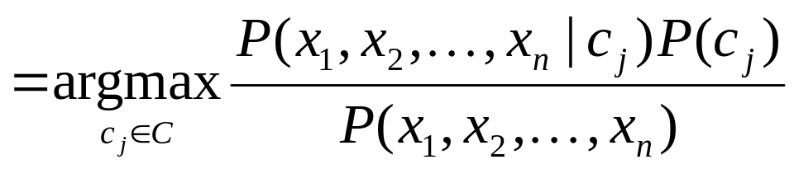
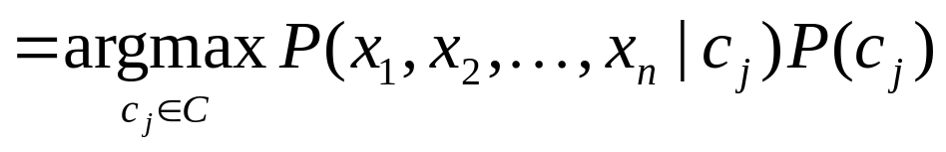
Naive Bayes Classifiers
Sec.13.2
Task: Classify a new instance d based on a tuple of attribute values into one of the classes c_{j} ∈ C
MAP is “maximum a posteriori” = most likely class

Slide 19
Naïve Bayes Classifier:
Naïve Bayes Assumption
Sec.13.2
P(c_{j})
  Can be estimated from the frequency of classes in the training examples.
P(x₁,x₂,…,x_{n}|c_{j})
  O(|X|^{n}•|C|) parameters
  Could only be estimated if a very, very large number of training examples was available.
Naïve Bayes Conditional Independence Assumption:
Assume that the probability of observing the conjunction of attributes is equal to the product of the individual probabilities P(x_{i}|c_{j}).

Slide 20
The Naïve Bayes Classifier
Sec.13.3
Flu
X₁
X₂
X₃
X₄
X₅
runnynose
sinus
cough
fever
muscle-ache
Conditional Independence Assumption: features detect term presence and are independent of each other given the class:
This model is appropriate for binary variables
  Multivariate Bernoulli model

Slide 21
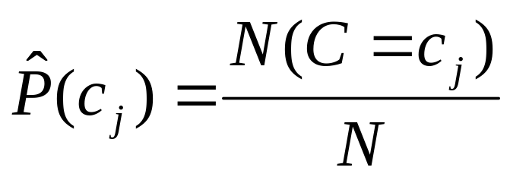
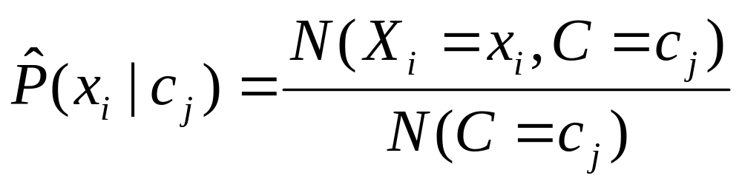
Learning the Model
Sec.13.3
C
X₁
X₂
X₃
X₄
X₅
X₆
First attempt: maximum likelihood estimates
  simply use the frequencies in the data

Slide 22
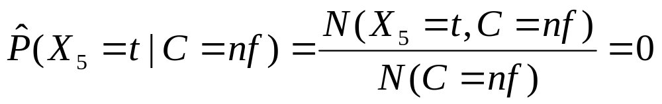
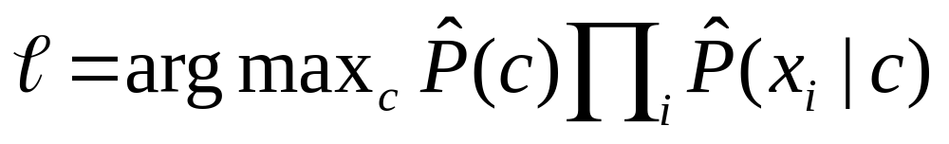
Problem with Maximum Likelihood
Sec.13.3
Flu
X₁
X₂
X₃
X₄
X₅
runnynose
sinus
cough
fever
muscle-ache
What if we have seen no training documents with the word muscle-ache and classified in the topic Flu?
Zero probabilities cannot be conditioned away, no matter the other evidence!

Slide 23
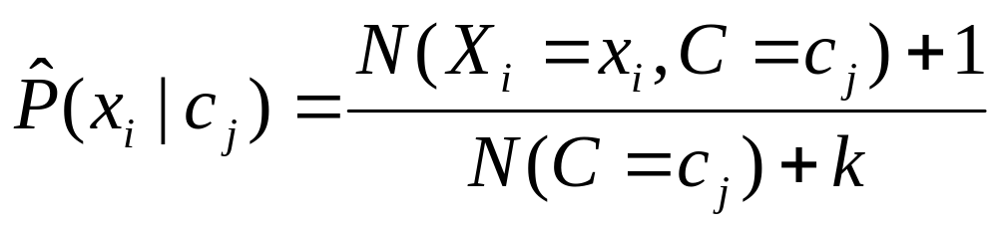
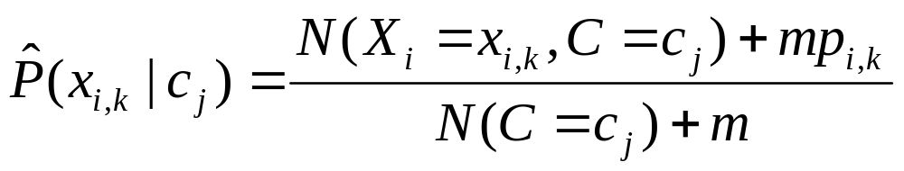
Smoothing to Avoid Overfitting
Sec.13.3
# of values of X_{i}
overall fraction in data where X_{i}=x_{i,k}
Somewhat more subtle version
extent of
“smoothing”
Notes:
Note that this was discussed in the review section, for giving better estimates in the spelling correction exercise.

Slide 24
Stochastic Language Models
Sec.13.2.1
Model probability of generating strings (each word in turn) in a language (commonly all strings over alphabet ∑). E.g., a unigram model
Model M
0.2 the
0.1 a
0.01 man
0.01 woman
0.03 said
0.02 likes
…
the
man
likes
the
woman
0.2
0.01
0.02
0.2
0.01
multiply
P(s | M) = 0.00000008

Slide 25
Stochastic Language Models
Sec.13.2.1
Model probability of generating any string
Model M1
Model M2
0.2 the
0.0001 class
0.03 sayst
0.02 pleaseth
0.1 yon
0.01 maiden
0.0001 woman
0.2 the
0.01 class
0.0001 sayst
0.0001 pleaseth
0.0001 yon
0.0005 maiden
0.01 woman
the
class
pleaseth
yon
maiden
0.2
0.01
0.0001
0.0001
0.0005
0.2
0.0001
0.02
0.1
0.01
P(s|M2) > P(s|M1)

Slide 26
Unigram and higher-order models
Sec.13.2.1
Unigram Language Models
Bigram (generally, n-gram) Language Models
Other Language Models
  Grammar-based models (PCFGs), etc.
    Probably not the first thing to try in IR
P ( )
= P ( )
P ( | )
P ( | )
P ( | )
Easy.
Effective!
P ( ) P ( ) P ( ) P ( )
P ( ) P ( | ) P ( | ) P ( | )

Slide 27
Naïve Bayes via a class conditional language model = multinomial NB
Sec.13.2
C
w₁
w₂
w₃
w₄
w₅
w₆
Effectively, the probability of each class is done as a class-specific unigram language model

Slide 28
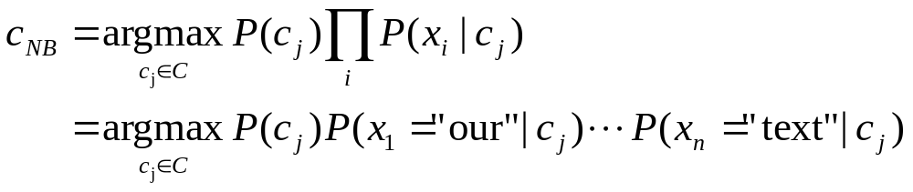
Using Multinomial Naive Bayes Classifiers to Classify Text: Basic method
Sec.13.2
Attributes are text positions, values are words.
Still too many possibilities
Assume that classification is independent of the positions of the words
  Use same parameters for each position
  Result is bag of words model (over tokens not types)

Slide 29
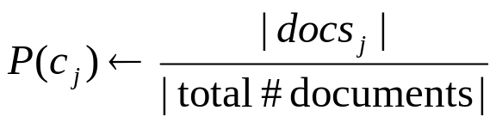
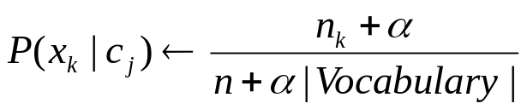
Naive Bayes: Learning
Sec.13.2
From training corpus, extract Vocabulary
Calculate required P(c_{j}) and P(x_{k} | c_{j}) terms
  For each c_{j} in C do
    docs_{j} ← subset of documents for which the target class is c_{j}
    Text_{j} ← single document containing all docs_{j}
    for each word x_{k} in Vocabulary
      n_{k} ← number of occurrences of x_{k} in Text_{j}

Slide 30
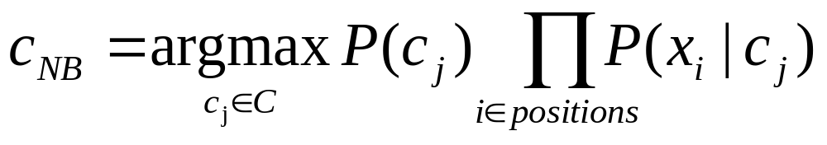
Naive Bayes: Classifying
Sec.13.2
positions ← all word positions in current document which contain tokens found in Vocabulary
Return c_{NB}, where

Slide 31
Naive Bayes: Time Complexity
Sec.13.2
Training Time: O(|D|L_{ave} + |C||V|)) where L_{ave} is the average length of a document in D.
  Assumes all counts are pre-computed in O(|D|L_{ave}) time during one pass through all of the data.
  Generally just O(|D|L_{ave}) since usually |C||V| < |D|L_{ave}
Test Time: O(|C| L_{t}) where L_{t} is the average length of a test document.
Very efficient overall, linearly proportional to the time needed to just read in all the data.
Why?

Slide 32
Underflow Prevention: using logs
Sec.13.2
Multiplying lots of probabilities, which are between 0 and 1 by definition, can result in floating-point underflow.
Since log(xy) = log(x) + log(y), it is better to perform all computations by summing logs of probabilities rather than multiplying probabilities.
Class with highest final un-normalized log probability score is still the most probable.
Note that model is now just max of sum of weights…

Slide 33
Naive Bayes Classifier
Simple interpretation: Each conditional parameter log P(x_{i}|c_{j}) is a weight that indicates how good an indicator x_{i} is for c_{j}.
The prior log P(c_{j}) is a weight that indicates the relative frequency of c_{j}.
The sum is then a measure of how much evidence there is for the document being in the class.
We select the class with the most evidence for it

Slide 34
Two Naive Bayes Models
Model 1: Multivariate Bernoulli
  One feature X_{w} for each word in dictionary
  X_{w} = true in document d if w appears in d
  Naive Bayes assumption:
    Given the document’s topic, appearance of one word in the document tells us nothing about chances that another word appears
This is the model used in the binary independence model in classic probabilistic relevance feedback on hand-classified data (Maron in IR was a very early user of NB)

Slide 35
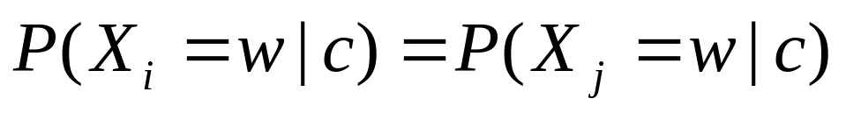
Two Models
Model 2: Multinomial = Class conditional unigram
  One feature X_{i} for each word pos in document
    feature’s values are all words in dictionary
  Value of X_{i} is the word in position i
  Naïve Bayes assumption:
    Given the document’s topic, word in one position in the document tells us nothing about words in other positions
  Second assumption:
    Word appearance does not depend on position
    Just have one multinomial feature predicting all words
for all positions i,j, word w, and class c

Slide 36
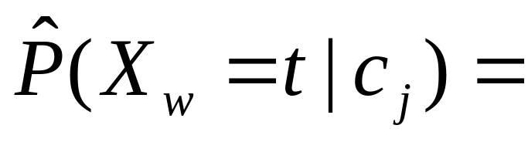
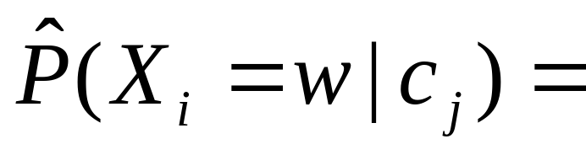
Parameter estimation
Multivariate Bernoulli model:
Multinomial model:
  Can create a mega-document for topic j by concatenating all documents in this topic
  Use frequency of w in mega-document
fraction of documents of topic c_{j}
in which word w appears
fraction of times in which
word w appears among all
words in documents of topic c_{j}

Slide 37
Classification
Multinomial vs Multivariate Bernoulli?
Multinomial model is almost always more effective in text applications!
    See results figures later
See IIR sections 13.2 and 13.3 for worked examples with each model

Slide 38
Feature Selection: Why?
Sec.13.5
Text collections have a large number of features
  10,000 – 1,000,000 unique words … and more
May make using a particular classifier feasible
  Some classifiers can’t deal with 100,000 of features
Reduces training time
  Training time for some methods is quadratic or worse in the number of features
Can improve generalization (performance)
  Eliminates noise features
  Avoids overfitting

Slide 39
Feature selection: how?
Sec.13.5
Two ideas:
  Hypothesis testing statistics:
    Are we confident that the value of one categorical variable is associated with the value of another
    Chi-square test (χ²)
  Information theory:
    How much information does the value of one categorical variable give you about the value of another
    Mutual information
They’re similar, but χ² measures confidence in association, (based on available statistics), while MI measures extent of association (assuming perfect knowledge of probabilities)

Slide 40
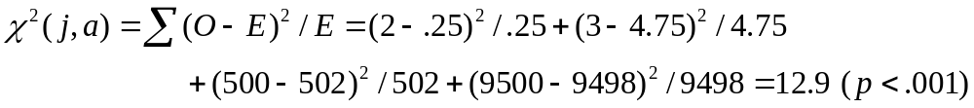
χ² statistic (CHI)
Sec.13.5.2
χ2 is interested in (f_{o} – f_{e})²/f_{e} summed over all table entries: is the observed number what you’d expect given the marginals?
The null hypothesis is rejected with confidence .999,
since 12.9 > 10.83 (the value for .999 confidence).
Term = jaguar
Term ≠ jaguar
expected: f_{e}
Class = auto
2
(0.25)
500
(502)
Class ≠ auto
3
(4.75)
9500
(9498)
observed: f_{o}

Slide 41

Sec.13.5.2
χ² statistic (CHI)
There is a simpler formula for 2x2 χ²:
A = #(t,c)
C = #(¬t,c)
B = #(t,¬c)
D = #(¬t, ¬c)
N = A + B + C + D
Value for complete independence of term and category?

Slide 42
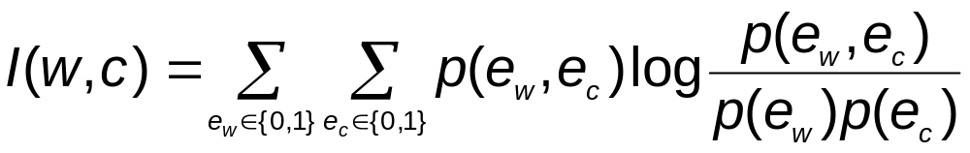
Feature selection via Mutual Information
Sec.13.5.1
In training set, choose k words which best discriminate (give most info on) the categories.
The Mutual Information between a word, class is:
  For each word w and each category c

Slide 43
Feature selection via MI (contd.)
Sec.13.5.1
For each category we build a list of k most discriminating terms.
For example (on 20 Newsgroups):
  sci.electronics: circuit, voltage, amp, ground, copy, battery, electronics, cooling, …
  rec.autos: car, cars, engine, ford, dealer, mustang, oil, collision, autos, tires, toyota, …
Greedy: does not account for correlations between terms
Why?

Slide 44
Feature Selection
Sec.13.5
Mutual Information
  Clear information-theoretic interpretation
  May select rare uninformative terms
Chi-square
  Statistical foundation
  May select very slightly informative frequent terms that are not very useful for classification
Just use the commonest terms?
  No particular foundation
  In practice, this is often 90% as good

Slide 45
Feature selection for NB
Sec.13.5
In general feature selection is necessary for multivariate Bernoulli NB.
Otherwise you suffer from noise, multi-counting
“Feature selection” really means something different for multinomial NB. It means dictionary truncation
  The multinomial NB model only has 1 feature
This “feature selection” normally isn’t needed for multinomial NB, but may help a fraction with quantities that are badly estimated

Slide 46
Evaluating Categorization
Sec.13.6
Evaluation must be done on test data that are independent of the training data (usually a disjoint set of instances).
  Sometimes use cross-validation (averaging results over multiple training and test splits of the overall data)
It’s easy to get good performance on a test set that was available to the learner during training (e.g., just memorize the test set).
Measures: precision, recall, F1, classification accuracy
Classification accuracy: c/n where n is the total number of test instances and c is the number of test instances correctly classified by the system.
  Adequate if one class per document
  Otherwise F measure for each class

Slide 47
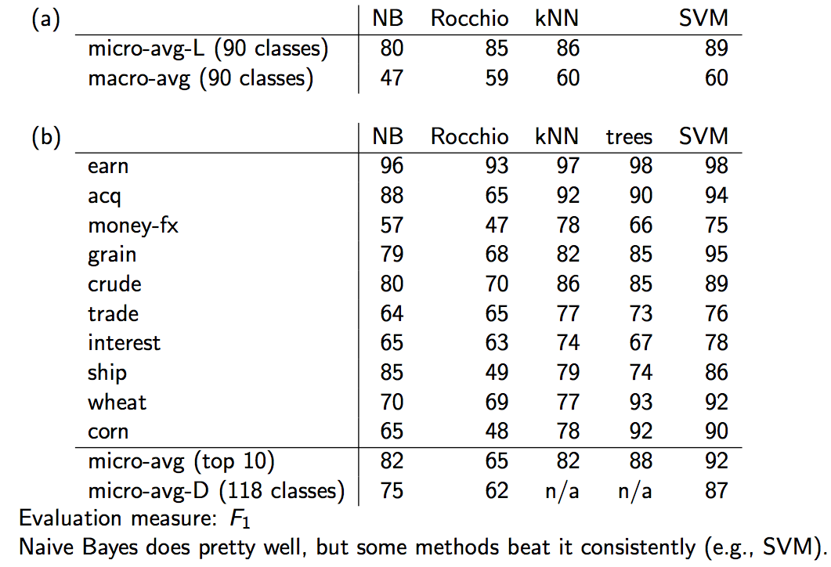
Naive Bayes vs. other methods
Sec.13.6

Slide 48
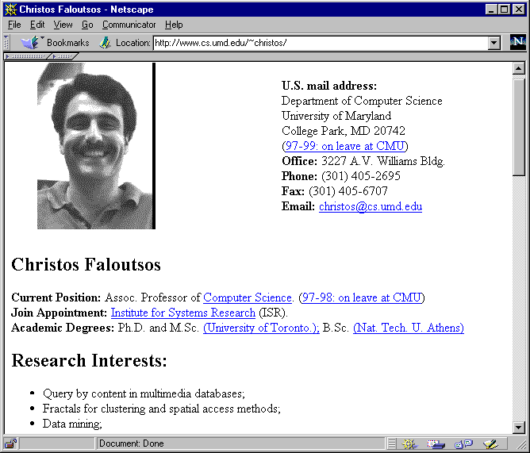
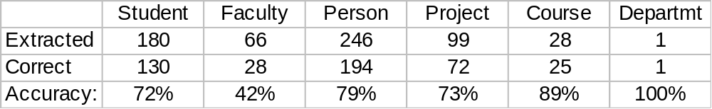
WebKB Experiment (1998)
Sec.13.6
Classify webpages from CS departments into:
  student, faculty, course,project
Train on ~5,000 hand-labeled web pages
  Cornell, Washington, U.Texas, Wisconsin
Crawl and classify a new site (CMU)
Results:

Slide 49
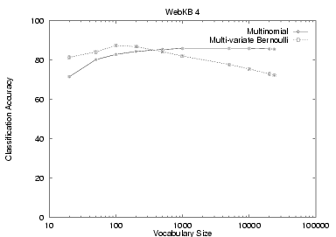
NB Model Comparison: WebKB
Sec.13.6

Slide 50
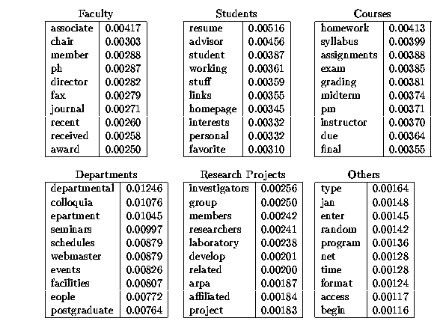

Slide 51
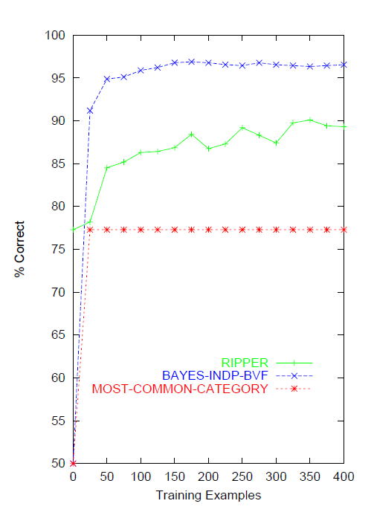
Naïve Bayes on spam email
Sec.13.6
Notes:
This graph is from
http://www.cs.utexas.edu/users/jp/research/email.paper.pdf
Naive-Bayes vs. Rule-Learning in Classification of Email
Jefferson Provost, UT Austin

Slide 52
SpamAssassin
Naïve Bayes has found a home in spam filtering
  Paul Graham’s A Plan for Spam
    A mutant with more mutant offspring...
  Naive Bayes-like classifier with weird parameter estimation
  Widely used in spam filters
    Classic Naive Bayes superior when appropriately used
      According to David D. Lewis
  But also many other things: black hole lists, etc.
Many email topic filters also use NB classifiers

Slide 53
Violation of NB Assumptions
The independence assumptions do not really hold of documents written in natural language.
  Conditional independence
  Positional independence
Examples?

Slide 54
Example: Sensors
Reality
Raining
Sunny
P(+,+,r) = 3/8
P(-,-,r) = 1/8
P(+,+,s) = 1/8
P(-,-,s) = 3/8
NB Model
NB FACTORS:
P(s) = 1/2
P(+|s) = 1/4
P(+|r) = 3/4
PREDICTIONS:
P(r,+,+) = (½)(¾)(¾)
P(s,+,+) = (½)(¼)(¼)
P(r|+,+) = 9/10
P(s|+,+) = 1/10
Raining?
M1
M2

Slide 55
Naïve Bayes Posterior Probabilities
Classification results of naïve Bayes (the class with maximum posterior probability) are usually fairly accurate.
However, due to the inadequacy of the conditional independence assumption, the actual posterior-probability numerical estimates are not.
  Output probabilities are commonly very close to 0 or 1.
Correct estimation ⇒ accurate prediction, but correct probability estimation is NOT necessary for accurate prediction (just need right ordering of probabilities)

Slide 56
Naive Bayes is Not So Naive
Naive Bayes won 1st and 2nd place in KDD-CUP 97 competition out of 16 systems
  Goal: Financial services industry direct mail response prediction model: Predict if the recipient of mail will actually respond to the advertisement – 750,000 records.
More robust to irrelevant features than many learning methods
  Irrelevant Features cancel each other without affecting results
  Decision Trees can suffer heavily from this.
More robust to concept drift (changing class definition over time)
Very good in domains with many equally important features
  Decision Trees suffer from fragmentation in such cases – especially if little data
A good dependable baseline for text classification (but not the best)!
Optimal if the Independence Assumptions hold: Bayes Optimal Classifier
  Never true for text, but possible in some domains
Very Fast Learning and Testing (basically just count the data)
Low Storage requirements

Slide 57
Resources for today’s lecture
Ch. 13
IIR 13
Fabrizio Sebastiani. Machine Learning in Automated Text Categorization. ACM Computing Surveys, 34(1):1-47, 2002.
Yiming Yang & Xin Liu, A re-examination of text categorization methods. Proceedings of SIGIR, 1999.
Andrew McCallum and Kamal Nigam. A Comparison of Event Models for Naive Bayes Text Classification. In AAAI/ICML-98 Workshop on Learning for Text Categorization, pp. 41-48.
Tom Mitchell, Machine Learning. McGraw-Hill, 1997.
  Clear simple explanation of Naïve Bayes
Open Calais: Automatic Semantic Tagging
  Free (but they can keep your data), provided by Thompson/Reuters (ex-ClearForest)
Weka: A data mining software package that includes an implementation of Naive Bayes
Reuters-21578 – the most famous text classification evaluation set
  Still widely used by lazy people (but now it’s too small for realistic experiments – you should use Reuters RCV1)

