Slide 1
CS276: Information Retrieval and Web Search
Christopher Manning, Pandu Nayak and Prabhakar Raghavan
Spelling Correction

Slide 2
Don’t forget …
5 queries for the Stanford intranet
(read the piazza post)

Slide 3
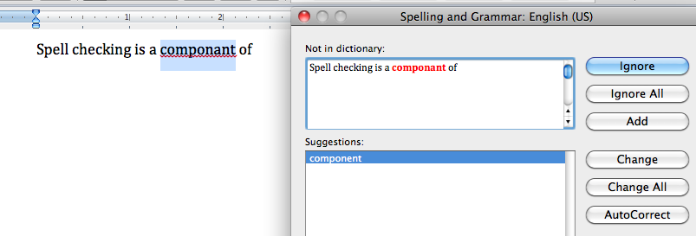
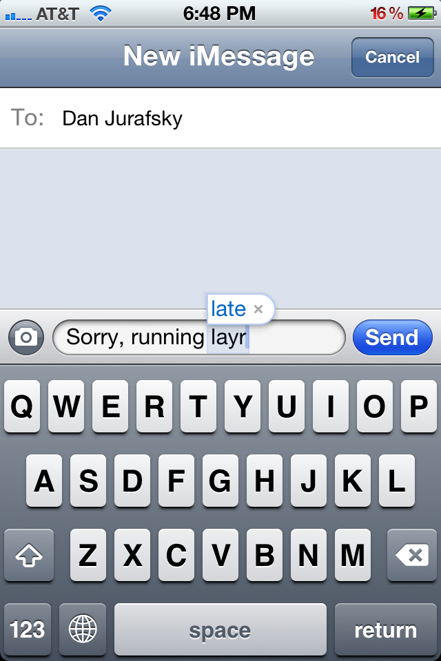
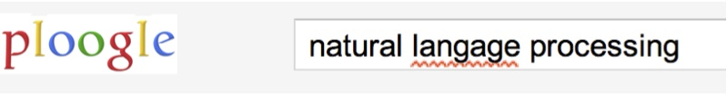

Applications for spelling correction
Word processing
Phones
Web search

Slide 4
Spelling Tasks
Spelling Error Detection
Spelling Error Correction:
  Autocorrect
    hte→the
  Suggest a correction
  Suggestion lists
Notes:
HCI issues and confidence determine.

Slide 5
Types of spelling errors
Non-word Errors
  graffe →giraffe
Real-word Errors
  Typographical errors
    three →there
  Cognitive Errors (homophones)
    piece→peace,
    too → two
    your →you’re

Slide 6
Rates of spelling errors
Depending on the application, ~1-20% error rates
  26%: Web queries Wang et al. 2003
  13%: Retyping, no backspace: Whitelaw et al. English&German
  7%: Words corrected retyping on phone-sized organizer
  2%: Words uncorrected on organizer Soukoreff &MacKenzie 2003
1-2%: Retyping: Kane and Wobbrock 2007, Gruden et al. 1983

Slide 7
Non-word spelling errors
Non-word spelling error detection:
  Any word not in a dictionary is an error
  The larger the dictionary the better
  (The Web is full of mis-spellings, so the Web isn’t necessarily a great dictionary … but …)
Non-word spelling error correction:
  Generate candidates: real words that are similar to error
  Choose the one which is best:
    Shortest weighted edit distance
    Highest noisy channel probability

Slide 8
Real word spelling errors
For each word w, generate candidate set:
  Find candidate words with similar pronunciations
  Find candidate words with similar spellings
  Include w in candidate set
Choose best candidate
  Noisy Channel view of spell errors
  Context-sensitive – so have to consider whether the surrounding words “make sense”
  Flying form Heathrow to LAX → Flying from Heathrow to LAX

Slide 9
Terminology
These are character bigrams:
  st, pr, an …
These are word bigrams:
  palo alto, flying from, road repairs
In today’s class, we will generally deal with word bigrams
In the accompanying Coursera lecture, we mostly deal with character bigrams (because we cover stuff complementary to what we’re discussing here)
Similarly trigrams,
k-grams etc

Slide 10
Spelling Correction and the Noisy Channel
The Noisy Channel Model of Spelling

Slide 11
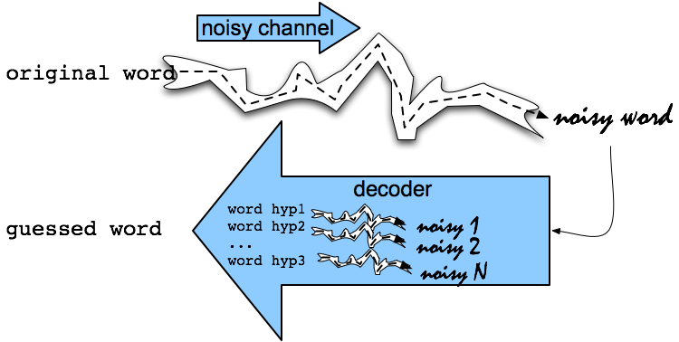
Noisy Channel Intuition

Slide 12
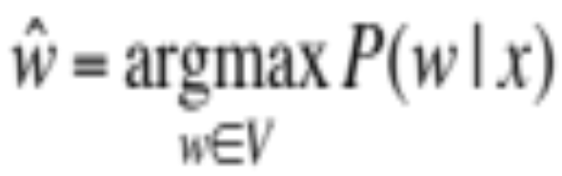
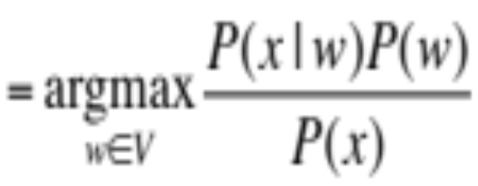
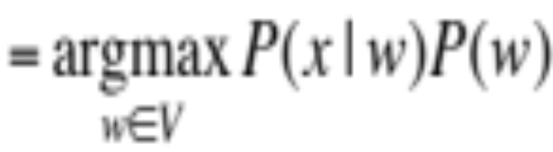
Noisy Channel + Bayes’ Rule
We see an observation x of a misspelled word
Find the correct word ŵ
Bayes
Notes:
Bayes Rule

Slide 13
History: Noisy channel for spelling proposed around 1990
IBM
  Mays, Eric, Fred J. Damerau and Robert L. Mercer. 1991. Context based spelling correction. Information Processing and Management, 23(5), 517–522
AT&T Bell Labs
  Kernighan, Mark D., Kenneth W. Church, and William A. Gale. 1990. A spelling correction program based on a noisy channel model. Proceedings of COLING 1990, 205-210

Slide 14
Non-word spelling error example
acress

Slide 15
Candidate generation
Words with similar spelling
  Small edit distance to error
Words with similar pronunciation
  Small distance of pronunciation to error
In this class lecture we mostly won’t dwell on efficient candidate generation
A lot more about candidate generation in the accompanying Coursera material

Slide 16
Damerau-Levenshtein edit distance
Minimal edit distance between two strings, where edits are:
  Insertion
  Deletion
  Substitution
  Transposition of two adjacent letters
See IIR sec 3.3.3 for edit distance

Slide 17
Words within 1 of acress
Error | Candidate Correction | Correct Letter | Error Letter | Type
acress | actress | t | - | deletion
acress | cress | - | a | insertion
acress | caress | ca | ac | transposition
acress | access | c | r | substitution
acress | across | o | e | substitution
acress | acres | - | s | insertion
acress | acres | - | s | insertion

Slide 18
Candidate generation
80% of errors are within edit distance 1
Almost all errors within edit distance 2
Also allow insertion of space or hyphen
  thisidea → this idea
  inlaw → in-law

Slide 19
Wait, how do you generate the candidates?
Run through dictionary, check edit distance with each word
Generate all words within edit distance ≤ k (e.g., k = 1 or 2) and then intersect them with dictionary
Use a character k-gram index and find dictionary words that share “most” k-grams with word (e.g., by Jaccard coefficient)
  see IIR sec 3.3.4
Compute them fast with a Levenshtein finite state transducer
Have a precomputed map of words to possible corrections
Notes:
Terrible.
Only okay for short words

Slide 20
A paradigm …
We want the best spell corrections
Instead of finding the very best, we
  Find a subset of pretty good corrections
    (say, edit distance at most 2)
  Find the best amongst them
These may not be the actual best
This is a recurring paradigm in IR including finding the best docs for a query, best answers, best ads …
  Find a good candidate set
  Find the top K amongst them and return them as the best

Slide 21
Let’s say we’ve generated candidates: Now back to Bayes’ Rule
We see an observation x of a misspelled word
Find the correct word ŵ
What’s P(w)?
Notes:
Bayes Rule

Slide 22
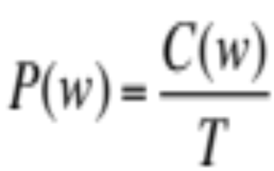
Language Model
Take a big supply of words (your document collection with T tokens); let C(w) = # occurrences of w
In other applications – you can take the supply to be typed queries (suitably filtered) – when a static dictionary is inadequate

Slide 23
Unigram Prior probability
Counts from 404,253,213 words in Corpus of Contemporary English (COCA)
word | Frequency of word | P(w)
actress | 9,321 | .0000230573
cress | 220 | .0000005442
caress | 686 | .0000016969
access | 37,038 | .0000916207
across | 120,844 | .0002989314
acres | 12,874 | .0000318463

Slide 24
Channel model probability
Error model probability, Edit probability
Kernighan, Church, Gale 1990
Misspelled word x = x₁, x₂, x₃… x_{m}
Correct word w = w₁, w₂, w₃,…, w_{n}
P(x|w) = probability of the edit
  (deletion/insertion/substitution/transposition)

Slide 25
Computing error probability: confusion “matrix”
del[x,y]: count(xy typed as x)
ins[x,y]: count(x typed as xy)
sub[x,y]: count(y typed as x)
trans[x,y]: count(xy typed as yx)
Insertion and deletion conditioned on previous character

Slide 26
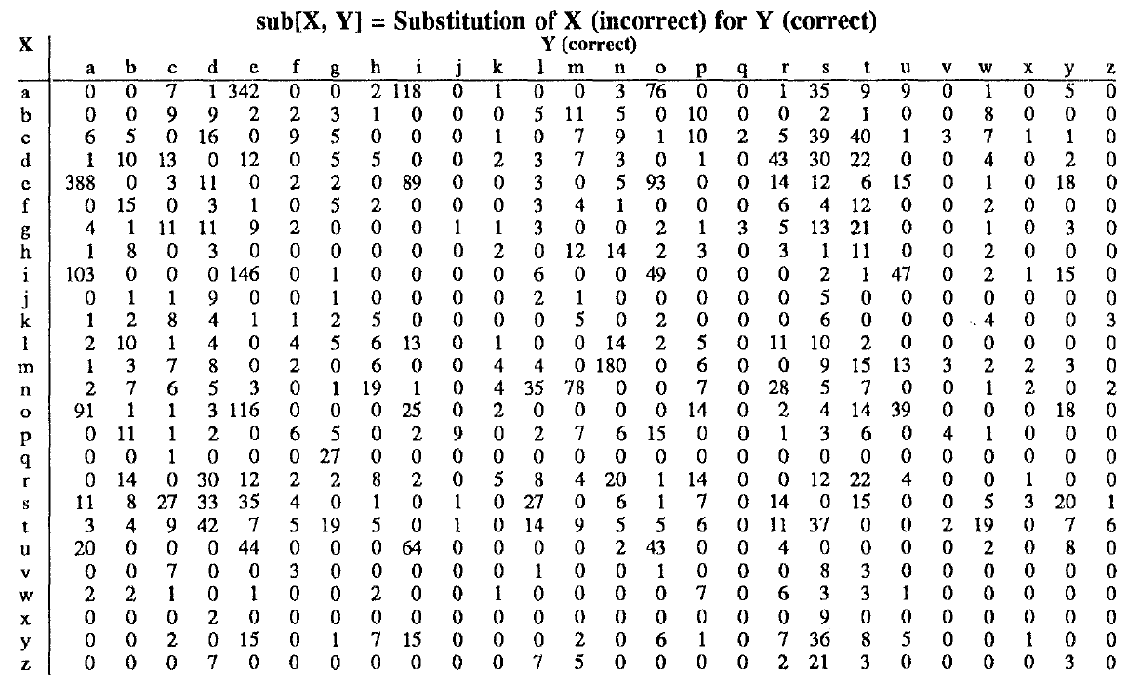
Confusion matrix for substitution

Slide 27
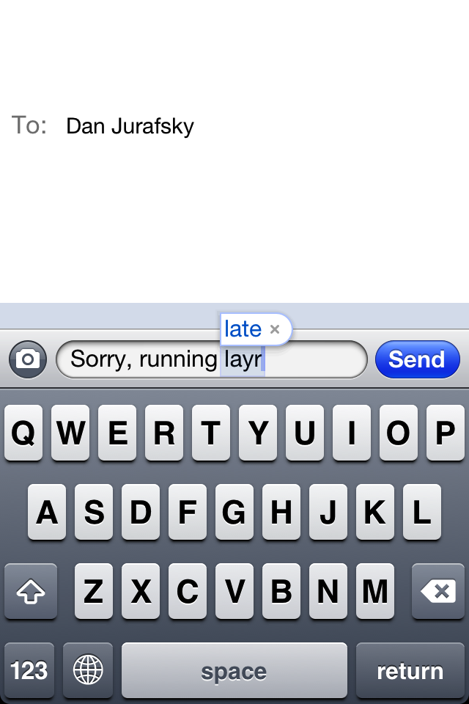
Nearby keys

Slide 28
Generating the confusion matrix
Peter Norvig’s list of errors
Peter Norvig’s list of counts of single-edit errors
    All Peter Norvig’s ngrams data links: http://norvig.com/ngrams/

Slide 29
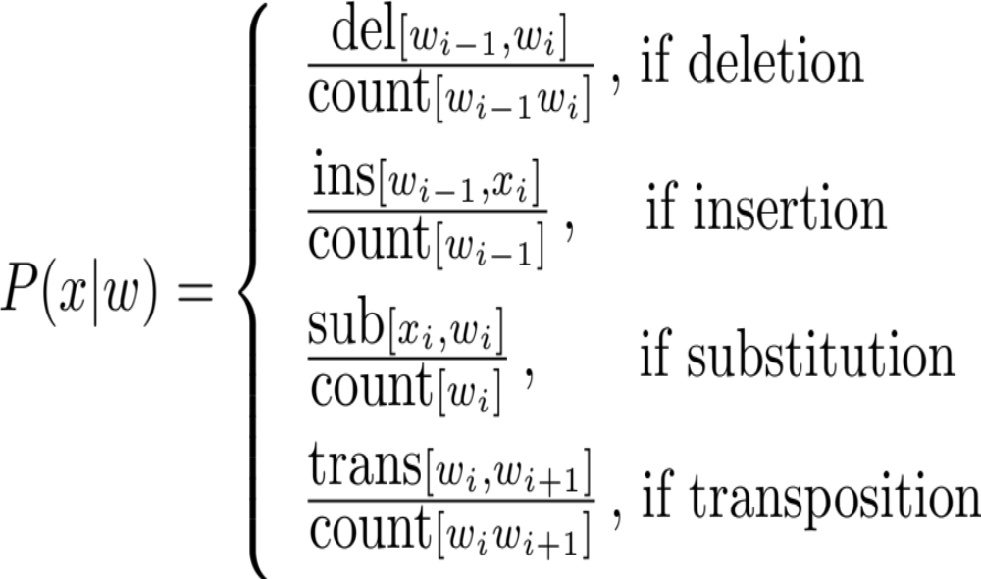
Channel model
Kernighan, Church, Gale 1990

Slide 30
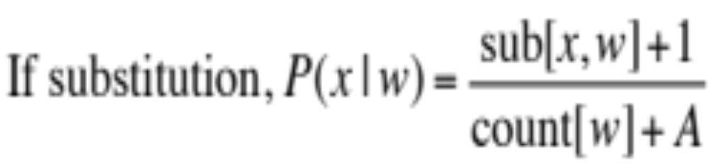
Smoothing probabilities: Add-1 smoothing
But if we use the confusion matrix example, unseen errors are impossible!
They’ll make the overall probability 0. That seems too harsh
  e.g., in Kernighan’s chart q➔a and a➔q are both 0, even though they’re adjacent on the keyboard!
A simple solution is to add 1 to all counts and then if there is a |A| character alphabet, to normalize appropriately:

Slide 31
Channel model for acress
Candidate Correction | Correct Letter | Error Letter | x|w | P(x|w)
actress | t | - | c|ct | .000117
cress | - | a | a|# | .00000144
caress | ca | ac | ac|ca | .00000164
access | c | r | r|c | .000000209
across | o | e | e|o | .0000093
acres | - | s | es|e | .0000321
acres | - | s | ss|s | .0000342

Slide 32
Noisy channel probability for acress
Candidate Correction | Correct Letter | Error Letter | x|w | P(x|w) | P(w) | 10^{9 *} P(x|w)* P(w)
actress | t | - | c|ct | .000117 | .0000231 | 2.7
cress | - | a | a|# | .00000144 | .000000544 | .00078
caress | ca | ac | ac|ca | .00000164 | .00000170 | .0028
access | c | r | r|c | .000000209 | .0000916 | .019
across | o | e | e|o | .0000093 | .000299 | 2.8
acres | - | s | es|e | .0000321 | .0000318 | 1.0
acres | - | s | ss|s | .0000342 | .0000318 | 1.0

Slide 33
Noisy channel probability for acress
Candidate Correction | Correct Letter | Error Letter | x|w | P(x|w) | P(w) | 10^{9 *}P(x|w)P(w)
actress | t | - | c|ct | .000117 | .0000231 | 2.7
cress | - | a | a|# | .00000144 | .000000544 | .00078
caress | ca | ac | ac|ca | .00000164 | .00000170 | .0028
access | c | r | r|c | .000000209 | .0000916 | .019
across | o | e | e|o | .0000093 | .000299 | 2.8
acres | - | s | es|e | .0000321 | .0000318 | 1.0
acres | - | s | ss|s | .0000342 | .0000318 | 1.0

Slide 34
Incorporating context words:
Context-sensitive spelling correction
Determining whether actress or across is appropriate will require looking at the context of use
We can do this with a better language model
  You learned/can learn a lot about language models in CS124 or CS224N
  Here we present just enough to be dangerous/do the assignment
A bigram language model conditions the probability of a word on (just) the previous word
    P(w₁…w_{n}) = P(w₁)P(w₂|w₁)…P(w_{n}|w_{n−1})

Slide 35
Incorporating context words
For unigram counts, P(w) is always non-zero
  if our dictionary is derived from the document collection
This won’t be true of P(w_{k}|w_{k−1}). We need to smooth
We could use add-1 smoothing on this conditional distribution
But here’s a better way – interpolate a unigram and a bigram:
    P_{li}(w_{k}|w_{k−1}) = λP_{uni}(w₁) + (1−λ)P_{bi}(w_{k}|w_{k−1})
      P_{bi}(w_{k}|w_{k−1}) = C(w_{k}|w_{k−1}) / C(w_{k−1})

Slide 36
All the important fine points
Note that we have several probability distributions for words
  Keep them straight!
    You might want/need to work with log probabilities:
      log P(w₁…w_{n}) = log P(w₁) + log P(w₂|w₁) + … + log P(w_{n}|w_{n−1})
  Otherwise, be very careful about floating point underflow
Our query may be words anywhere in a document
  We’ll start the bigram estimate of a sequence with a unigram estimate
  Often, people instead condition on a start-of-sequence symbol, but not good here
  Because of this, the unigram and bigram counts have different totals. Not a problem

Slide 37
Using a bigram language model
“a stellar and versatile acress whose combination of sass and glamour…”
Counts from the Corpus of Contemporary American English with add-1 smoothing
P(actress|versatile)=.000021 P(whose|actress) = .0010
P(across|versatile) =.000021 P(whose|across) = .000006
P(“versatile actress whose”) = .000021*.0010 = 210 x10⁻¹⁰
P(“versatile across whose”) = .000021*.000006 = 1 x10⁻¹⁰

Slide 38
Using a bigram language model
“a stellar and versatile acress whose combination of sass and glamour…”
Counts from the Corpus of Contemporary American English with add-1 smoothing
P(actress|versatile)=.000021 P(whose|actress) = .0010
P(across|versatile) =.000021 P(whose|across) = .000006
P(“versatile actress whose”) = .000021*.0010 = 210 x10⁻¹⁰
P(“versatile across whose”) = .000021*.000006 = 1 x10⁻¹⁰

Slide 39
Evaluation
Some spelling error test sets
  Wikipedia’s list of common English misspelling
  Aspell filtered version of that list
  Birkbeck spelling error corpus
  Peter Norvig’s list of errors (includes Wikipedia and Birkbeck, for training or testing)

Slide 40
Spelling Correction and the Noisy Channel
Real-Word Spelling Correction

Slide 41
Real-word spelling errors
…leaving in about fifteen minuets to go to her house.
The design an construction of the system…
Can they lave him my messages?
The study was conducted mainly be John Black.
25-40% of spelling errors are real words Kukich 1992

Slide 42
Solving real-word spelling errors
For each word in sentence (phrase, query …)
  Generate candidate set
    the word itself
    all single-letter edits that are English words
    words that are homophones
    (all of this can be pre-computed!)
Choose best candidates
    Noisy channel model

Slide 43
Noisy channel for real-word spell correction
Given a sentence w₁,w₂,w₃,…,w_{n}
Generate a set of candidates for each word w_{i}
  Candidate(w₁) = {w₁, w’₁ , w’’₁ , w’’’₁ ,…}
  Candidate(w₂) = {w₂, w’₂ , w’’₂ , w’’’₂ ,…}
  Candidate(w_{n}) = {w_{n}, w’_{n} , w’’_{n} , w’’’_{n} ,…}
Choose the sequence W that maximizes P(W)

Slide 44
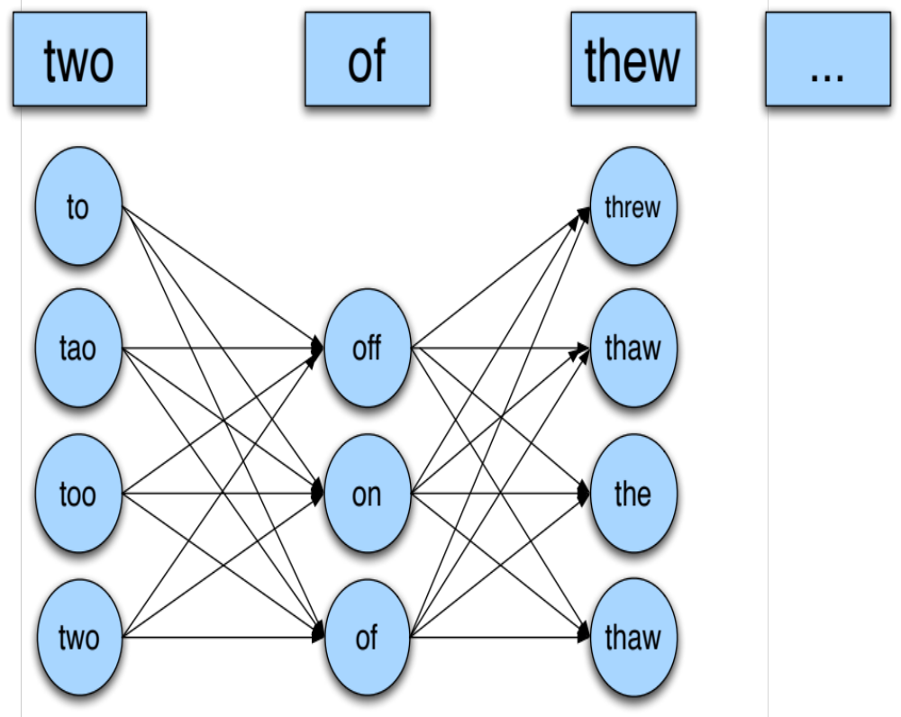
Noisy channel for real-word spell correction

Slide 45
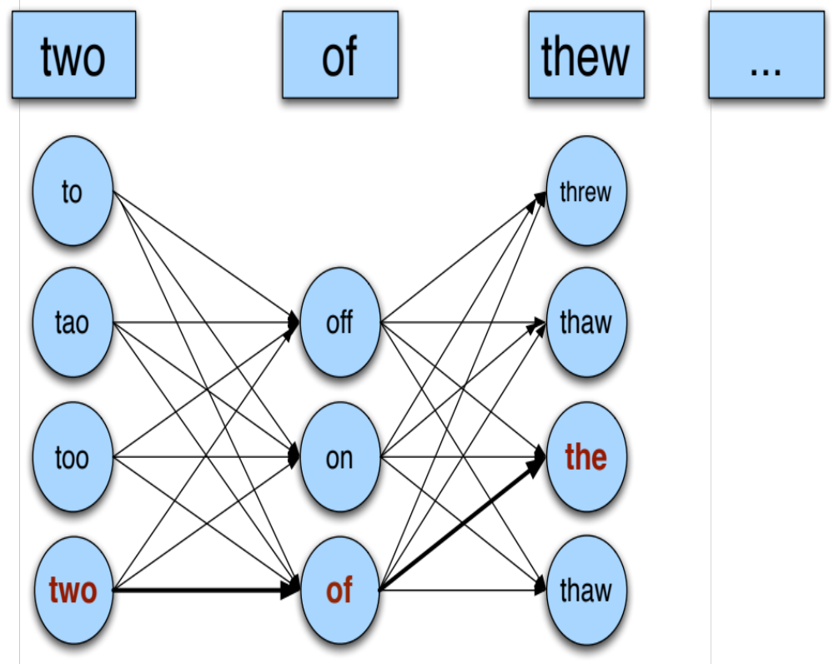
Noisy channel for real-word spell correction

Slide 46
Simplification: One error per sentence
Out of all possible sentences with one word replaced
  w₁, w’’₂,w₃,w₄ two off thew
  w₁,w₂,w’₃,w₄ two of the
  w’’’₁,w₂,w₃,w₄ too of thew
  …
Choose the sequence W that maximizes P(W)

Slide 47
Where to get the probabilities
Language model
  Unigram
  Bigram
  etc.
Channel model
  Same as for non-word spelling correction
  Plus need probability for no error, P(w|w)

Slide 48
Probability of no error
What is the channel probability for a correctly typed word?
P(“the”|“the”)
  If you have a big corpus, you can estimate this percent correct
But this value depends strongly on the application
  .90 (1 error in 10 words)
  .95 (1 error in 20 words)
  .99 (1 error in 100 words)

Slide 49
Peter Norvig’s “thew” example
x | w | x|w | P(x|w) | P(w) | 10⁹ P(x|w)P(w)
thew | the | ew|e | 0.000007 | 0.02 | 144
thew | thew |  | 0.95 | 0.00000009 | 90
thew | thaw | e|a | 0.001 | 0.0000007 | 0.7
thew | threw | h|hr | 0.000008 | 0.000004 | 0.03
thew | thwe | ew|we | 0.000003 | 0.00000004 | 0.0001

Slide 50
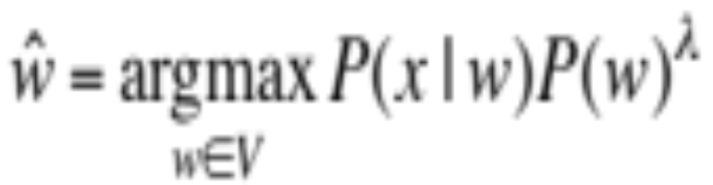
State of the art noisy channel
We never just multiply the prior and the error model
Independence assumptions→probabilities not commensurate
Instead: Weight them
Learn λ from a development test set

Slide 51
Improvements to channel model
Allow richer edits (Brill and Moore 2000)
  ent→ant
  ph→f
  le→al
Incorporate pronunciation into channel (Toutanova and Moore 2002)
Incorporate device into channel
  Not all Android phones need have the same error model
  But spell correction may be done at the system level

