Slide 1
IN3120 week 13
Group 1

Slide 2
Teaching assistants next year
Apply, it’s fun!

Slide 3
Agenda
Important topics
TAAT vs. DAAT
BSBI & SPIMI
Double shoutout!!

Slide 4
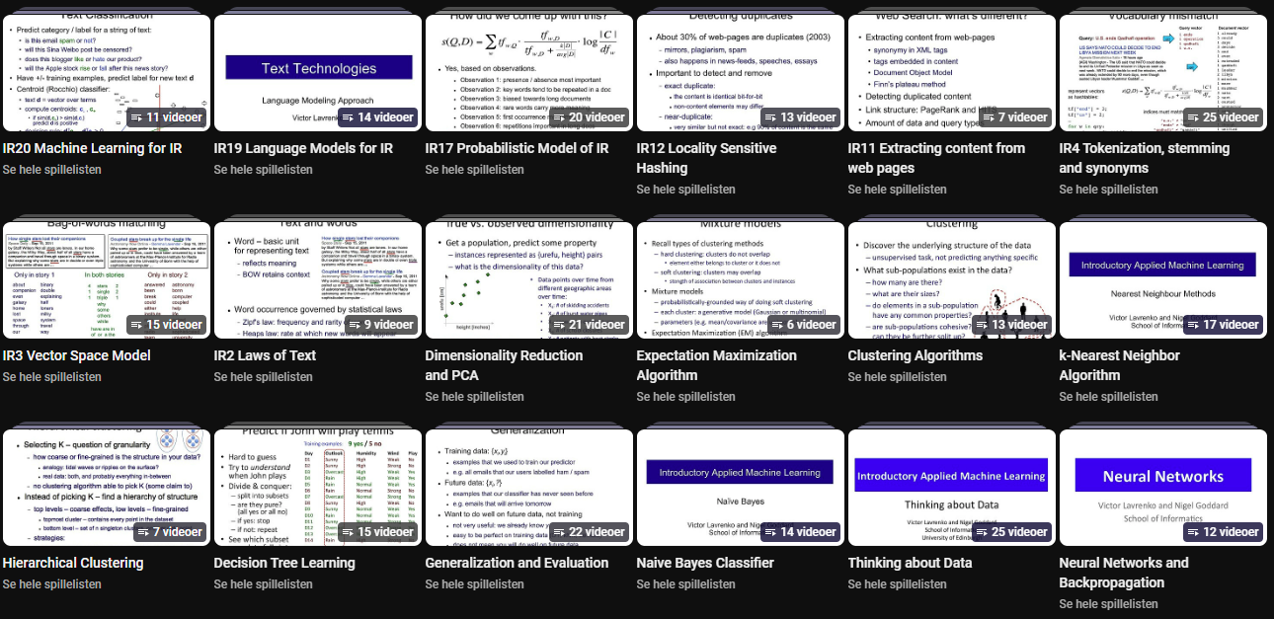
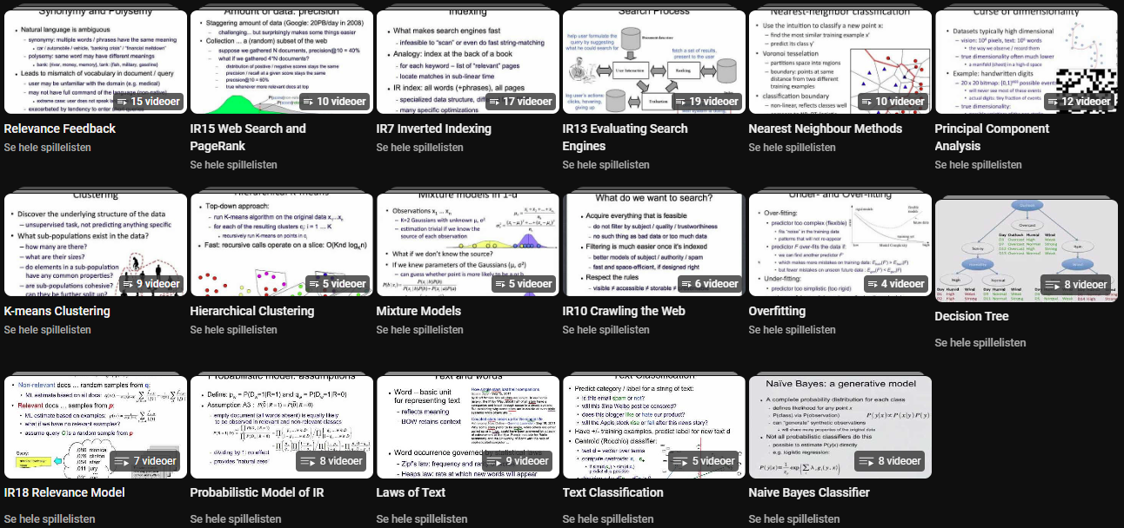















Victor Lavrenko – The StatQuest of IR
Inverted index playlist (incl. DAAT, TAAT): https://www.youtube.com/playlist?list=PLBv09BD7ez_448q9kRfZRxYb3cbeEanRb

Slide 5
Document-at-a-time
What we did in assignment C-1
Compute the score for a document, then move on to new document
But we keep pointers on many docs at the same time?
Documents with score 0 is not a part of the result set
Why?

Slide 6
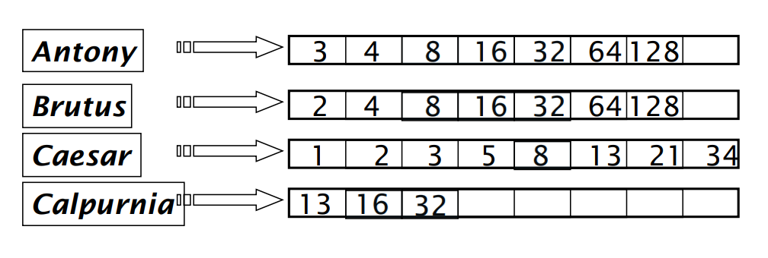
Eksempel-postinglister
Notes:
It’s nice to have someone holding you accountable, and that you can bother with questions, because you’re working towards the same goal!

Slide 7
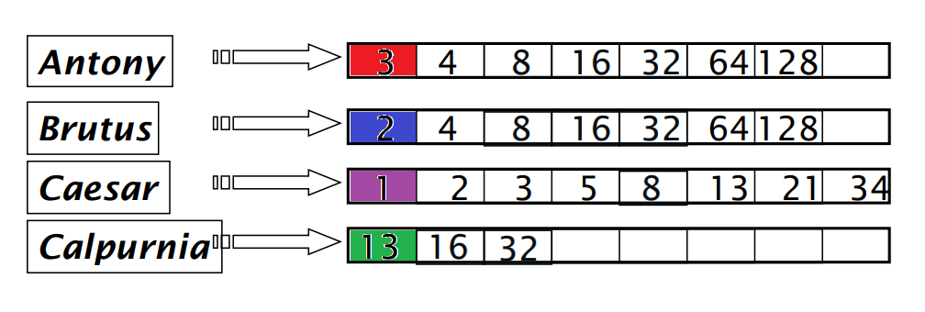
FRONTIER: 1
Notes:
It’s nice to have someone holding you accountable, and that you can bother with questions, because you’re working towards the same goal!

Slide 8
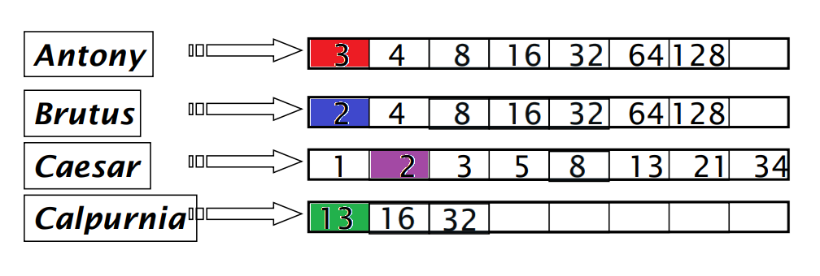
FRONTIER: 2
Notes:
It’s nice to have someone holding you accountable, and that you can bother with questions, because you’re working towards the same goal!

Slide 9
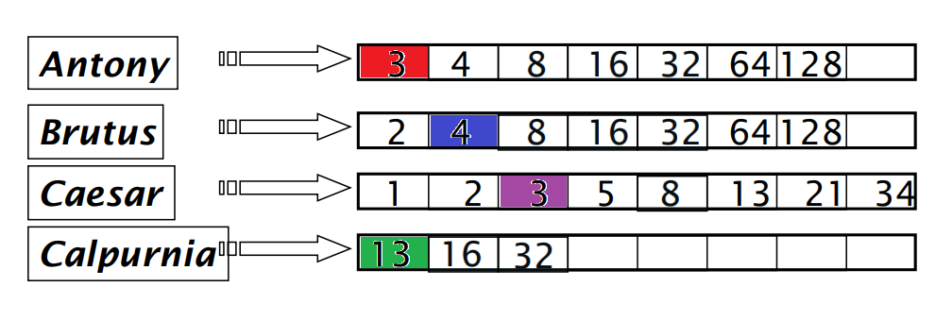
FRONTIER: 2
Notes:
It’s nice to have someone holding you accountable, and that you can bother with questions, because you’re working towards the same goal!

Slide 10
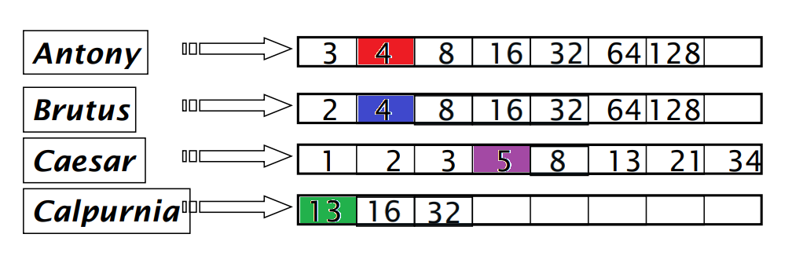
FRONTIER: 2
Notes:
It’s nice to have someone holding you accountable, and that you can bother with questions, because you’re working towards the same goal!

Slide 11
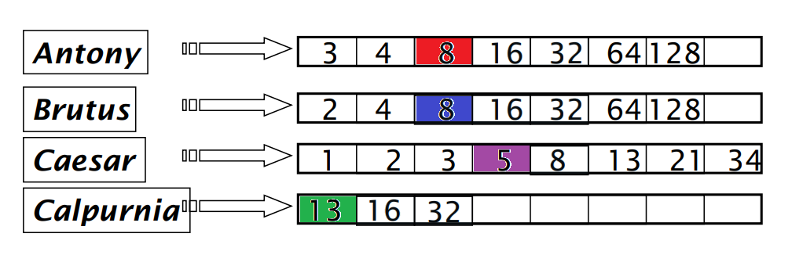
FRONTIER: 1
Notes:
It’s nice to have someone holding you accountable, and that you can bother with questions, because you’re working towards the same goal!

Slide 12
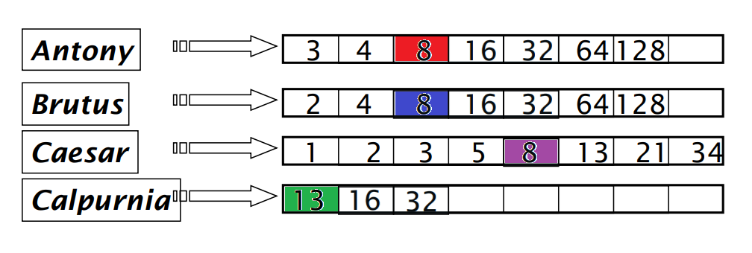
FRONTIER: 3
Notes:
It’s nice to have someone holding you accountable, and that you can bother with questions, because you’re working towards the same goal!

Slide 13
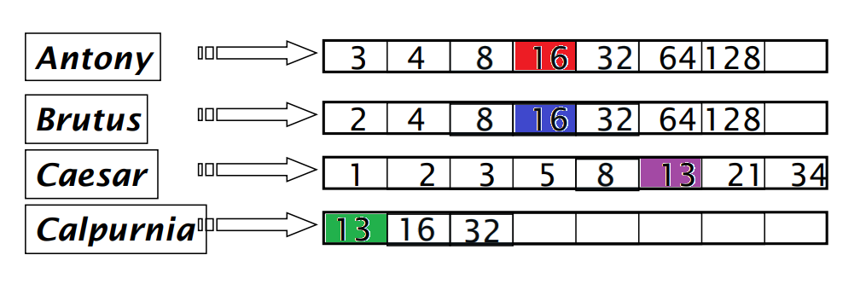
FRONTIER: 2
Notes:
It’s nice to have someone holding you accountable, and that you can bother with questions, because you’re working towards the same goal!

Slide 14
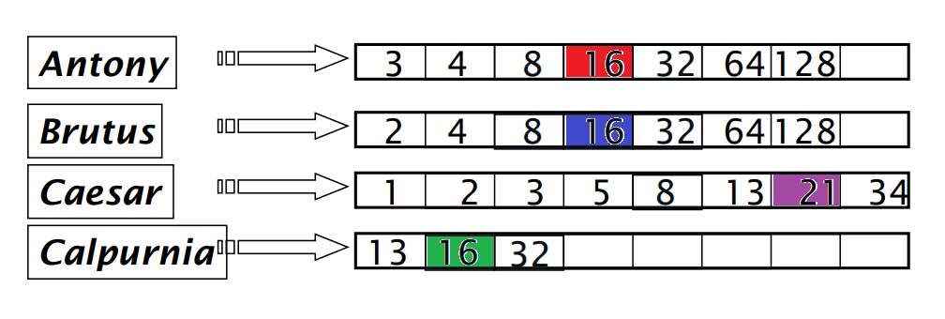
FRONTIER: 3
Notes:
It’s nice to have someone holding you accountable, and that you can bother with questions, because you’re working towards the same goal!

Slide 15
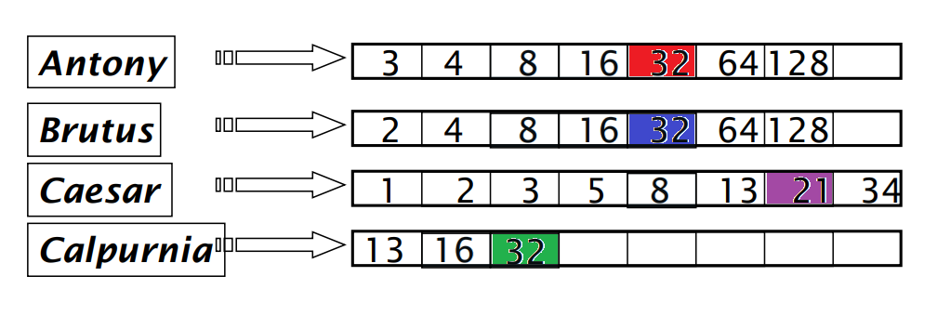
FRONTIER: 1
Notes:
It’s nice to have someone holding you accountable, and that you can bother with questions, because you’re working towards the same goal!

Slide 16
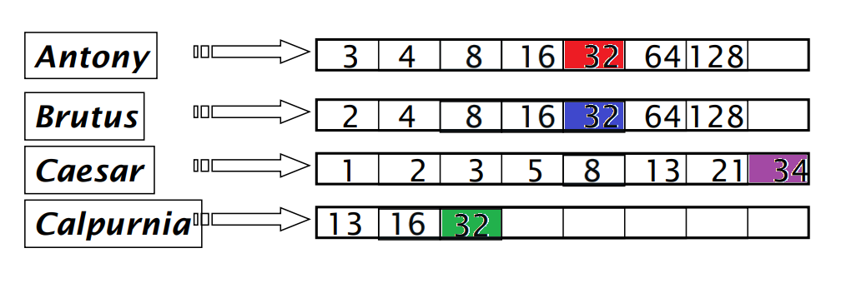
FRONTIER: 3
Notes:
It’s nice to have someone holding you accountable, and that you can bother with questions, because you’re working towards the same goal!

Slide 17
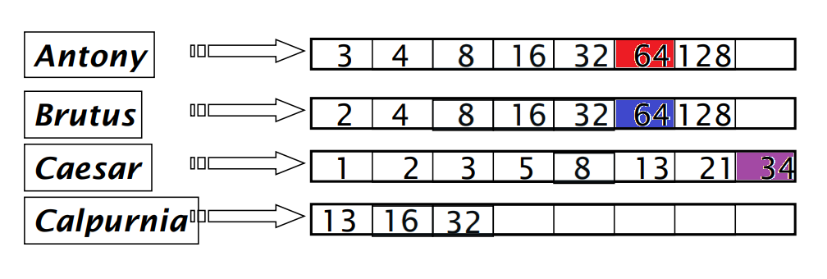
FRONTIER: 1
Notes:
It’s nice to have someone holding you accountable, and that you can bother with questions, because you’re working towards the same goal!

Slide 18
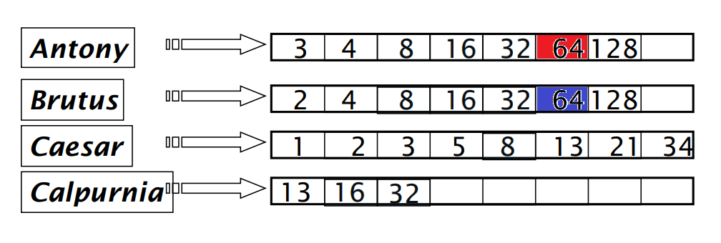
LEN(REMAINING_CURSORS) < N
Notes:
It’s nice to have someone holding you accountable, and that you can bother with questions, because you’re working towards the same goal!

Slide 19
Term-at-a-time
Incrementally compute the score for all documents
Instead of keeping a pointer at the frontier of the posting lists, keep a structure of the current scores of all documents and iterate over the query

Slide 20
Example
Given the query "Antony Brutus Caesar Calpurnia"
And the inverted index
index = {
"Antony" : [{"docId" : 1, "tf" : 3}, {"docId" : 5, "tf" : 1}],
"Brutus" : [{"docId" : 4, "tf" : 10}, {"docId" : 5, "tf" : 1}],
"Caesar" : [{"docId" : 1, "tf" : 1}, {"docId" : 2, "tf" : 1}, {"docId" : 3, "tf" : 1}],
"Calpurnia" : [{"docId" : 2, "tf" : 4}, {"docId" : 6, "tf" : 8}]
...
}

Slide 21
Antony
"Antony" : [{"docId" : 1, "tf" : 3}, {"docId" : 5, "tf" : 1}]
 | 1 | 2 | 3 | 4 | 5 | 6
Antony | 3 | 0 | 0 | 0 | 1 | 0
Brutus
Caesar
Calpurnia

Slide 22
Brutus
"Brutus" : [{"docId" : 4, "tf" : 10}, {"docId" : 5, "tf" : 1}]
 | 1 | 2 | 3 | 4 | 5 | 6
Antony | 3 | 0 | 0 | 0 | 1 | 0
Brutus | 3 | 0 | 0 | 10 | 2 | 0
Caesar
Calpurnia

Slide 23
Caesar
"Caesar" : [{"docId" : 1, "tf" : 1}, {"docId" : 2, "tf" : 1}, {"docId" : 5, "tf" : 1}]
 | 1 | 2 | 3 | 4 | 5 | 6
Antony | 3 | 0 | 0 | 0 | 1 | 0
Brutus | 3 | 0 | 0 | 10 | 2 | 0
Caesar | 4 | 1 | 0 | 10 | 3 | 0
Calpurnia

Slide 24
Calpurnia
"Calpurnia" : [{"docId" : 2, "tf" : 4}, {"docId" : 6, "tf" : 8}]
 | 1 | 2 | 3 | 4 | 5 | 6
Antony | 3 | 0 | 0 | 0 | 1 | 0
Brutus | 3 | 0 | 0 | 10 | 2 | 0
Caesar | 4 | 1 | 0 | 10 | 3 | 0
Calpurnia | 4 | 5 | 0 | 10 | 3 | 8

Slide 25
Final scores
1 | 2 | 3 | 4 | 5 | 6
3 | 0 | 0 | 0 | 1 | 0
3 | 0 | 0 | 10 | 2 | 0
4 | 1 | 0 | 10 | 3 | 0
4 | 5 | 0 | 10 | 3 | 8

Slide 26
Agenda
Some random topics
TAAT vs. DAAT
BSBI & SPIMI
Double shoutout!!

Slide 27
BSBI –Blocked sort-based indexing
Split disk into blocks fitting in memory
Tokenize documents in block and create postings
Sort lexicographically
Repeat 1-3 for entire disk
Read and merge from multiple blocks, write back to disk

Slide 28
Blocked sort-based indexing
Break corpus into blocks which can approximately fit in main memory

Slide 29
Blocked sort-based indexing
Read one block at a time

Slide 30
Blocked sort-based indexing
Tokenise the documents

Slide 31
Blocked sort-based indexing
Create postings from all terms, sort alphabetically
Term1, doc: 1
Term2, doc: 1
Term3, doc: 1
Term4, doc: 1
Term5, doc: 1
Term6, doc: 2
Term7, doc: 2
Term8, doc: 3

Slide 32
Blocked sort-based indexing
Write it back to disk

Slide 33
Blocked sort-based indexing
Start over with a new block

Slide 34
Blocked sort-based indexing
Continue until all blocks are converted

Slide 35
Blocked sort-based indexing
Read parts of blocks from disk

Slide 36
Blocked sort-based indexing
Merge them

Slide 37
Blocked sort-based indexing
Write them back to disk

Slide 38
Blocked sort-based indexing
Continue until all the postings are one big inverted index

Slide 39
SPIMI – Single pass in memory indexing
What if we can’t keep the dictionary in memory?
2 key points
Create separate dictionaries for each block
Accumulate postings in posting lists as they occur. Don’t sort
Each block will be a complete inverted index
The separate indexes can be merged into one larger index

Slide 40
Single-pass in-memory indexing
Given a huge corpus

Slide 41
Single-pass in-memory indexing
Break corpus into blocks which can approximately fit in main memory

Slide 42
Single-pass in-memory indexing
Read one block at a time
Doc 1
Doc 2
Doc 3
Doc 4
Doc 5
Doc 6
etc...

Slide 43
Single-pass in-memory indexing
Tokenise the documents
15 tokens
99 tokens
5 tokens
52 tokens
1 token
68 tokens
etc…

Slide 44
Single-pass in-memory indexing
Create an inverted index for the block
term, freq, posting_list
term, freq, posting_list
term, freq, posting_list
term, freq, posting_list
term, freq, posting_list
term, freq, posting_list
term, freq, posting_list

Slide 45
Single-pass in-memory indexing
Write the block/mini inverted index to disk

Slide 46
Single-pass in-memory indexing
Start over with a new block

Slide 47
Single-pass in-memory indexing
Continue until all blocks are converted

Slide 48
Single-pass in-memory indexing
Using a k-way merge, merge the blocks to a single inverted index

Slide 49
Single-pass in-memory indexing
We keep some of it in memory and store the rest on disk

Slide 50
BSBI SPIMI
Create postings of global index, merge postings togetherin this index
Each block contains postings sorted lexicographically
Needs global term-termID mapping: need dictionary to fit in memory
Create multiple local indexes, merge these together to make global index
Each block is a separate index
A block has term-termID mappings for its own index: Only need to know the terms in one block

Slide 51
Agenda
Some random topics
TAAT vs. DAAT
BSBI & SPIMI
Double shoutout!!

Slide 52

Shoutout #1

Slide 53

Shoutout #2

Slide 54
15 min break

