Slide 1
INTERNSHIP PRESENTATION

Slide 2
TABLE OF CONTENTS
1.
2.
3.
4.
5.
ABOUT code9
SKILLS ACQUIRED DURING INTERNSHIP
INTERNSHIP PROJECT: WEB DEVELOPMENT TASK
6.
.
MORE ABOUT HTML AND
CSS
MORE ABOUT JAVASCRIPT
AND GSAP(ANIMATIONS)
CHALLENGES AND SOLUTIONS

Slide 3
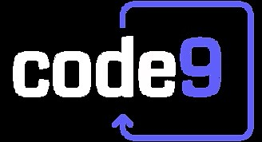
INTERNSHIP AT – code9
What is code9
Keltron (Kerala State Electronics Development Corporation Limited), established in 1973, is a state-owned electronics company in Kerala. It manufactures electronic components, consumer electronics, and industrial systems, playing a key role in Kerala’s technological and industrial development.
Keltron's goal is to drive technological development in Kerala by producing high-quality electronics, supporting industrial growth, and promoting self-reliance in electronics manufacturing.

Slide 4
SKILLS ACQUIRED DURING INTERNSHIP
1.
4.
2.
5.
3.
HTML
HTML is the standard language for creating web pages. It uses tags to structure content like text, links, and images, forming the foundation of web development.
CSS
CSS (Cascading Style Sheets) is used to style and design web pages. It controls the layout, colors, fonts, and overall appearance of HTML elements, enhancing the visual presentation of websites.
JAVASCRIPT
JavaScript is a programming language that adds interactivity and dynamic features to web pages, such as animations and real-time updates.
PROJECT STAGES
You can describe the topic of theThe project offered real-world web development experience, using HTML, CSS, and JavaScript to build an interactive site, tackle design issues, and solve practical coding challenges.
TEAM EXPERIENCE
JavaScript is a programming language that adds interactivity and dynamic features to web pages, such as animations and real-time updates.

Slide 5
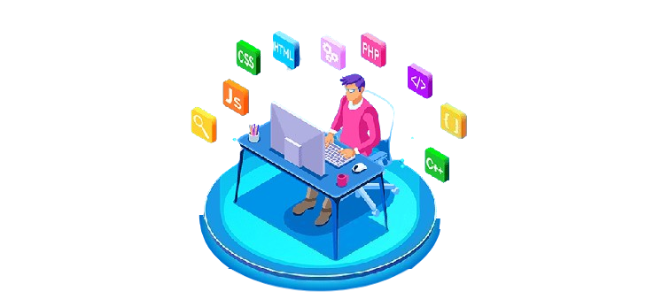
Internship Project: Web Development Task
~Internship Overview
During the Keltron internship, the user gained experience in web development with HTML, CSS, and Java.
~Technologies Used
HTML, CSS, GSAP (animations) and JavaScript.
~Key Learning
Gained practical experience in creating web pages.
Developed skills in structuring content, styling with CSS, and adding interactivity using JavaScript.
YOUR LOGO

Slide 6


HTML AND CSS
HTML (HyperText Markup Language) is the standard language used to create and structure content on the web. It uses elements, or tags, to define parts of a webpage, such as headings, paragraphs, links, images, and other media. HTML provides the basic structure for web pages, allowing browsers to render content correctly.
CSS (Cascading Style Sheets) is a language used to style and layout HTML elements on a webpage. It controls the design aspects like colors, fonts, spacing, positioning, and responsiveness. CSS allows developers to separate content (HTML) from its appearance, making webpages visually appealing and easier to maintain.

Slide 7


JAVASCRIPT AND GSAP
JavaScript is a programming language that enables dynamic interactions on webpages. It allows developers to create features like interactive forms, animations, and real-time updates by manipulating HTML and CSS elements. JavaScript runs on the client side (in the browser), making it essential for creating responsive and engaging web applications.
GSAP (GreenSock Animation Platform) is a powerful JavaScript library used to create high-performance animations for web pages. It allows developers to animate HTML, CSS, SVG, and JavaScript properties with smooth transitions and precise control. GSAP is known for its ease of use, efficiency, and ability to handle complex animations, making it a popular choice for creating dynamic, interactive web experiences.

Slide 8


CHALLENGES
The user encountered challenges with GSAP animation, finding it difficult to grasp the syntax and structure, which required a trial-and-error approach. Additionally, as a beginner in web development, integrating design elements and ensuring smooth functionality posed challenges. Balancing project work with learning new concepts and refining the design process also added to the complexity, but the experience was ultimately rewarding and educational.
SOLUTIONS
To overcome challenges, the user used online tutorials and forums to master GSAP animations and improve web design integration. They broke tasks into smaller segments to balance learning with project work, focusing on key concepts first and applying them progressively, which helped enhance both technical skills and project management.

Slide 9

THANK YOU
MADE BY:-
ABHINAV KASHYAP
CS-B
113

