Slide 1

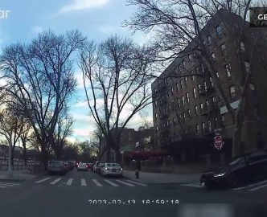


client-0 / class 0 prototypeの内訳
同じnormal class 3件でも q^{post} は揃わず、平均値が μ^{post}_{k,r} になる
代表sample A（client内診断） label=normal
q^{pre} = [0.854, 0.146]
q^{post} = [0.749, 0.251]
Δq = [-0.106, 0.106]
client-0 / class 0 | q^{post}(normal) | q^{post}(risk)
sample A | 0.749 | 0.251
sample B | 0.166 | 0.834
sample C | 0.333 | 0.667
μ^{post}_{k,r} | 0.416 | 0.584
prototype
μ^{post}_{k,r}
[0.416, 0.584]
Δμ_{k,r}
[-0.094, 0.094]
π_{k,r} = 3
client内の診断例（raw frame・private sample IDはserverへ未送信）。性能評価や一般的傾向は示さない。
Notes:
Source: artifacts/runs/fedpact_stage1/p1d_layer1_20260917_01/client_local/client-0/private_trace.json
Source images: artifacts/datasets/fedpact_stage1/manifest_paired_alert_quartiles.jsonl
This slide is a Stage I diagnostic example, not a performance result.

Slide 2






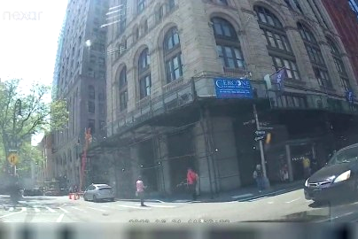
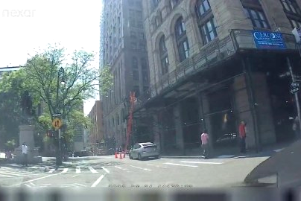
prototypeからserver-side proxyまでの具体例
class制約なし検索でrisk seedを選び、contrast 1.15を適用した例
元seed 6d24134fb5a44162 label=risk retrieval rank=1
μ^{post}_{k,r} = [0.416, 0.584]
Δμ_{k,r} = [-0.094, 0.094]
top 3 seed labels
1: risk KL=1.20e-6
2: normal KL=8.09e-4
3: normal KL=2.19e-3
x̃_{k,r} contrast 1.15
proxy上のglobal surrogate
M_G^0: [0.477, 0.523]
M_G^1: [0.406, 0.594]
post KL = 2.04e-4
delta error = 4.94e-4
L_match = 6.99e-4
foundation pair KL: 0.007656 → 0.007709（この1件は増加）
同じ4 pairの加重総和で更新。foundationは同じ3B基盤から独立LoRAとして初期化し、個別KL非増加は保証しない。
Notes:
Source: artifacts/runs/fedpact_stage1/p1d_full_20260917_02/server/layer2_trace.json
Source: artifacts/runs/fedpact_stage1/p1d_full_20260917_02/foundation/layer3_trace.json
The selected seed ID is server-side trace information. No client private sample ID was transmitted to the server.

Slide 3
4 prototypeの診断結果
formal 1-round wiring check：2 client × 2 class、60 seed、top 3 × 5変換
client / class | target Δμ risk | proxy Δ risk | 方向 | seed label | 変換 | post KL | delta error | L_match | foundation KL (same pair)
client-0 class 0 | 0.094 | 0.072 | 一致 | risk | contrast 1.15 | 2.04e-4 | 4.94e-4 | 6.99e-4 | 0.007656 → 0.007709
client-0 class 1 | 0.238 | 0.051 | 一致 | normal | identity | 8.35e-10 | 3.49e-2 | 3.49e-2 | 0.006065 → 0.005999
client-1 class 0 | -0.103 | 0.056 | 逆向き | risk | identity | 3.51e-4 | 2.51e-2 | 2.55e-2 | 0.004202 → 0.004094
client-1 class 1 | 0.005 | 0.010 | 一致 | normal | identity | 9.45e-5 | 1.78e-5 | 1.12e-4 | 0.000091 → 0.000009
観測 1
4/4でprototype classとseed labelが不一致。ただし検索・model誤分類・class不整合は未分離。
観測 2
delta方向は3/4で一致。client-1 / class 0は目標 −0.103 に対しproxy +0.056で逆向き。
同じ4 pair上の加重KL：0.05404 → 0.05343（4件中1件は増加）。未知データへの転移は未評価。
1 roundの配線確認結果であり、検索品質・proxy再現成功・性能向上は結論しない。
Notes:
Source: artifacts/runs/fedpact_stage1/p1d_full_20260917_02/server/layer2_trace.json
Source: artifacts/runs/fedpact_stage1/p1d_full_20260917_02/foundation/layer3_trace.json
The four opposite-label selections are an observed diagnostic fact in one round, not evidence that class constraints improve the method.

