Slide 1
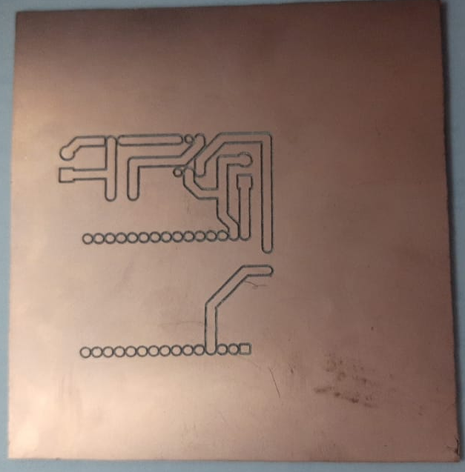





Encoder
Motor
Gearbox
Wheel
$$\frac{1}{20}$$
$$1$$
$$\frac{1}{78}$$
$$0.2638 m$$
$$1 rad$$

