Slide 1
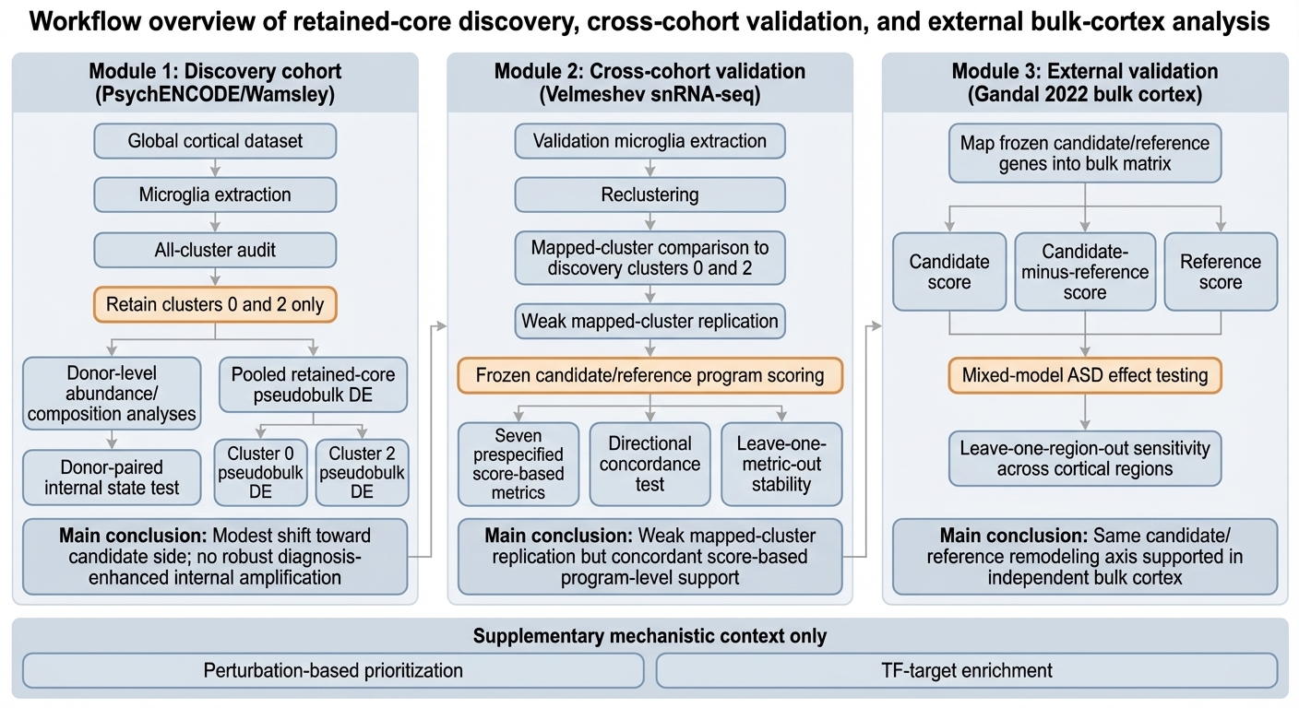
Supplementary Figure S1. Workflow overview of retained-core discovery, cross-cohort validation, and external bulk-cortex analysis
This schematic summarizes the analytical framework used in the study. Module 1 shows the discovery-stage workflow in the PsychENCODE/Wamsley cohort, including global cortical profiling, microglial extraction, all-cluster auditing, retained-core definition, donor-level composition analyses, donor-paired internal state testing, and pseudobulk differential expression analyses. Module 2 summarizes cross-cohort validation in the Velmeshev single-nucleus RNA-seq dataset, including microglial extraction, reclustering, mapped-cluster comparison to discovery clusters 0 and 2, frozen candidate/reference program scoring, prespecified score-based validation metrics, directional concordance testing, and leave-one-metric-out stability analyses. Module 3 shows the external validation framework in the Gandal 2022 bulk-cortex dataset, including mapping of frozen candidate/reference genes, candidate/reference score testing, mixed-model ASD effect estimation, and leave-one-region-out sensitivity analyses. The bottom strip indicates supplementary mechanistic prioritization layers, including perturbation-based prioritization and TF-target enrichment, which are presented as supportive context rather than causal proof.

Slide 2
Supplementary Figure S2. Discovery-cohort audit and quality-control context for the all-cluster microglial analysis space
(A) UMAP of the discovery-stage microglial analysis space colored by donor identity. This panel is provided to show that the global embedding is not dominated by any single donor and to place the retained-core analyses in donor-aware context. (B) Donor-level proportions across all discovery-stage microglial clusters. This panel provides descriptive all-cluster compositional context and is not intended as a primary inferential analysis. (C) Number of discovery-stage clusters assigned to each audit superclass after the all-cluster review. (D) Cluster-level lineage total scores used to contextualize retention and exclusion decisions across the discovery-stage analysis space. Together, these panels provide the quality-control and audit framework underlying the retained-core definition shown in Figure 1.

Slide 3
Supplementary Figure S3. Validation-cohort microglial context and score-based supporting analyses in the Velmeshev dataset
(A) UMAP of validation-cohort microglia colored by validation subcluster identity. (B) Validation-cohort microglial cell counts by diagnosis. Panels A and B provide descriptive context for downstream validation analyses. (C) Donor-level all-microglia candidate-minus-reference scores in the validation cohort. ASD donors showed a positive effect estimate in the expected direction (beta = 0.106, P = 0.090). (D) Donor-level score-defined candidate proportion in the validation cohort. ASD donors showed a higher candidate-defined proportion (beta = 0.177, P = 0.037). (E) Donor-level score-defined candidate-versus-reference shift in the validation cohort. The estimated ASD effect was directionally positive but not statistically robust (beta = 0.022, P = 0.432). Together, these panels show that although mapped-cluster replication was weak, score-based analyses in the validation cohort remained directionally consistent with the candidate/reference remodeling axis described in the main text.

Slide 4
Supplementary Figure S4. Perturbation-based prioritization highlights candidate reversal signals linked to the candidate/reference remodeling axis
(A) Top primary perturbation-based reversal candidates identified from the candidate-oriented remodeling program. (B) Primary reversal scatter plot highlighting bidirectional candidate perturbations in the primary analysis. Highlighted signals include recurrent MAPK/BRAF-related candidates identified under the primary prioritization framework. (C) Sensitivity analysis based on pooled retained-core differential expression, shown as a complementary perturbation-prioritization layer. These results are presented as supplementary, hypothesis-generating evidence and should not be interpreted as proof of direct therapeutic reversal.

Slide 5
Supplementary Figure S5. TF-target enrichment prioritizes convergent regulators of the candidate-oriented remodeling program
(A) Top transcription factor target enrichments for the primary candidate-oriented program. (B) Top transcription factor target enrichments for pooled ASD-up genes across the retained microglial core. (C) Convergent transcription factors shared by the candidate-oriented program and pooled ASD-up genes. This panel is shown in a single-color format to emphasize convergence without implying a formal statistical subgrouping within the displayed factors. These analyses are provided as supplementary mechanistic prioritization and do not establish causal upstream regulation.

