Slide 1
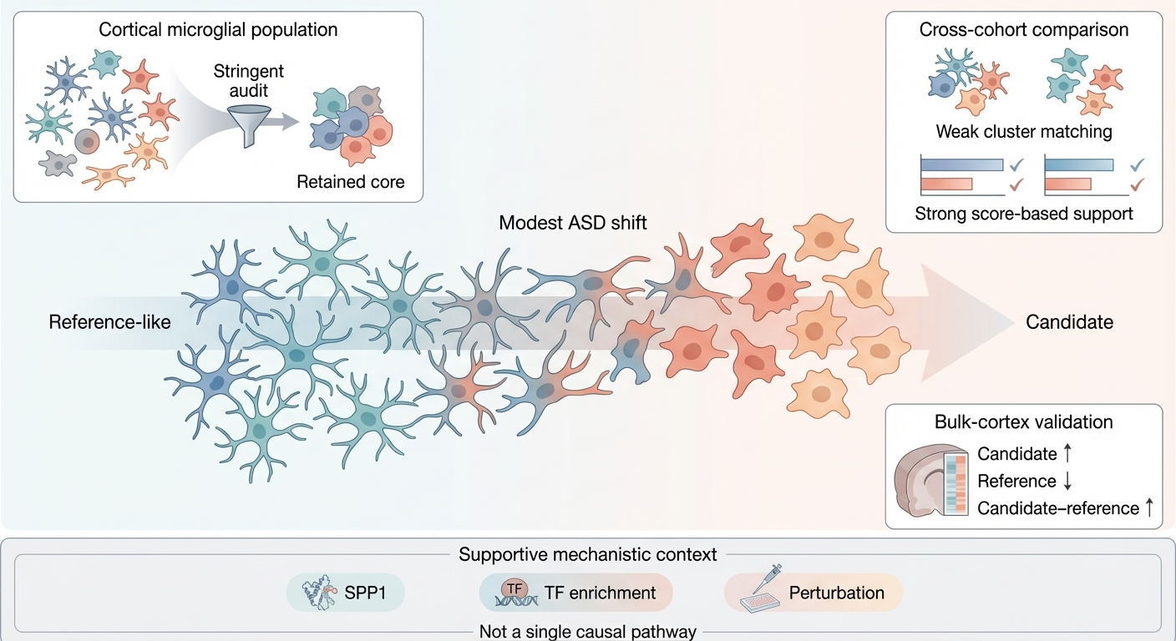


Cross-cohort validation

