Slide 1

Introduction to Feedback Control

Slide 2
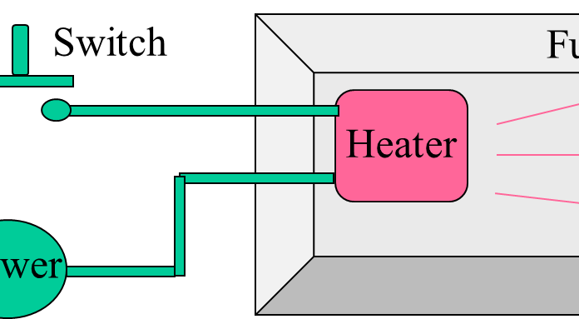
Open-loop Control

Slide 3
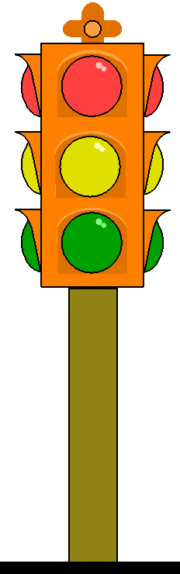
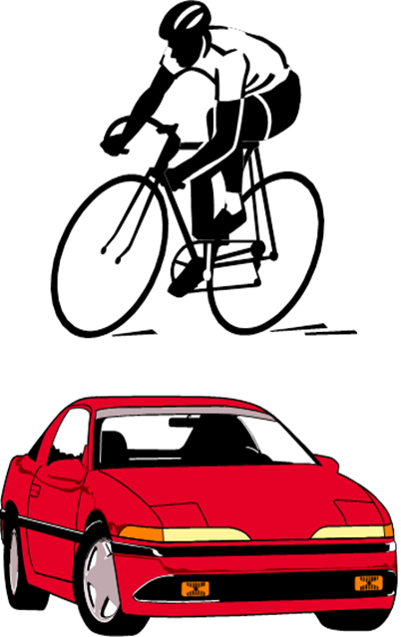
Control of Traffic Lights

