Slide 1
UCSC Extension E4357 Embedded Firmware Essentials Final Project
by
Aytug Karalar, Drew Plant, Scott Cauble 01-DEC-2014

Slide 2
Goal
Implement wireless communication using Xbee S1 between two mbed LPC1768 boards.
Use tera term that communicates with transmitter mbed via USB connection for sending the typed characters(0-9 and A-F).
Use a 7-segment display for displaying the typed characters on receiver side

Slide 3
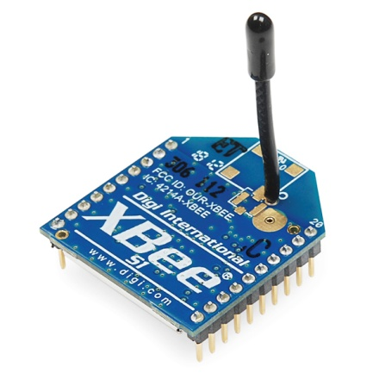
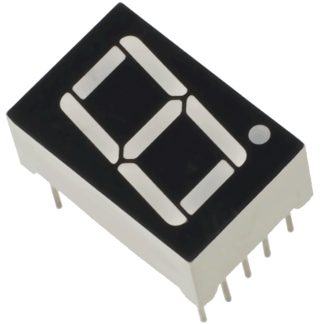
Hardware
LPC1768 mbed board
Xbee S1 wireless communication module
7-segment display
LEDs (Blue, Green)

Slide 4
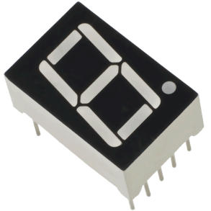
Block diagram
5V
PC
Tera term
LPC1768
Mbed
(tx)
USB
LPC1768
Mbed
(tx)
Serial
Serial

Slide 5
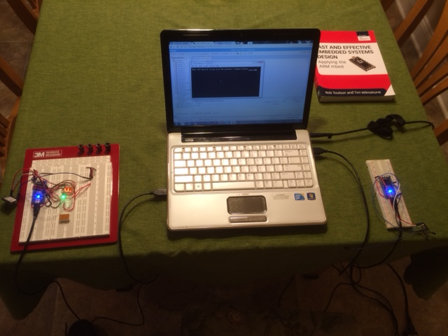
Setup

