Slide 1
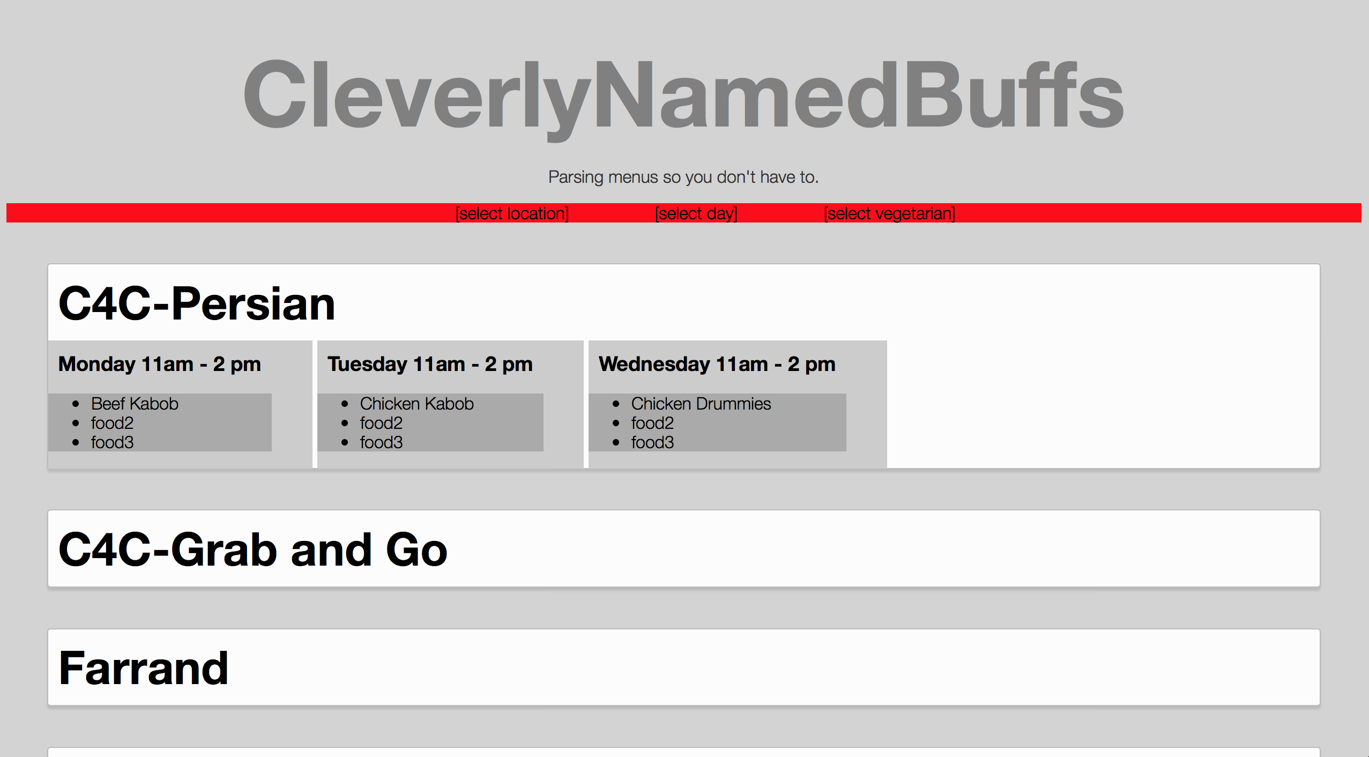
Added Features
Drop down menus for each dining hall
Subcategories for each dining hall

Slide 2
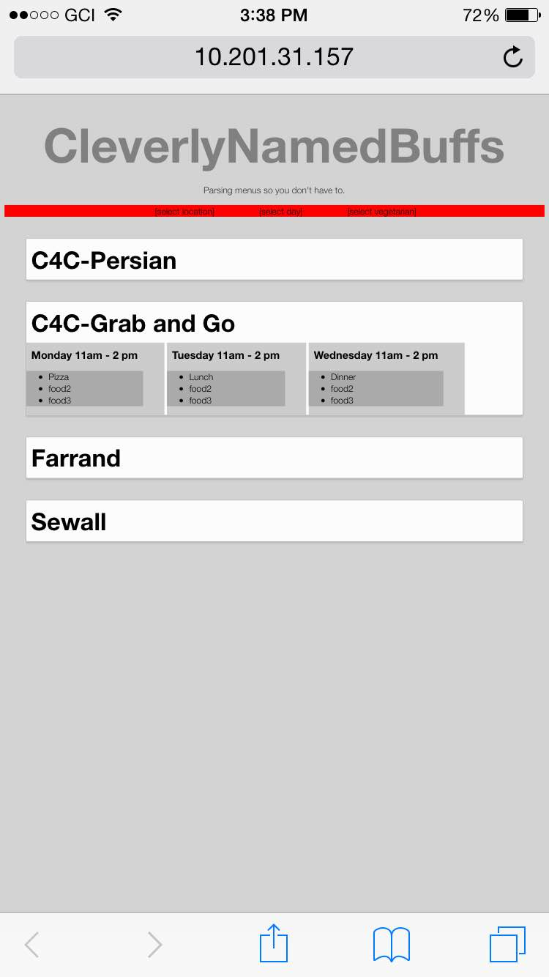
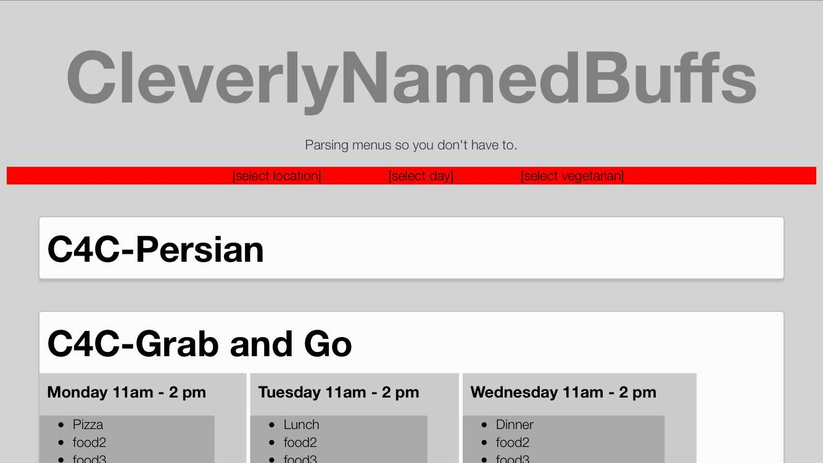
Mobile Interface

