Slide 1
BUILDING PLAYER MUSIC SYSTEM
BY VUE.JS
Thu Dau Mot University – Institute of Engineering - Technology
Business implementation
Master: Tran Van Huu
Executor: Nguyen Anh Hao
Tran Tien Dat

Slide 2
What is Vue.JS?
Component structure
About the Vue.JS technology
Vue (pronounced /vjuː/, like view) is a progressive framework for building user interfaces. Unlike other monolithic frameworks, Vue is designed from the ground up to be incrementally adoptable. The core library is focused on the view layer only, and is easy to pick up and integrate with other libraries or existing projects. On the other hand, Vue is also perfectly capable of powering sophisticated Single-Page Applications when used in combination with modern tooling and supporting libraries.
The player music system
BUILDING PLAYER MUSIC SYSTEM
BY VUE.JS
WHAT IS VUE.JS?
Source: https://vuejs.org/

Slide 3
Building Vue.JS project
DEMO
HOW TO BUILD VUE.JS PROJECT?

Slide 4
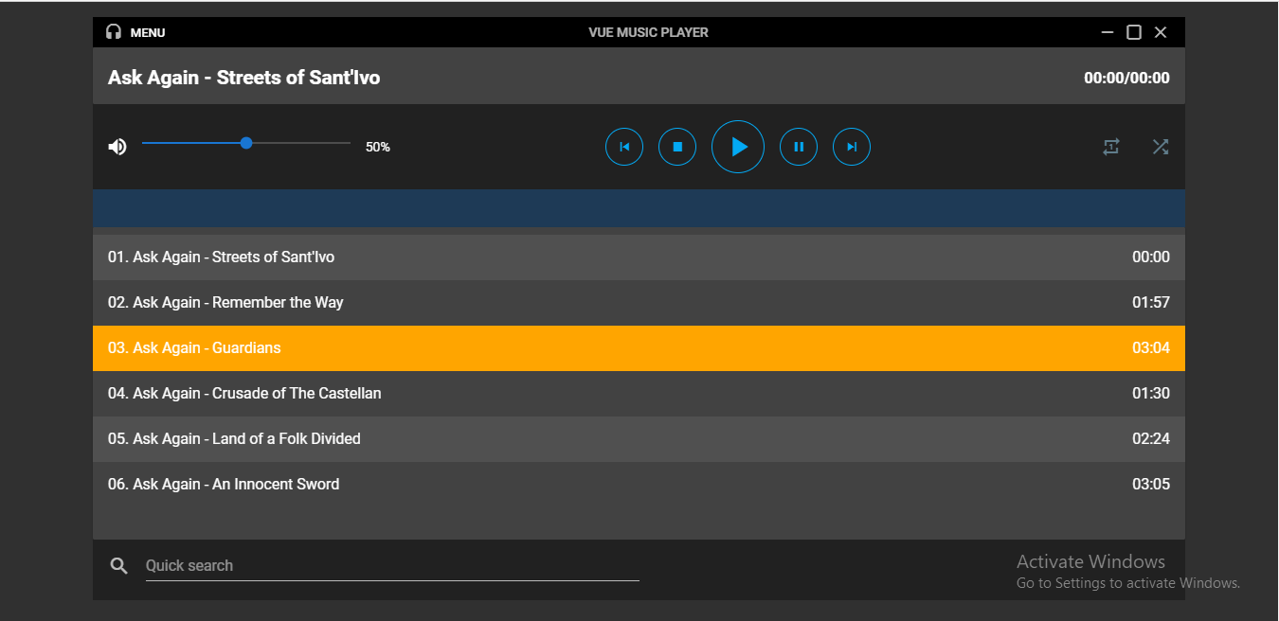
The player music system

