Slide 1
対外厳秘
隊本部及びICS
に限定
春日仮説構築
【趣 旨】
春日基地におけるスレットハンティングの為の仮説構築
令和８年２月１９日
ＣＰＴ１班２分隊

Slide 2
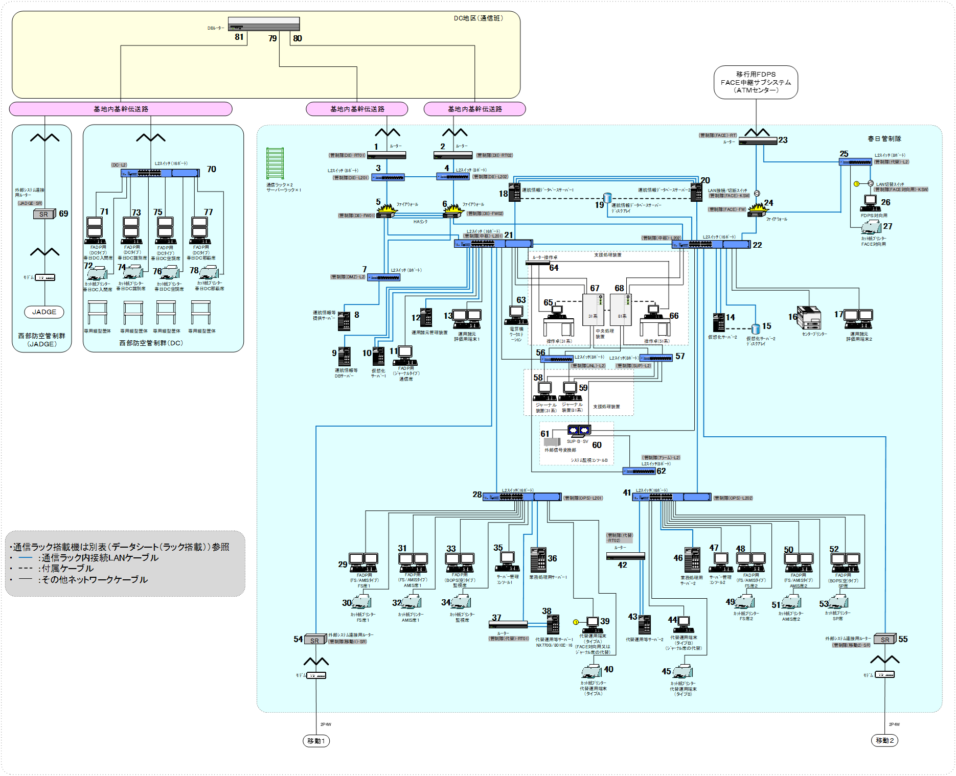
システム構成図（春日）
名称 | 場所 | 数量
外部ｼｽﾃﾑ連接用ﾙｰﾀｰ | 春日管制隊/ 西部防空管制群(JADGE) | 3
ﾙｰﾀｰ | 春日管制隊 | 3
L2ｽｲｯﾁ(8ﾎﾟｰﾄ) | 春日管制隊 | 6
L2ｽｲｯﾁ(16ﾎﾟｰﾄ) | 春日管制隊 | 2
ﾌｧｲｱｳｫｰﾙ | 春日管制隊 | 3
LAN切替ｽｲｯﾁ | 春日管制隊 | 1
支援処理装置 | 春日管制隊 | 2
運航情報ﾃﾞｰﾀﾍﾞｰｽｻｰﾊﾞｰ | 春日管制隊 | 2
運航情報ﾃﾞｰﾀﾍﾞｰｽｻｰﾊﾞｰ ﾃﾞｨｽｸｱﾚｲ | 春日管制隊 | 1
運用諸元管理装置 | 春日管制隊 | 1
運用諸元評価用端末 | 春日管制隊 | 2
仮想化ｻｰﾊﾞｰ1 | 春日管制隊 | 1
（ｾﾝﾀｰﾌﾟﾘﾝﾀｰ） | 春日管制隊 | 1
仮想化ｻｰﾊﾞｰ2 | 春日管制隊 | 1
仮想化ｻｰﾊﾞｰ2 ﾃﾞｨｽｸｱﾚｲ | 春日管制隊 | 1
代替運用等ｻｰﾊﾞｰ | 春日管制隊 | 2
代替運用端末(ﾀｲﾌﾟA) | 春日管制隊 | 1
（ｶｯﾄ紙ﾌﾟﾘﾝﾀｰ） | 春日管制隊 | 1
代替運用端末(ﾀｲﾌﾟB) | 春日管制隊 | 1
（ｶｯﾄ紙ﾌﾟﾘﾝﾀｰ） | 春日管制隊 | 1
電算機ﾜｰｸｽﾃｰｼｮﾝ | 春日管制隊 | 1
システム監視ｺﾝｿｰﾙB | 春日管制隊 | 1
通信ﾗｯｸ | 春日管制隊 | 1
ｻｰﾊﾞｰﾗｯｸ | 春日管制隊 | 1
飛行管理業務処理部
名称 | 場所 | 数量
ﾙｰﾀｰ | 春日管制隊 | 2
L2ｽｲｯﾁ(8ﾎﾟｰﾄ) | 春日管制隊 | 1
L2ｽｲｯﾁ(16ﾎﾟｰﾄ) | 春日管制隊/西部防空管制群(DC) | 3
LAN切替ｽｲｯﾁ | 春日管制隊 | 1
FADP用(FS/AMISﾀｲﾌﾟ) | 春日管制隊 | 4
（ｶｯﾄ紙ﾌﾟﾘﾝﾀｰ） | 春日管制隊 | 4
FADP用(BOPS(空)ﾀｲﾌﾟ) | 春日管制隊/ | 2
（ｶｯﾄ紙ﾌﾟﾘﾝﾀｰ） | 春日管制隊 | 2
FADP用(ｼﾞｬｰﾅﾙｰﾀｰｲﾌﾟ) | 春日管制隊 | 1
FADP用(DCﾀｲﾌﾟ) | 西部防空管制群(DC) | 4
（ｶｯﾄ紙ﾌﾟﾘﾝﾀｰ） | 西部防空管制群(DC) | 4
FDPS対向用 | 春日管制隊 | 1
（ｶｯﾄ紙ﾌﾟﾘﾝﾀｰ） | 春日管制隊 | 1
業務処理用ｻｰﾊﾞｰ | 春日管制隊 | 2
運航情報等提供ｻｰﾊﾞｰ | 春日管制隊 | 1
運航情報等DBｻｰﾊﾞｰ | 春日管制隊 | 1
ｻｰﾊﾞｰ管理ｺﾝｿｰﾙ | 春日管制隊 | 2
通信ﾗｯｸ | 春日管制隊 | 1

Slide 3
IP一覧
IP一覧
1 | 10.107.189.30 | 31 | 10.107.190.132 | 61 | 172.20.0.1
2 | 10.107.189.29 | 32 | 10.107.190.143 | 62 | 172.18.0.254
3 | 10.107.189.25 | 33 | 10.107.190.133 | 63 | 10.107.190.20
4 | 10.107.189.24 | 34 | 10.107.190.145 | 64 | 172.18.0.6
5 | 10.107.189.253 | 35 | 10.107.190.21 | 65 | 172.18.0.1
6 | 10.107.189.252 | 36 | 10.107.190.100 | 66 | 172.18.0.2
7 | 10.107.189.11 | 37 | 10.107.190.116 | 67 | 10.107.190.1
8 | 10.107.189.1 | 38 | 10.107.190.103 | 68 | 10.107.190.2
9 | 10.107.190.102 | 39 | 10.107.190.137 | 69 | 10.107.191.1
10 | 10.107.190.10 | 40 | 10.107.190.139 | 70 | 10.107.191.249
11 | 10.107.190.130 | 41 | 10.107.190.246 | 71 | 10.107.191.12
12 | 10.107.190.150 | 42 | 10.107.190.117 | 72 | 10.107.191.16
13 | 10.107.190.148 | 43 | 10.107.190.109 | 73 | 10.107.191.11
14 | 10.107.190.13 | 44 | 10.107.190.138 | 74 | 10.107.191.15
15 | 10.107.190.23 | 45 | 10.107.190.140 | 75 | 10.107.191.10
16 | 10.107.190.16 | 46 | 10.107.190.101 | 76 | 10.107.191.14
17 | 10.107.190.149 | 47 | 10.107.190.22 | 77 | 10.107.191.13
18 | 10.107.190.121 | 48 | 10.107.190.134 | 78 | 10.107.191.17
19 | 10.107.190.123 | 49 | 10.107.190.142 | 79 | 10.107.189.12
20 | 10.107.190.122 | 50 | 10.107.190.135 | 80 | 10.107.190.254
21 | 10.107.190.249 | 51 | 10.107.190.144 | 81 | 10.107.191.254
22 | 10.107.190.248 | 52 | 10.107.190.136
23 | 10.2.70.201 | 53 | 10.107.190.146
24 | 10.2.70.100 | 54 | 10.107.190.149
25 | 10.2.70.200 | 55 | 10.107.190.244
26 | 10.2.70.1 | 56 | 10.107.190.35
27 | 10.2.70.2 | 57 | 192.168.4.254
28 | 10.107.190.247 | 58 | 10.107.190.33
29 | 10.107.190.131 | 59 | 10.107.190.34
30 | 10.107.190.141 | 60 | 10.107.190.6

Slide 4
脅威アクター（APT41）の特徴
APT41（別名：Wicked Panda, Double Dragon, BARIUM, Winnti Groupなど）は、中国を拠点とすると見られる極めて高度で多才なサイバー脅威グループです。2012年頃（一説には2014年頃）から活動しており、最大の特徴は「国家支援型のスパイ活動」と「金銭目的の犯罪活動」の両方を行う二刀流（Dual-Purpose）である点です。
APT41の主な特徴
1. 活動（国家スパイ＋金銭目的）
国家支援型スパイ活動: 中国の5カ年経済計画に沿った戦略的産業の機密情報窃取（通信、ハイテク、医療、製薬、教育、政府機関など）を行う。
金銭目的の犯罪: ビデオゲーム業界（ソースコードやバーチャル通貨の窃取）、仮想通貨のマイニング、ランサムウェアの展開などを行う。
特徴: 通常、国家支援型アクターは金銭的犯罪をあまり行わないが、APT41は「自身の活動資金を自身で稼ぐ」あるいは「スパイ活動をカモフラージュするために犯罪活動を利用する」というユニークな特性を持つ。
2. 攻撃技術と戦術（TTPs）
サプライチェーン攻撃: ソフトウェア更新機能（アップデータ）や開発者用ツールを汚染し、そのソフトウェアを利用する顧客へ不正プログラムを配布する手法が非常に巧み。
ゼロデイの悪用: Citrix, Zoho, Ciscoなど、外部に公開されている脆弱性（ゼロデイ含む）を迅速に武器化して侵入する。
「Living off the Land」手法: 標的環境に元からある正規ツール（certutil.exe, powershell.exeなど）を悪用し、不正ツールの持ち込みを最小限にして検知を回避する。
多様なバックドアとルートキット: Cobalt Strikeのほか、Speculoosなどのカスタムバックドア、ルートキット、ルートキット機能を持つブートキットを使用する。
デジタル証明書の盗用: 盗んだ認証済みのデジタル証明書でマルウェアに署名し、安全なソフトと見せかける。
3. 活動状況とターゲット
グローバルな攻撃: 米国をはじめ、日本を含む世界各地の政府、企業、大学などを無差別に、かつ執拗に攻撃する。
長期間の持続性: 一度侵入すると、半年以上にわたってネットワークに留まり、長期的にデータを盗み出し続ける。
活発な更新: 2023年から2024年にかけて「APT41 DUST」と呼ばれる活動が確認されるなど、進化を続けている。
4. 組織的な背景
成都404: 米国司法省（DOJ）は、成都404ネットワークテクノロジー社（Chengdu 404 Network Technology Company）の従業員らが、このグループの活動に関与していると指摘している。
FBIの指名手配: 米国政府は、APT41のメンバー複数を指名手配し、その活動を強く非難している。
まとめると、APT41は「政府級の高度なスキルを持ちながら、サイバー犯罪者のような金銭への執着も併せ持つ、最も危険なアクターの一つ」といえます。

Slide 5
TA0043: Reconnaissance
T1595: Active Scanning | T1595.001: Scanning IP Blocks
 | T1595.002: Vulnerability Scanning
 | T1595.003: Wordlist Scanning
T1592: Gather Victim Host Information
T1589: Gather Victim Identity Information
T1590: Gather Victim Network Information
T1591: Gather Victim Org Information
T1598: Phishing for Information
T1597: Search Closed Sources
T1596: Search Open Technical Databases | T1596.004: CDNs
 | T1596.003: Digital Certificates
 | T1596.001: DNS/Passive DNS
 | T1596.005: Scan Databases
 | T1596.002: WHOIS
T1593: Search Open Websites/Domains | T1593.003: Code Repositories
 | T1593.002: Search Engines
 | T1593.001: Social Media
T1681: Search Threat Vendor Data
T1594: Search Victim-Owned Websites
TA0042: Resource Development
T1650: Acquire Access
T1583: Acquire Infrastructure | T1583.005: Botnet
 | T1583.002: DNS Server
 | T1583.001: Domains
 | T1583.008: Malvertising
 | T1583.004: Server
 | T1583.007: Serverless
 | T1583.003: Virtual Private Server
 | T1583.006: Web Services
T1586: Compromise Accounts | T1586.003: Cloud Accounts
 | T1586.002: Email Accounts
 | T1586.001: Social Media Accounts
T1584: Compromise Infrastructure
T1587: Develop Capabilities
T1585: Establish Accounts
T1588: Obtain Capabilities | T1588.007: Artificial Intelligence
 | T1588.003: Code Signing Certificates
 | T1588.004: Digital Certificates
 | T1588.005: Exploits
 | T1588.001: Malware
 | T1588.002: Tool
 | T1588.006: Vulnerabilities
T1608: Stage Capabilities
TA0001: Initial Access
T1659: Content Injection
T1189: Drive-by Compromise
T1190: Exploit Public-Facing Application
T1133: External Remote Services
T1200: Hardware Additions
T1566: Phishing | T1566.001: Spearphishing Attachment
 | T1566.002: Spearphishing Link
 | T1566.003: Spearphishing via Service
 | T1566.004: Spearphishing Voice
T1091: Replication Through Removable Media
T1195: Supply Chain Compromise | T1195.003: Compromise Hardware Supply Chain
 | T1195.001: Compromise Software Dependencies and Development Tools
 | T1195.002: Compromise Software Supply Chain
T1199: Trusted Relationship
T1078: Valid Accounts
T1669: Wi-Fi Networks

Slide 6
TA0002: Execution
T1651: Cloud Administration Command
T1059: Command and Scripting Interpreter | T1059.002: AppleScript
 | T1059.010: AutoHotKey & AutoIT
 | T1059.009: Cloud API
 | T1059.013: Container CLI/API
 | T1059.012: Hypervisor CLI
 | T1059.007: JavaScript
 | T1059.011: Lua
 | T1059.008: Network Device CLI
 | T1059.001: PowerShell
 | T1059.006: Python
 | T1059.004: Unix Shell
 | T1059.005: Visual Basic
 | T1059.003: Windows Command Shell
T1609: Container Administration Command
T1610: Deploy Container
T1675: ESXi Administration Command
T1203: Exploitation for Client Execution
T1674: Input Injection
T1559: Inter-Process Communication
T1106: Native API
T1677: Poisoned Pipeline Execution
T1053: Scheduled Task/Job | T1053.002: At
 | T1053.007: Container Orchestration Job
 | T1053.003: Cron
 | T1053.005: Scheduled Task
 | T1053.006: Systemd Timers
T1648: Serverless Execution
T1129: Shared Modules
T1072: Software Deployment Tools
T1569: System Services | T1569.001: Launchctl
 | T1569.002: Service Execution
 | T1569.003: Systemctl
T1204: User Execution
T1047: Windows Management Instrumentation
TA0003: Persistence
T1098: Account Manipulation | T1098.001: Additional Cloud Credentials
 | T1098.003: Additional Cloud Roles
 | T1098.006: Additional Container Cluster Roles
 | T1098.002: Additional Email Delegate Permissions
 | T1098.007: Additional Local or Domain Groups
 | T1098.005: Device Registration
 | T1098.004: SSH Authorized Keys
T1197: BITS Jobs
T1547: Boot or Logon Autostart Execution | T1547.014: Active Setup
 | T1547.002: Authentication Package
 | T1547.006: Kernel Modules and Extensions
 | T1547.015: Login Items
 | T1547.008: LSASS Driver
 | T1547.010: Port Monitors
 | T1547.012: Print Processors
 | T1547.007: Re-opened Applications
 | T1547.001: Registry Run Keys / Startup Folder
 | T1547.005: Security Support Provider
 | T1547.009: Shortcut Modification
 | T1547.003: Time Providers
 | T1547.004: Winlogon Helper DLL
 | T1547.013: XDG Autostart Entries
T1037: Boot or Logon Initialization Scripts
T1671: Cloud Application Integration
T1554: Compromise Host Software Binary
T1136: Create Account | T1136.003: Cloud Account
 | T1136.002: Domain Account
 | T1136.001: Local Account
T1543: Create or Modify System Process | T1543.005: Container Service
 | T1543.001: Launch Agent
 | T1543.004: Launch Daemon
 | T1543.002: Systemd Service
 | T1543.003: Windows Service
T1546: Event Triggered Execution | T1546.008: Accessibility Features
 | T1546.009: AppCert DLLs
 | T1546.010: AppInit DLLs
 | T1546.011: Application Shimming
 | T1546.001: Change Default File Association
 | T1546.015: Component Object Model Hijacking
 | T1546.014: Emond
 | T1546.012: Image File Execution Options Injection
 | T1546.016: Installer Packages
 | T1546.006: LC_LOAD_DYLIB Addition
 | T1546.007: Netsh Helper DLL
 | T1546.013: PowerShell Profile
 | T1546.018: Python Startup Hooks
 | T1546.002: Screensaver
 | T1546.005: Trap
 | T1546.017: Udev Rules
 | T1546.004: Unix Shell Configuration Modification
 | T1546.003: Windows Management Instrumentation Event Subscription
T1668: Exclusive Control
T1133: External Remote Services
T1574: Hijack Execution Flow | T1574.014: AppDomainManager
 | T1574.012: COR_PROFILER
 | T1574.001: DLL
 | T1574.004: Dylib Hijacking
 | T1574.006: Dynamic Linker Hijacking
 | T1574.005: Executable Installer File Permissions Weakness
 | T1574.013: KernelCallbackTable
 | T1574.007: Path Interception by PATH Environment Variable
 | T1574.008: Path Interception by Search Order Hijacking
 | T1574.009: Path Interception by Unquoted Path
 | T1574.010: Services File Permissions Weakness
 | T1574.011: Services Registry Permissions Weakness
T1525: Implant Internal Image
T1556: Modify Authentication Process
T1112: Modify Registry
T1137: Office Application Startup
T1653: Power Settings
T1542: Pre-OS Boot | T1542.003: Bootkit
 | T1542.002: Component Firmware
 | T1542.004: ROMMONkit
 | T1542.001: System Firmware
 | T1542.005: TFTP Boot
T1053: Scheduled Task/Job | T1053.002: At
 | T1053.007: Container Orchestration Job
 | T1053.003: Cron
 | T1053.005: Scheduled Task
 | T1053.006: Systemd Timers
T1505: Server Software Component | T1505.004: IIS Components
 | T1505.001: SQL Stored Procedures
 | T1505.005: Terminal Services DLL
 | T1505.002: Transport Agent
 | T1505.006: vSphere Installation Bundles
 | T1505.003: Web Shell
T1176: Software Extensions
T1205: Traffic Signaling
T1078: Valid Accounts

Slide 7
TA0004: Privilege Escalation
T1548: Abuse Elevation Control Mechanism
T1134: Access Token Manipulation
T1098: Account Manipulation | T1098.001: Additional Cloud Credentials
 | T1098.003: Additional Cloud Roles
 | T1098.006: Additional Container Cluster Roles
 | T1098.002: Additional Email Delegate Permissions
 | T1098.007: Additional Local or Domain Groups
 | T1098.005: Device Registration
 | T1098.004: SSH Authorized Keys
T1547: Boot or Logon Autostart Execution | T1547.014: Active Setup
 | T1547.002: Authentication Package
 | T1547.006: Kernel Modules and Extensions
 | T1547.015: Login Items
 | T1547.008: LSASS Driver
 | T1547.010: Port Monitors
 | T1547.012: Print Processors
 | T1547.007: Re-opened Applications
 | T1547.001: Registry Run Keys / Startup Folder
 | T1547.005: Security Support Provider
 | T1547.009: Shortcut Modification
 | T1547.003: Time Providers
 | T1547.004: Winlogon Helper DLL
 | T1547.013: XDG Autostart Entries
T1037: Boot or Logon Initialization Scripts
T1543: Create or Modify System Process | T1543.005: Container Service
 | T1543.001: Launch Agent
 | T1543.004: Launch Daemon
 | T1543.002: Systemd Service
 | T1543.003: Windows Service
T1484: Domain or Tenant Policy Modification | T1484.001: Group Policy Modification
 | T1484.002: Trust Modification
T1611: Escape to Host
T1546: Event Triggered Execution | T1546.008: Accessibility Features
 | T1546.009: AppCert DLLs
 | T1546.010: AppInit DLLs
 | T1546.011: Application Shimming
 | T1546.001: Change Default File Association
 | T1546.015: Component Object Model Hijacking
 | T1546.014: Emond
 | T1546.012: Image File Execution Options Injection
 | T1546.016: Installer Packages
 | T1546.006: LC_LOAD_DYLIB Addition
 | T1546.007: Netsh Helper DLL
 | T1546.013: PowerShell Profile
 | T1546.018: Python Startup Hooks
 | T1546.002: Screensaver
 | T1546.005: Trap
 | T1546.017: Udev Rules
 | T1546.004: Unix Shell Configuration Modification
 | T1546.003: Windows Management Instrumentation Event Subscription
T1068: Exploitation for Privilege Escalation
T1574: Hijack Execution Flow | T1574.014: AppDomainManager
 | T1574.012: COR_PROFILER
 | T1574.001: DLL
 | T1574.004: Dylib Hijacking
 | T1574.006: Dynamic Linker Hijacking
 | T1574.005: Executable Installer File Permissions Weakness
 | T1574.013: KernelCallbackTable
 | T1574.007: Path Interception by PATH Environment Variable
 | T1574.008: Path Interception by Search Order Hijacking
 | T1574.009: Path Interception by Unquoted Path
 | T1574.010: Services File Permissions Weakness
 | T1574.011: Services Registry Permissions Weakness
T1055: Process Injection
T1053: Scheduled Task/Job | T1053.002: At
 | T1053.007: Container Orchestration Job
 | T1053.003: Cron
 | T1053.005: Scheduled Task
 | T1053.006: Systemd Timers
T1078: Valid Accounts
TA0005: Defense Evasion
T1548: Abuse Elevation Control Mechanism
T1134: Access Token Manipulation
T1197: BITS Jobs
T1612: Build Image on Host
T1622: Debugger Evasion
T1678: Delay Execution
T1140: Deobfuscate/Decode Files or Information
T1610: Deploy Container
T1006: Direct Volume Access
T1484: Domain or Tenant Policy Modification | T1484.001: Group Policy Modification
 | T1484.002: Trust Modification
T1672: Email Spoofing
T1480: Execution Guardrails | T1480.001: Environmental Keying
 | T1480.002: Mutual Exclusion
T1211: Exploitation for Defense Evasion
T1222: File and Directory Permissions Modification
T1564: Hide Artifacts
T1574: Hijack Execution Flow | T1574.014: AppDomainManager
 | T1574.012: COR_PROFILER
 | T1574.001: DLL
 | T1574.004: Dylib Hijacking
 | T1574.006: Dynamic Linker Hijacking
 | T1574.005: Executable Installer File Permissions Weakness
 | T1574.013: KernelCallbackTable
 | T1574.007: Path Interception by PATH Environment Variable
 | T1574.008: Path Interception by Search Order Hijacking
 | T1574.009: Path Interception by Unquoted Path
 | T1574.010: Services File Permissions Weakness
 | T1574.011: Services Registry Permissions Weakness
T1562: Impair Defenses | T1562.007: Disable or Modify Cloud Firewall
 | T1562.008: Disable or Modify Cloud Logs
 | T1562.012: Disable or Modify Linux Audit System
 | T1562.013: Disable or Modify Network Device Firewall
 | T1562.004: Disable or Modify System Firewall
 | T1562.001: Disable or Modify Tools
 | T1562.002: Disable Windows Event Logging
 | T1562.010: Downgrade Attack
 | T1562.003: Impair Command History Logging
 | T1562.006: Indicator Blocking
 | T1562.009: Safe Mode Boot
 | T1562.011: Spoof Security Alerting
T1656: Impersonation
T1070: Indicator Removal | T1070.003: Clear Command History
 | T1070.002: Clear Linux or Mac System Logs
 | T1070.008: Clear Mailbox Data
 | T1070.007: Clear Network Connection History and Configurations
 | T1070.009: Clear Persistence
 | T1070.001: Clear Windows Event Logs
 | T1070.004: File Deletion
 | T1070.005: Network Share Connection Removal
 | T1070.010: Relocate Malware
 | T1070.006: Timestomp
T1202: Indirect Command Execution
T1036: Masquerading | T1036.009: Break Process Trees
 | T1036.012: Browser Fingerprint
 | T1036.007: Double File Extension
 | T1036.001: Invalid Code Signature
 | T1036.010: Masquerade Account Name
 | T1036.008: Masquerade File Type
 | T1036.004: Masquerade Task or Service
 | T1036.005: Match Legitimate Resource Name or Location
 | T1036.011: Overwrite Process Arguments
 | T1036.003: Rename Legitimate Utilities
 | T1036.002: Right-to-Left Override
 | T1036.006: Space after Filename
T1556: Modify Authentication Process
T1578: Modify Cloud Compute Infrastructure
T1666: Modify Cloud Resource Hierarchy
T1112: Modify Registry
T1601: Modify System Image
T1599: Network Boundary Bridging
T1027: Obfuscated Files or Information | T1027.001: Binary Padding
 | T1027.010: Command Obfuscation
 | T1027.004: Compile After Delivery
 | T1027.015: Compression
 | T1027.007: Dynamic API Resolution
 | T1027.009: Embedded Payloads
 | T1027.013: Encrypted/Encoded File
 | T1027.011: Fileless Storage
 | T1027.006: HTML Smuggling
 | T1027.005: Indicator Removal from Tools
 | T1027.016: Junk Code Insertion
 | T1027.012: LNK Icon Smuggling
 | T1027.014: Polymorphic Code
 | T1027.002: Software Packing
 | T1027.003: Steganography
 | T1027.008: Stripped Payloads
 | T1027.017: SVG Smuggling
T1647: Plist File Modification
T1542: Pre-OS Boot | T1542.003: Bootkit
 | T1542.002: Component Firmware
 | T1542.004: ROMMONkit
 | T1542.001: System Firmware
 | T1542.005: TFTP Boot
T1055: Process Injection
T1620: Reflective Code Loading
T1207: Rogue Domain Controller
T1014: Rootkit
T1679: Selective Exclusion
T1553: Subvert Trust Controls | T1553.002: Code Signing
 | T1553.006: Code Signing Policy Modification
 | T1553.001: Gatekeeper Bypass
 | T1553.004: Install Root Certificate
 | T1553.005: Mark-of-the-Web Bypass
 | T1553.003: SIP and Trust Provider Hijacking
T1218: System Binary Proxy Execution | T1218.003: CMSTP
 | T1218.001: Compiled HTML File
 | T1218.002: Control Panel
 | T1218.015: Electron Applications
 | T1218.004: InstallUtil
 | T1218.013: Mavinject
 | T1218.014: MMC
 | T1218.005: Mshta
 | T1218.007: Msiexec
 | T1218.008: Odbcconf
 | T1218.009: Regsvcs/Regasm
 | T1218.010: Regsvr32
 | T1218.011: Rundll32
 | T1218.012: Verclsid
T1216: System Script Proxy Execution
T1221: Template Injection
T1205: Traffic Signaling
T1127: Trusted Developer Utilities Proxy Execution
T1535: Unused/Unsupported Cloud Regions
T1550: Use Alternate Authentication Material | T1550.001: Application Access Token
 | T1550.002: Pass the Hash
 | T1550.003: Pass the Ticket
 | T1550.004: Web Session Cookie
T1078: Valid Accounts
T1497: Virtualization/Sandbox Evasion
T1600: Weaken Encryption
T1220: XSL Script Processing

Slide 8
TA0006: Credential Access
T1557: Adversary-in-the-Middle
T1110: Brute Force
T1555: Credentials from Password Stores | T1555.006: Cloud Secrets Management Stores
 | T1555.003: Credentials from Web Browsers
 | T1555.001: Keychain
 | T1555.005: Password Managers
 | T1555.002: Securityd Memory
 | T1555.004: Windows Credential Manager
T1212: Exploitation for Credential Access
T1187: Forced Authentication
T1606: Forge Web Credentials
T1056: Input Capture | T1056.004: Credential API Hooking
 | T1056.002: GUI Input Capture
 | T1056.001: Keylogging
 | T1056.003: Web Portal Capture
T1556: Modify Authentication Process
T1111: Multi-Factor Authentication Interception
T1621: Multi-Factor Authentication Request Generation
T1040: Network Sniffing
T1003: OS Credential Dumping | T1003.008: /etc/passwd and /etc/shadow
 | T1003.005: Cached Domain Credentials
 | T1003.006: DCSync
 | T1003.004: LSA Secrets
 | T1003.001: LSASS Memory
 | T1003.003: NTDS
 | T1003.007: Proc Filesystem
 | T1003.002: Security Account Manager
TA0007: Discovery
T1087: Account Discovery | T1087.004: Cloud Account
 | T1087.002: Domain Account
 | T1087.003: Email Account
 | T1087.001: Local Account
T1010: Application Window Discovery
T1217: Browser Information Discovery
T1580: Cloud Infrastructure Discovery
T1538: Cloud Service Dashboard
T1526: Cloud Service Discovery
T1619: Cloud Storage Object Discovery
T1613: Container and Resource Discovery
T1622: Debugger Evasion
T1652: Device Driver Discovery
T1482: Domain Trust Discovery
T1083: File and Directory Discovery
T1615: Group Policy Discovery
T1680: Local Storage Discovery
T1654: Log Enumeration
T1046: Network Service Discovery
T1135: Network Share Discovery
T1040: Network Sniffing
T1201: Password Policy Discovery
T1120: Peripheral Device Discovery
T1069: Permission Groups Discovery
T1057: Process Discovery
T1012: Query Registry
T1018: Remote System Discovery
T1518: Software Discovery
T1082: System Information Discovery
T1614: System Location Discovery
T1016: System Network Configuration Discovery
T1049: System Network Connections Discovery
T1033: System Owner/User Discovery
T1007: System Service Discovery
T1124: System Time Discovery
T1673: Virtual Machine Discovery
T1497: Virtualization/Sandbox Evasion
TA0008: Lateral Movement
T1210: Exploitation of Remote Services
T1534: Internal Spearphishing
T1570: Lateral Tool Transfer
T1563: Remote Service Session Hijacking
T1021: Remote Services | T1021.007: Cloud Services
 | T1021.008: Direct Cloud VM Connections
 | T1021.003: Distributed Component Object Model
 | T1021.001: Remote Desktop Protocol
 | T1021.002: SMB/Windows Admin Shares
 | T1021.004: SSH
 | T1021.005: VNC
 | T1021.006: Windows Remote Management
T1091: Replication Through Removable Media
T1072: Software Deployment Tools
T1080: Taint Shared Content
T1550: Use Alternate Authentication Material | T1550.001: Application Access Token
 | T1550.002: Pass the Hash
 | T1550.003: Pass the Ticket
 | T1550.004: Web Session Cookie

Slide 9
TA0009: Collection
T1557: Adversary-in-the-Middle
T1560: Archive Collected Data | T1560.003: Archive via Custom Method
 | T1560.002: Archive via Library
 | T1560.001: Archive via Utility
T1123: Audio Capture
T1119: Automated Collection
T1185: Browser Session Hijacking
T1115: Clipboard Data
T1530: Data from Cloud Storage
T1602: Data from Configuration Repository
T1213: Data from Information Repositories | T1213.003: Code Repositories
 | T1213.001: Confluence
 | T1213.004: Customer Relationship Management Software
 | T1213.006: Databases
 | T1213.005: Messaging Applications
 | T1213.002: Sharepoint
T1005: Data from Local System
T1039: Data from Network Shared Drive
T1025: Data from Removable Media
T1074: Data Staged | T1074.001: Local Data Staging
 | T1074.002: Remote Data Staging
T1114: Email Collection
T1056: Input Capture | T1056.004: Credential API Hooking
 | T1056.002: GUI Input Capture
 | T1056.001: Keylogging
 | T1056.003: Web Portal Capture
T1113: Screen Capture
T1125: Video Capture
TA0011: Command and Control
T1071: Application Layer Protocol | T1071.004: DNS
 | T1071.002: File Transfer Protocols
 | T1071.003: Mail Protocols
 | T1071.005: Publish/Subscribe Protocols
 | T1071.001: Web Protocols
T1092: Communication Through Removable Media
T1659: Content Injection
T1132: Data Encoding
T1001: Data Obfuscation | T1001.001: Junk Data
 | T1001.003: Protocol or Service Impersonation
 | T1001.002: Steganography
T1568: Dynamic Resolution | T1568.003: DNS Calculation
 | T1568.002: Domain Generation Algorithms
 | T1568.001: Fast Flux DNS
T1573: Encrypted Channel | T1573.002: Asymmetric Cryptography
 | T1573.001: Symmetric Cryptography
T1008: Fallback Channels
T1665: Hide Infrastructure
T1105: Ingress Tool Transfer
T1104: Multi-Stage Channels
T1095: Non-Application Layer Protocol
T1571: Non-Standard Port
T1572: Protocol Tunneling
T1090: Proxy
T1219: Remote Access Tools
T1205: Traffic Signaling
T1102: Web Service | T1102.002: Bidirectional Communication
 | T1102.001: Dead Drop Resolver
 | T1102.003: One-Way Communication
TA0010: Exfiltration
T1020: Automated Exfiltration
T1030: Data Transfer Size Limits
T1048: Exfiltration Over Alternative Protocol | T1048.002: Exfiltration Over Asymmetric Encrypted Non-C2 Protocol
 | T1048.001: Exfiltration Over Symmetric Encrypted Non-C2 Protocol
 | T1048.003: Exfiltration Over Unencrypted Non-C2 Protocol
T1041: Exfiltration Over C2 Channel
T1011: Exfiltration Over Other Network Medium
T1052: Exfiltration Over Physical Medium
T1567: Exfiltration Over Web Service | T1567.004: Exfiltration Over Webhook
 | T1567.002: Exfiltration to Cloud Storage
 | T1567.001: Exfiltration to Code Repository
 | T1567.003: Exfiltration to Text Storage Sites
T1029: Scheduled Transfer
T1537: Transfer Data to Cloud Account
TA0040: Impact
T1531: Account Access Removal
T1485: Data Destruction
T1486: Data Encrypted for Impact
T1565: Data Manipulation
T1491: Defacement
T1561: Disk Wipe
T1667: Email Bombing
T1499: Endpoint Denial of Service
T1657: Financial Theft
T1495: Firmware Corruption
T1490: Inhibit System Recovery
T1498: Network Denial of Service
T1496: Resource Hijacking | T1496.002: Bandwidth Hijacking
 | T1496.004: Cloud Service Hijacking
 | T1496.001: Compute Hijacking
 | T1496.003: SMS Pumping
T1489: Service Stop
T1529: System Shutdown/Reboot

Slide 10
各サービスの情報
機器名 | 型番 | ＯＳバージョン
ＦＷ | Juniper SRX320 | 20.4R3-S3.4
ルーター | NEC IX2207 | 10.6.63
Ｌ２ＳＷ | Panasonic Switch-M8eG/ Switch-M16eG | Boot:1.00.22 Runtime:3.0.0.03
ＳＲ | SEIKO SC-8259
仮想化サーバー | Windows Server 2019 Standard | 10.0.17763.3770
ＦＡＤＰ端末 | Windows 10 Enterprise LTSC | 10.0.17763.3287
運航情報サーバー | Red Hat Enterprise Linux | 8.5
ＷＥＢサーバー | Oracle WebLogic Server | 14.1.1
ＤＢサーバー | Oracle Database 19c Standard Edition 2 | 19.0.0.0.0

Slide 11
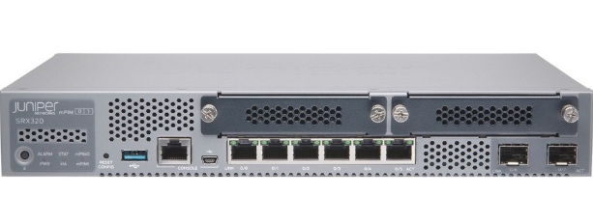
Juniper Networks Junos OS 20.4R3-S3.4 脆弱性
主な脆弱性と推奨される対応
1. 20.4R3-S3.4に影響する主な脆弱性
CVE-2024-21591 (Critical, CVSS: 9.8)
概要: SRX/EXシリーズのJ-Webコンポーネントにおけるスタックベースのバッファオーバーフロー。認証されていないリモートの攻撃者が、細工されたリクエストによりルート権限でのリモートコード実行（RCE）やDoS攻撃を行う可能性。
影響: 20.4R3-S3.4は「20.4R3-S9より前のバージョン」に該当するため、影響を受ける可能性。
CVE-2023-44177 (High, CVSS: 7.5)
概要: CLIコマンドのスタックベースのバッファオーバーフロー。低権限のユーザーが特定のCLIコマンドを実行し、サービス拒否（DoS）を引き起こす可能性。
CVE-2024-21619/21620 (Medium/High)
概要: J-Webにおける認証の欠如やXSS（クロスサイトスクリプティング）。20.4系に影響。
OpenSSH関連の脆弱性 (2024-05)
概要: ssh cipher listにchacha20-poly1305が含まれる場合に影響を受ける。
2. 推奨される対応策
速やかなアップグレード (推奨)
20.4R3-S9 またはそれ以降のサービスリリース（20.4R3-S10以上）へアップグレードする。
可能であれば、より新しい長期サポート（LTS）バージョン（21.4R3-S5以降, 22.4R3-S2以降）への更新。
回避策（アップグレード不可の場合）
J-Webを無効にする:
delete system services web-management
J-Webアクセスを制限する: ファイアウォールフィルターを使用して、信頼できる管理IPからのみアクセスを許可する。

Slide 12
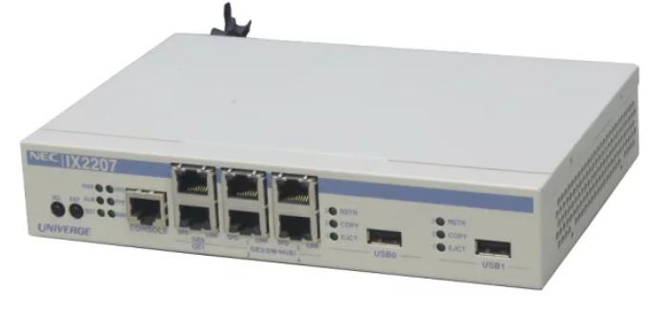
NEC UNIVERGE IX2207 OS 10.6.63 の脆弱性
主な脆弱性と推奨対応
1. 10.6.63に影響する主な最新脆弱性
CVE-2024-11013（High, CVSS: 7.2）
概要：コマンドインジェクション
Web管理インターフェースにおいて入力検証が不十分なため、認証済みの攻撃者が任意のCLIコマンドを実行可能
影響：ルータの完全乗っ取り、設定変更、VPN侵入、通信盗聴
影響バージョン：IXシリーズ Ver.10.2 ～ Ver.10.6系 → 10.6.63は影響を受ける
CVE-2024-11014（Medium, CVSS: 4.3）
概要：CSRF（クロスサイトリクエストフォージェリ）
攻撃者が細工したページを管理者に閲覧させることで、管理者権限で設定変更が可能
影響：ルータ設定改ざん、管理者権限悪用
CVE-2025-8153（Medium, CVSS: 6.1）
概要：クロスサイトスクリプティング（XSS）
Web管理画面において、悪意のあるスクリプトが実行される可能性
影響：管理者セッション乗っ取り、不正設定変更
2. 推奨される対応策
ファームウェアアップグレード（最推奨）
NECの修正版へアップデート
推奨：Ver.10.7系以降または最新安定版
回避策（アップグレード不可の場合）
Web管理無効化（最重要）
no http-server enable
HTTPSアクセス制限
管理端末のみ許可
Telnet無効化
no telnet-server enable
ssh-server enable

Slide 13
Ｌ２ＳＷ なし

Slide 14
ＳＲ なし

Slide 15
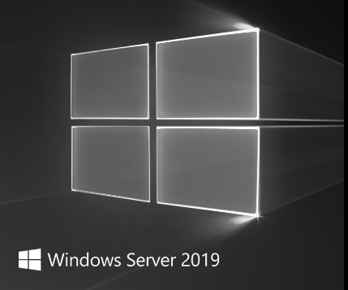
Windows Server 2019 Standard OS 10.0.17763.3770の脆弱性
主な脆弱性と推奨される対応
1. Windows Server 2019 Standardに影響する主な脆弱性
CVE-2025-59287（Critical, CVSS: 9.8）
概要：Windows Server Update Services（WSUS）のリモートコード実行
WSUSの処理の不備により、認証されていない攻撃者がSYSTEM権限でリモートコード実行可能
影響：サーバー完全乗っ取り、マルウェア実行、ドメイン侵害
影響条件：WSUS役割がインストールされている場合 → 仮想化基盤で使用されることが多いため注意
CVE-2023-28252（Critical, CVSS: 7.8）
概要：CLFS（Common Log File System）の権限昇格
Windowsのログ処理機能の不備により、攻撃者がSYSTEM権限を取得可能
影響：管理者権限取得、ランサムウェア実行
影響バージョン：Windows Server 2019 → 17763.3770 は影響を受ける可能性あり
CVE-2023-32019（High, CVSS: 7.8）
概要：Win32kの権限昇格
ローカルアクセスした攻撃者が、カーネル権限（SYSTEM）を取得可能
影響：完全なOS制御、セキュリティ機能回避
2. 推奨される対応策
Windows Update適用（最推奨）
最新の累積更新プログラム（CU）を適用
推奨：Build 17763.5xxx 以降、回避策
WSUSを使用している場合
不要なら停止：
net stop wsusservice
不要なサービス停止
特に：RDP（3389）、SMB（445）
外部公開禁止

Slide 16
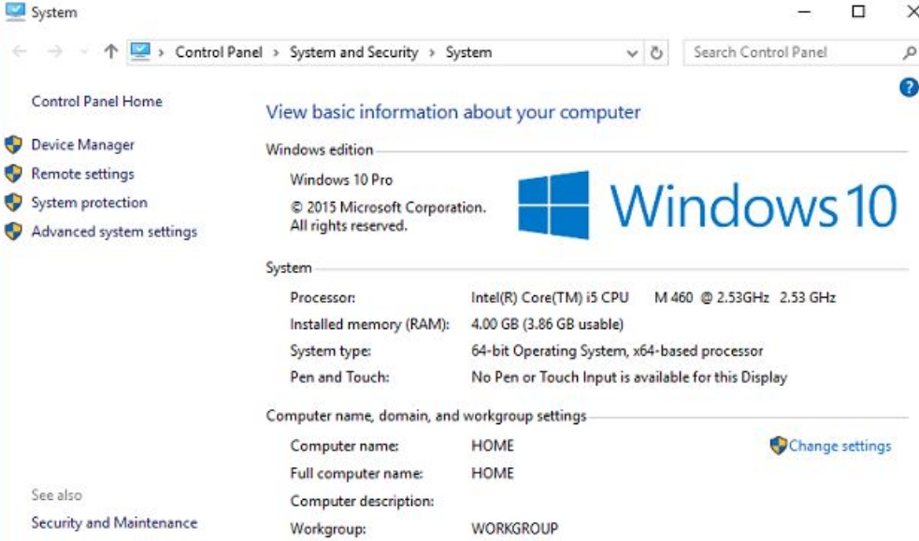
Windows 10 Enterprise LTSC 10.0.17763.3287
1. 17763.3287に影響する主な脆弱性
CVE-2025-59287（Critical, CVSS: 9.8）
概要：Windows Update Services関連のリモートコード実行
Windows Update関連コンポーネントの不備により、攻撃者がSYSTEM権限でコード実行可能
影響：端末完全乗っ取り、マルウェア感染、ドメイン侵害
影響バージョン：Windows 10 Enterprise LTSC 2019 含む → 17763.3287 は影響を受ける可能性あり
CVE-2023-28252（Critical, CVSS: 7.8）
概要：CLFS（ログシステム）の権限昇格
攻撃者がローカルアクセス後、SYSTEM権限取得可能
影響：ランサムウェア実行、セキュリティ回避
CVE-2023-32019（High, CVSS: 7.8）
概要：Win32k権限昇格
ローカル攻撃者がカーネル権限取得可能
影響：完全な端末制御
CVE-2024-21338 （Critical, CVSS: 7.8）
概要:Windowsのカーネルドライバの権限昇格（Privilege Escalation）脆弱性
ローカル攻撃者が悪用すると、SYSTEM権限取得、カーネルレベルアクセス、セキュリティソフト無効化が可能になる。
影響:攻撃成功時に管理者権限取得、完全な端末乗っ取り、永続化（rootkit）、横展開（Lateral Movement）
2. 推奨される対応策
Windows Update適用（最優先）
推奨：最新Build（17763.5xxx以降）へ更新、回避策（アップデート不可の場合）
不審ファイル実行防止（メール添付、USB）
管理者権限使用制限
RDP制限
外部公開禁止

Slide 17
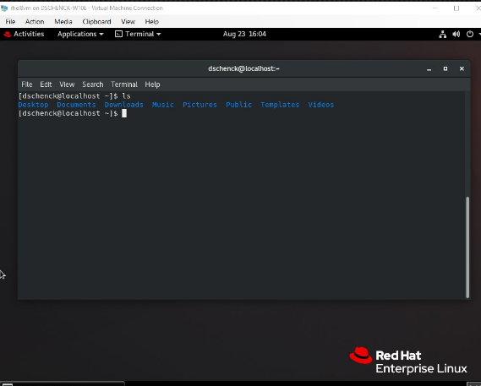
Red Hat Enterprise Linux 8.5
1. RHEL 8.5 に影響する主な脆弱性
CVE-2024-1086（Critical, CVSS: 7.8）
概要：Linuxカーネルの権限昇格（nf_tables）
Linuxカーネルのパケット処理の不備により、ローカルユーザーがroot権限を取得可能
影響：root権限取得、サーバー完全制御、コンテナ脱出
影響対象：RHEL 8系 含む→ RHEL 8.5 は該当
CVE-2024-6387（Critical, CVSS: 8.1）
概要：OpenSSH “regreSSHion” リモートコード実行
SSHサービスの欠陥により、認証前にリモートコード実行の可能性
影響：SSH経由侵入、サーバー乗っ取り
影響条件：SSHサービス有効（通常は有効）
CVE-2023-4911（Critical, CVSS: 7.8）
概要：Looney Tunables（glibc）
環境変数処理の不備により、ローカルユーザーがroot権限取得
影響：root権限取得、システム完全侵害
CVE-2024-3094（Critical, CVSS: 10.0）
概要：XZ Utils バックドア
SSH認証を悪用し、外部から完全侵害可能 ※RHEL 8.5 標準は通常非該当（手動更新している場合は影響あり）
2. 推奨される対応策
最優先：RHELアップデート
dnf update -y
推奨：RHEL 8.10 以降またはRHEL 9系
回避策（アップデート不可の場合）
SSHアクセス制限
/etc/ssh/sshd_config
変更：
PermitRootLogin no
不要サービス停止
systemctl disable telnet

Slide 18
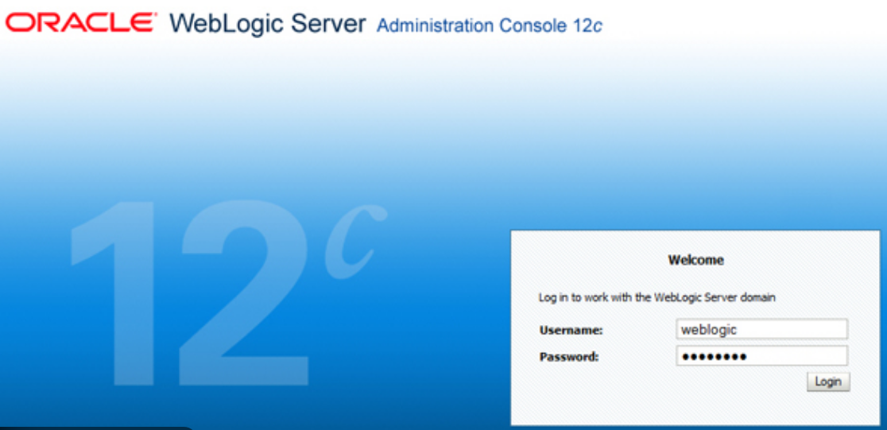
Oracle WebLogic Server 14.1.1
1. 14.1.1 に影響する主な最新脆弱性
CVE-2024-20931（Critical, CVSS: 9.8）
概要：未認証リモートコード実行（RCE）
IIOP / T3プロトコル処理の不備により、認証不要でリモートコード実行可能
影響：Webサーバー完全乗っ取り、WebShell設置、マルウェア感染
影響バージョン：WebLogic Server 14.1.1 → 該当
CVE-2023-21839（Critical, CVSS: 9.8）
概要：T3/IIOP経由のRCE
外部から細工した通信を送ることで、サーバー上で任意コード実行可能
影響：完全侵害、データベース侵入、WebShell設置
CVE-2024-21006（High, CVSS: 8.1）
概要：管理コンソール関連の脆弱性
攻撃者が管理機能を悪用
影響：設定変更、不正アクセス
CVE-2023-21931（High, CVSS: 7.5）
概要：DoS攻撃
攻撃者が細工したリクエストを送信
影響：Webサービス停止
2. 推奨される対応策
最優先：Oracle Critical Patch Update適用
Oracle公式：最新CPU（Critical Patch Update）適用
推奨：2025年CPU
回避策（アップデート不可の場合）
T3プロトコル無効化
config.xml：<t3-enabled>false</t3-enabled>
管理コンソール外部公開禁止
ポート：7001、7002
外部アクセス禁止
Web Application Firewall導入

Slide 19
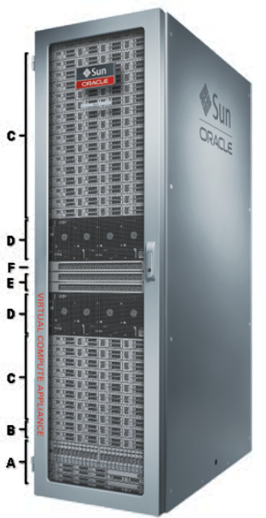
Oracle Database 19c Standard Edition 2 19.0.0.0.0
Oracle Database 19c Standard Edition 2（19.0.0.0.0）の脆弱性
1. 該当する主な脆弱性
CVE-2025-21181（High）
概要:Oracle Database Server の脆弱性により、ネットワーク経由でサービス拒否（DoS）が発生する可能性
影響:データベース停止、業務停止
CVE-2024-21120（High）
概要:Oracle Net Services の脆弱性により、認証済ユーザーが権限昇格やサービス妨害を行う可能性
影響:権限昇格、不正操作、DoS
CVE-2023-22081（High）
概要:Oracle Database Server の脆弱性により、不正アクセスやサービス拒否が発生する可能性
影響:不正アクセス、DoS
2. 推奨される対応策
Oracle Database 19c を最新のパッチレベルへ更新
推奨：Critical Patch Update（CPU）を適用
可能であればOracle Database 19c 最新RU（Release Update）
(19.22 以降、19.23 以降（推奨）)
回避策（アップデート不可の場合）
アップデートができない場合は、以下の対策を実施
① 外部からの接続制限（最重要）
Oracleポート：1521/TCPをFWで制限、管理ネットワークのみ許可
許可：DBサーバー、アプリサーバー
拒否：インターネット、一般端末
② 不要なOracleサービス停止：Oracle XML DB、Oracle HTTP Server、外部プロシージャ
③ 権限管理の強化：DBA権限の最小化、不要なユーザー削除、強力なパスワード設定
④ Oracle Listener制限
listener.ora にて制限：
ADMIN_RESTRICTIONS_LISTENER=ON
VALID_NODE_CHECKING_REGISTRATION=ON

Slide 20
攻撃経路１

Slide 21
攻撃手法
運行情報等DBサーバーの情報入手を目的とする
・Reconnaissance
T1595: Active Scanning
T1592.002:ソフトウェア調査
T1592.003:ファームウェア調査
・不正にアカウントを使用（FACE対抗用端末へ）
初期侵入（T1078: Valid Accounts）→権限昇格（ CVE-2024-21338の脆弱性を利用 ）→永続化（T1197: BITS Jobs、T1547: Boot or Logon Autostart Execution）→C2通信（T1071.004: DNS、T1071.001: Web Protocols）
・認証情報窃取（端末内のドメイン管理者認証情報を取得）
（T1003.001:LSASS Memory ）
・内部ネットワーク調査
T1016: System Network Configuration Discovery
T1046: Network Service Discovery
T1018: Remote System Discovery
T1087.002: Domain Account
・DBサーバーの情報窃取
T1213.006 : Data from Information Repositories: Databases

Slide 22
検知・緩和策
検知手段
・ FACE対向用端末のSecurityログで不審な端末からアクセスがないかを確認 (4624/4625)
・ FACE対向用端末のSecurityログで不審なサービスやタスクが登録されていないかを確認
・ FACE対向用端末のnetstat実行結果に不審な通信先が含まれていないかを確認
・ FACE対向用端末のtasklist実行結果に不審なプロセスが含まれていないかを確認
・ FACE対抗用端末のSecurityログで新規ドライバ/サービスの作成がないかを確認(7045)
・ 運行管理情報DBに不審なアクセスログはないかを確認
緩和策
・不要なサービスの停止
・パスワードを強化
・重要な認証情報は残さない。

Slide 23
攻撃経路２

Slide 24
攻撃経路２
FACEネットワークからDIIへ侵入することを目的とする
・ Reconnaissance
T1595: Active Scanning
T1592.002:ソフトウェア情報収集
T1592.003:フォームウェア情報収集）
・不正にアカウントを使用（FACE対抗用端末へ）
初期侵入（T1078: Valid Accounts）→権限昇格（T1203: Exploitation for Client Execution）→永続化（T1197: BITS Jobs、T1547: Boot or Logon Autostart Execution）→C2通信（T1071.004: DNS、T1071.001: Web Protocols）
・仮想化サーバーへ横展開
認証情報窃取（T1003.001:LSASS Memory ）、（T1550.002:Pass the Hash ）→情報窃取（T1213.006:Databases）→C2通信（T1071.004:DNS、T1071.001:Web Protocols）
・DIIから他のシステムへ侵入
T1021.001: Remote Desktop Protocol
T1021.002: SMB/Windows Admin Shares

Slide 25
検知・緩和策

