Slide 1
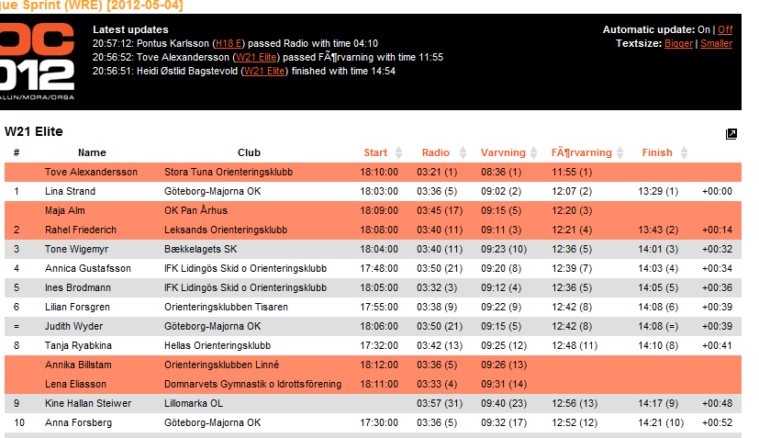
The last passings for all classes are shown on top
Turn on/off automatic updates or increase font-size
Results are default ordered by ”virtual position” in the race.
Virtual position is calculated as the place the runner have at his/her last intermediate control compared to the other runners.
Click on a column header to sort on that intermediate control
Current position at each intermediate control are shown together with the time
Newly updated rows are shown in red

Slide 2
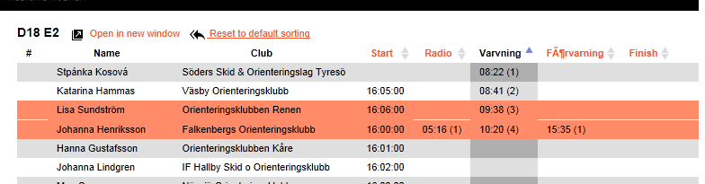
When sorting is changed, a link to reset to sorting by virtual position again appear

