Slide 1


An introduction to TensorFlow
Alex Oldemeier

Slide 2
My background
I am an epistemologist by academic training
I am a full-stack web developer since 2014
I study mathematics and information science

Slide 3
Aims
Practical
Theoretical

Slide 4
Structure of the talk
Motivation
Understanding Tensor and Flow in TensorFlow
Why TensorFlow instead of library xyz?

Slide 5
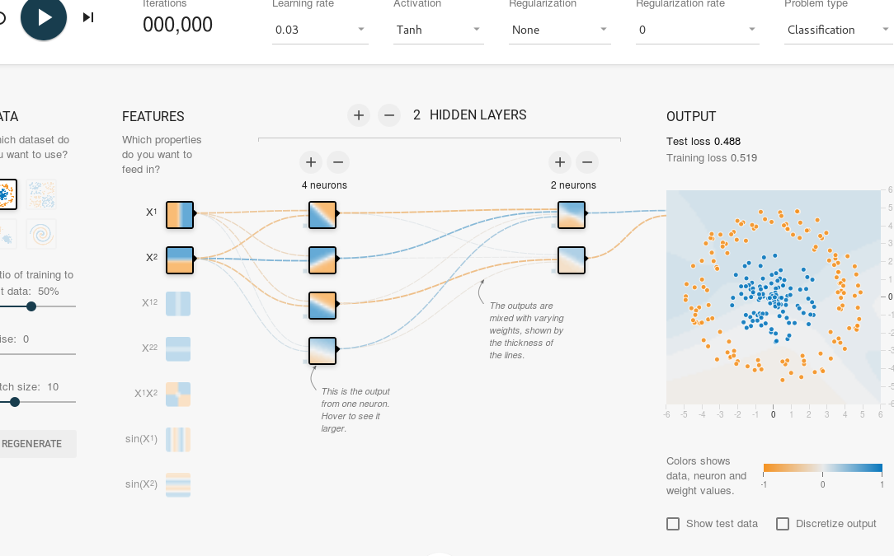
Getting started: Playground
Go to http://playground.tensorflow.org

Slide 6
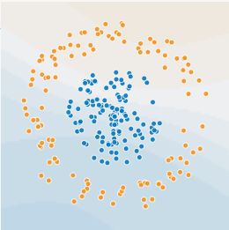
Neural networks: machine learning
Mathematical models
Classification, regression, clustering

Slide 7
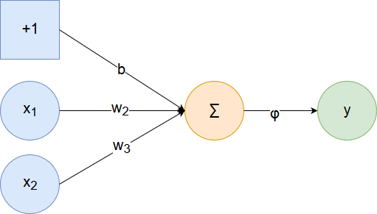
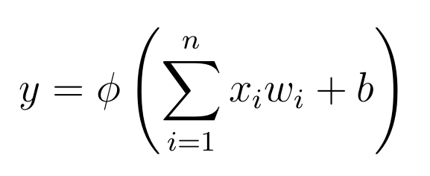
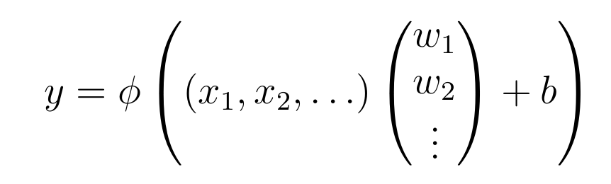
Neural networks: neurons

Slide 8
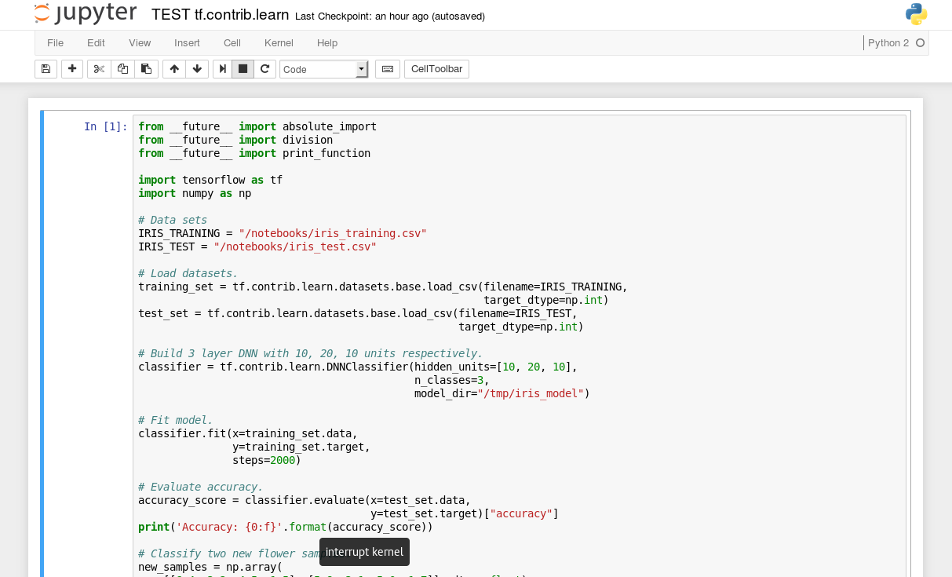
TensorFlow: docker
$ docker run -it -p 8888:8888 -p 6006:6006 gcr.io/tensorflow/tensorflow
localhost:8888

Slide 9
TensorFlow: neuron output calculation
Define data flow graph
TensorBoard
Execute it in a session using a TF kernel
Execution done by evaluation

Slide 10
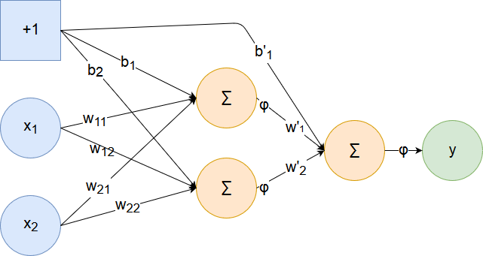
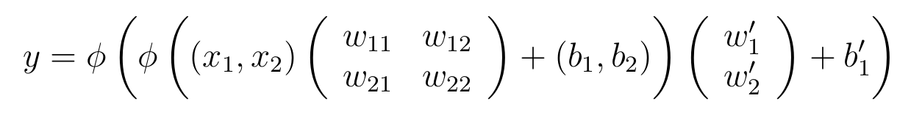
Neural networks: feedforward

Slide 11
TensorFlow: feedforward calculation
Placeholder
Purpose of activation functions

Slide 12
Neural networks: training
The output is a function depending on input and weights.
Look for the best weights for the function.
The best weights are those that minimize the output error.

Slide 13
Neural networks: training
Training set
Test data

Slide 14
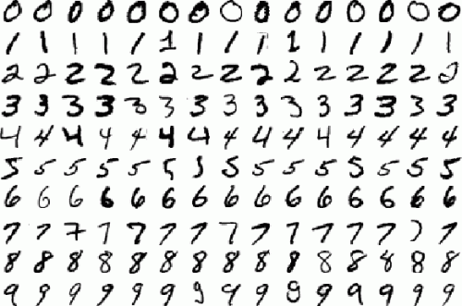
Example: the problem
MNIST: a bunch of 28x28 images of handwritten digits with solutions:

Slide 15
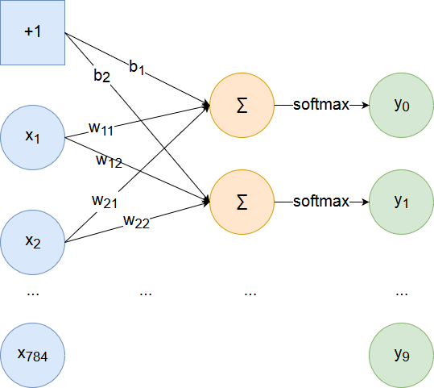
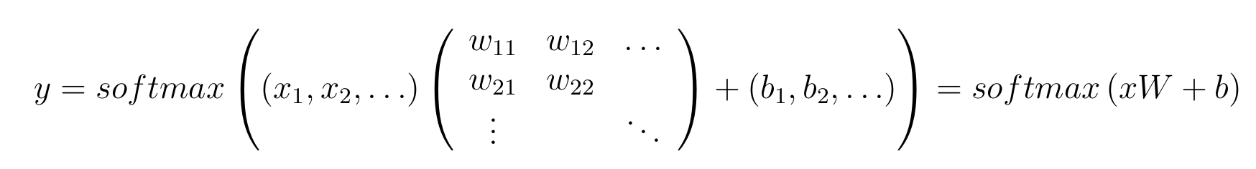
Example: the network

Slide 16
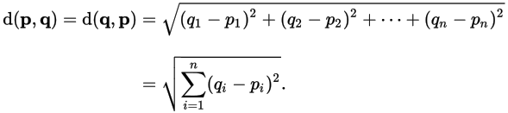

Example: calculating error
For training we need to calculate the error.
Error is distance from the desired output.
We use Euclidean distance:

Slide 17
Example: learning
Foreach training image, adapt weights to minimize errors.
Adapting weights is a classical optimization problem.

Slide 18

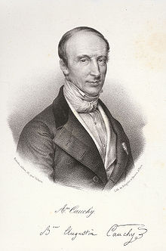
Example: optimizing
Gradient Descent

Slide 19
TensorFlow: training
TensorFlow example libraries
Gradient descent optimizer

Slide 20
Summing up: TensorFlow
Higher-dimensional arrays for weights etc: tensors. You need the higher-dimensional case for more complicated networks (deep learning).
TensorFlow is a good implementation for tensor calculations.
Calculations are represented as data flow graphs.

Slide 21
TensorFlow: why should I care?
Alternatives: Encog, Torch, R, DeepLearning4J, Core ML. So why TensorFlow?
Steep learning curve. Easy experimentation.
A fast amount of examples.
Active project.

Slide 22
References
References on https://github.com/aoldemeier

