Slide 1


An introduction to TensorFlow
Alex Oldemeier

Slide 2
Aims
Practical: I tell you what I have learned as an interested tinkerer who has heard many things about TensorFlow and wants to find out what it is all about.
Theoretical: I tell you how I classify TensorFlow‘s position in the vast conceptual network and toolchain of AI, machine learning, linear algebra, etc. This will help ourselves to avoid quasi-religious beliefs in Google, exchange thoughts more clearly later on, and facilitate discussion.
Disclaimer: OWTTE „Talks are great for learning. Talk about things you don‘t know more about than at least some members of the audience, then you will learn the most“ (an anonymous CTO).

Slide 3
My background
I am an epistemologist by academic training.
I am a web developer.
I study mathematics and information science.

Slide 4
Structure of the talk
Motivation: an awesome (tm) example of artificial neurons at work.
Understanding: some concepts and an example of a neural net and machine learning.
We will see training a major type of neural network is simply the problem of optimizing (finding the right values for) a weight matrix, which is a type of tensor. Hence the „Tensor“ in „TensorFlow“.
Practise: we use TensorFlow to train a neural network. We realize that operations on tensors used to implement optimizing weight matrices are usefully represented as data flow graphs. Hence the „Flow“ in „TensorFlow“.
I close with the question why should you care?

Slide 5
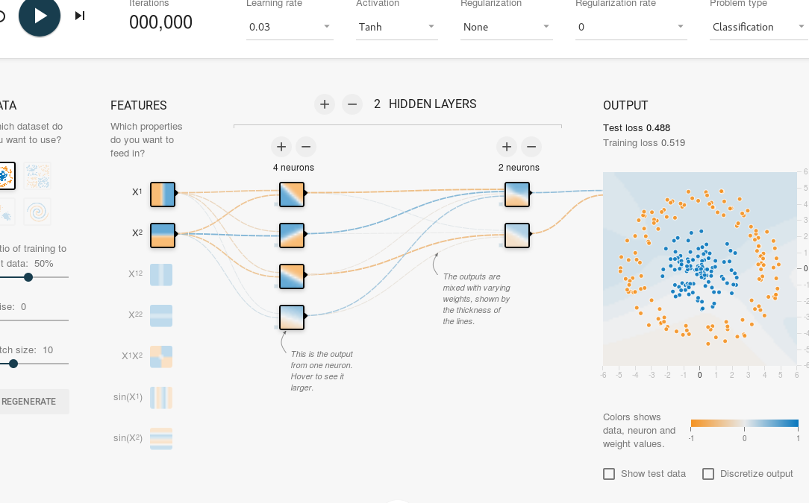
Getting started: Playground
Go to http://playground.tensorflow.org.
Be inspired.

Slide 6
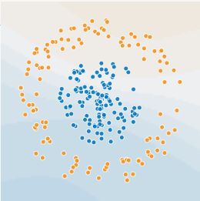
Neural networks: machine learning
Mathematical models inspired by (arrangements of) biological neurons for solving some problems in machine learning. These include:
Classification
Regression
Clustering

Slide 7
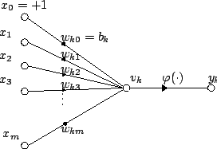

Neural networks: neurons
Artificial neurons are the basic units of a neural network.
Neurons have multiple inputs and one output.
The output is generated as follows: the inputs are weighted and summed up, and usually an additional activation function φ is applied to the sum.

Slide 8
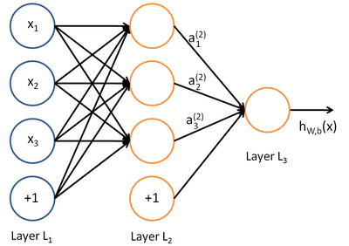
Neural networks: feedforward
Consists of: input layer, output layer, hidden layers.
In feedforward networks, the outputs flow in one direction, no cycles or loops (!), hence the name.
They are characterized by the number of hidden layers, the size of the input and output layers, interconnections, bias and the activation function.
They can be used for classification and regression.
Instances are characterized by the particular weights (and biases, if you distinguish). These have to be learned / trained in order for the network to be used. Finding weights by hand is quite hard.

Slide 9
Neural networks: training
Just as for neurons, the output (the state of the output neurons) of a certain neural network just depends on the input and the weights (and biases).
There is a mathematical function mapping the input and the weights (and biases) to an output. It is a combination of the output functions of all the neurons in the network.
The aim of learning is simply looking for weights that deliver the best (=desired, correct) results for this function when combined with relevant inputs.

Slide 10
Neural networks: training
For this we need a training set --- a set of inputs where we know the desired output. We train by optimizing weights for this set.
We can then test the network with test data, where we also know the desired output. This is to ensure that we did not just train for the test data but that our weights „generalize“.
If the tests run well, we can use the network by feeding it with inputs where we do not know the correct output. If the network is well-trained, it will tell us what the correct output is.

Slide 11
Example: classifying images
Consider the following problem: given an 28x28 image with handwritten digits, tell me what digit it is (0-9).
We can use a simple feedforward network to solve this problem.
We use one input neuron for each pixel and 10 output neurons. Each output neuron stands for one digit. The values represent the probabilities for the respective digits.

Slide 12
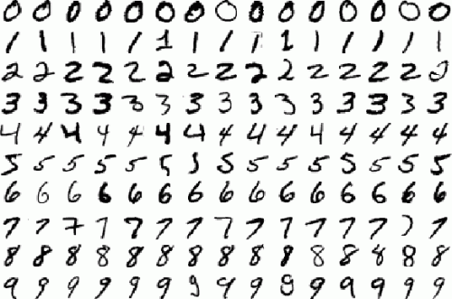
An example: the data
We use the famous MNIST data set from: http://yann.lecun.com/exdb/mnist/
It contains a bunch of 28x28 images of handwritten digits with solutions:

Slide 13
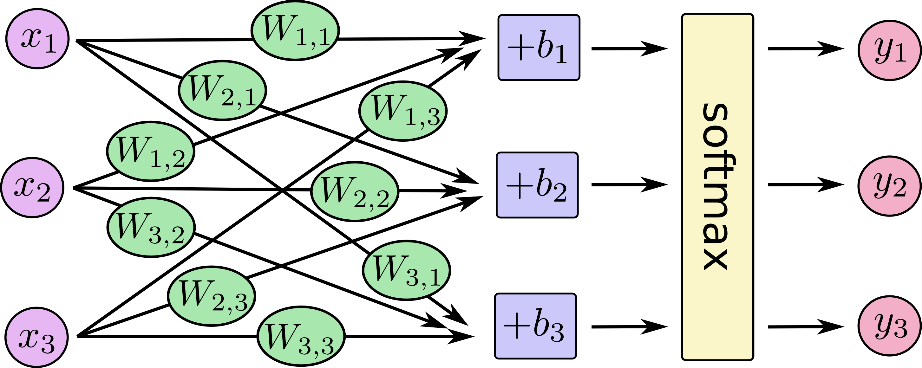
Example: the network
Here is a simplified graphical representation of the network which makes biases explicit:
There are, of course, 28*28 x_{i}s and 10 y_{j}s

Slide 14

Example: calculating output
We store all weights in a 10x768 matrix (= a table / multidimensional array with 10 rows and 768 columns). We store biases in a vector b with 10 rows.
Using matrix algebra, the y_{j}s can then be calculated by the formula:
This is a function depending on W, x and b.
The state of our output neurons for a particular input (the result of this calculation) is thus stored in a vector (array) with 10 rows.
W and b specify instances of the network. We can fill them with random values to have a network to start with. However, this network will be useless and classify images at random.

Slide 15
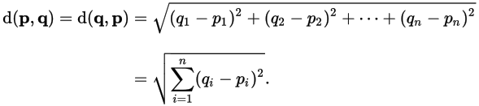
Example: calculating error
In other words, the output vector for an image Im is likely to be different from the solution that MNIST has for Im.
For training, we need more than knowing we are wrong. We need a measure for how wrong we are.
We use Euclidean distance between the actual values of our output neurons (stored in a vector (array) with 10 columns) and the ideal output (given by MNIST, also in a vector (array) with 10 columns).
Euclidean distance between two vectors is defined as:

Slide 16
Example: learning
The idea for training is now as follows: for each image in the training set, we adapt the weights (the weight matrix) and the biases in such a way that the current error is minimized.
The error for a given image (= the Euclidean distance between actual output and desired output) is just a mathematical function depending on (the values in) W and b.
So this is a simple optimization problem! We can use well-known mathematical methods for finding values of W and b for which the current error function takes a (local) minimum.

Slide 17

Example: optimizing
We optimize by using Gradient Descent. The idea is to walk always downhill on a (multivariate) function --- the function from all the weights and biases to our error --- until we reach a local minimum.
Example:

Slide 18
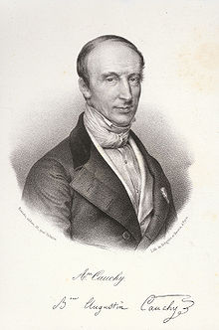
Example: optimizing W
We do this until our errors are small enough.
We can then use test data to see whether the network is not only trained for the training data.
This is essentially the „secret“ of machine learning. It works by finding minima of functions.
It is nothing invented by Google. The optimization technique explained is from the early 19th century.

Slide 19
Neural network: tensors
The example is really simple. For more complicated networks, we need higher-dimensional arrays.
These higher-dimensional arrays are not called matrices anymore but called tensors, which is a more general concept. (note that matrices and vectors are also tensors!)
Now the computations become very expensive. We need good implementations.
TensorFlow is simply a mathematical library that contains good implementations of operations on tensors and (well-known!) algorithms to find our weight matrices / arrays / tensors that can run in parallel and on GPUs.

Slide 20
Neural network: deep learning
Deep learning is basically just employing complicated and large forms of feedforward networks.
Deep learning networks and training algorithms are used for advanced tasks such as image classification.
Because we need really good implementations of our algebra, and TensorFlow provides one, TensorFlow is relevant for Deep Learning.
But let‘s install TensorFlow and use it to actually train a network of the type explained before with the technique explained before.

Slide 21
Getting started: use docker
I assume a working docker setup
$ docker run -it -p 8888:8888 -p 6006:6006 gcr.io/tensorflow/tensorflow
This image contains TensorFlow 0.8. Some examples require TensorFlow >= 0.9. So, for example, you might want to do a:
$ docker exec tensorflow_tinkering_1 pip install --upgrade https://storage.googleapis.com/tensorflow/linux/cpu/tensorflow-0.10.0rc0-cp27-none-linux_x86_64.whl

Slide 22
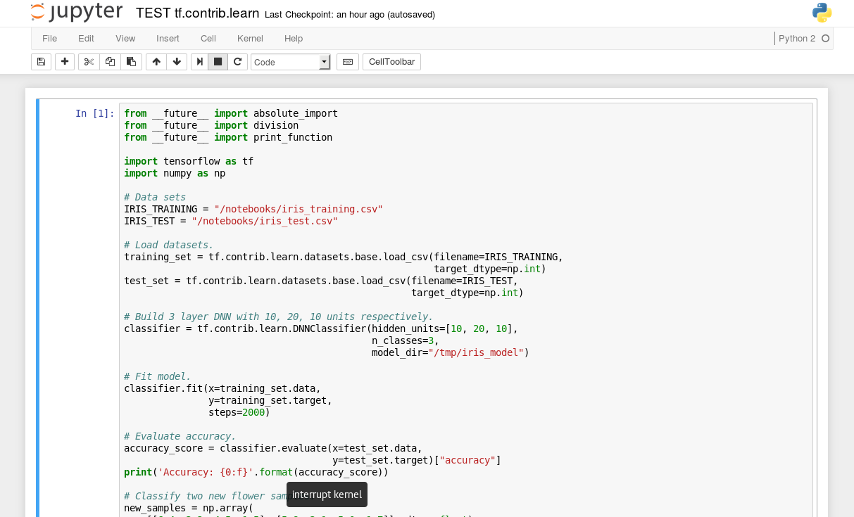
Getting started: jupyter
Go to: localhost:8888 in a browser
Jupyter is a kind of IDE for machine learning running in a browser
The examples run from scratch

Slide 23
Getting started: multiply matrices
As I said, TensorFlow is a library for efficiently performing mathematical operations on tensors used for machine learning. Let‘s start with a simple example: multiplying matrices.
We first define a data flow graph, representing the desired calculations (nodes are tensors, edges are operations on them).
We then run the calculation by evaluating the graph using a TensorFlow session running in a TensorFlow kernel.
Let‘s use jupyter to run an example.

Slide 24
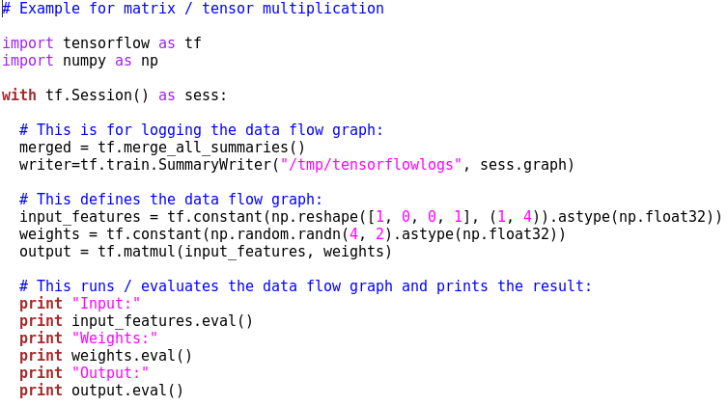
Getting started: multiply matrices

Slide 25
Getting started: TensorBoard
Use TensorBoard to analyze your computational graph.
$ docker exec tensorflow_tinkering_1 tensorboard –logdir=/tmp/tensorflowlogs
Go to http://127.0.0.1:6006/

Slide 26
An example: Implementation
Now let‘s implement our neural network.
We use the TF examples module to load MNIST data.
We use TensorFlow to define the network, define an error function, and calculate the right weights using its built-in gradient descent optimization functionality.
Let‘s see how this goes.

Slide 27
Summing up
TensorFlow is a mathematical library that contains special functions to implement neural networks.
Such networks are implemented by constructing computational / data flow graphs representing mathematical operations on multi-dimensional arrays / tensors.
Setup is easy, there are many examples around and one can start tinkering quickly. Cool stuff.

Slide 28
TensorFlow: why should I care?
TensorFlow is not a tool to rule the world. Moreover, there are many libraries around that do similar things and are similarly fast (some also use the GPU): Encog, Torch, R, DeepLearning4J. So why should I have a look at TensorFlow?
Learning. It‘s easy. It already contains standard training sets useful for tinkering. It uses Python. Everyone knows Python. And it works well together with numpy, matplotlib etc.
Support and outlook. DeepMind moved to TensorFlow. Google is behind it. It also contains functionality for distributed computing and serving.
Basically, you should care about machine learning.

Slide 29
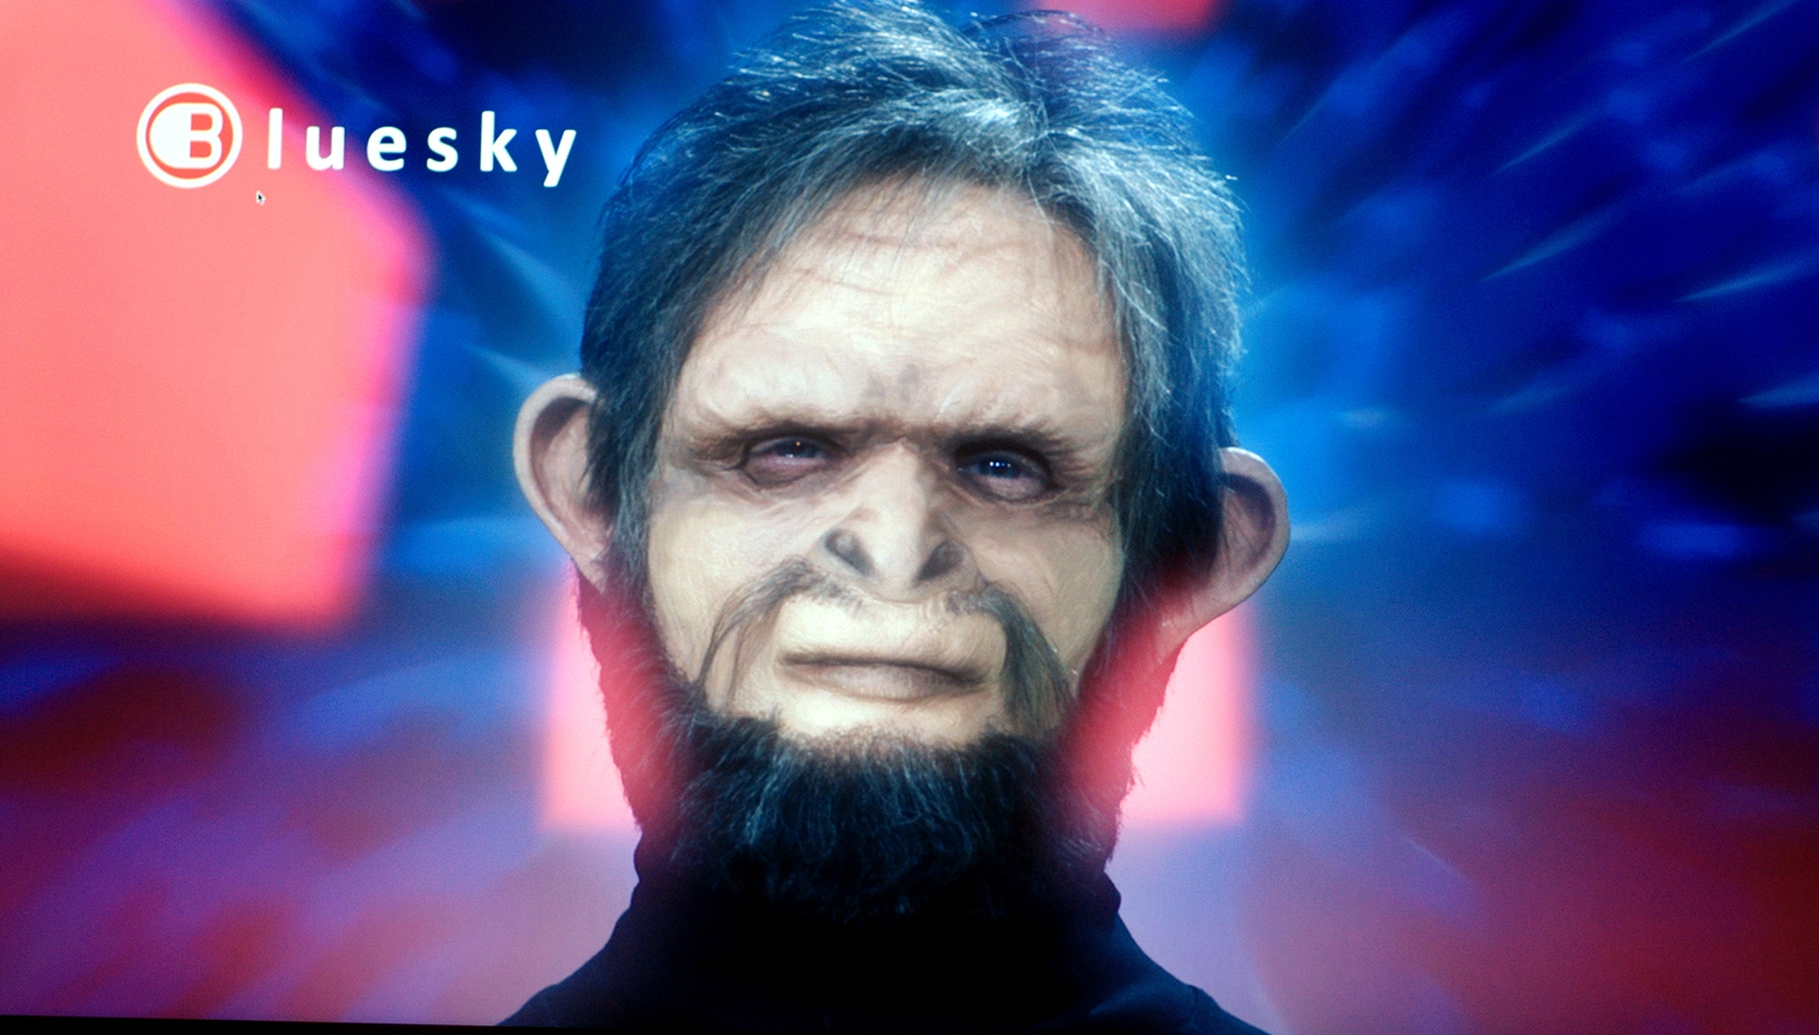
Why Neural Networks and Machine Learning?
We have beer. Let‘s discuss it.

Slide 30
References
Mostly tensorflow.org, wikipedia.org, „Artificial Intelligence for Humans“ (volumes 1-3), and „An introduction to TensorFlow“.
References will be put on https://github.com/aoldemeier. Thank you for your patience.

