Slide 1


An introduction to TensorFlow
Alex Oldemeier

Slide 2
Aims
Practical
Theoretical
Disclaimer

Slide 3
My background
I am an epistemologist by academic training.
I am a web developer.
I study mathematics and information science.

Slide 4
Structure of the talk
Motivation
Understanding the „Tensor“ in „TensorFlow“
Understanding the „Flow“ in „TensorFlow“
Why should you care?

Slide 5
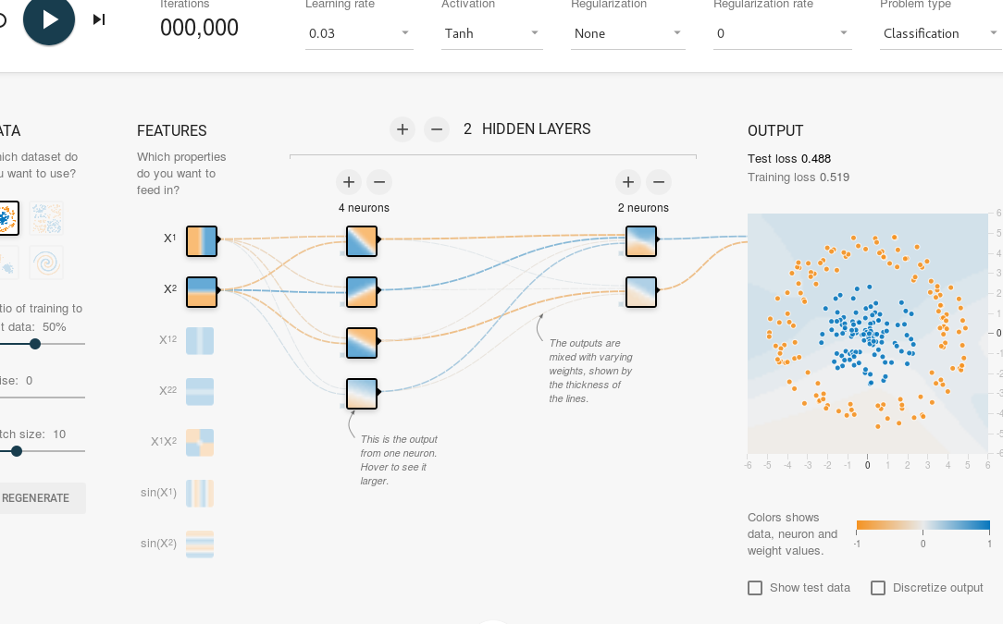
Getting started: Playground
Go to http://playground.tensorflow.org.

Slide 6
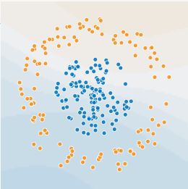
Neural networks: machine learning
Mathematical models
Classification, regression, clustering

Slide 7
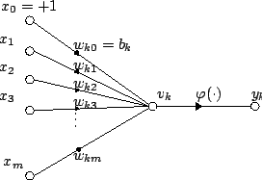

Neural networks: neurons

Slide 8
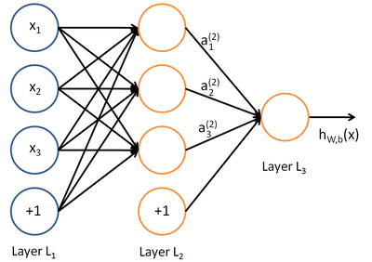
Neural networks: feedforward

Slide 9
Neural networks: training
The network is a function depending on input and weights
Look for the best weights for the function

Slide 10
Neural networks: training
Training set
Test data

Slide 11
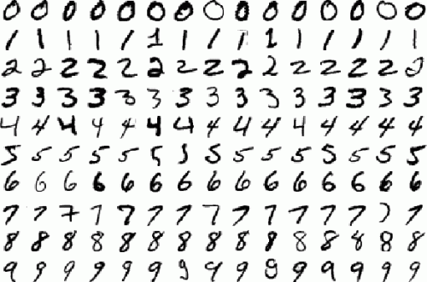
Example: the problem
MNIST: a bunch of 28x28 images of handwritten digits with solutions:

Slide 12
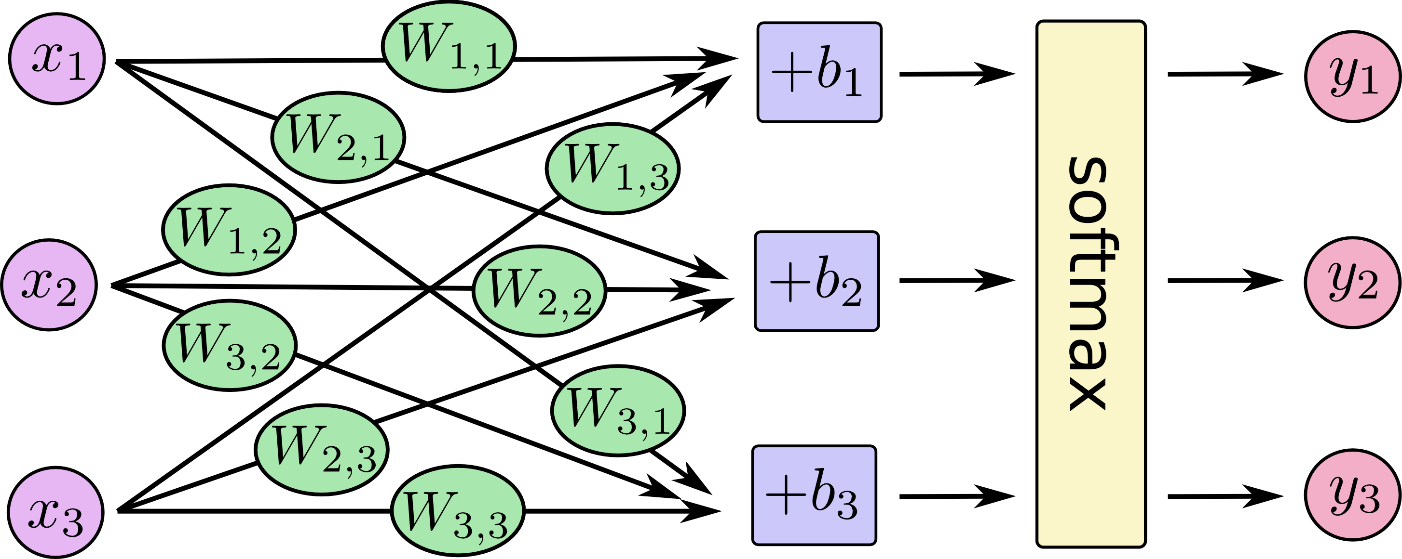

Example: the network

Slide 13
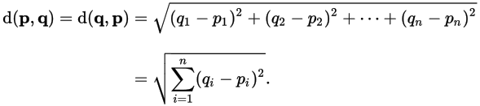
Example: calculating error
For training we need to measure error
Error is distance from the desired output
We use Euclidean distance:

Slide 14
Example: learning
Foreach training image, adapt weights to minimize errors
Adapting weights is an optimization problem on a function

Slide 15

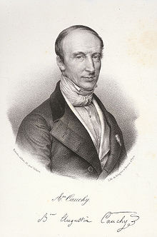
Example: optimizing
Gradient Descent

Slide 16
Neural network: tensors
Higher-dimensional arrays for weights etc: tensors
TensorFlow is a good implementation
Deep Learning

Slide 17
Getting started: docker
$ docker run -it -p 8888:8888 -p 6006:6006 gcr.io/tensorflow/tensorflow
For TensorFlow >= 0.9, do a: $ docker exec tensorflow_tinkering_1 pip install --upgrade https://storage.googleapis.com/tensorflow/linux/cpu/tensorflow-0.10.0rc0-cp27-none-linux_x86_64.whl

Slide 18
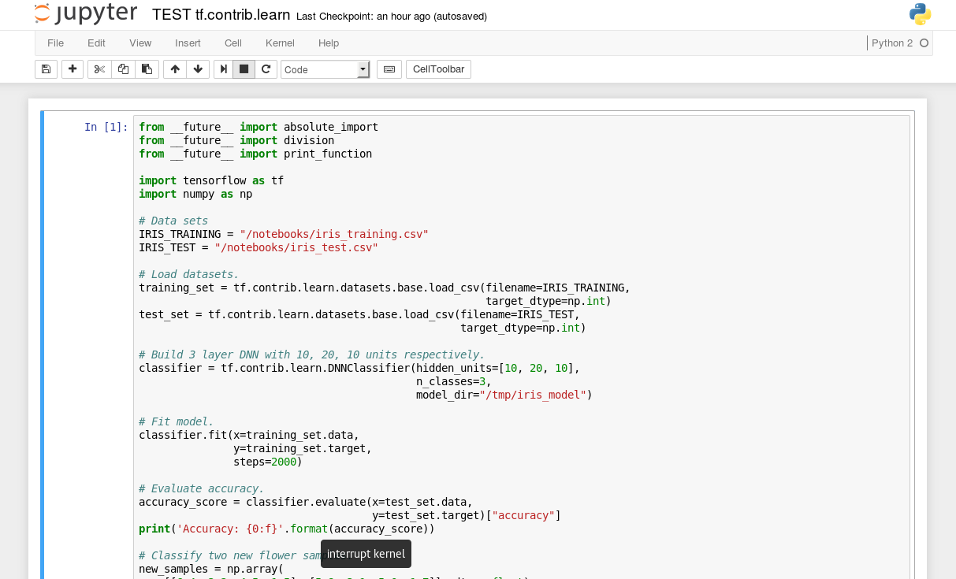
Getting started: jupyter
Go to: localhost:8888

Slide 19
Summing up
TensorFlow is a mathematical library, nothing more, nothing less
Data flow graphs
Setup is easy, many examples

Slide 20
TensorFlow: why should I care?
Alternatives: Encog, Torch, R, DeepLearning4J. So why should I have a look at TensorFlow?
Learning
Support and outlook

Slide 21
References
References on https://github.com/aoldemeier

