Slide 1

AI-Powered Risk Platform
Engineering & Implementation Plan — 3-Month Roadmap
Netevia Risk & Technology Division
Version 4.0 · May 2026 · Internal — Confidential

Slide 2






Manual, reactive risk workflows expose Netevia to financial loss, card brand penalties, and partner attrition
Overnight Vulnerability: Transactions go unreviewed until business hours — holds are missed, fraud accumulates.
Communication Gaps: Merchants and ISOs receive no notification when holds are placed, generating inbound call volume and partner friction.
False Positives: Flags on legitimate merchants (construction, government, high-ticket) damage relationships and revenue.
Unquantified Exposure: Chargeback tracking inaccuracies and ACH reject blind spots create unquantified loss exposure.
Compliance Risk: No systematic card brand compliance tracking — VAMP, VIRP, and ECP breaches can result in fines exceeding $25,000/month.

Slide 3




Three autonomous capabilities eliminate the operational gap and protect Netevia at every level
1. Autonomous AI Agent
2. Automated Notification Engine
3. Self-Correcting ML Feedback Loop
Runs nightly at 5 AM, reviews all overnight activity, executes holds via TSYS/wc3270, and delivers a prioritized morning briefing to the Risk team by 7:30 AM. No schedule change required.
The instant any hold is applied, the system simultaneously notifies Merchant, ISO Office, and Agent with hold reason, timeline, required docs, and a secure upload link. Zero manual steps.
When the AI identifies a false positive, it automatically releases the hold, recalibrates the rule threshold, annotates the merchant account, writes a tamper-evident audit log entry, and feeds the correction back into the training dataset.

Slide 4
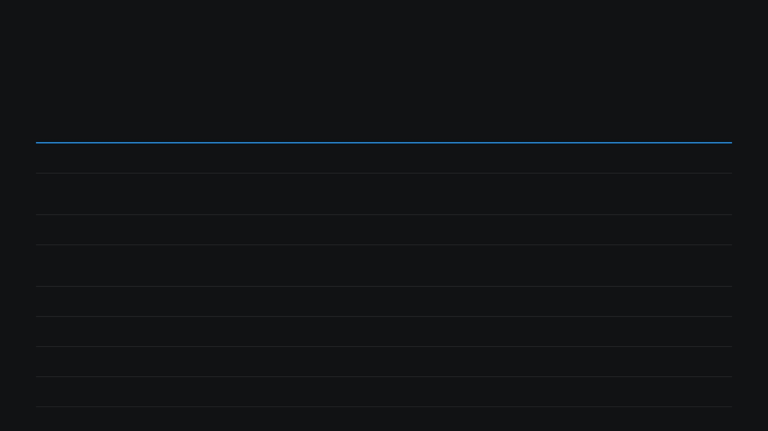
A decoupled microservices architecture bridges legacy mainframe operations with modern ML infrastructure
Subsystem
Stack
Function
Data Ingestion Pipeline
REST API / SFTP + Apache Kafka
Real-time auth/capture logs + overnight TSYS Mreports batches
Dynamic Rules Engine
Python (FastAPI) + Redis
Sub-second hierarchical rule evaluation across Portfolio → Merchant
Mainframe Automation
wc3270 / Py3270 Python Wrapper
Programmatic hold/release execution on TSYS green screen
ML & AI Layer
Python (XGBoost) + LLM
Context-aware transaction scoring + false positive self-correction
Agent Orchestration
Apache Airflow / Temporal
Nightly 5 AM agent scheduling, coordination, and reporting
Notification Gateway
SendGrid / Twilio
Automated Email + SMS alerts to Merchant, ISO, Agent
Persistent Storage
PostgreSQL + Elasticsearch
Case management, config, and high-speed audit log querying
Presentation Layer
React / TypeScript (RBAC)
Risk dashboards, ISO Partner Portal, Executive views

Slide 5
Six engineering objectives define the full scope of the platform build
1
TSYS / Mreports Data Integration
2
wc3270 Green Screen Automation
Real-time and batch ingestion pipelines normalizing auth, capture, and settlement data across the full Portfolio → Merchant hierarchy.
Headless Py3270 service eliminating all manual mainframe intervention for holds and releases.
3
Hierarchical Dynamic Rules Engine
4
ML-Driven Anomaly Detection
Editable thresholds at Portfolio, MCC, ISO Office, Agent, and Merchant levels with full audit trail on every rule change.
XGBoost models trained on 90-day behavioral baselines, reducing false positives without adding friction to legitimate merchants.
5
Autonomous AI Agent (24/7 Coverage)
6
Card Brand Compliance Monitoring
Scheduled orchestration agent delivering overnight review and morning briefing with no schedule change required.
Dedicated subsystem tracking VAMP, VIRP, ECP, BRAM with internal thresholds set 30–40% below official network limits.

Slide 6






Phase 1 delivers the foundational infrastructure and first four critical detection flags in 4 weeks
Weeks 1–2 — Infrastructure Sprint
Weeks 3–4 — Core Engine Sprint
TSYS/Mreports ingestion pipeline (REST API + SFTP) configured with data normalization schema
Dynamic rules engine framework live — UI for creating/editing rules at all 5 hierarchy levels
wc3270 Py3270 emulation service built — programmatic hold/release execution live
OOP Flags 1–4 (Critical): Duplicate BIN, Auth/Capture Gap, Duplicate Auths, High Velocity
AI agent fully architected: data inputs, decision logic, notification triggers, false-positive loop documented
Automated hold execution connected to wc3270 + simultaneous Merchant/ISO/Agent notifications
ISO ACH reject notification pipeline live
Urgency-based triage matrix deployed (replaces call-order processing)

Slide 7



Phase 2 expands detection coverage to 10 flags and begins active AI agent development
Weeks 5–6: Detection Expansion Sprint
Weeks 7–8: Integration & QA Sprint
AI Agent Integration Testing: Testing against live TSYS data feeds.
OOP Flags 5–10 (High severity): 90-day behavioral baselines for Dollar Clusters, Large Anomalies, AVS/CVV Spikes, Device Fingerprinting, Unmatched Credits, BIN+Auth Correlation.
ACH Update SLA Enforcement: 3-business-day maximum enforced.
Underwriting ↔ Risk Alignment: Industry-specific thresholds for construction, government, high-ticket merchants embedded in rules.
Root Cause Requirement: Enforced before any fund release.
Chargeback Tracking: Accuracy audit and fix deployed.
Document Deduplication Rule: Prevents re-requesting docs submitted at underwriting within 6 months.
Green Screen Migration: Migration plan documented and finalized.
AI Agent Core Logic: Active development and build begins.

Slide 8

Phase 3 ships the production AI engine, partner portals, and card brand compliance monitoring — full go-live Week 12
Weeks 9–10 — ML & Agent Production Launch
Weeks 11–12 — Go-Live Sprint (Code Freeze Week 11)
Autonomous AI Agent live — 5 AM nightly run, wc3270 holds executed, prioritized briefing delivered by 7:30 AM
ISO Partner Portal — real-time hold status, reserve balances, chargeback data
ML transaction scoring engine deployed with self-correcting false positive feedback loop
Executive Profitability Dashboard — risk exposure vs. revenue per account
OOP Flags 11–15 (Medium): Proxy/VPN/TOR, Host Capture Voids, BIN Concentration, Same Billing Address clusters
Rolling reserve & loss reporting replacing estimated figures
UAT → Full production go-live
Force Post monitoring + Deposit Spike detection (150% of 30-day trailing average)
VAMP/ECP/VIRP compliance monitoring module live

Slide 9





The AI Agent eliminates the overnight coverage gap without requiring any change to the Risk team's schedule
Trigger
Data Sources
Scheduled nightly at 5:00 AM via Apache Airflow / Temporal orchestration
Overnight TSYS Mreports batch · ACH reject feed · Active OOP flag queue · Open case backlog
Core Functions
Output
Ingest overnight data → Evaluate accounts against rules engine → Apply holds for Critical flags → Queue High-severity cases for analyst review → Generate morning briefing
Prioritized case queue delivered to Risk team inbox by 7:30 AM — sorted Critical / High / Medium with recommended actions
Notification
Frictionless Design
Every hold applied by the agent immediately fires the notification pipeline — Merchant, ISO, and Agent notified with hold reason, timeline, and secure upload link
Holds applied only when ML confidence thresholds are met; borderline cases surfaced for human review, never auto-actioned

Slide 10
When the AI identifies a false positive, it corrects itself automatically — no human intervention required
1
Detection
5
Account Annotation
Transaction scored against merchant behavioral baseline, underwriting profile, and MCC norms.
Structured note written to merchant record: flag type, false positive rationale, parameter delta, timestamp.
2
False Positive Determination
6
Audit Log Entry
Confidence score falls below hold threshold OR contextual signals (industry, tenure, UW-approved limits) override the raw flag.
Tamper-evident entry: transaction ID, original flag, AI confidence score, false positive rationale, parameter delta, hold status change, system identity.
3
Hold Prevention / Release
If hold was applied, wc3270 release command issued automatically; if in-flight, no hold applied.
7
ML Model Feedback
Corrected event fed back into training dataset; model accuracy improves with every transaction processed.
4
Parameter Adjustment
Triggering rule threshold dynamically recalibrated for this merchant/MCC/hierarchy level within defined safety bounds.

Slide 11
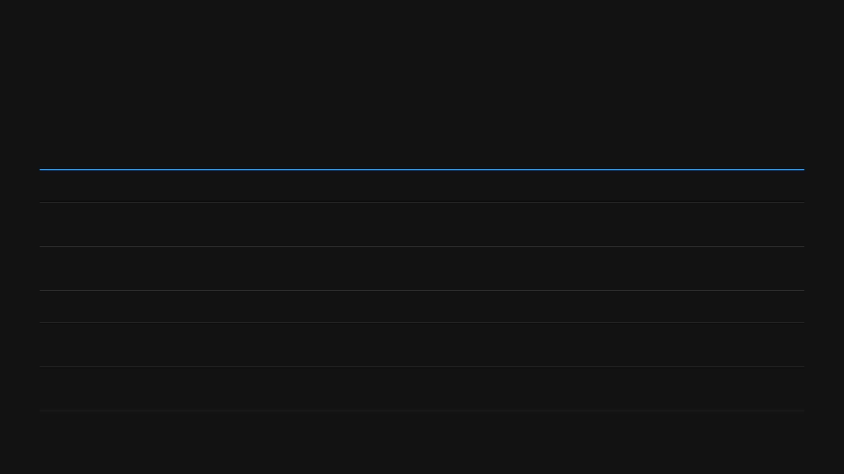
Internal alert thresholds set 30–40% below official network limits protect Netevia from reporting lag penalties
Program
Network
Official Threshold
Netevia Alert Fires At
Automated Action
VAMP (Acquirer)
Visa
>0.5% fraud + disputes
0.35% portfolio ratio
Executive alert + ISO throttling
VAMP (Merchant)
Visa
>1.5% Standard / >2.2% Excessive
1.0% merchant ratio
Warning to Merchant & ISO + RDR/CDRN enrollment
VIRP
Visa
Zero tolerance HIR MCCs
Any unapproved MCC drift
Continuous screening + immediate hold on category drift
ECP (ECM)
Mastercard
>1.5% + 100 CBs
1.0% + 75 CBs
Mandatory remediation plan + Ethoca Alerts
BRAM / QMAP
Mastercard
Zero tolerance prohibited activity
AI behavioral flag
Fund freeze + immediate manual review
RDR / CDRN / Ethoca
Cross-Network
Mitigation tools
Real-time webhook
Auto-refund within 24h SLA — excluded from VAMP ratio

Slide 12
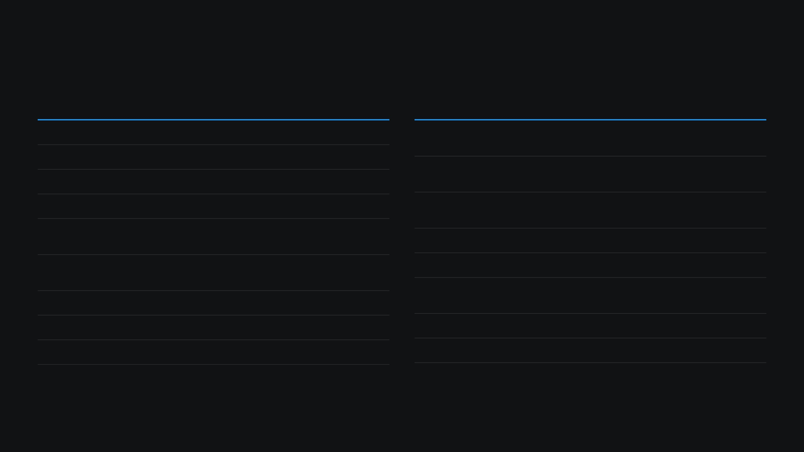
17 detection flags deployed across 3 phases cover the full spectrum of transaction risk patterns
#
Flag
Severity
Trigger
Phase
#
Flag
Severity
Trigger
Phase
1
Duplicate BIN
Critical
Same BIN >3x in 10 min
Month 1
10
BIN+Auth Correlation
High
Same BIN across >3 merchants
Month 2
2
Auth/Capture Gap
Critical
>72h gap or >15% variance
Month 1
11
Proxy/VPN/TOR
Medium
Known anonymizer IP detected
Month 3
3
Duplicate Auths
Critical
Same amount/card >2x/hour
Month 1
4
High Velocity
Critical
>200% of 30-day avg in 24h
Month 1
12
Host Capture Voids
Medium
>5% void rate on host capture
Month 3
5
Dollar Clusters
High
>10 txns within $1 of each other
Month 2
13
BIN Concentration
Medium
>40% txns from single BIN
Month 3
6
Large Anomalies
High
Single txn >3x merchant avg ticket
Month 2
14
Same Billing Address
Medium
>10 cards, same address, 24h
Month 3
15
Geographic Anomaly
Medium
Card country ≠ merchant country
Month 3
7
AVS/CVV Spikes
High
>30% mismatch rate in 1 hour
Month 2
8
Device Fingerprinting
High
>5 cards from same device
Month 2
+
Force Post Monitor
Critical
Force post >$1,000
Month 3
9
Unmatched Credits
High
Credits exceed debits >10%
Month 2
+
Deposit Spike
High
>150% of 30-day trailing avg
Month 3

Slide 13

Six named engineering sprints deliver a fully operational AI risk platform in 12 weeks
Week
Sprint Name
Key Deliverables
1–2
Infrastructure Sprint
Mreports pipeline · wc3270 service · AI agent design · Data schema
3–4
Core Engine Sprint
Rules engine · OOP Flags 1–4 · Auto hold + notifications · ACH alerts
5–6
Detection Expansion Sprint
OOP Flags 5–10 · Behavioral baselines · UW alignment · Agent build
7–8
Integration & QA Sprint
Agent integration testing · ACH SLA · Root cause audit · CB fix
9–10
ML & Agent Production Launch
Agent live 5AM · ML scoring · Flags 11–15 · VAMP/ECP module
11–12
Go-Live Sprint
ISO portal · Profitability dashboard · Loss reporting · UAT → Go-live

Slide 14
Four dependencies must be resolved before or at Week 1 kickoff to keep the 12-week timeline on track
1
TSYS API Access (Longest Lead Time)
2
ML Training Data Extraction
Mreports API credentials and wc3270 mainframe access must be provisioned before Week 1. This is the single item most likely to delay the project if not started immediately.
A minimum of 6 months of historical transaction data must be extracted and staged for model training. Data extraction should begin in parallel with project kickoff.
3
Code Freeze Enforcement
4
Card Brand Threshold Governance
All feature development must be complete by end of Week 10. A hard code freeze must be enforced to protect the 2-week UAT window in Weeks 11–12.
Netevia's internal alert thresholds (set 30–40% below official Visa/Mastercard limits) must not be overridden without Risk Management sign-off. Network reporting lag means breaches can be penalized before they are detected.

Slide 15




Ready to build — pending CTO approval and TSYS access provisioning
Engineering kickoff can begin immediately upon CTO approval
TSYS API access provisioning should be initiated in parallel today
Historical transaction data extraction to begin Week 1
Project lead and Risk liaison to be assigned before kickoff meeting
Netevia Group LLC · 2590 Hollywood Blvd, Hollywood, FL 33020
Internal — Confidential · Version 4.0

