Slide 1
Spark 2.1 MLlib includes MinHash

Slide 2
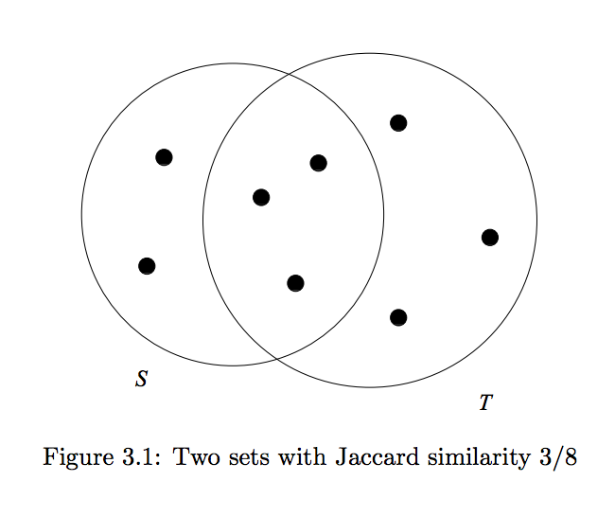
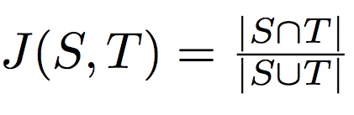
What is Jaccard Similarity

Slide 3
Text Pre-Processing
N-gram:

Slide 4

N-Grams
Notes:
English Language word count is approx:
English is not efficient (i.e. no word ‘aaaa’)
choose N to be: 6 <= N <= 9
Definition of space is not universally defined
choose N-grams of characters and not words

Slide 5
Why not Brute Force Jaccard Sim?
Let n be the number of different sets (ST) and e/a has k elements:
=> Complexity = O(n² k)
Plug In Numbers:
n ~ 10⁶ crash groups (sets)
k ~ 1000 characters
1 calculation of J(S,T) ~ 10⁻⁶ sec
Computation Time = 10⁵ sec
Even with 100 machines = 16 hrs !!!!
We need to speed it up !!!

Slide 6
MinHash Algo.

Slide 7
MinHash Calculation Strategy
Strategy:
Convert characters in ST to N-Gram (i.e. N = 6)
Convert N-Grams to Vectors (i.e. Word2Vec, dim = 2^(30))
Compute MinHash between Documents
using Vectors as the elements of the Set.

Slide 8
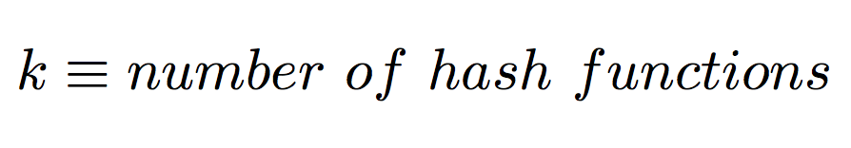
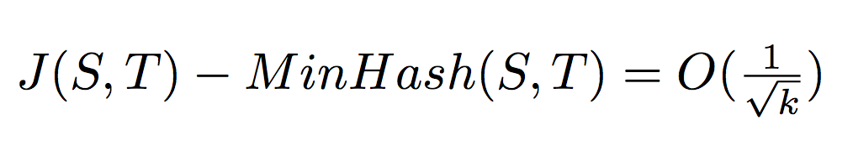
MinHash Approximation Error
Parameter:
Error (by Chernoff bound):
i.e. 400 hash function implies error of 0.05

Slide 9
Demo

Slide 10
Results

Slide 11
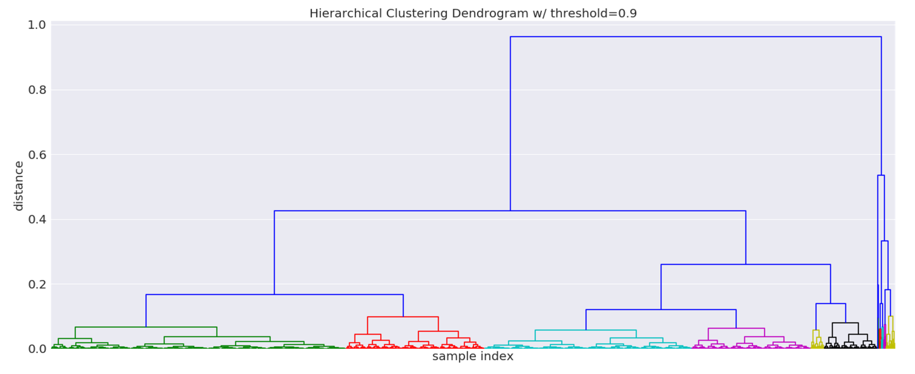
Hierarchical Cluster
150 crash groups - > 12 parent groups

Slide 12
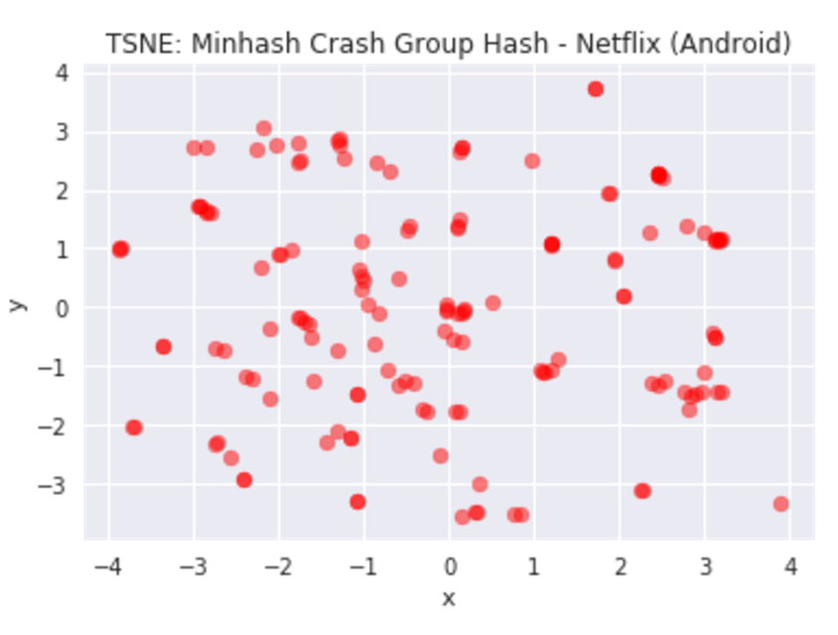
TSNE:

Slide 13
Future Considerations
Weighted MinHash:
Kernel
Inverse Frequency

