Slide 1
Weather Station Anne-Marie O’Loughlin 20086619
To Do:
Run tests to calibrate the temp data on the senseHat
Create Python code which will send the temperature, humidity and pressure to Thingspeak every 15 mins.
Create a website to display the data.
Research equations which will calculate probability of rain based on temperature, humidity and pressure – if not possible use Matlab to calculate dew point and relative humidity.
Explore graphs in Thinspeak and using Matlab – what is the best way to present the data?
Using Javascript, create a button which will allow the user to switch the data from Celsius to Fahrenheit.
Create an email alert, which will notify the user when the temperature drops below freezing.
Create an email alert to tell the user each morning how the weather is outside.
Date Filters – Can the user select a date range for the charts? How to update Thingspeak graphs based on user input

Slide 2


Process Flow:
React
Sends email when below 0 degrees
Matlab
Analysis
Present Data on a Website
Send the Data to Thingspeak using the URL
Create Graphs

Slide 3
Website Plan:
Summary
Data
°C
°F
Date From Date To
Current Weather
Temperature:
Humidity:
Pressure:

Slide 4
Website Plan:
Summary
Data
°C
°F
Date Filter
Date Time | Temperature | Humidity | Pressure

Slide 5
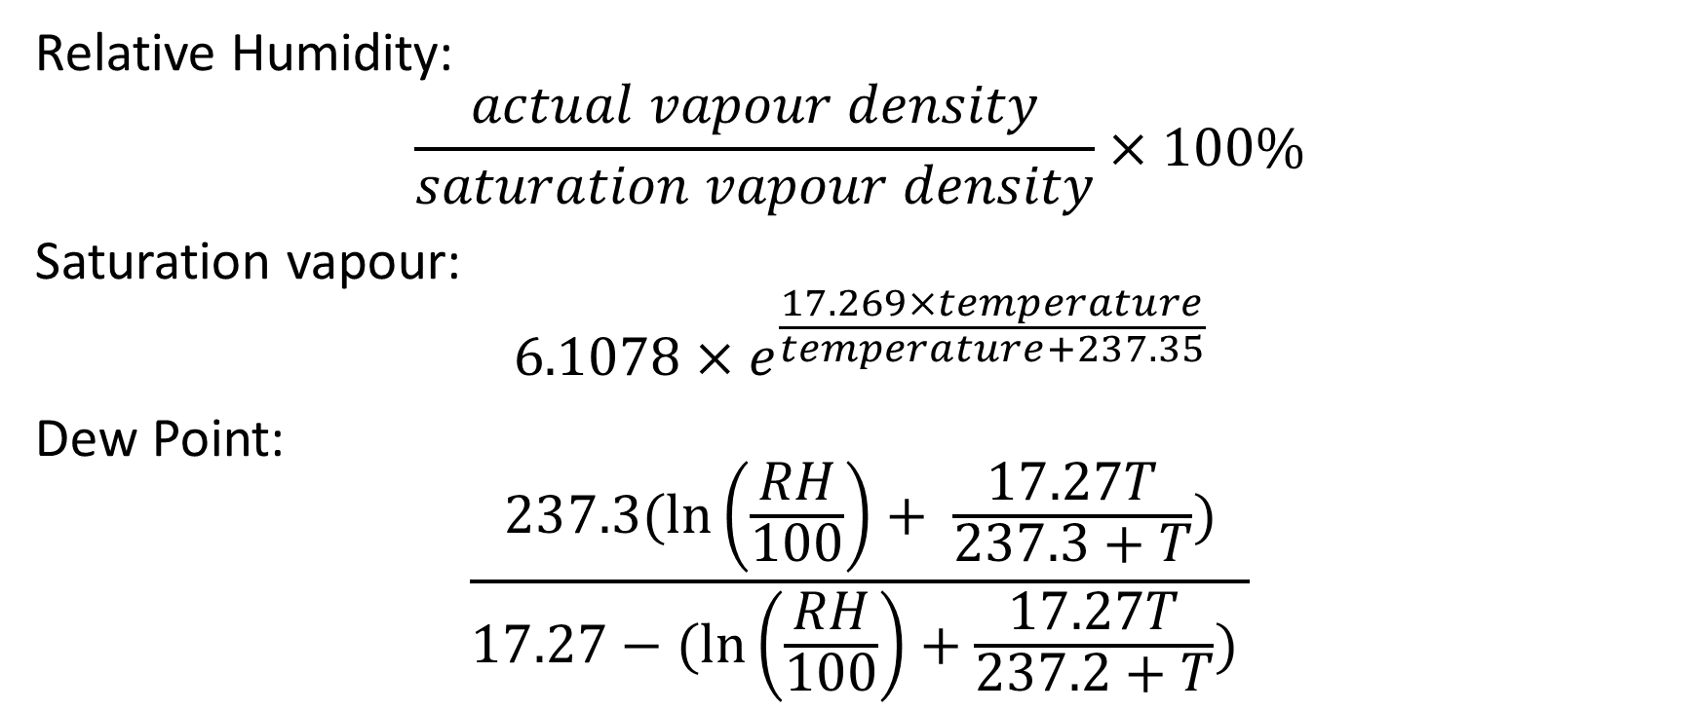
Calculations
Relative Humidity:
$$\frac{actual vapour density}{saturation vapour density}×100\%$$
Saturation vapour:
$$6.1078×e^{\frac{17.269×temperature}{temperature+237.35}}$$
Dew Point:
$$\frac{237.3(\ln\left(\frac{RH}{100}\right)+ \frac{17.27T}{237.3+T})}{17.27−(\ln\left(\frac{RH}{100}\right)+\frac{17.27T}{237.2+T}) }$$

