Slide 1


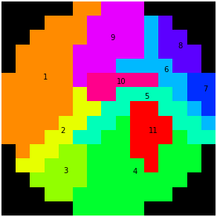
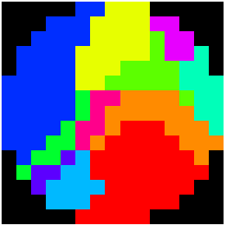
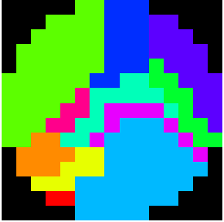
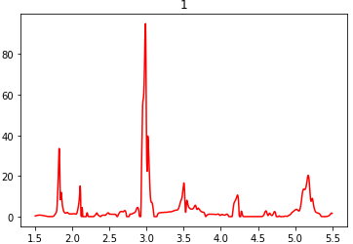
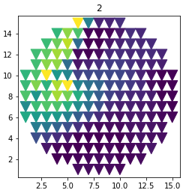
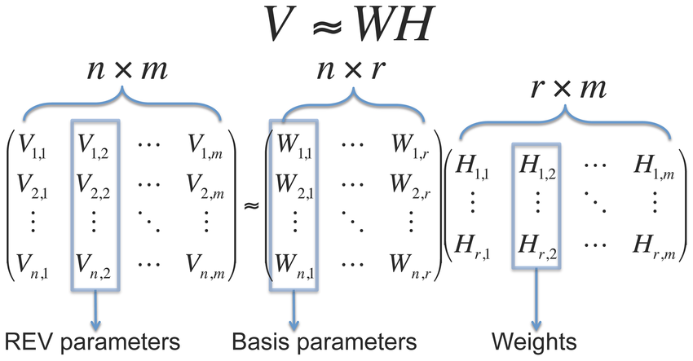
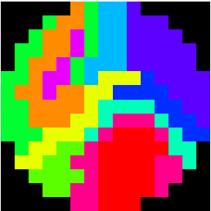
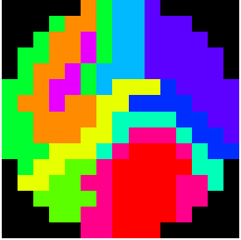
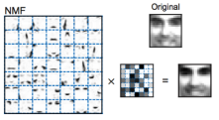
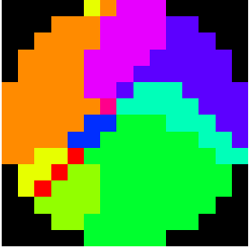
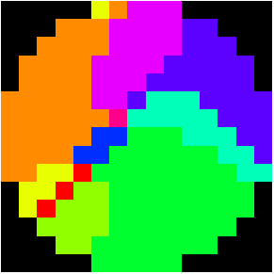
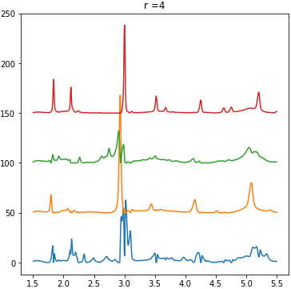
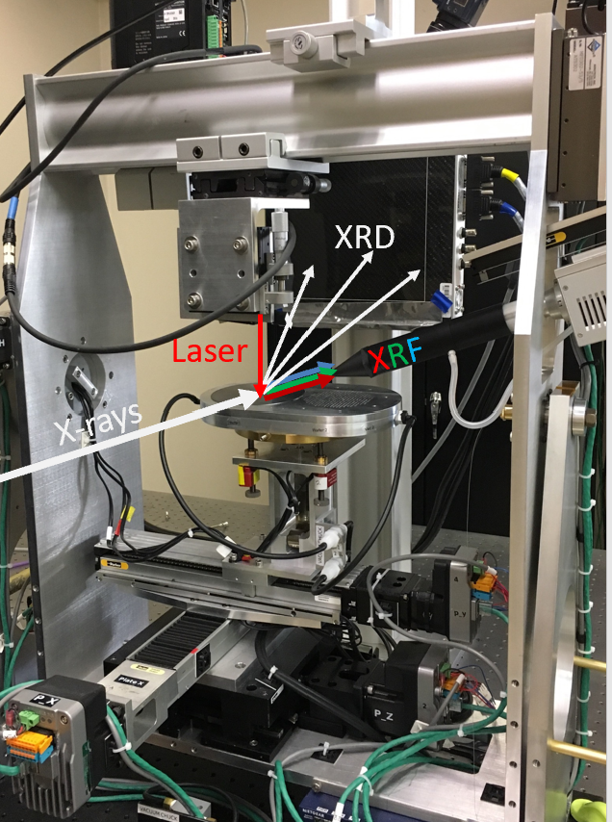
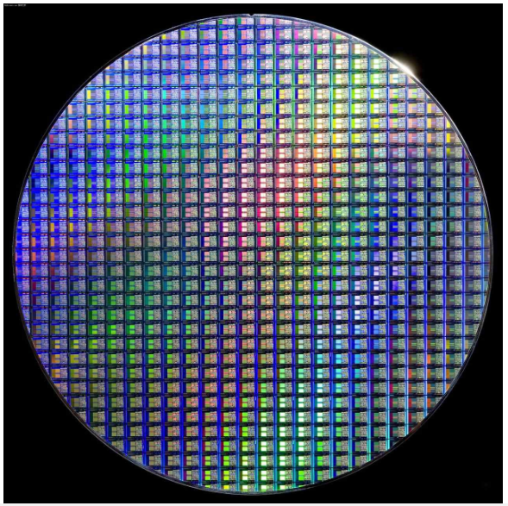
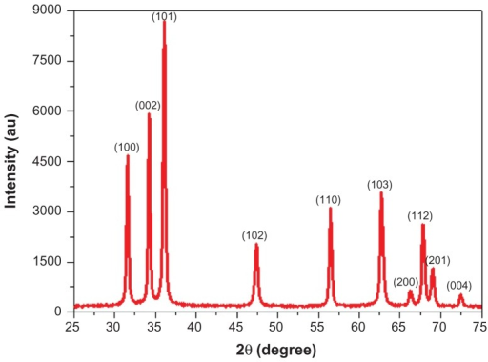
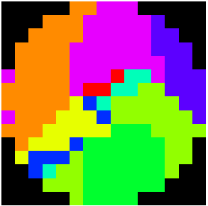
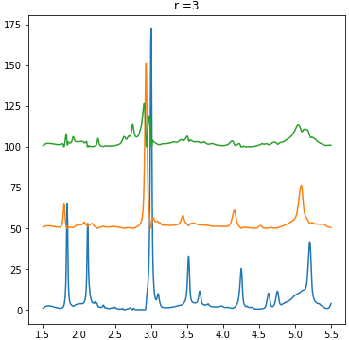
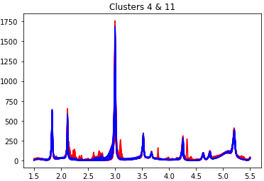
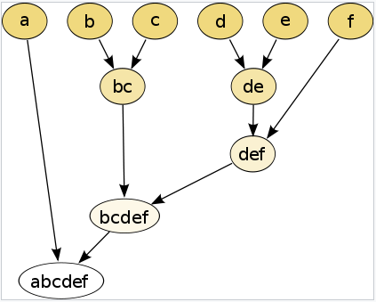
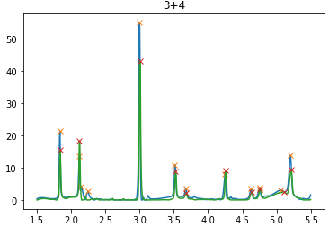
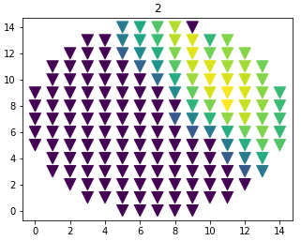
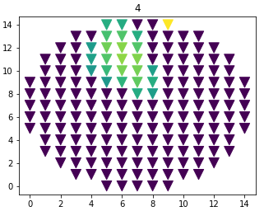
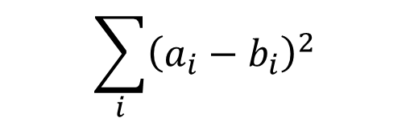








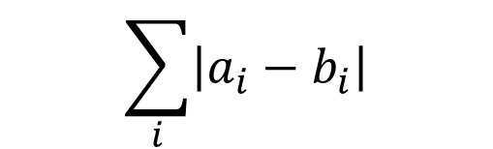

Machine Learning Methods for
Classifying X-ray Diffraction Data
Abimbola Oluwade¹, Robert Tang-Kong²⁺
¹Howard University, 2400 Sixth Street NW, Washington DC, 20059
²Stanford Synchrotron Radiation Lightsource (SSRL), SLAC National Accelerator Laboratory, 2575 Sand Hill Road, Menlo Park, CA 94025, USA.
⁺Contact: roberttk@slac.stanford.edu
Introduction
Non-Negative Matrix Factorization(NMF):
Result
Hard X-ray experiments at SSRL like Wide-Angle X-ray Scattering (WAXS) enable users to obtain X-ray Diffraction (XRD) patterns utilized for identifying the structures of crystalline materials e.g. BCC, FCC, etc. The process involves bombarding wafer plates, laden with materials, with X-ray pulses and consequently collecting the resulting diffraction patterns.
Current classification/clustering of the crystal structures involves expert, manual identification of the different phases present in the materials; this approach, therefore, takes time and may delay crystal structure identification in the absence of an expert. As a result, it is desirable to train a machine learning model to identify the crystal structures without any expert analysis.
We investigated two different methods of clustering X-ray Diffraction dataset, specifically working with the TiNiSn dataset. The first method uses Agglomerative Clustering with four (4) different dissimilarity metrics. The second method employs Non-negative Matrix Factorization (NMF) technique prominent with non-negative datasets; the inherent positive nature of XRD dataset makes NMF a good candidate.
NMF, a dimension reduction and clustering technique reduces a non-negative dataset, V(n_features, m_samples), into two smaller non-negative matrices, W&H. The columns of W depict the basis vectors/phases and the rows of H depict the weights of each phase. Past work by Stanev et. al [1] showed that NMF works well for Al-Li-Fe & Fe-Ga-Pd XRD datasets.
Agglomerative Clustering
Ground Truth: 1.00
Cosine: 0.799978
Manhattan: 0.629109
sEuclidean: 0.504296
Euclidean: 0.504296
Fig. 8 Agglomerative results with 4 dissimilarity measures
Fig. 4 NMF reduces a dataset into W & H whose product is almost equal to the dataset
Non-negative Matrix Factorization
Result show that less r values, 3-5, have higher accuracy scores
Higher values, 7-11, performed poorly since multi-phased regions extended the total number of clusters beyond the required (11)
Best 3 based on thresholds utilized:
Lee, D., Seung, H. Learning the parts of objects by non-negative matrix factorization. Nature 401, 788–791 (1999). https://doi.org/10.1038/44565
Fig. 5 Application of NMF to
image reduction
Procedures
Agglomerative Clustering
Load TiNiSn dataset (800,177)
Obtain a dissimilarity matrix by performing a pair-wise comparison of the 177 spectra using dissimilarity 1,2,3, or 4
Plot the cluster map
Perform agglomerative clustering using Scikit learn with “complete” linkage. Obtain the labels
Quantify the accuracy of the cluster by averaging Adjusted Rand Index, Adjusted mutual info score, and the Fowlkes Mallows score
0.731279
r = 4,
Correl. Threshold= 0.7, Contri. Threshold= 0.25
0.731279
r = 4,
Correl. Threshold= 0.8, Contri. Threshold= 0.25
Basis phases for r=4
e.g. Ti-Ni-Sn
Fig. 1 A hard X-ray experiment with a wafer plate laden with materials. Each point/sample on the wafer plate produces an XRD pattern
0.640481
r = 3,
Correl. Threshold= 0.7,
Contri. Threshold= 0.15
Ground Truth: 1.00
Basis phases for r=3
Fig. 9 Best 3 NMF results with their basis phases
Research
Challenges & Future work
Scope & Objective
Non-Negative Matrix Factorization
Subtle but significant differences between spectra make it hard to separate some clusters
Current models cannot separate cluster 11 from 4; squaring and taking log of the dataset was futile due to the huge similarity between the spectra in the two clusters.
Assess clusters 4&11 by trying other data techniques on the dataset.
Expand the dataset: Implement the algorithm on another TiNiSn dataset and also explore other materials’ datasets.
Train a machine learning model to classify a TiNiSn XRD dataset i.e. group the materials on the wafer plate into clusters corresponding to their crystal structures.
Load TiNiSn dataset (800,177)
Vary r, 3:11. For each r, perform NMF on the dataset using Scikit learn. Obtain W & H
*Check for peak shifting by comparing columns of W (phases) with one another, w_{i} , w_{j} (where i ≠ j) using Pearson correlation. Extract the phases/columns with correlation ≥ [0.7, 0.8, 0.9]
*Check if the extracted spectra from above have the same number of peaks. Any phases satisfying the above and this condition is labeled as peak shifted and only one phase/column is kept
For each column of the weight matrix, H, remove all phases contributing ≤ [0.15, 0.2, 0.25]. Then remove the least contributing phases till 3 are left
Plot the cluster map
Quantify cluster accuracy by averaging Adjusted Rand Index, Adjusted mutual info score, and the Fowlkes Mallows score
Ground Truth analysed by an expert
Ground Truth
Fig 10. Clusters 4 & 11 from Ground Truth
Fig. 2 Main goal of this research
Methods
Agglomerative Clustering:
Agglomerative clustering is a bottom-up hierarchical clustering that groups datapoints based on their similarities defined by a (dis)similarity measure.
The four (4) dissimilarity measures employed in this work are given below:
Cosine: 2. Manhattan:
3. Euclidean: 4. Squared Euclidean:
Conclusion
This research shows a couple of successful results:
TiNiSn XRD dataset can be classified up to an accuracy of 0.8.
Further refinements of the algorithm could improve the accuracy e.g. training the algorithm to spot cluster 11.
This approach could be employed on XRD datasets to obtain a firsthand classification of materials where expert classification would take time.
https://en.wikipedia.org/
wiki/Hierarchical_clustering
Mean energy of each time slice
Fig. 3 Bottom-up hierarchy with the closest grouped first
(*) optional step
Acknowledgements
$$1−\frac{\sum_{i=1}^{n}{a_{i}b_{i}}}{\sqrt{\sum_{i=1}^{n}{a_{i}^{2}}}\sqrt{\sum_{i=1}^{n}{b_{i}^{2}}}}$$
$$\sum_{i}{\left|a_{i}−b_{i}\right|}$$
Work at the LCLS is supported by the U.S. Department of Energy, Office of Science, under Contract No. DE-AC02-76SF00515.
Acknowledgements go Alan Fry for the opportunity to be here, and Robert Tang-Kong for guidance and mentorship throughout this research.
$$\sqrt{\sum_{i}{{\left(a_{i}−b_{i}\right)}^{2}}}$$
$$\sum_{i}{{\left(a_{i}−b_{i}\right)}^{2}}$$
Fig. 6 An example of peak shifted phases
Fig. 7 A typical point with more than one phase contribution
Date: 08/14/2020
1. Stanev et. al “Unsupervised phase mapping of X-ray diffraction data by nonnegative matrix factorization integrated with custom Clustering”

