Slide 1
NMF Clustering on X-ray Diffraction Patterns
Abimbola Oluwade | 07/31/2020

Slide 2
Outline
Background info and work
NMF and methods
Results so far
Future work

Slide 3
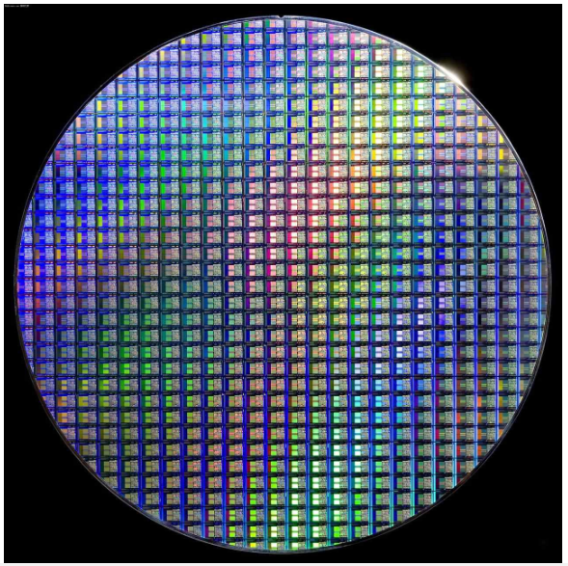
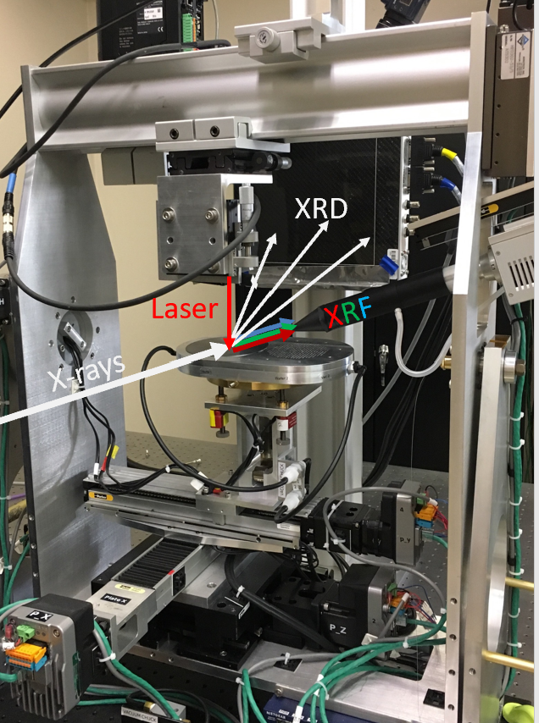
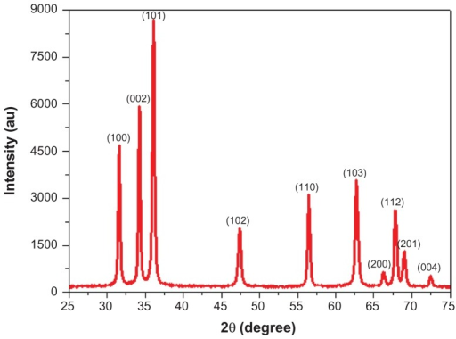
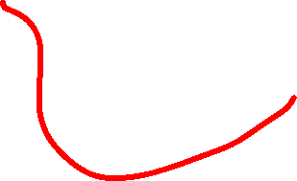




Background
e.g. Al-Fe-Sn
X-ray experiments like those at SSRL help produce XRD patterns for crystal structure identification in materials
Non-negative Matrix Factorization(NMF) is a dimensional reduction and clustering technique used for datasets with positive values like XRD datasets

Slide 4
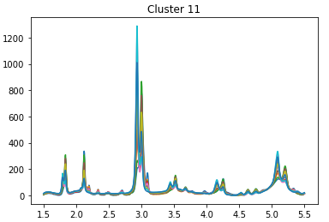
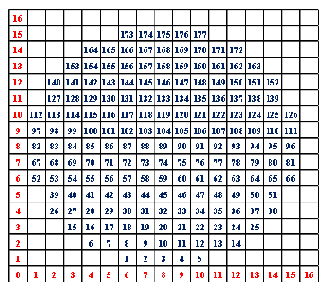
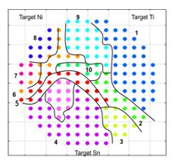
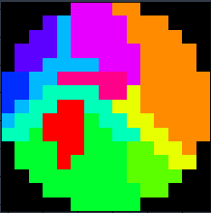


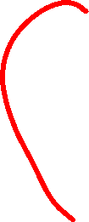




Objective
Train computer to divide the materials on the wafer plates into their different clusters
Some clusters could be single, double or triple phased e.g BCC, FCC+BCC, etc
Work with TiNiSn_500C XRD dataset for now
BCC or BCC+FCC?
Ground Truth

Slide 5
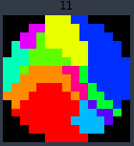
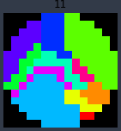
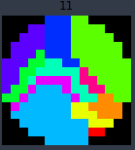
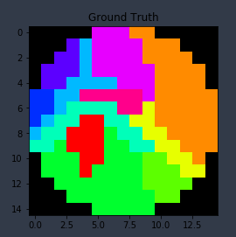
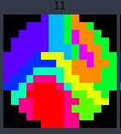

Peripheral Work
First Attempt: Agglomerative Clustering with different distance metrics
Assessment score: average of adjusted mutual info, adjusted rand index, and Fowlkes mallows scores (AMI, ARI & FM scores)
Cosine: 0.799978 Average Diff.: 0.642952 Manhattan: 0.629109
Ground Truth :1.00
Turns out Alexander had gotten these ☹
sEuclidean: 0.504296 Euclidean: 0.504296

Slide 6
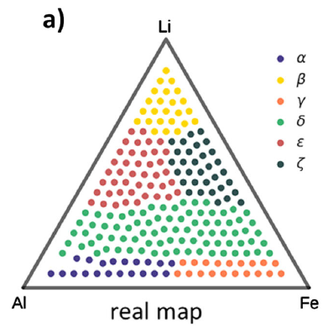
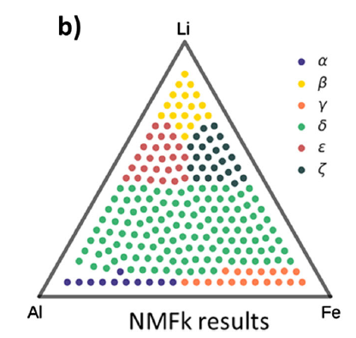
Why NMF?
NMF has been reported to work well for Al-Li-Fe and Fe-Ga-Pd XRD datasets (Stanev et. al)
Will it improve the assessment score for TiNiSn_500C dataset?
Stanev et. al “Unsupervised phase mapping of X-ray diffraction data by nonnegative matrix factorization integrated with custom Clustering”

Slide 7
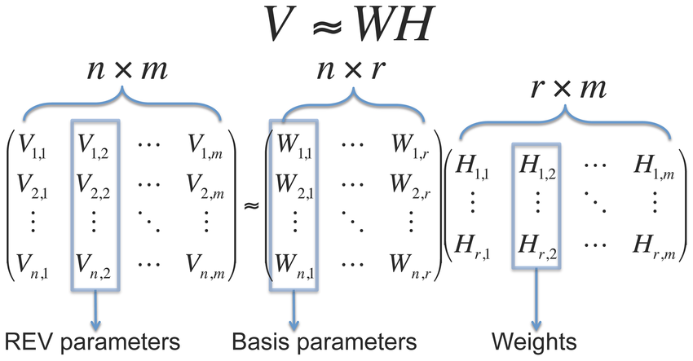
NMF as a dimension reduction technique
NMF is a dimension reduction technique just like Principal Component Analysis (PCA)
However it reduces a matrix V (n_features × m_samples) to 2 matrices: W(n_features×r) and H(r×m_samples).
r is smaller than both n and m hence dimension reduction
Main idea: Find W and H such that

Slide 8

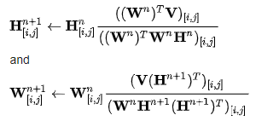
NMF Solution Implementation
NMF aims to find the best W and H by iteratively updating them until their product is very similar to V starting with random W and H
Frobenius Norm method
Minimize
Update:
Note that updates are done element-wise [i,j] and solution is not unique
(Similar to Euclidean Distance)
Coefficients

Slide 9
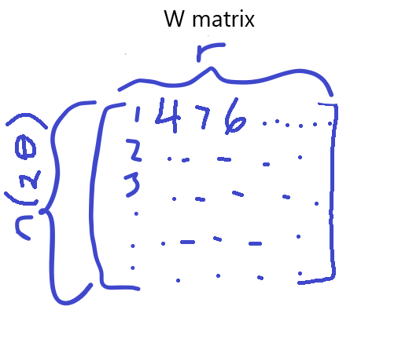
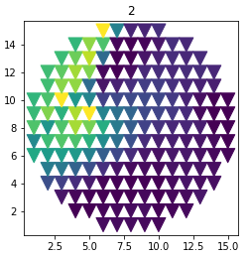
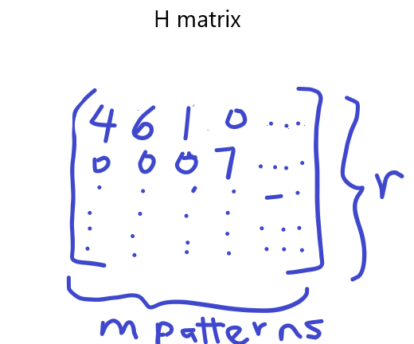
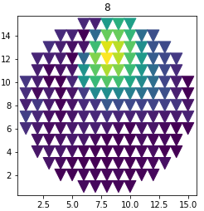
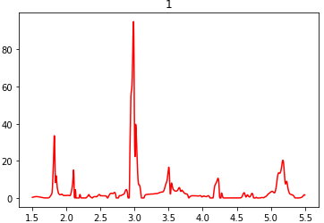
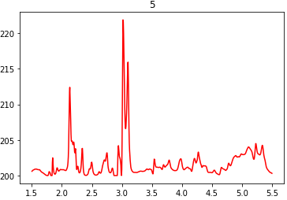




Clustering with NMF/Visualizing W and H matrices
Each column of the W matrix represents 1 distinct phase so r = no. of phases
Each row of the H matrix represents the weight/abundance of each phase in our wafer map
Multiphased region is a cluster

Slide 10
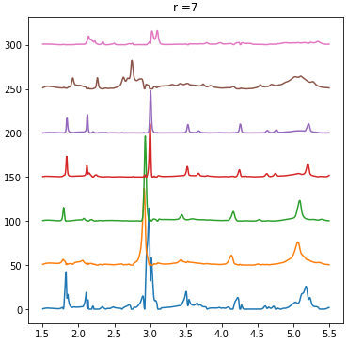
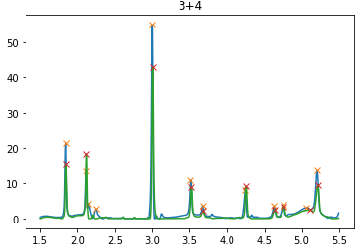
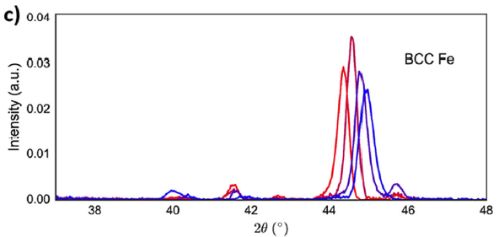
Procedures
Since r is unknown, try r = 3:11 to obtain many solutions
For each r, check for peak shifting among the r distinct phases
Pearson Correlation on each pair ≥ [0.7,0.8,0.9]
Any pair in criteria i. should have same no. of peaks above 2 a.u.
Combine any peak shifted phase(s) found in 2.

Slide 11
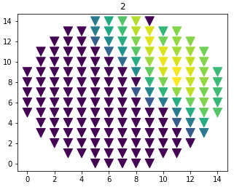
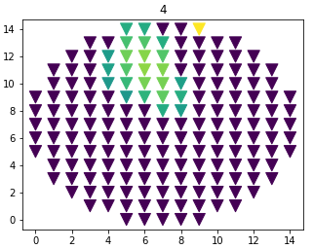
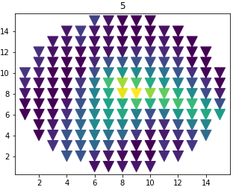
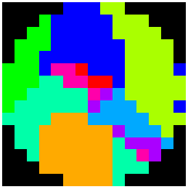
Procedures contd.
At every point, remove any phase contributing ≤ [0.08,0.15,0.25]
At every point, take the 3 most contributing phase if necessary
Plot the wafer map noting that any overlapping phases is a separate cluster (multiphase)

Slide 12
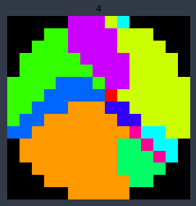
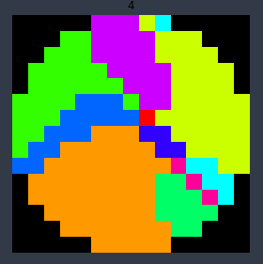
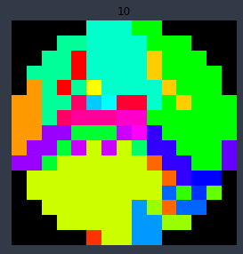
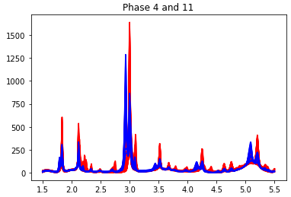

Results and Observation
The best 4 so far:
r = 4, Correlation Threshold=0.7, Contribution Threshold= 0.25
r = 4, Correlation Threshold=0.8, Contribution Threshold = 0.25
r = 4, Correlation Threshold=0.9, Contribution Threshold = 0.25
r = 10, Correlation Threshold=0.9, Contribution Threshold = 0.15
Ground Truth:1.00 0.731279 0.731279 0.731279 0.646537
So far the algorithm is not detecting that cluster
Is still not better than Cosine!

Slide 13
Future Work
Improve Algorithm
Look into NMFk algorithm to find best r
Adjust the same peak threshold to account for different max. peaks
Expand dataset
TiNiSn_600C dataset
Citrination website

Slide 14
Q&A

