Slide 1
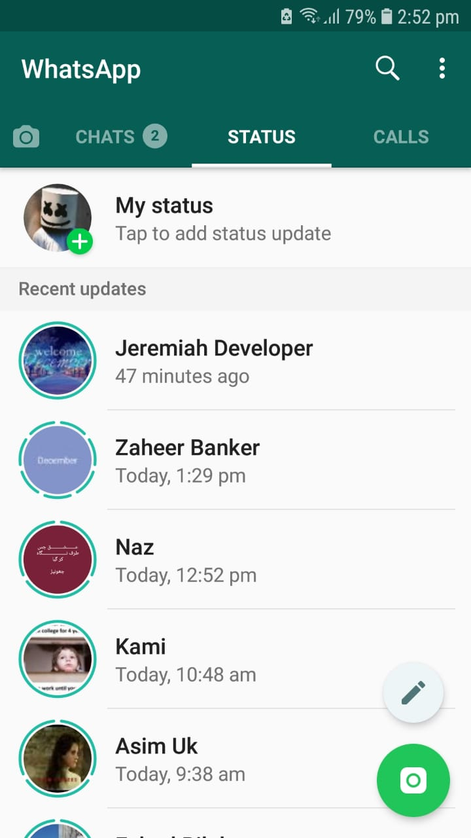
Click
Payed
COIN PROCESSING IN JUST ONE CLICK
Android | iOS | Web
www.ClickPayed.com

Slide 2

Sign In
to your ClickPayed account
Registered Mobile Number
Enter Password
Forgot Password? Click Here
Don’t have an account? Signup for a new eWallet account Here
www.ClickPayed.com

Slide 3
Sign Up
for a new ClickPayed account
Full Name
Mobile Number
Choose Country
Set New Password
Re-Type New Password
I agree to the Terms & Conditions of use
Register Now
www.ClickPayed.com

Slide 4

Sign Up
for a new eWallet account
Full Name
Mobile Number
YOUR REGISTRATION IS COMPLETE
Choose Country
COMPLETE PROFILE
Set New Password
SKIP >>>
Re-Type New Password
Register Now
www.ClickPayed.com

Slide 5







Available Balance
PKR 2,000.00
1
20,000
Play against your friends
& Win real time cash
NOTICE BOARD
Currently we are accepting balance top-ups via easypaisa and jazzcash only. For any assistance, please reach us via our customer service WhatsApp
BUY COINS
REDEEM COINS
TRANSFER COINS
TOPUP YOUR WALLET
REQUEST A WITHDRAWAL
VIEW TRANSACTION HISTORY
VIEW AVAILABLE GAMES
In case you do not receive your deposit in your wallet account in 2 hours, send us a message on below mentioned WhatsApp with your TRX number
Get in Touch
www.ClickPayed.com

Slide 6
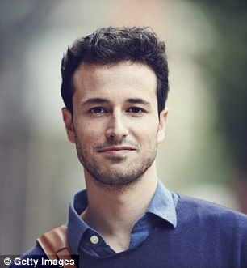
Salman Ahmad
Member Since 13:30 July 7th 2020
Total Coins Earned: 15000
Edit Profile
Personal
Achievements
Account Name
Wallet Balance
Salman Ahmad
PKR 2000
Registered Mobile No.
Email Address
03006543216
salman123@gmail.com
City
Country
Lahore
Pakistan
Preferred Payout Method
Easypaisa
JazzCash
Note: Easypaisa or Jazzcash accounts must be registered with the same mobile number as ClickPayed wallet account
www.ClickPayed.com

Slide 7
Salman Ahmad
Member Since 13:30 July 7th 2020
Total Coins Earned: 15000
Edit Profile
Personal
Achievements
Coins Spent
Coins Earned
Carom Disc
8-Ball Pool
Battle Field
Sea Battle
Tic-Tac Toe
200
100
50
20
180
1800
200
60
100
500
Total
450
2660
www.ClickPayed.com

Slide 8
Available Balance
PKR 2,000.00
1
20,000
VIEW TRANSACTION HISTORY
Date/Time Trx # Cr Db Balance
14/11 1:20pm 12124653 200 0 1800
14/11 1:20pm Coin Purchase 200 20 1800 14/11 1:20pm 12124653 200 100 1800 14/11 1:20pm 12124653 200 0 1800 14/11 1:20pm 12124653 200 0 1800 14/11 1:20pm 12124653 200 0 1800 14/11 1:20pm 12124653 200 0 1800 14/11 1:20pm 12124653 200 50 1800 14/11 1:20pm 12124653 200 0 1800 14/11 1:20pm 12124653 200 0 1800 14/11 1:20pm 12124653 200 200 1800 14/11 1:20pm 12124653 200 0 1800 14/11 1:20pm 12124653 200 0 1800 14/11 1:20pm 12124653 200 0 1800 14/11 1:20pm 12124653 200 0 1800
Show More Entries
In case you do not receive your deposit in your wallet account in 2 hours, send us a message on below mentioned WhatsApp with your TRX number
Get in Touch
www.ClickPayed.com

Slide 9
Available Balance
PKR 2,000.00
1
20,000
REQUEST A WITHDRAWAL
Choose an Amount to Withdraw
You can only make a withdrawal in multiples of 100.
For Example 100, 200, 300, 400, 500 etc.
PKR 200.00
Remaining Balance: PKR 1800.00
ClickPayed charges a service fee of 20% on all withdrawal requests
SUBMIT WITHDRAWAL REQUEST
All withdrawal requests will be credited to your preferred payout account. You can change your preferred payout account from your profile page
IMPORTANT
Due to a high volume of transactions, withdrawals requests may take up to 24hours to complete. Incase if you face any difficulty, please feel free to reach us on the given WhatsApp number below
In case you do not receive your deposit in your wallet account in 2 hours, send us a message on below mentioned WhatsApp with your TRX number
Get in Touch
www.ClickPayed.com

Slide 10
Available Balance
PKR 2,000.00
1
20,000
BUY COINS
Coin Rate | PKR 1 = 10 Coins
ENTER AMOUNT TO PURCHASE COINS
PKR
100
1000
PURCHASE COINS
Remaining Balance: PKR 1800.00
IMPORTANT
Due to a high volume of transactions, withdrawals requests may take up to 24hours to complete. Incase if you face any difficulty, please feel free to reach us on the given WhatsApp number below
In case you do not receive your deposit in your wallet account in 2 hours, send us a message on below mentioned WhatsApp with your TRX number
Get in Touch
www.ClickPayed.com

Slide 11
Available Balance
PKR 2,000.00
1
20,000
REDEEM COINS
Coin Rate | 10 Coins = PKR 1
ENTER AMOUNT TO PURCHASE COINS
1000
PKR
100
REDEEM COINS
Remaining Balance: PKR 1800.00
IMPORTANT
Due to a high volume of transactions, withdrawals requests may take up to 24hours to complete. Incase if you face any difficulty, please feel free to reach us on the given WhatsApp number below
In case you do not receive your deposit in your wallet account in 2 hours, send us a message on below mentioned WhatsApp with your TRX number
Get in Touch
www.ClickPayed.com

Slide 12
Available Balance
PKR 2,000.00
1
20,000
TRANSFER COINS
TRANSFER DETAILS
Enter Number of Coins
Enter the number of coins you wish to transfer
Registered Mobile Number
Enter a ClickPayed registered mobile number
SEARCH
Recipient Registered Name
TRANSFER COINS
Remaining Coins: 18000
IMPORTANT
Due to a high volume of transactions, withdrawals requests may take up to 24hours to complete. Incase if you face any difficulty, please feel free to reach us on the given WhatsApp number below
In case you do not receive your deposit in your wallet account in 2 hours, send us a message on below mentioned WhatsApp with your TRX number
Get in Touch
www.ClickPayed.com

Slide 13

Available Balance
PKR 2,000.00
1
20,000
TRANSFER COINS
PLEASE CONFIRM THAT YOU WISH TO TRANSFER
TRANSFER DETAILS
1200
Enter Number of Coins
Enter the number of coins you wish to transfer
to
Registered Mobile Number
Haider Khan
03006524314
Enter a ClickPayed registered mobile number
YOUR REMAINING COINS WILL BE
20,000
Recipient Registered Name
TRANSFER COINS
TRANSFER NOW
CANCEL REQUEST
Remaining Coins: 18000
IMPORTANT
Due to a high volume of transactions, withdrawals requests may take up to 24hours to complete. Incase if you face any difficulty, please feel free to reach us on the given WhatsApp number below
In case you do not receive your deposit in your wallet account in 2 hours, send us a message on below mentioned WhatsApp with your TRX number
Get in Touch
www.ClickPayed.com

Slide 14
Available Balance
PKR 2,000.00
1
20,000
TRANSFER COINS
TRANSFER DETAILS
Enter Number of Coins
Your coin transfer request is complete
Enter the number of coins you wish to transfer
Registered Mobile Number
Enter a ClickPayed registered mobile number
YOUR REMAINING COINS ARE
20,000
Recipient Registered Name
TRANSFER COINS
OKAY!!!
Remaining Coins: 18000
IMPORTANT
Due to a high volume of transactions, withdrawals requests may take up to 24hours to complete. Incase if you face any difficulty, please feel free to reach us on the given WhatsApp number below
In case you do not receive your deposit in your wallet account in 2 hours, send us a message on below mentioned WhatsApp with your TRX number
Get in Touch
www.ClickPayed.com

Slide 15

Available Balance
PKR 2,000.00
1
20,000
TOPUP YOUR WALLET
In order to make new deposits, you need to have an easypaisa / jazzcash wallet account. Using your easypaisa account, you can deposit or withdraw cash from ClickPayed wallet
To make a new deposit, just follow 3 simple steps below
STEP 1:
STEP 2:
STEP 3:
STEP 4:
Download easypaisa / jazzcash app & Create your mobile account
Load cash into your easypaisa / jazzcash mobile wallet account through you nearest easypaisa / jazzcash outlet
Use mobile Transfer to send cash from easypaisa / jazzcash to 0300*******
Receive cash in your ClickPayed wallet account & Login to your preferred game and buy coins using ClickPayed wallet
Get Easypaisa APP
Get JazzCash App
In case you do not receive your deposit in your wallet account in 2 hours, send us a message on below mentioned WhatsApp with your TRX number
Get in Touch
www.ClickPayed.com

Slide 16
Last logged in at
1310 PST July 22nd 2020
Lahore, Pakistan
1
ADMIN DASHBOARD
MAKE A NEW DEPOSIT
PROCESS WITHRAWALS
SET NEW RULES
CREATE NEW NOTIFICATION
Password
Total Deposits
PKR 12,000,000
Show Details
Deposit Transactions
Withdrawal Transactions
Coin Conversion History
Coin Redeem History
Show No of Coins being used in Games
Total Withdrawals
Total Fee Charged: PKR 540,000
Show Ledger
PKR 2,700,000
Show Details
Total Coins Converted
120,000,000
Show Details
Total Coins Redeemed
80,000,000
Show Details
Total Coins in Circulation
40,000,000
Show Details
2019 Broker92 – All rights reserved

Slide 17
Last logged in at
1310 PST July 22nd 2020
Lahore, Pakistan
1
MAKE A NEW DEPOSIT
Enter a ClickPayed Registered Number
SEARCH
SEARCH RESULTS
Account Name
Registered Mobile Number
Arsalan Ahmad
030046352725
City
Country
Lahore
Pakistan
Select Beneficiary
Enter Amount Here
Enter the Amount to be Deposited
DEPOSIT NOW

Slide 18
Last logged in at
1310 PST July 22nd 2020
Lahore, Pakistan
1
MAKE A NEW DEPOSIT
Enter a ClickPayed Registered Number
SEARCH
PLEASE CONFIRM THAT YOU WISH TO DEPOSIT
SEARCH RESULTS
Account Name
Registered Mobile Number
PKR 2000.00
Arsalan Ahmad
030046352725
to
City
Country
Lahore
Pakistan
Haider Khan
03006524314
Select Beneficiary
DEPOSIT NOW
CANCEL REQUEST
Enter Amount Here
Enter the Amount to be Deposited
DEPOSIT NOW

Slide 19
Last logged in at
1310 PST July 22nd 2020
Lahore, Pakistan
1
PROCESS WITHRAWALS
VIEW | All Withdrawal Requests
Date | Time Account No. Amount
22/11/2020 | 1327 03006562423 300
22/11/2020 | 1327 03006562423 300
22/11/2020 | 1327 03006562423 300
22/11/2020 | 1327 03006562423 300
22/11/2020 | 1327 03006562423 300
22/11/2020 | 1327 03006562423 300
22/11/2020 | 1327 03006562423 300
22/11/2020 | 1327 03006562423 300
Pending
Pending
Approved
Rejected
Pending
Pending
Pending
Pending

Slide 20
Last logged in at
1310 PST July 22nd 2020
Lahore, Pakistan
1
PROCESS WITHRAWALS
ENTER TRX ID HERE
VIEW | All Withdrawal Requests
FOR AMOUNT
PKR 2000.00
Date | Time Account No. Amount
22/11/2020 | 1327 03006562423 300
22/11/2020 | 1327 03006562423 300
22/11/2020 | 1327 03006562423 300
22/11/2020 | 1327 03006562423 300
22/11/2020 | 1327 03006562423 300
22/11/2020 | 1327 03006562423 300
22/11/2020 | 1327 03006562423 300
22/11/2020 | 1327 03006562423 300
FOR THE WALLET WITHDRAWAL REQUEST OF
Pending
Pending
Haider Khan
03006524314
Approved
Rejected
AVAILABLE FUNDS
PKR 5000.00
Pending
Pending
Pending
WITHDRAWAL REQUESTED AT
2250 PST | MAY 20TH 2020
Pending
Optional Note
Type Here
APPROVED
REJECTED

Slide 21

Last logged in at
1310 PST July 22nd 2020
Lahore, Pakistan
1
PROCESS WITHRAWALS
VIEW | All Withdrawal Requests
Date | Time Account No. Amount
22/11/2020 | 1327 03006562423 300
22/11/2020 | 1327 03006562423 300
22/11/2020 | 1327 03006562423 300
22/11/2020 | 1327 03006562423 300
22/11/2020 | 1327 03006562423 300
22/11/2020 | 1327 03006562423 300
22/11/2020 | 1327 03006562423 300
22/11/2020 | 1327 03006562423 300
Pending
PKR 2000.00
Pending
Approved
CREDITED TO EXTERNAL WALLET ACCOUNT OF
Rejected
Pending
Haider Khan
03006524314
Pending
Pending
Pending
WITHDRAWAL PROCESSED AT
2255 PST | MAY 20TH 2020
OKAY!!!

