Slide 1
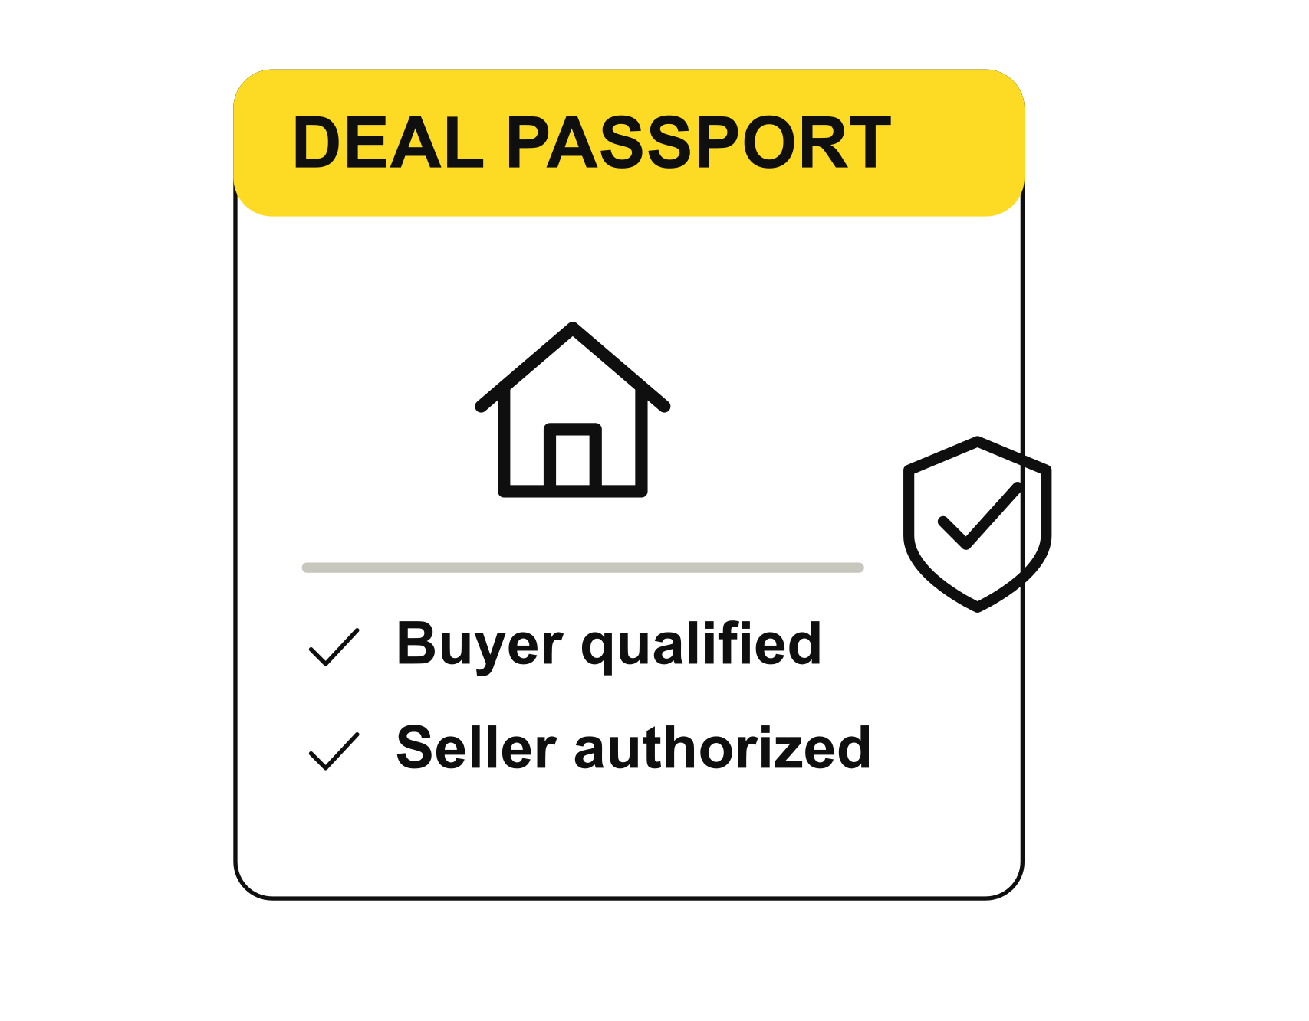



HACKMERIDIAN 2026 · LISBON
PLATFORM 01 / 07
GENESIS / STELLAR UNLOCKED
DEAL
PASSPORT
Private qualification. Mutual consent. Real Testnet.
EasyAI / Oleksiy Onishchenko / Solo builder
TESTNET MVP / 26 OCT 2026
#HackMeridian26
© 2026 HackMeridian · Lisbon
Notes:
Deal Passport / EasyAI / Oleksiy Onishchenko, solo builder. Live demo: https://dealpassport.aonishchenko33.workers.dev. Repository: https://github.com/aonishchenko/dealpassport.
Implemented synthetic Testnet MVP: browser Groth16 proof generation; issuer-root membership, threshold, expiry, deal and recipient binding; authenticated property marketing-authority attestation; both participants’ consents; protected dossier API with fresh onchain reads; expiry, replay, forgery, withdrawal and revocation checks; session-private operation history and expired-session recovery. Browser proof times of 1.6–2.6 seconds were observed on this device, not a performance guarantee. Source evidence: docs/evidence/gate-a.json through gate-e.json, demo-feedback.json, docs/BUILD_LOG.md, worker/index.ts, worker/chain.ts and src/App.tsx. All identities, credentials and property examples are synthetic. Stellar verification is genuine. The single-party setup and educational verifier remain unaudited.
No pre-event Deal Passport code, designs or assets. Third-party tools and educational verifier are attributed in docs/THIRD_PARTY.md. Original work retains its root license; dependencies retain their respective licenses.
Post-MVP only by Oleksiy’s decision on 26 October 2026: real identity and property-authority providers, a controlled human-reviewed property pilot, and migration to non-GPL proving components. Same-deal proof renewal is a proposed policy improvement and is not implemented; the current holder/deal nullifier is consumed once, buyer access ends at the current five-minute epoch boundary, and a fresh demo deal is required after expiry. Seller authority and sessions expire within 20 minutes. No real bank, registry, Didit or Stripe integration is claimed.

Slide 2
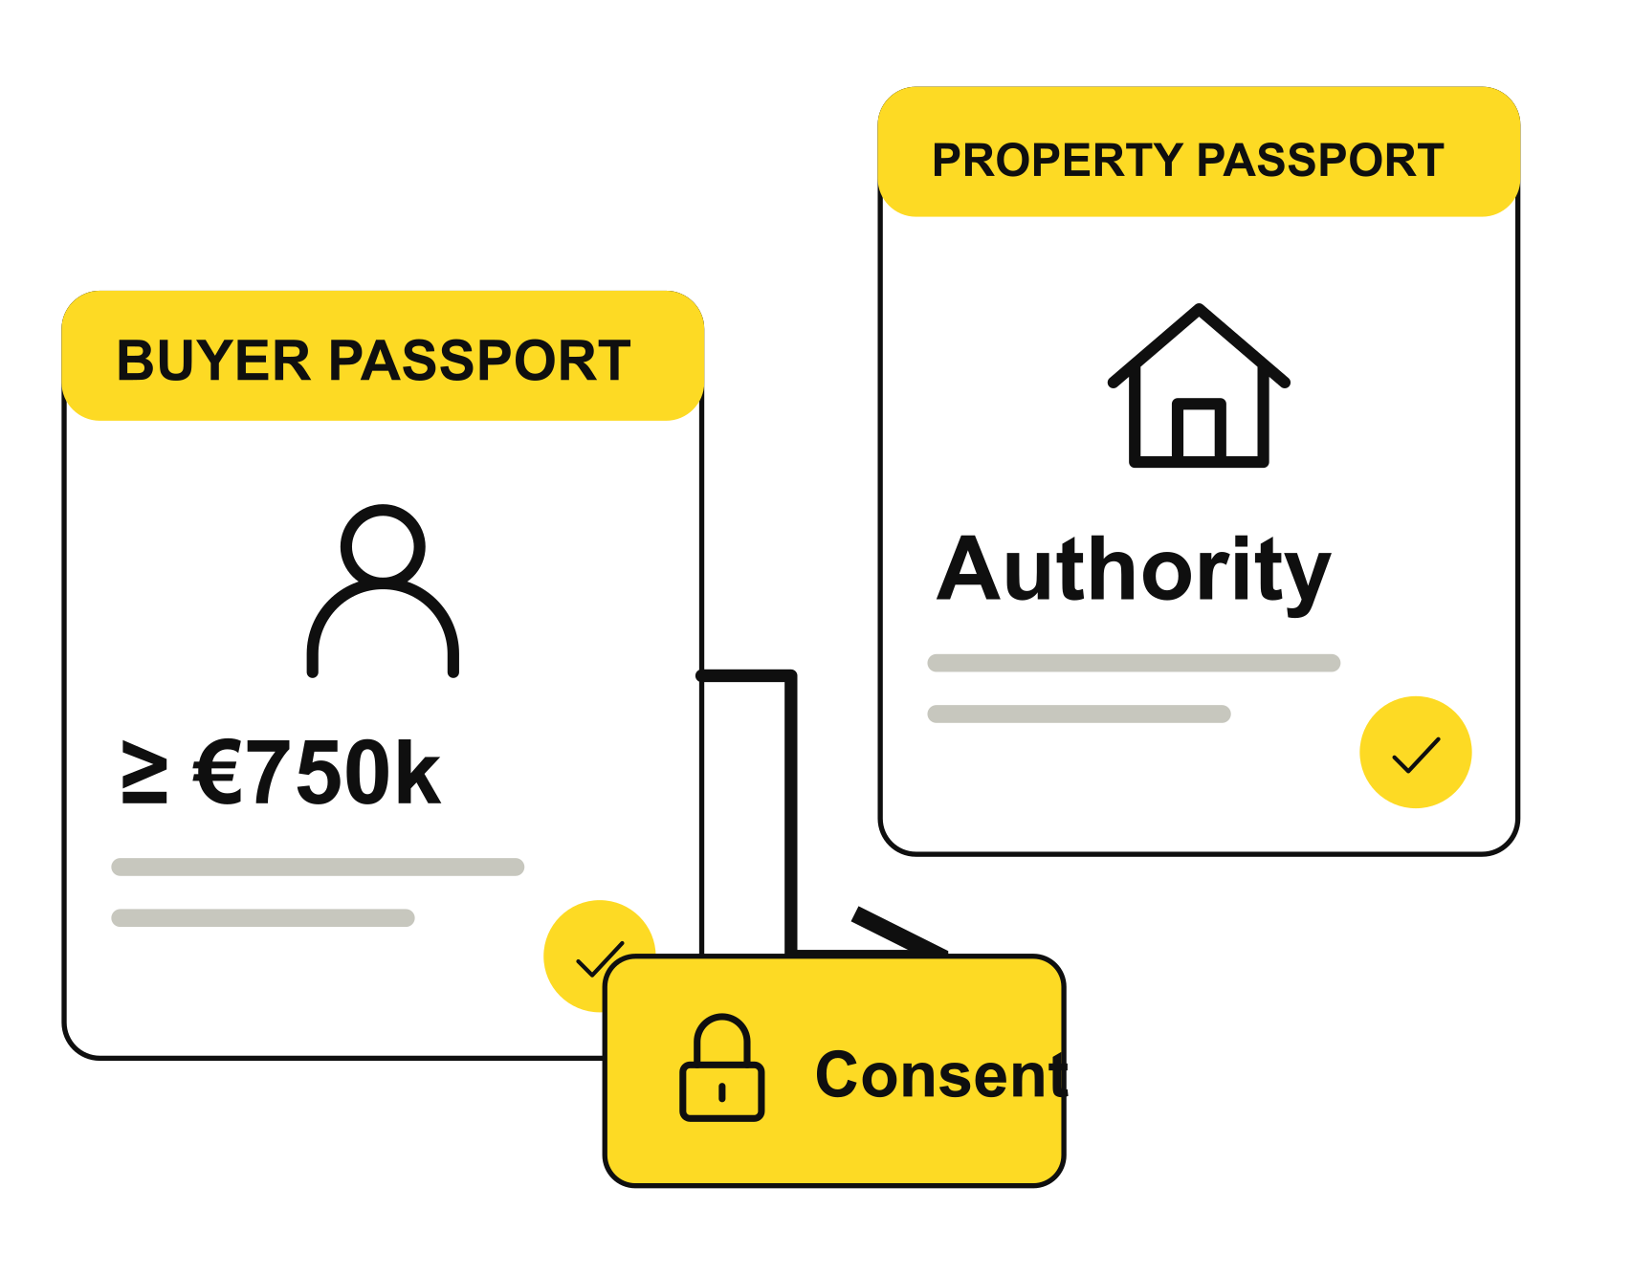

PLATFORM 02 / 07
HACKMERIDIAN 2026 · LISBON
NEXT ▸ PMF
PITCH STEP 01 / 04
THE SOLUTION
Two passports. Mutual consent. One private introduction.
Buyer Passport: prove ≥ €750k while keeping the exact balance private.
Property Passport: issuer-attested marketing authority for this deal.
Deal Passport: both passports and both consents unlock the dossier.
€900k buyer qualifies; underfunded and expired credentials fail.
The dossier opens only after both participants consent.
Live Testnet MVP / Synthetic credentials / No real bank or registry integration
© 2026 HackMeridian · Lisbon · #HackMeridian26
Notes:
The seller requires €750,000. A synthetic financial issuer certifies a private €900,000 credential. The browser proves issuer membership and the threshold without placing the balance or witness onchain. The authorized property issuer attests AUTHORIZED_TO_MARKET for this deal, which does not assert ownership, title or planning approval. Both consents and fresh qualification checks are necessary before the Worker returns the synthetic dossier.
Implemented synthetic Testnet MVP: browser Groth16 proof generation; issuer-root membership, threshold, expiry, deal and recipient binding; authenticated property marketing-authority attestation; both participants’ consents; protected dossier API with fresh onchain reads; expiry, replay, forgery, withdrawal and revocation checks; session-private operation history and expired-session recovery. Browser proof times of 1.6–2.6 seconds were observed on this device, not a performance guarantee. Source evidence: docs/evidence/gate-a.json through gate-e.json, demo-feedback.json, docs/BUILD_LOG.md, worker/index.ts, worker/chain.ts and src/App.tsx. All identities, credentials and property examples are synthetic. Stellar verification is genuine. The single-party setup and educational verifier remain unaudited.

Slide 3
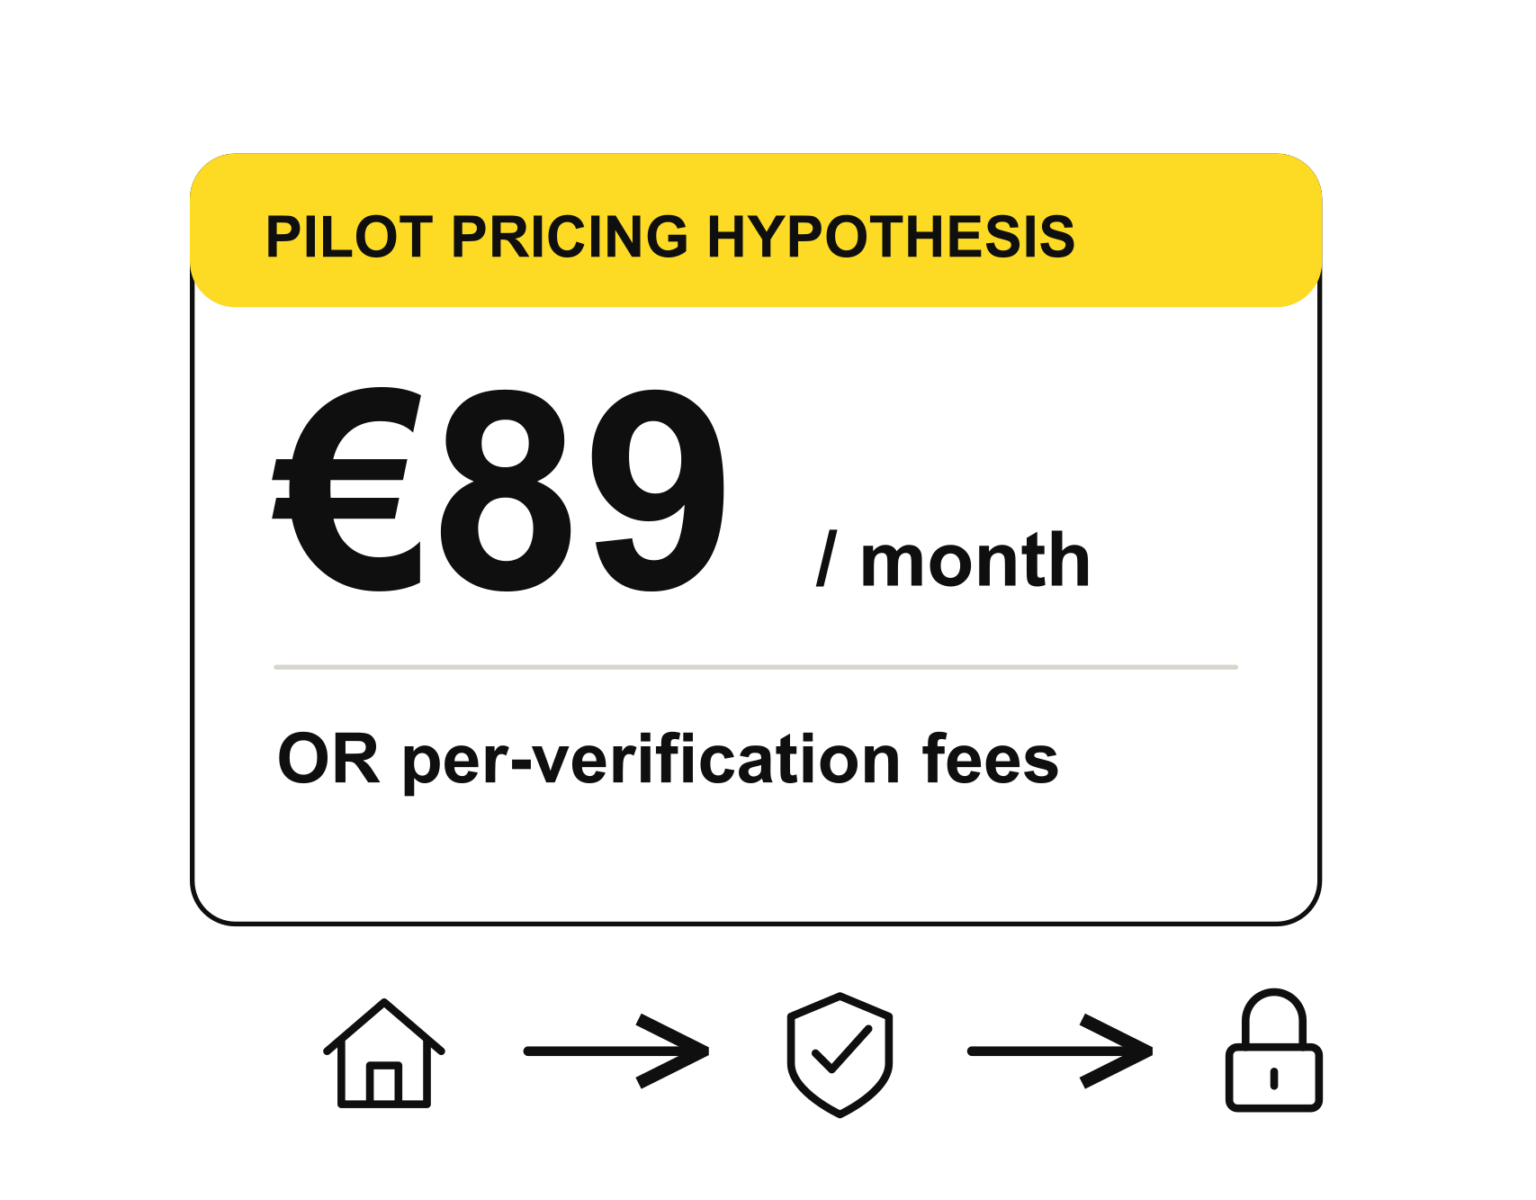
PLATFORM 03 / 07
HACKMERIDIAN 2026 · LISBON
NEXT ▸ MARKET & NOVELTY
PITCH STEP 02 / 04
PMF
Private deals stall when neither side wants to reveal first
Customer: off-market platforms and licensed brokers in Portugal.
Pain: repeated proof-of-funds checks and premature document sharing.
Pilot pricing hypothesis: €89/month or per-verification fees.
Portugal, 2025: 169,812 home sales / €41.2B
All home sales. Market context only. PMF remains unvalidated.
Live Testnet MVP / Synthetic credentials / No real bank or registry integration
© 2026 HackMeridian · Lisbon · #HackMeridian26
Notes:
Target customers: licensed Portuguese brokers and off-market property platforms. Price hypothesis selected by Oleksiy: €89 per month OR per-verification fees, as alternatives. Per-verification price, demand and willingness to pay remain unvalidated. No paying customers, secured pilot, measured savings or revenue are claimed.
Portugal recorded 169,812 home sales totaling €41.2 billion in 2025. All home sales are market context, not Deal Passport TAM. Source: https://estatistica.dgeconomia.gov.pt/indice-de-precos-da-habitacao-ine-18/ (checked 25 October 2026).
Post-MVP only by Oleksiy’s decision on 26 October 2026: real identity and property-authority providers, a controlled human-reviewed property pilot, and migration to non-GPL proving components. Same-deal proof renewal is a proposed policy improvement and is not implemented; the current holder/deal nullifier is consumed once, buyer access ends at the current five-minute epoch boundary, and a fresh demo deal is required after expiry. Seller authority and sessions expire within 20 minutes. No real bank, registry, Didit or Stripe integration is claimed.

Slide 4
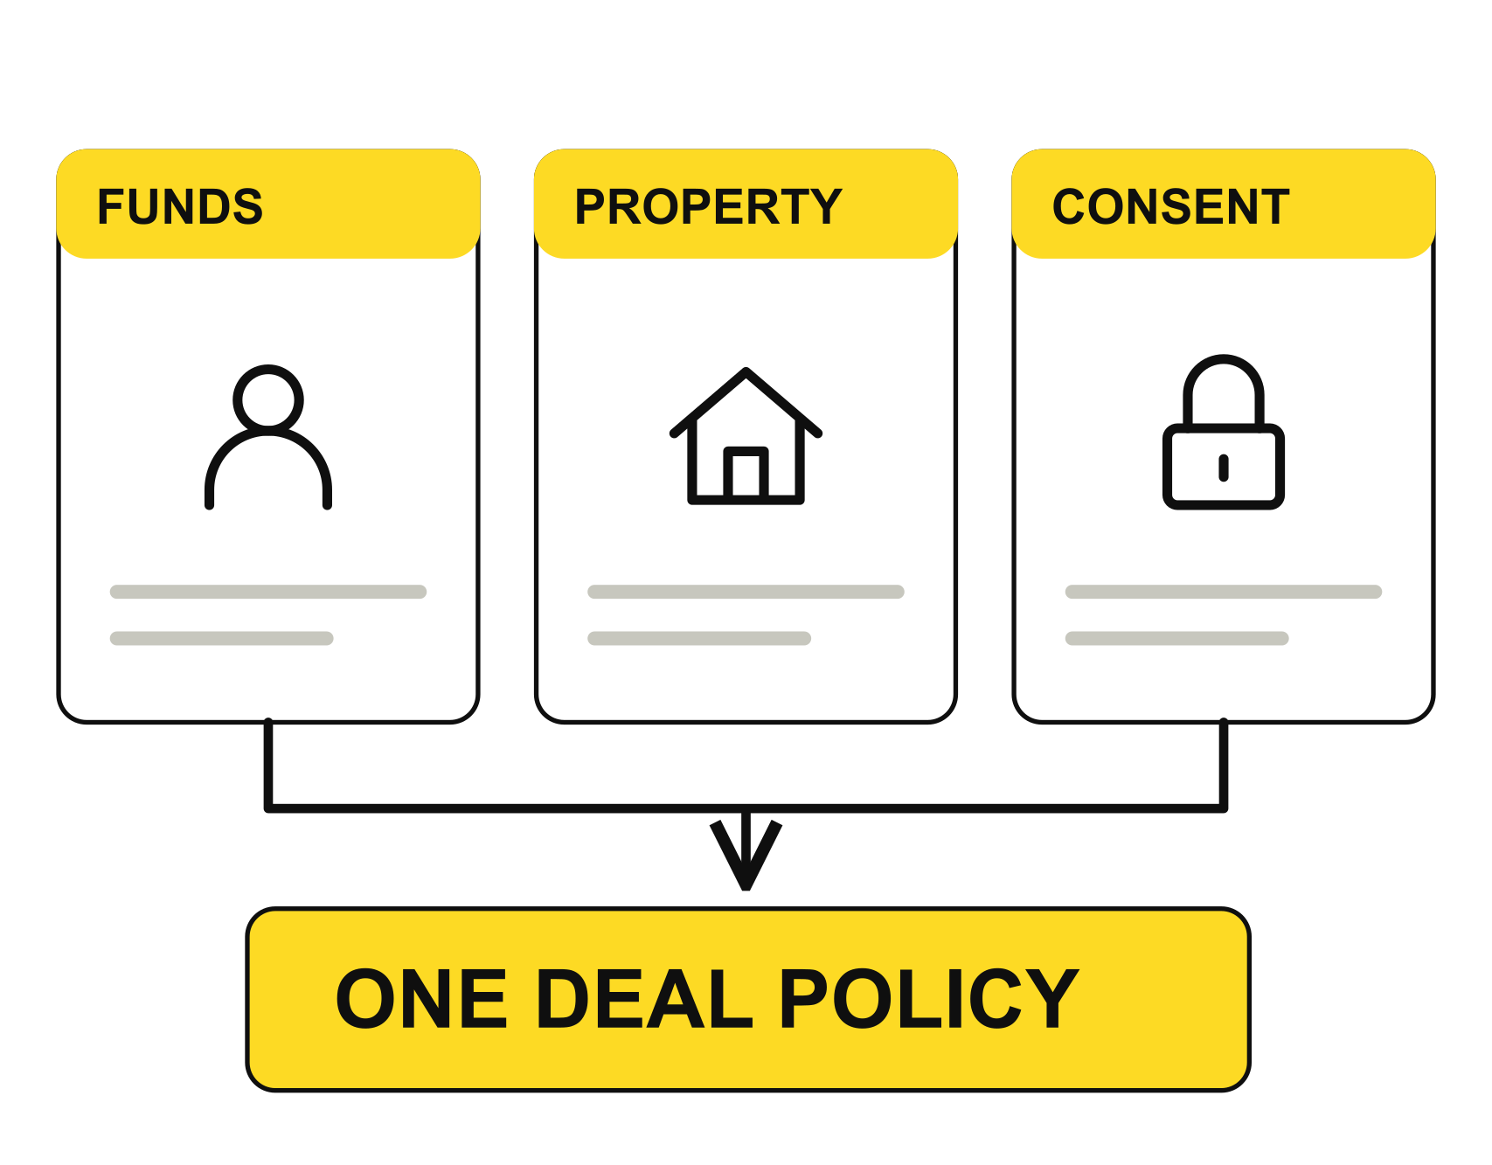

PLATFORM 04 / 07
HACKMERIDIAN 2026 · LISBON
NEXT ▸ TECHNICAL WORKFLOW
PITCH STEP 02 / 04
MARKET & NOVELTY
Existing services validate parts of the same private-deal workflow
Product | Existing offer | Our implemented MVP
RealOpen | Crypto funds letter Reveals verified balance | Issuer-bound threshold proof Hides the exact balance
IntegraLayer | Attested property data Onchain Asset Passport | Deal-specific authority claim From an authorized issuer
MERKAO | Verified counterparties NDAs and private data rooms | Stellar-enforced qualification And mutual disclosure consent
Market signal: MERKAO reports 250+ verified professionals.
Our focus: a private buyer proof and one enforceable mutual policy.
Vendor claims are not audited. Deal Passport demand remains unvalidated.
© 2026 HackMeridian · Lisbon · #HackMeridian26
Notes:
Step 02 continuation. Comparison of adjacent published offers with the implemented synthetic MVP; not an exhaustive market search or worldwide novelty proof.
Sources reviewed 25–26 October 2026: https://realopen.com/get-started — free crypto proof-of-funds letter discloses the verified balance; https://integralayer.com/ — Asset Passport enriched with data and external attestors; https://www.merkao.io/ — counterparty verification, NDAs, data rooms and vendor-reported 250+ verified professionals. These signals support interest in the surrounding category; they do not validate Deal Passport demand, uniqueness, willingness to pay or revenue. See docs/COMPETITOR_CONTEXT.md.
Implemented synthetic Testnet MVP: browser Groth16 proof generation; issuer-root membership, threshold, expiry, deal and recipient binding; authenticated property marketing-authority attestation; both participants’ consents; protected dossier API with fresh onchain reads; expiry, replay, forgery, withdrawal and revocation checks; session-private operation history and expired-session recovery. Browser proof times of 1.6–2.6 seconds were observed on this device, not a performance guarantee. Source evidence: docs/evidence/gate-a.json through gate-e.json, demo-feedback.json, docs/BUILD_LOG.md, worker/index.ts, worker/chain.ts and src/App.tsx. All identities, credentials and property examples are synthetic. Stellar verification is genuine. The single-party setup and educational verifier remain unaudited.

Slide 5
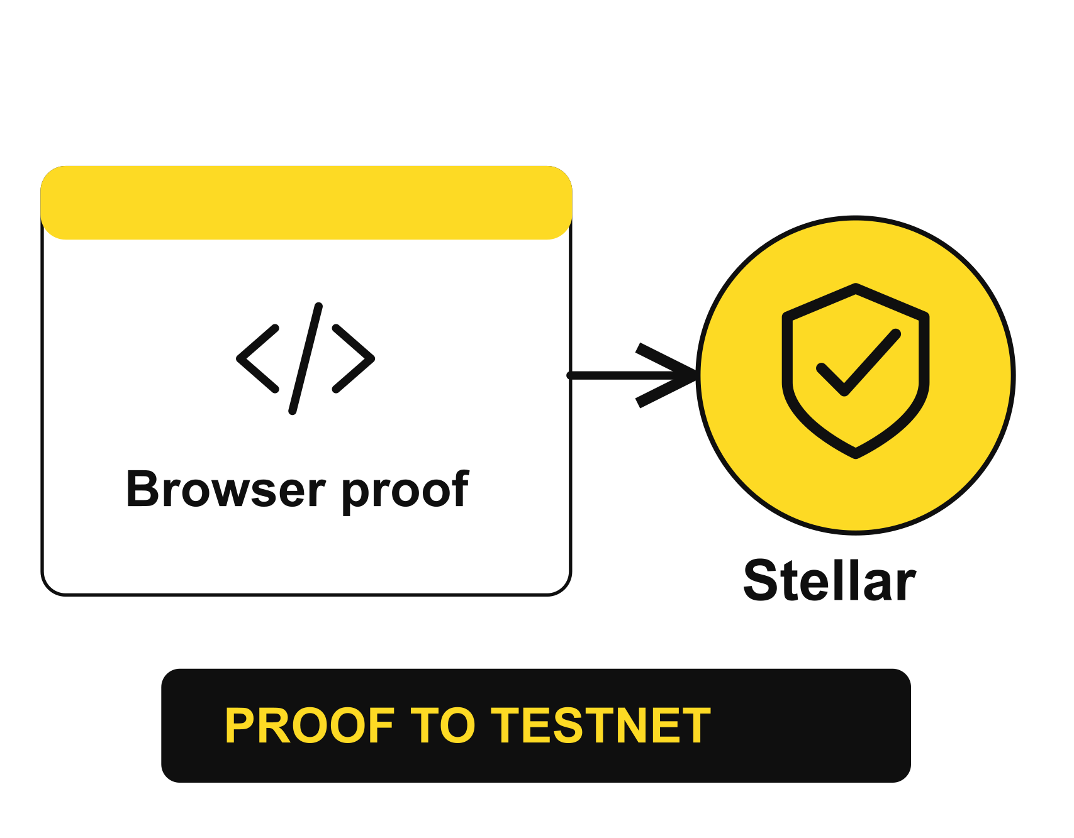
PLATFORM 05 / 07
HACKMERIDIAN 2026 · LISBON
NEXT ▸ SYSTEM ARCHITECTURE
PITCH STEP 03 / 04
VERIFIED WORKFLOW
Buyer proof, seller authority and consent are live on Testnet
Browser generates a genuine Groth16 eligibility proof.
Stellar verifies the proof and the property issuer’s authority.
Both parties consent; the API rechecks current chain state.
Underfunding, expiry, forgery, replay and revoked access fail.
1.6–2.6s browser proof observed on this demo device.
Live operation history and public Testnet receipts.
Live Testnet MVP / Synthetic credentials / Unaudited demo setup
© 2026 HackMeridian · Lisbon · #HackMeridian26
Notes:
Step 03. Live demo: https://dealpassport.aonishchenko33.workers.dev. React/TypeScript interface, browser snarkjs Groth16 prover, Circom circuit, Rust/Soroban BN254 contracts, Cloudflare Worker and D1. Proof generation and initial Testnet transactions can take longer on other devices or networks.
Implemented synthetic Testnet MVP: browser Groth16 proof generation; issuer-root membership, threshold, expiry, deal and recipient binding; authenticated property marketing-authority attestation; both participants’ consents; protected dossier API with fresh onchain reads; expiry, replay, forgery, withdrawal and revocation checks; session-private operation history and expired-session recovery. Browser proof times of 1.6–2.6 seconds were observed on this device, not a performance guarantee. Source evidence: docs/evidence/gate-a.json through gate-e.json, demo-feedback.json, docs/BUILD_LOG.md, worker/index.ts, worker/chain.ts and src/App.tsx. All identities, credentials and property examples are synthetic. Stellar verification is genuine. The single-party setup and educational verifier remain unaudited.
Post-MVP only by Oleksiy’s decision on 26 October 2026: real identity and property-authority providers, a controlled human-reviewed property pilot, and migration to non-GPL proving components. Same-deal proof renewal is a proposed policy improvement and is not implemented; the current holder/deal nullifier is consumed once, buyer access ends at the current five-minute epoch boundary, and a fresh demo deal is required after expiry. Seller authority and sessions expire within 20 minutes. No real bank, registry, Didit or Stripe integration is claimed.

Slide 6
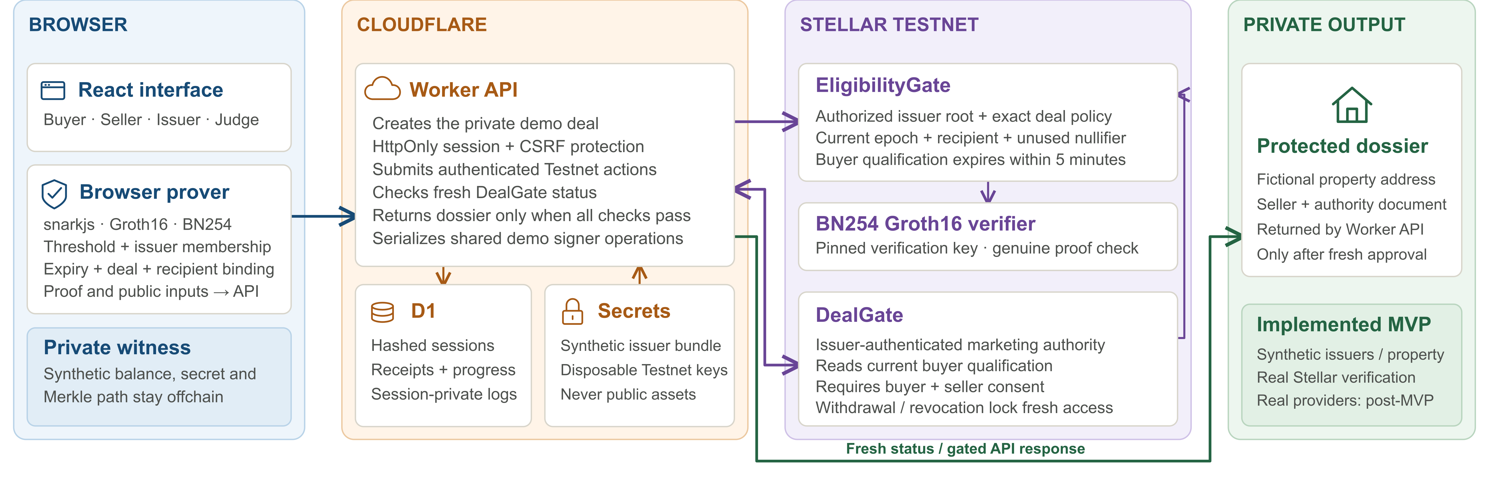
PLATFORM 06 / 07
HACKMERIDIAN 2026 · LISBON
NEXT ▸ THE TEAM
PITCH STEP 03 / 04
SYSTEM ARCHITECTURE
© 2026 HackMeridian · Lisbon · #HackMeridian26
Notes:
Step 03 continuation: implemented system architecture. The browser obtains a private synthetic witness from the session-scoped API and creates the proof in its Web Worker. Only the proof and public signals are submitted to Stellar. The Cloudflare Worker uses disposable Testnet signer keys from secrets, records hashed sessions and operation receipts in D1, and rechecks DealGate.status before each protected dossier response. EligibilityGate pins the Groth16 verification key and authenticates financial roots and exact policy inputs. DealGate reads fresh buyer qualification and requires property authority plus both consents. The dossier is an offchain API response, not a blockchain document.
Implemented synthetic Testnet MVP: browser Groth16 proof generation; issuer-root membership, threshold, expiry, deal and recipient binding; authenticated property marketing-authority attestation; both participants’ consents; protected dossier API with fresh onchain reads; expiry, replay, forgery, withdrawal and revocation checks; session-private operation history and expired-session recovery. Browser proof times of 1.6–2.6 seconds were observed on this device, not a performance guarantee. Source evidence: docs/evidence/gate-a.json through gate-e.json, demo-feedback.json, docs/BUILD_LOG.md, worker/index.ts, worker/chain.ts and src/App.tsx. All identities, credentials and property examples are synthetic. Stellar verification is genuine. The single-party setup and educational verifier remain unaudited.
Post-MVP only by Oleksiy’s decision on 26 October 2026: real identity and property-authority providers, a controlled human-reviewed property pilot, and migration to non-GPL proving components. Same-deal proof renewal is a proposed policy improvement and is not implemented; the current holder/deal nullifier is consumed once, buyer access ends at the current five-minute epoch boundary, and a fresh demo deal is required after expiry. Seller authority and sessions expire within 20 minutes. No real bank, registry, Didit or Stripe integration is claimed.
Diagram source: docs/architecture-assets/dealpassport-system.svg. Visual reference supplied by Oleksiy: https://github.com/aonishchenko/prooftrace/blob/main/docs/architecture-assets/prooftrace-system.svg. The reference informed trust-boundary grouping; component names, text and flows were authored for Deal Passport.

Slide 7
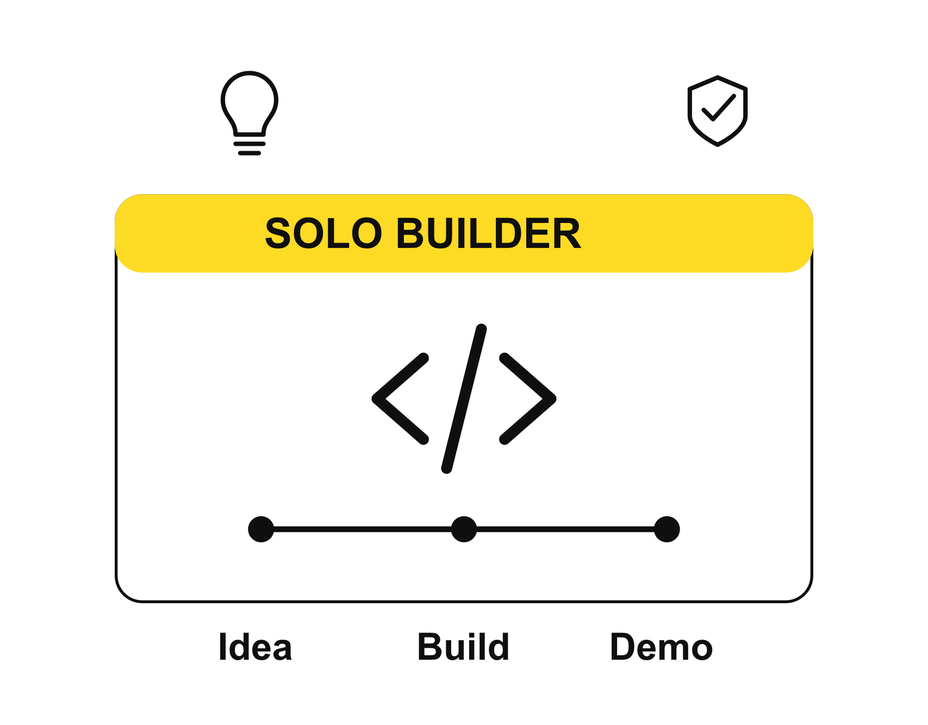
PLATFORM 07 / 07
HACKMERIDIAN 2026 · LISBON
FINAL STOP
PITCH STEP 04 / 04
THE TEAM
EasyAI / Oleksiy Onishchenko / Solo builder
25+ years in software, including fintech and cloud systems.
Solo engineer behind two production marketplaces.
Former 3Commas Engineering Manager and R&D Engineering Director.
Built: proof circuit, policy contracts, API, interface and demo.
Post-MVP: real verification, proof renewal and non-GPL stack.
Human review and submission: Oleksiy / Real bank and registry integration: post-MVP
© 2026 HackMeridian · Lisbon · #HackMeridian26
Notes:
EasyAI / Oleksiy Onishchenko, solo participant. Worked out the idea, designed the architecture and implemented the Testnet MVP and demo. Oleksiy performs reviews, corrections and submission. CV-supplied background: 25+ years in software, fintech/cloud systems, solo production marketplaces, former 3Commas Engineering Manager and OpenCascade R&D Engineering Director. Personal contact details omitted. AI tooling: ChatGPT for planning and specification, Codex for engineering, debugging, verification and presentation/demo materials.
Post-MVP only by Oleksiy’s decision on 26 October 2026: real identity and property-authority providers, a controlled human-reviewed property pilot, and migration to non-GPL proving components. Same-deal proof renewal is a proposed policy improvement and is not implemented; the current holder/deal nullifier is consumed once, buyer access ends at the current five-minute epoch boundary, and a fresh demo deal is required after expiry. Seller authority and sessions expire within 20 minutes. No real bank, registry, Didit or Stripe integration is claimed.
Original SVG illustrations were authored for this update. PNG versions are deterministic renders; no stock photos or generated real-property imagery are presented as evidence.

