Slide 1
Same Mutation.
Different Outcome.
Different Outcome.
Mapping the tumor microenvironment in lung cancer
when targeted therapies fail despite actionable mutations
PEAT-Nucleate BioHack 2026 • HistoTME + TCGA Lung
Notes:
Open with the core tension: trials stratify by mutation, but patients with the same EGFR, ALK, or KRAS alteration respond very differently. The missing variable is the tumor microenvironment and how immune and stromal cells are organized in space.

Slide 2
The clinical problem
Mutation panels are necessary — but not sufficient
NSCLC trials increasingly enroll by driver: EGFR, ALK, KRAS G12C, MET, RET…
Initial targeted responses can be strong, yet median benefit is limited by resistance
Immunotherapy combinations often fail in oncogene-driven disease despite 'targetable' biology
Trial readouts report averages for 'EGFR+' or 'KRAS G12C+' — masking within-group heterogeneity
Key question: What differs between responders and non-responders with the same mutation?
PEAT-Nucleate BioHack 2026 | Lung cancer TME mapping
Notes:
Emphasize that this is not about finding new mutations. The mutation is known and druggable. The puzzle is why two EGFR-mutant patients on the same TKI or trial arm have different durability.

Slide 3
Trials with the right mutation — disappointing results
Trial | Population | Intervention | Outcome
KEYNOTE-789 | EGFR+ post-TKI | Pembro + chemo vs chemo | No significant PFS/OS benefit
CheckMate 722 | EGFR+ post-TKI | Nivo + chemo vs chemo | No significant benefit
TATTON | EGFR-mutant | Osimertinib + durvalumab | Arm halted — ILD toxicity
IMpower151 | EGFR/ALK enriched | Atezo + bev + chemo | Negative primary PFS endpoint
CodeBreaK 200 | KRAS G12C | Sotorasib vs docetaxel | PFS improved; OS not improved
PEAT-Nucleate BioHack 2026 | Lung cancer TME mapping
Notes:
These are anchor examples for judges and clinicians. The through-line: genotype-qualified patients still fail or see modest benefit. Resistance mechanisms include bypass signaling, but also immunosuppressive TME remodeling.

Slide 4
Hypothesis
TME architecture explains residual heterogeneity
Patients with identical driver mutations occupy distinct tumor microenvironment states
Immune desert vs immune inflamed
Macrophage/Treg-rich niches vs effector T-cell infiltration
CAF/stromal barriers vs angiogenic remodeling
Spatial organization matters — not just bulk immune scores
Genomics tells us what to target; TME tells us whether therapy will work
Spatial transcriptomics is gold standard — but costly and rarely run at trial scale
We need a scalable first pass on standard diagnostic H&E
PEAT-Nucleate BioHack 2026 | Lung cancer TME mapping
Notes:
Clarify nuance: EGFR/ALK tumors often have LOW tumor mutational burden and cold immune phenotypes — the issue is not always 'too many mutations.' For KRAS G12C, resistance includes TME shifts toward immunologically cold states after treatment.

Slide 5
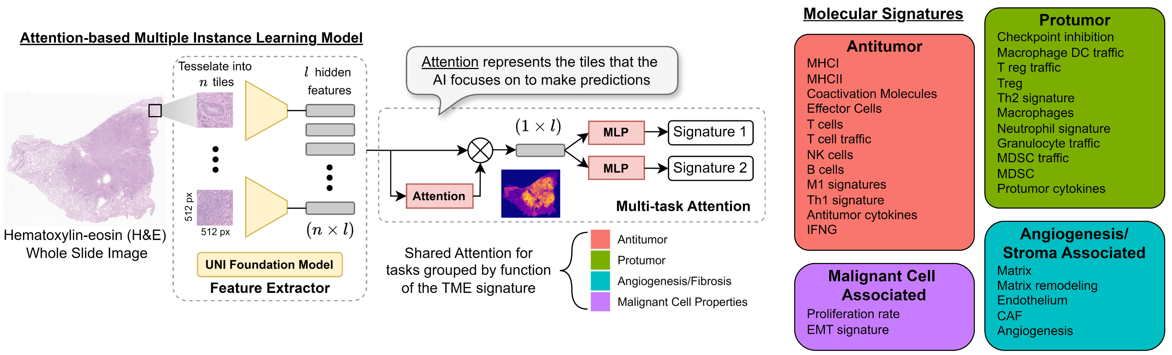
Our approach: HistoTME
Infer TME programs from H&E whole-slide images
Weakly supervised deep learning on pathology foundation-model embeddings
Predicts 29 curated gene-expression signatures
No extra staining; works on archived diagnostic slides
Published in NSCLC; pan-cancer HistoTMEv2 extension
Bulk mode → patient/slide-level TME profile
Spatial mode → tile-level maps across the WSI
PEAT-Nucleate BioHack 2026 | Lung cancer TME mapping
Notes:
HistoTME bridges histology and transcriptomics. It was originally developed for NSCLC immunotherapy response prediction. HistoTMEv2 extends across 25 cancer types including lung.

Slide 6
29 interpretable TME signatures
Biology clinicians recognize — not a black-box score
Immune-active: Effector_cells, T_cells, NK_cells, M1_signatures, Antitumor_cytokines, MHCII
Immunosuppressive: Treg, MDSC, Checkpoint_inhibition, Th2_signature, Protumor_cytokines
Myeloid: Macrophages, Macrophage_DC_traffic, Neutrophil_signature, Granulocyte_traffic
Stroma / escape: CAF, Angiogenesis, Matrix_remodeling, EMT_signature
Tumor state: Proliferation_rate
Downstream clustering → Immune Desert vs Immune Inflamed archetypes
Validated against IHC (CD4/CD8, B cells, macrophages) in published analyses
PEAT-Nucleate BioHack 2026 | Lung cancer TME mapping
Notes:
These signatures come from curated bulk RNA programs. The downstream module shows Immune Inflamed phenotype predicts better ICI outcomes than PD-L1 alone in several subgroups.

Slide 7
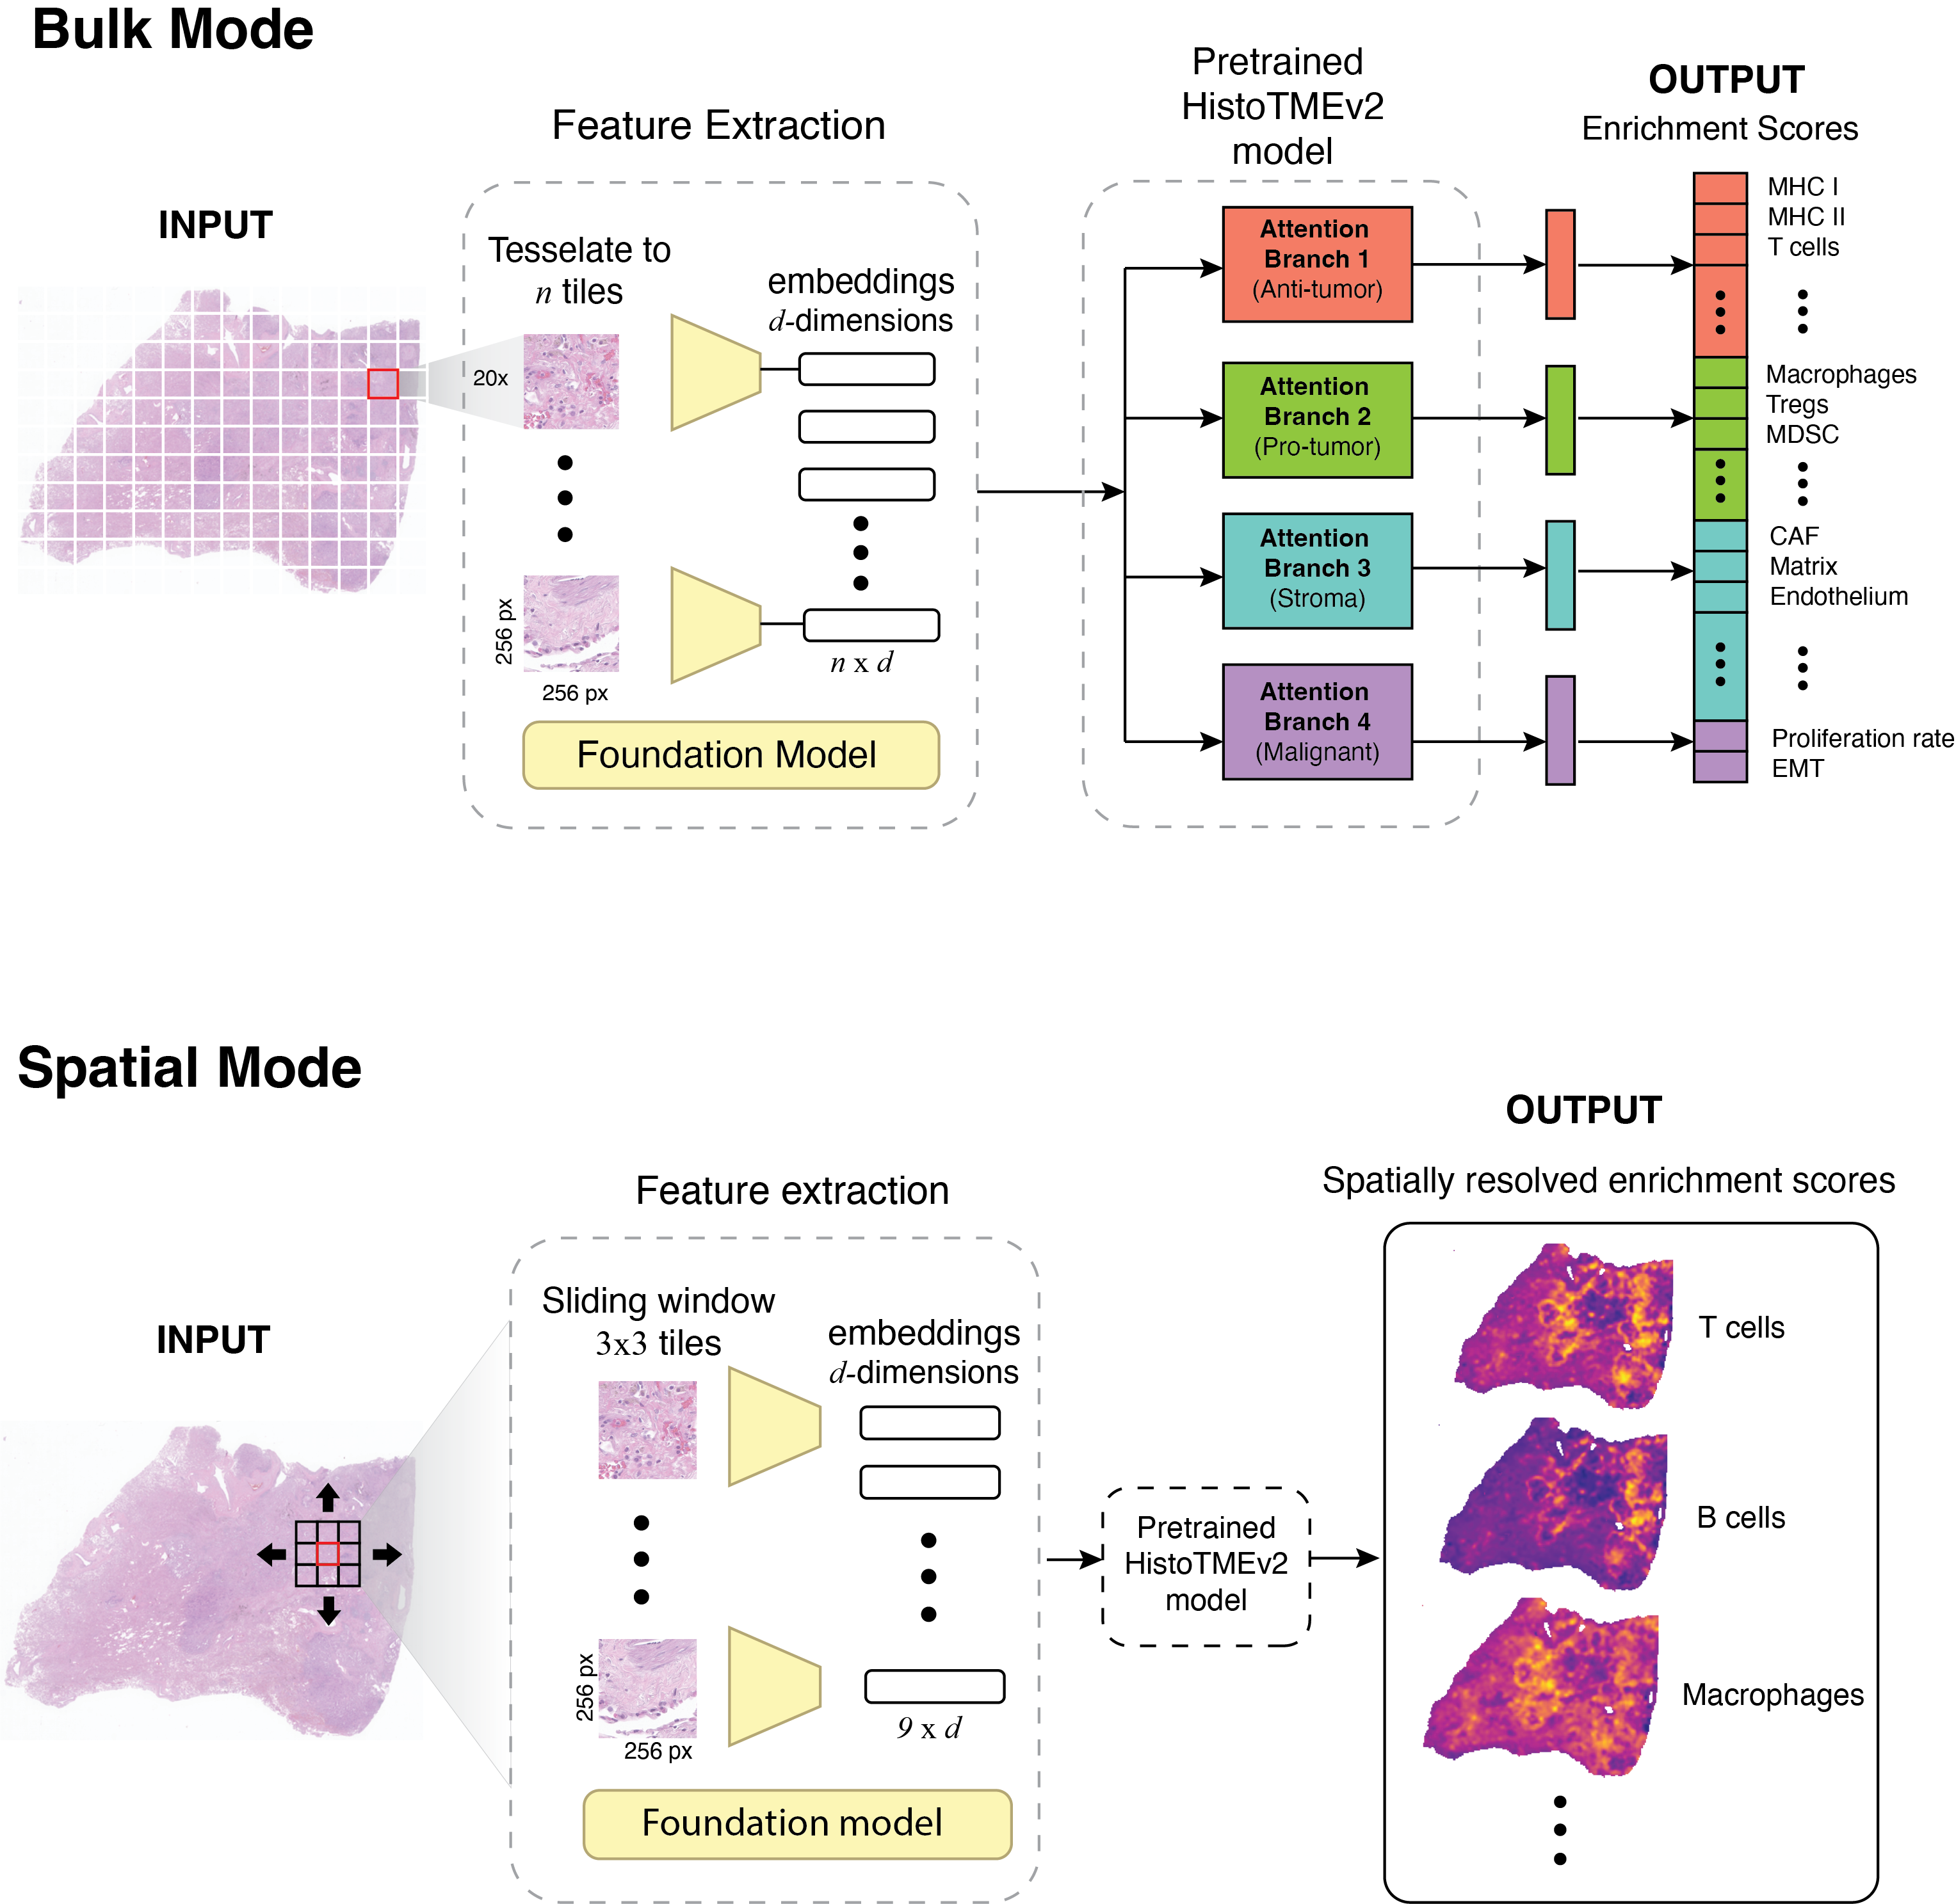
Bulk vs spatial inference
One slide → whole-patient profile or spatial TME map
PEAT-Nucleate BioHack 2026 | Lung cancer TME mapping
Notes:
Spatial mode is the differentiator for your pitch. predict_spatial.py outputs enrichment scores per tile coordinate — a computational analogue of spatial transcriptomics screening.

Slide 8
PEAT-Nucleate pipeline (this repo)
TCGA lung cohort ready to run
1,053 diagnostic H&E slides — TCGA-LUAD (541) + TCGA-LUSC (512)
~824 GB total; open access; manifests committed in data/tcga_lung/
Pipeline:
download.py → whole-slide images (.svs)
Foundation model embeddings → HDF5 (coords + features)
predict_bulk.py / predict_spatial.py → TME signature outputs
Link to clinical + mutation metadata for stratified analysis
Outputs land in outputs/histotme/ — ready for dashboard (Taylor UI branch)
PEAT-Nucleate BioHack 2026 | Lung cancer TME mapping
Notes:
Walk through the repo as an end-to-end demo path. Pilot with --limit 3 slides for the hackathon. Clinical metadata branch adds patient-level joins for EGFR/KRAS/ALK stratification.

Slide 9
HistoTME + spatial transcriptomics
Complementary — not competing
 | Spatial transcriptomics | HistoTME on H&E
Input | Fresh/frozen; specialized workflow | Standard diagnostic H&E
Scale | Limited spots / FOVs | Whole slide; 1,000+ TCGA lungs
Cost & time | High | Compute-only after slide download
Output | Measured genes at locations | Predicted signature activity per tile
Best role | Mechanistic ground truth | Trial-scale screening & stratification
Workflow: HistoTME screens the cohort → spatial transcriptomics validates on a focused subset
PEAT-Nucleate BioHack 2026 | Lung cancer TME mapping
Notes:
This slide prevents the 'but it's not real spatial omics' objection. You're proposing a two-layer strategy: scalable H&E inference first, spatial transcriptomics validation second.

Slide 10
Proposed analysis
Test the hypothesis on TCGA lung
Stratify patients by driver mutation (EGFR, ALK, KRAS, wild-type)
Run HistoTME bulk + spatial on diagnostic H&E slides
Cluster into TME archetypes (immune desert, inflamed, stroma-high, myeloid-rich)
Compare TME states within each mutation stratum
Retrospective trial framing:
Do non-responders in mutation-positive trials show distinct spatial TME maps?
Can TME archetype explain heterogeneity that mutation status alone cannot?
Validate signature maps against public spatial transcriptomics lung datasets
PEAT-Nucleate BioHack 2026 | Lung cancer TME mapping
Notes:
TCGA lacks trial treatment arms, so you frame this as retrospective hypothesis generation that motivates prospective biopsy studies and trial enrichment designs.

Slide 11
BioHack deliverables
What we will show live
Pilot TCGA lung download (3–10 slides) + tissue thumbnails
HistoTME bulk predictions for LUAD/LUSC pilot cohort
Spatial heatmaps for 2–3 exemplar slides (Treg, Macrophages, Effector_cells)
Mutation-stratified TME cluster comparison (EGFR vs KRAS vs WT)
Dashboard mock-up: slide browser + TME overlay (Taylor UI branch)
Stretch goal: correlate HistoTME signatures with spatial transcriptomics public data
PEAT-Nucleate BioHack 2026 | Lung cancer TME mapping
Notes:
Be concrete about what is demo-ready vs stretch. Judges reward a working pilot over promises.

Slide 12
Impact
• Enrich future targeted-therapy and combination trials by TME — not mutation alone
• Explain post-hoc why mutation-positive trials underperform in subsets
• Use existing H&E biobanks — no new biopsy protocol required for screening
• Bridge to spatial transcriptomics for mechanistic validation
Mutation is the lock. TME is whether the key turns.
Notes:
Close with the clinical translation path: retrospective TCGA → trial biobank re-analysis → prospective enrichment biomarker on pre-treatment H&E.

Slide 13
Key references
Patkar et al. NPJ Precision Oncology 2024 — HistoTME NSCLC / ICI
HistoTMEv2 preprint (2025) — pan-cancer extension
Yang et al. J Clin Oncol 2024 — KEYNOTE-789 (EGFR+ post-TKI)
de Langen et al. Lancet 2023 — CodeBreaK 200 (KRAS G12C)
Tsai et al. JCI — KRAS G12Ci resistance & TME remodeling
Nature Reviews Clinical Oncology 2025 — NSCLC TME crosstalk
Repo: github.com/aonkondey01/PEAT-Nucleate-BIoHack-2026
PEAT-Nucleate BioHack 2026 | Lung cancer TME mapping
Notes:
Keep this slide for Q&A. Offer to share the deck and pilot notebooks after the talk.

Slide 14
Thank you
Questions?
PEAT-Nucleate BioHack 2026
Notes:
Invite questions on trial selection, spatial validation plan, and live demo timeline.

