Slide 1
TCGA Lung Cancer Visual Summary
956 patients | 1,053 diagnostic slides | LUAD 478 | LUSC 478
Important-gene mutations, RNA expression, RPPA protein expression, and exploratory survival associations

Slide 2
Significant Kaplan-Meier curves (p < 0.05)

Slide 3
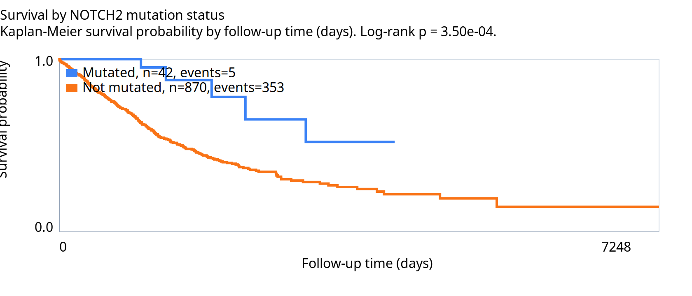
Mutation km NOTCH2

Slide 4
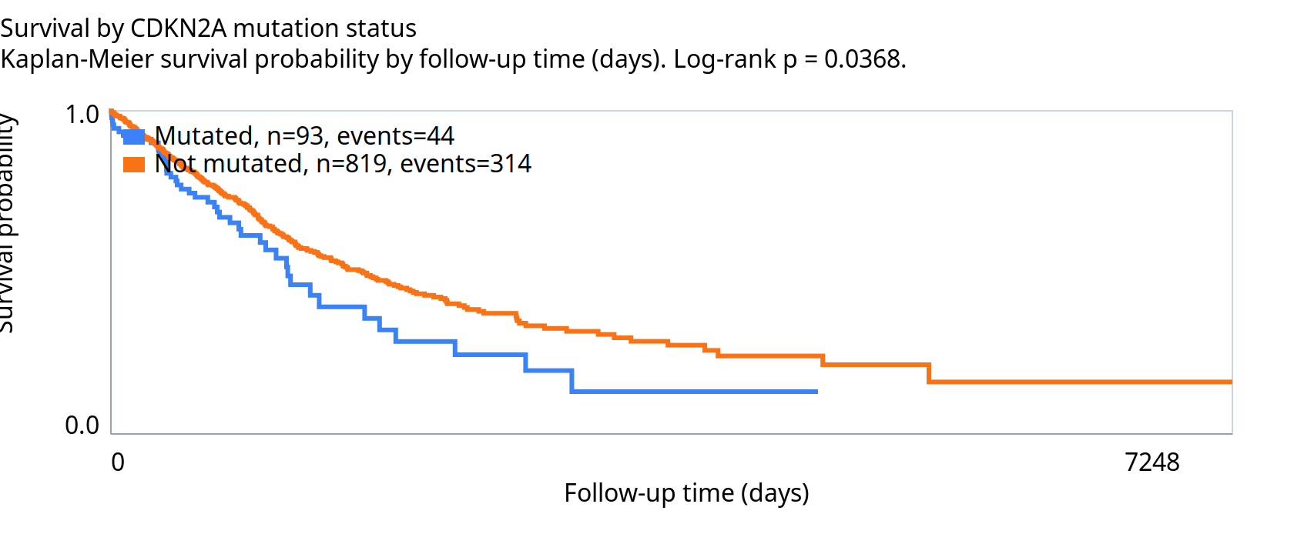
Mutation km CDKN2A

Slide 5
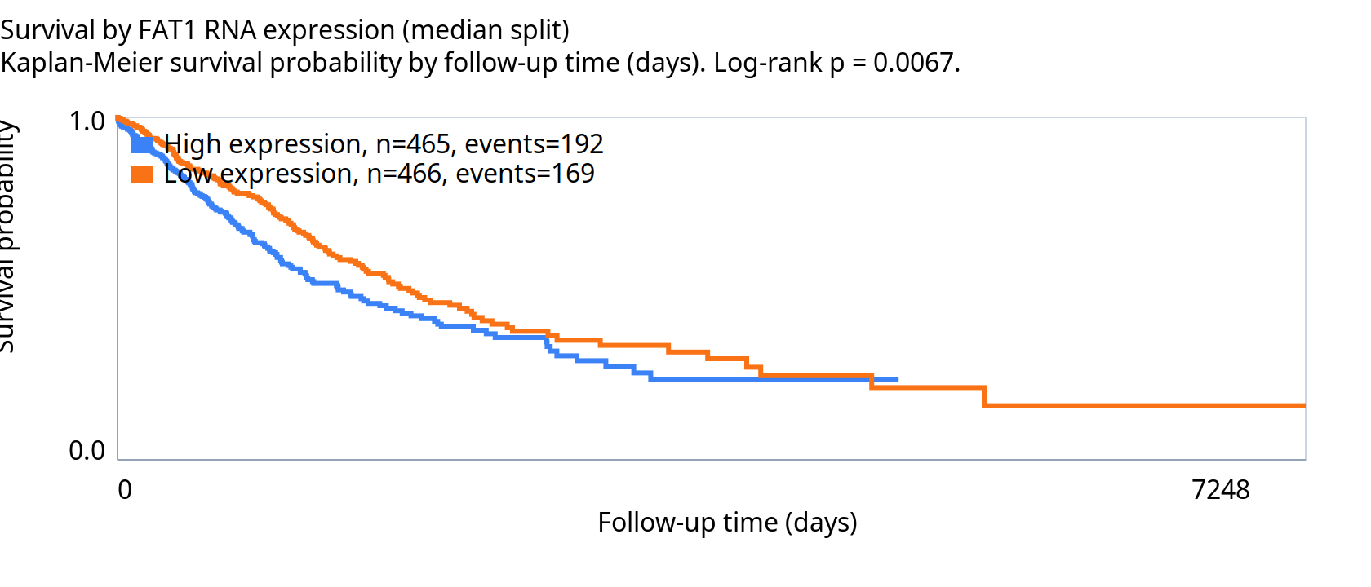
Rna km FAT1

Slide 6
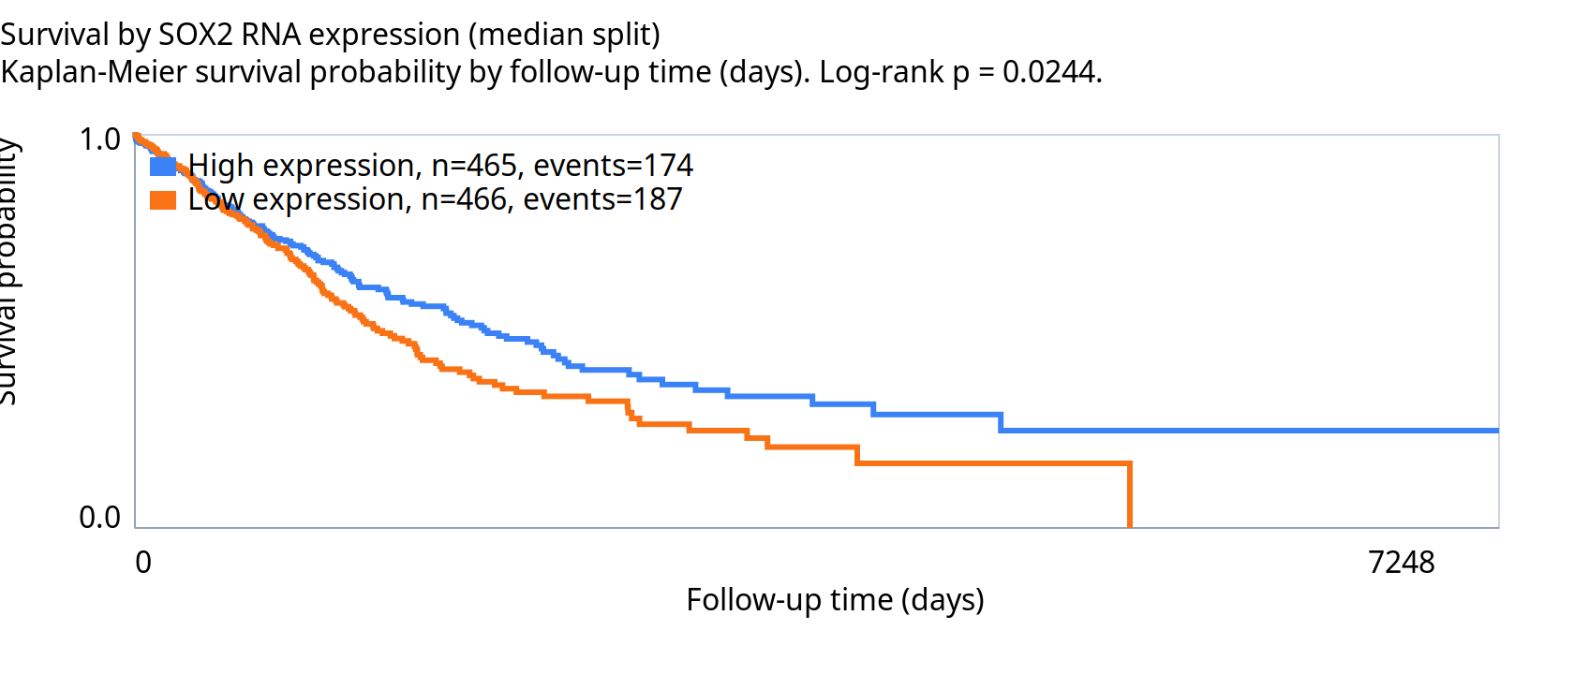
Rna km SOX2

Slide 7
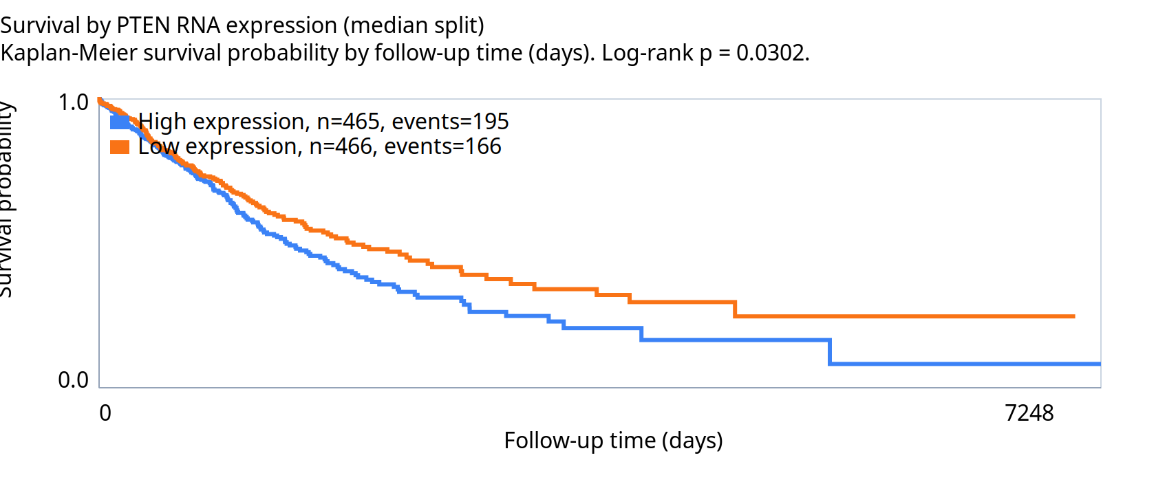
Rna km PTEN

Slide 8
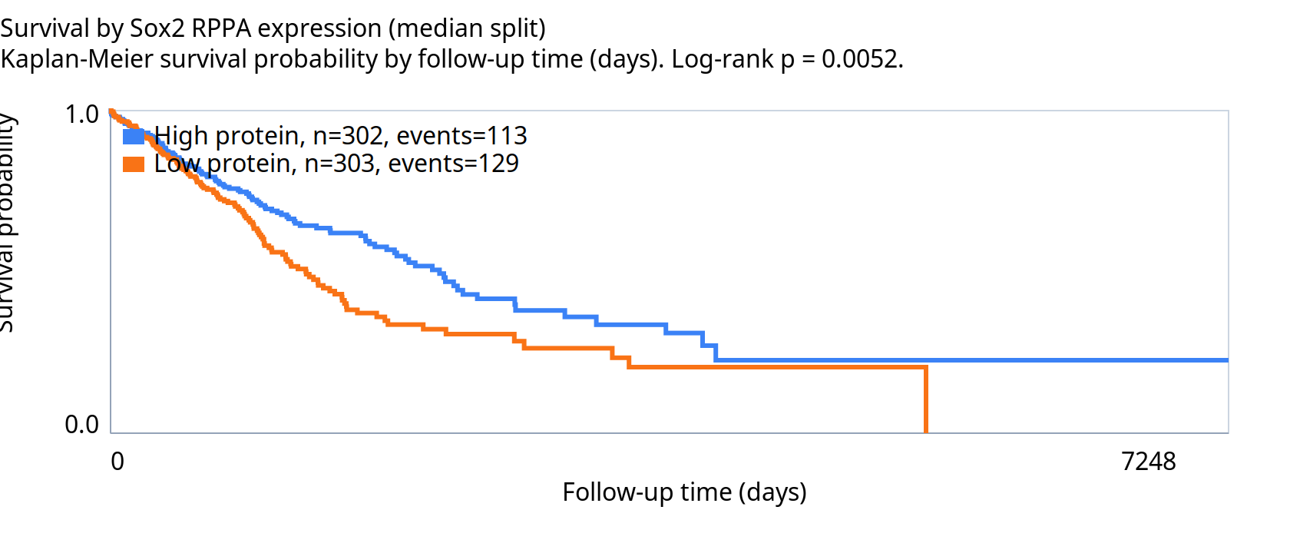
Protein km Sox2

