Slide 1
TCGA Lung Cancer Visual Summary
956 patients | 1,053 diagnostic slides | LUAD 478 | LUSC 478
Important-gene mutations, RNA expression, RPPA protein expression, and exploratory survival associations

Slide 2
Cohort overview

Slide 3
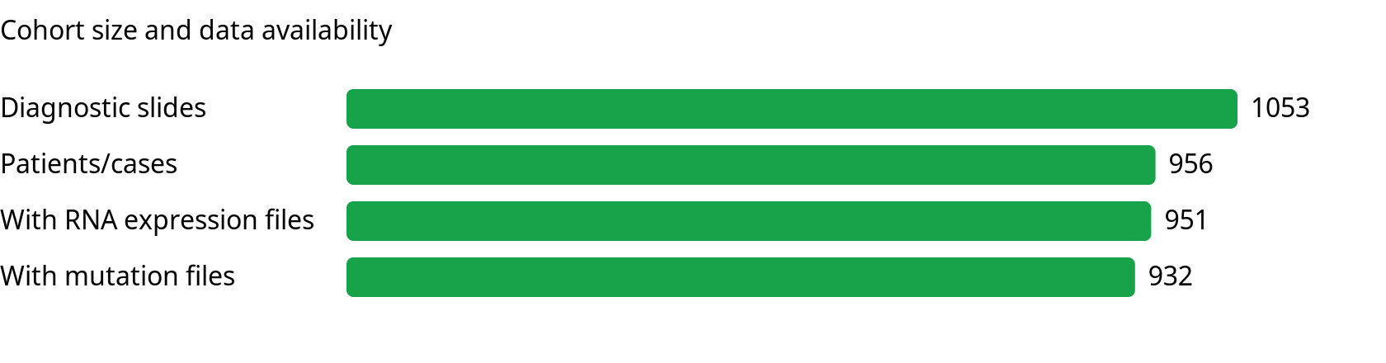
Cohort size and availability

Slide 4
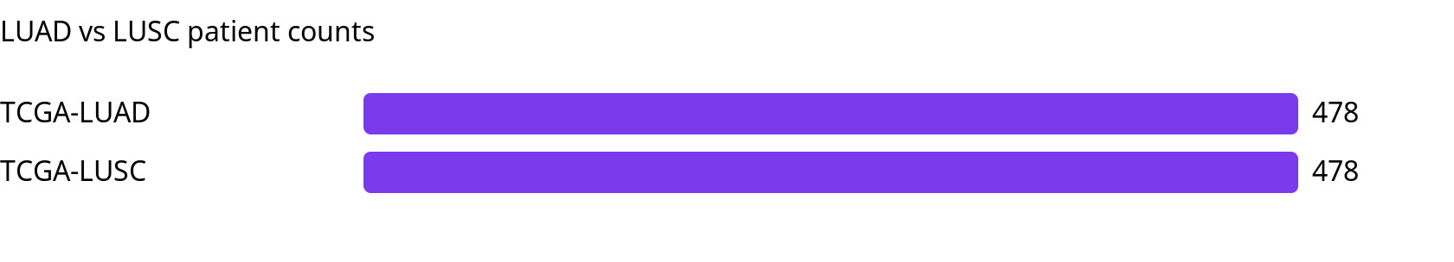
Luad vs lusc patient counts

Slide 5
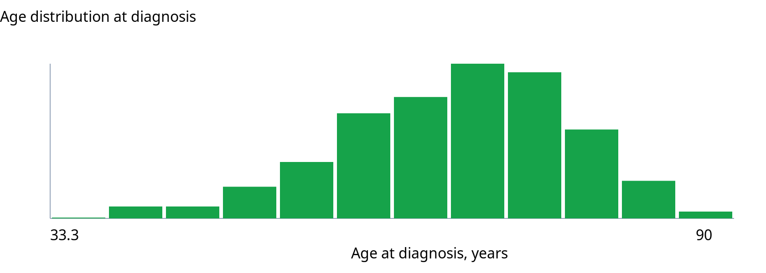
Age distribution

Slide 6
Demographics and clinical variables

Slide 7
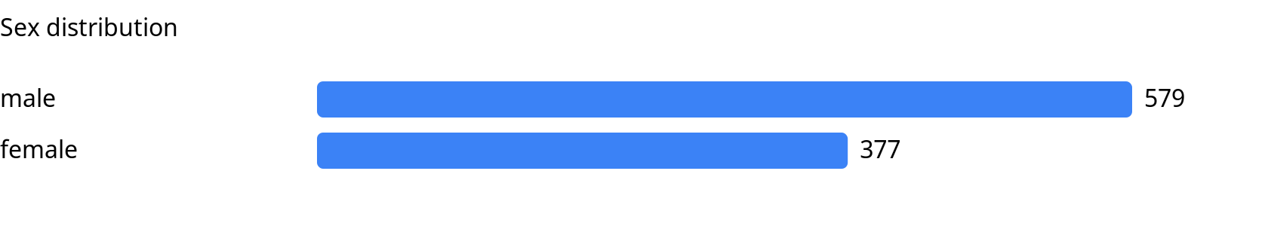
Sex distribution

Slide 8
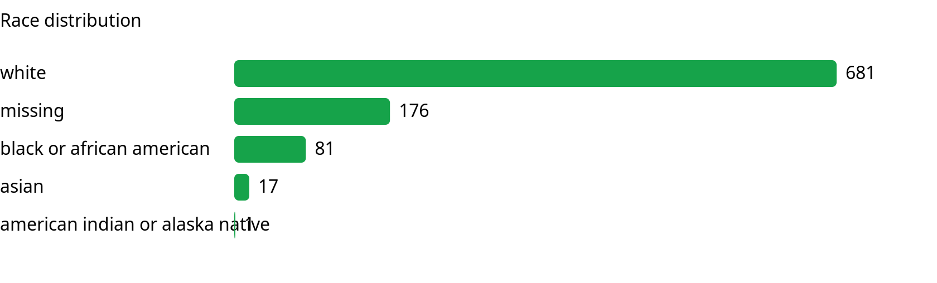
Race distribution

Slide 9
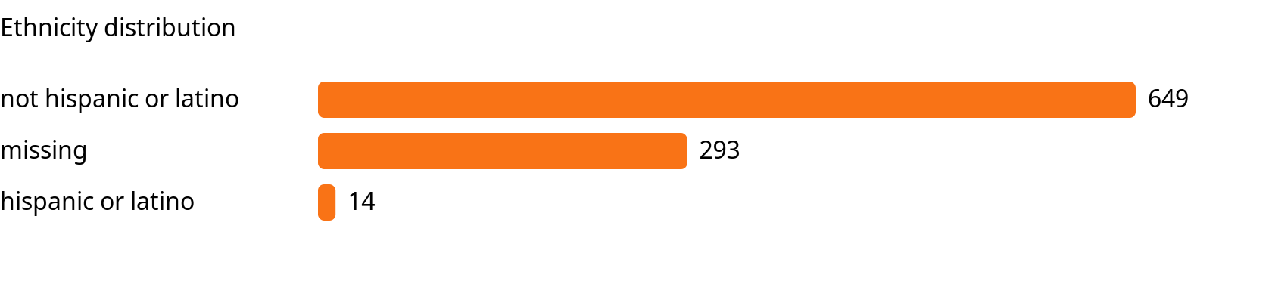
Ethnicity distribution

Slide 10
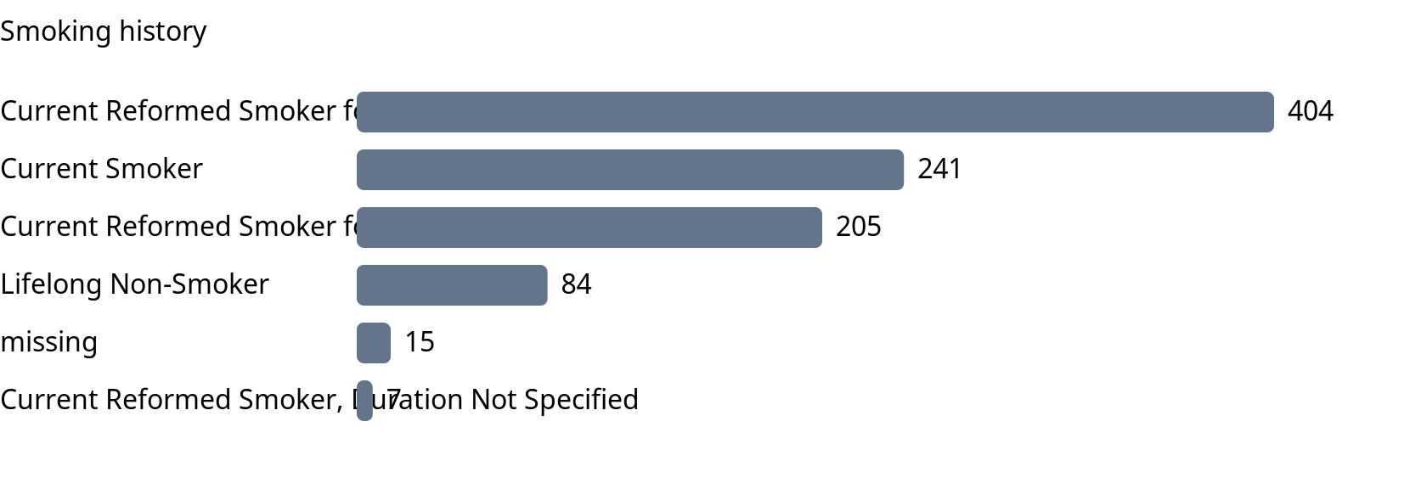
Smoking history

Slide 11
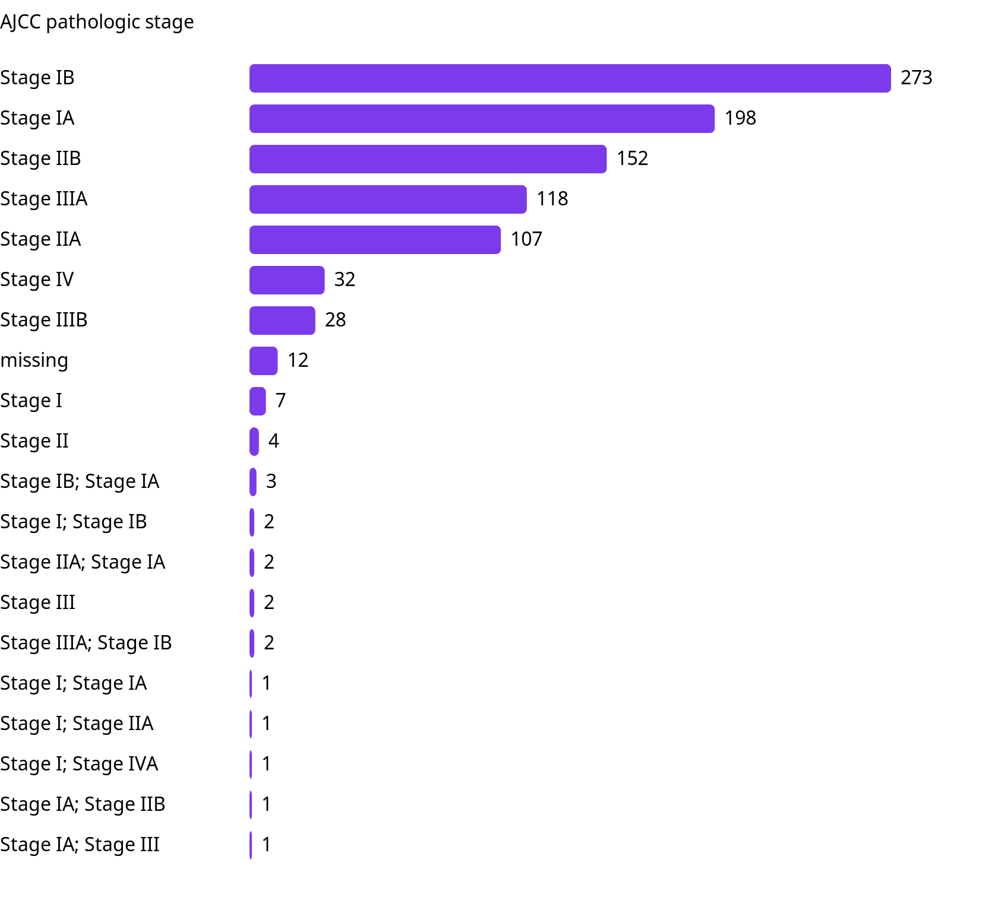
Ajcc pathologic stage

Slide 12
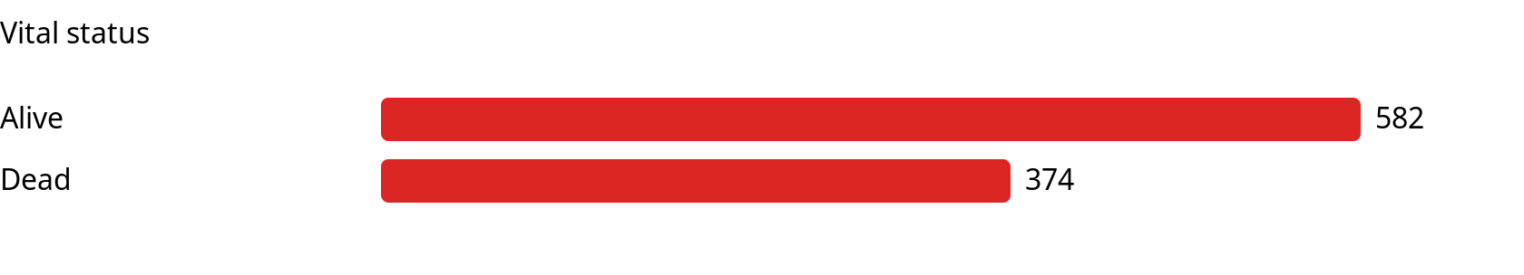
Vital status

Slide 13
Driver mutations

Slide 14
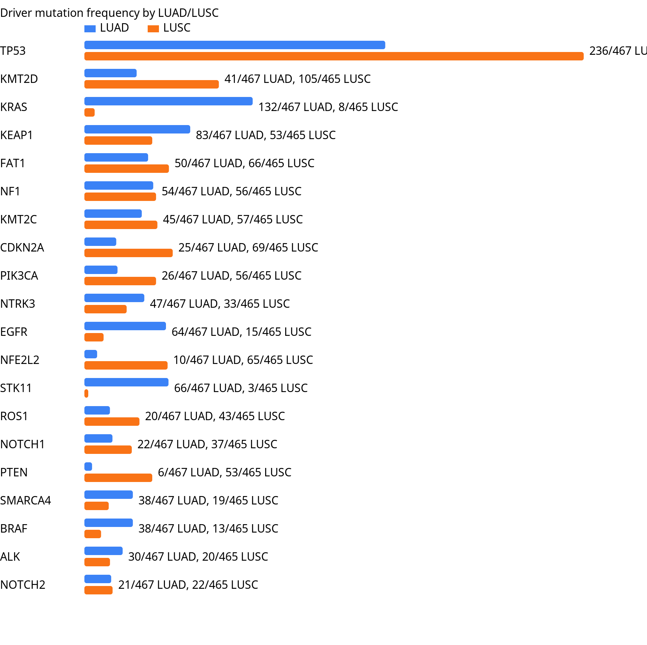
Driver mutation frequency luad lusc

Slide 15
Clinical differences by mutation status

Slide 16
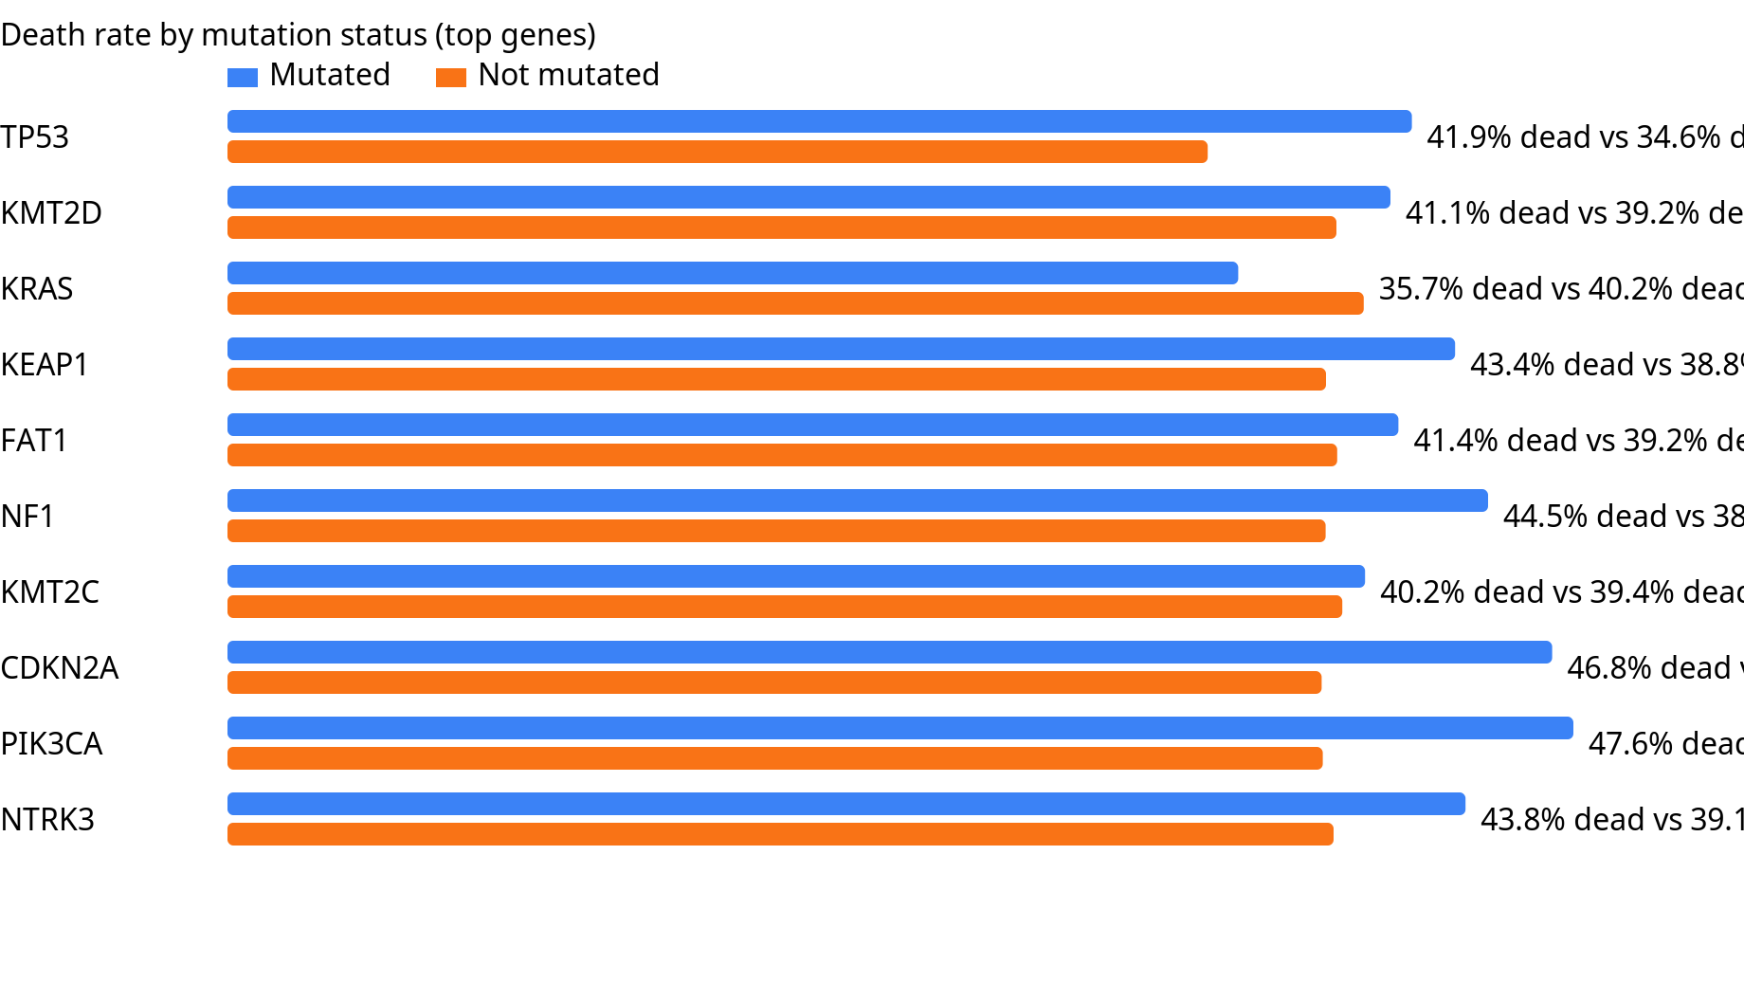
Clinical death rate by mutation status

Slide 17
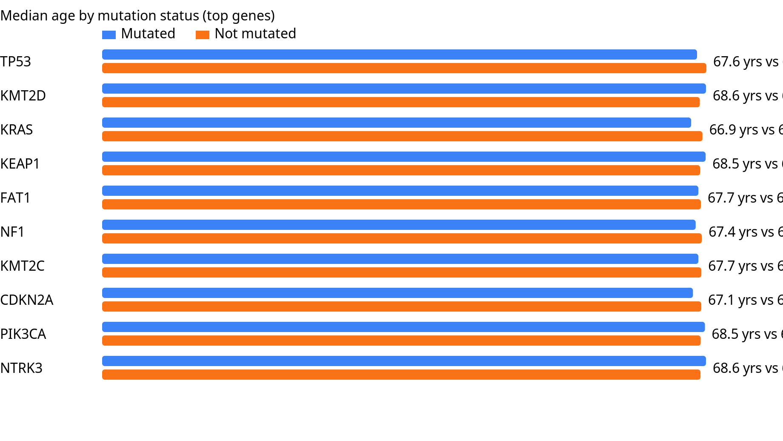
Clinical median age by mutation status

Slide 18
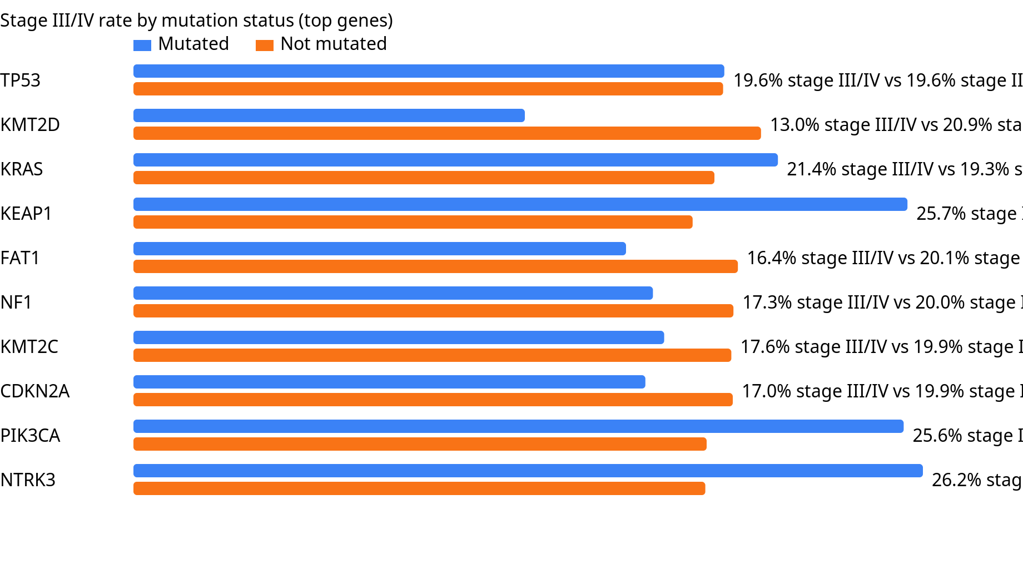
Clinical advanced stage by mutation status

Slide 19
Exploratory survival associations

Slide 20
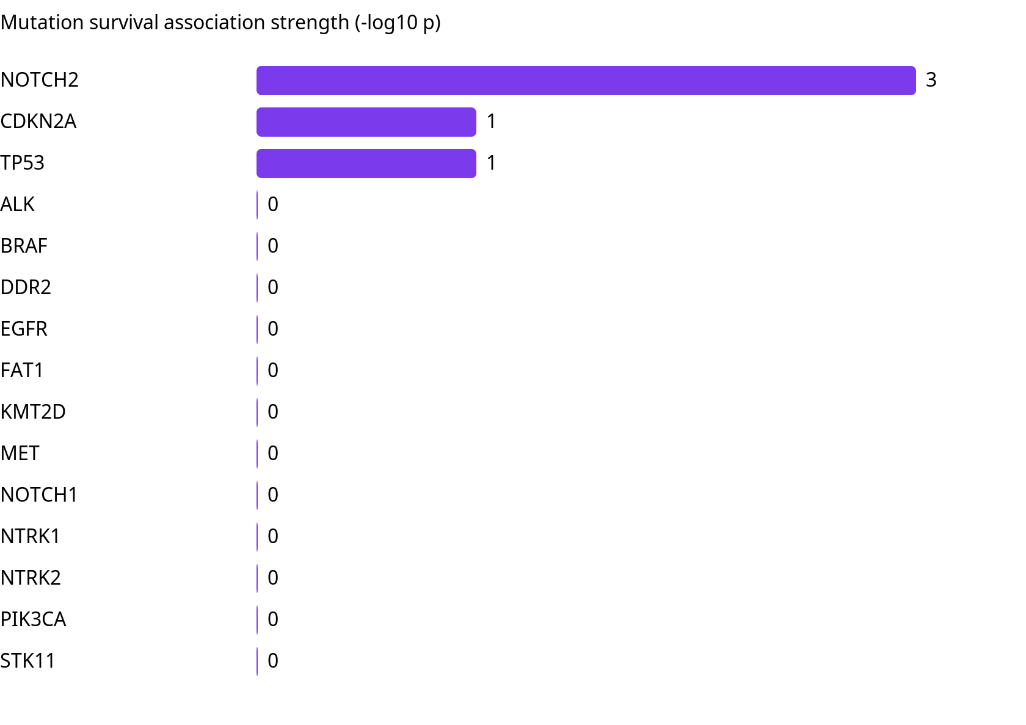
Mutation survival pvalues

Slide 21
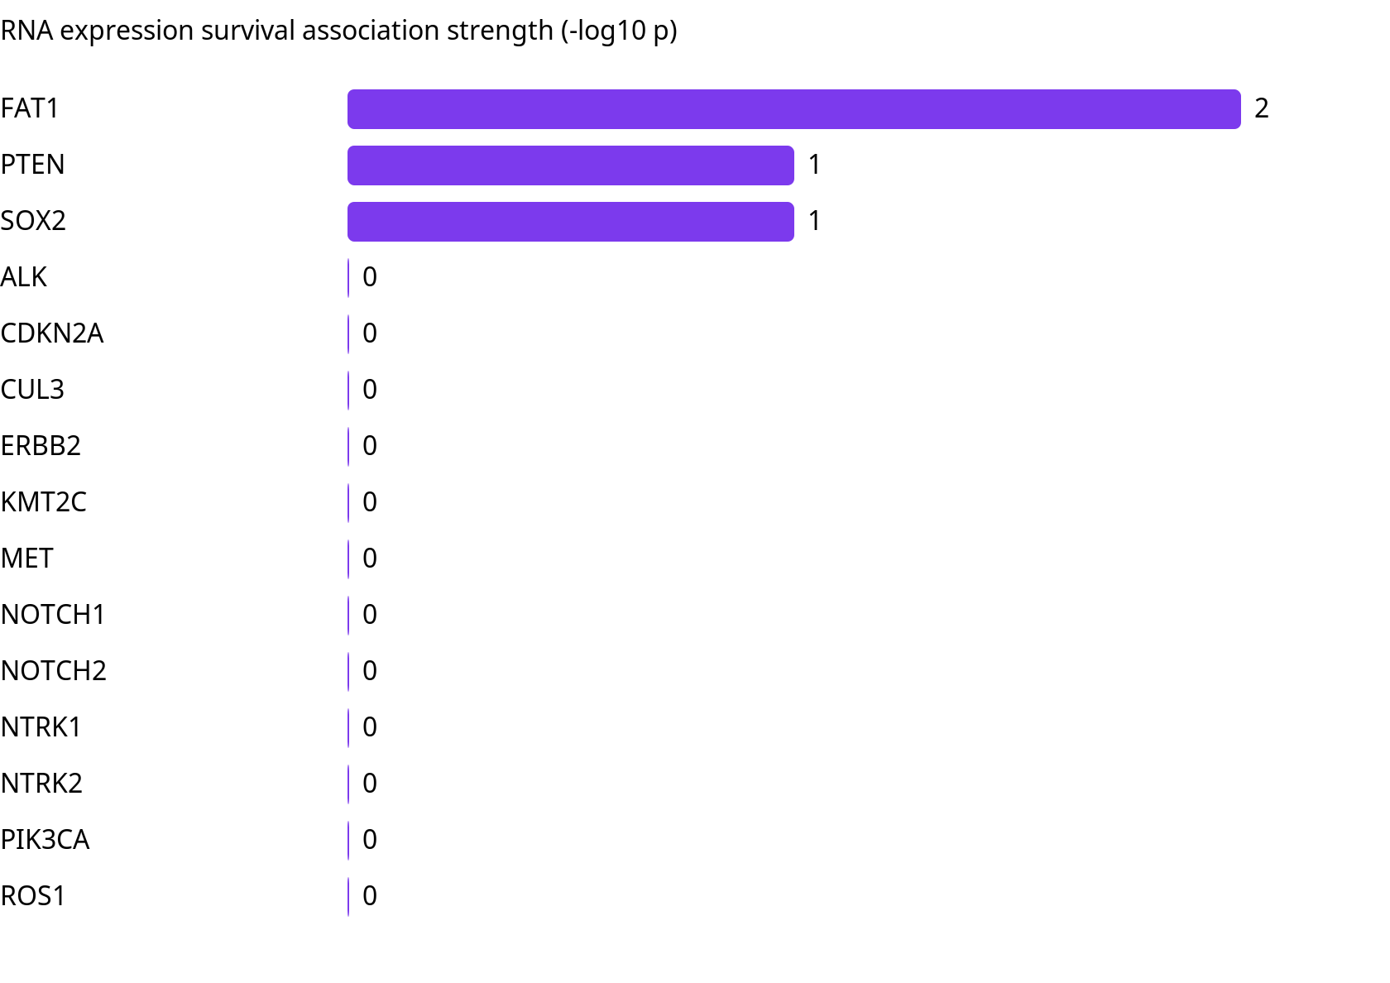
Rna expression survival pvalues

Slide 22
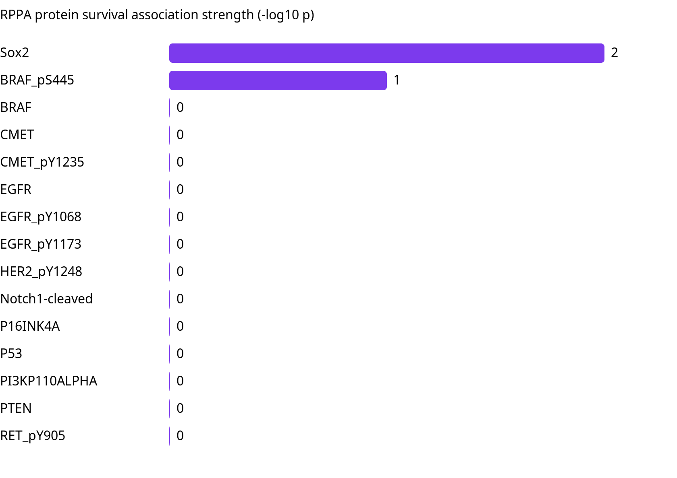
Protein expression survival pvalues

Slide 23
Treatment history and resistance proxies

Slide 24
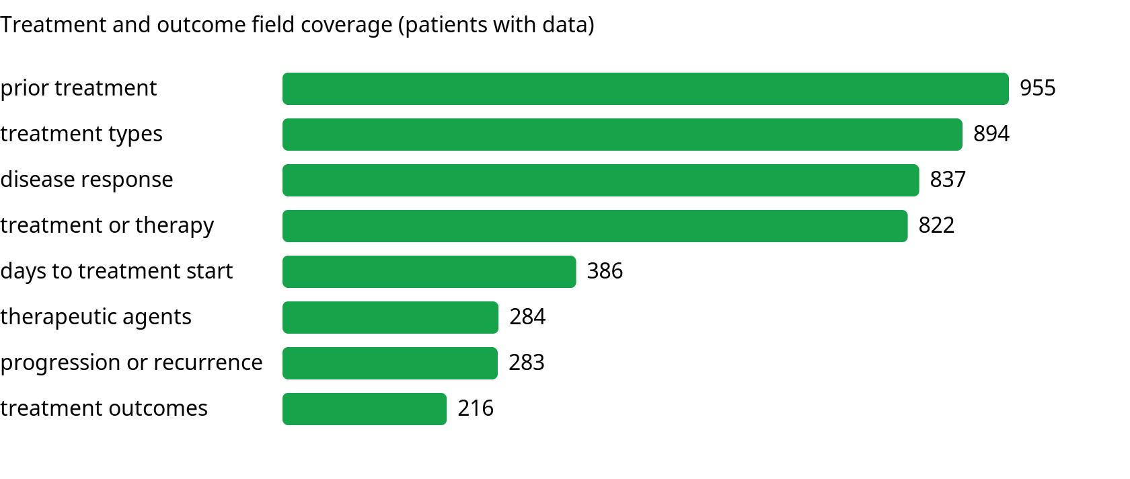
Treatment field coverage

Slide 25
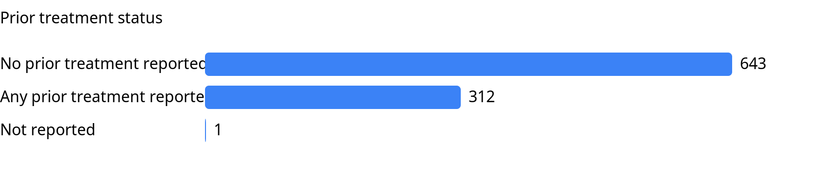
Prior treatment status

Slide 26
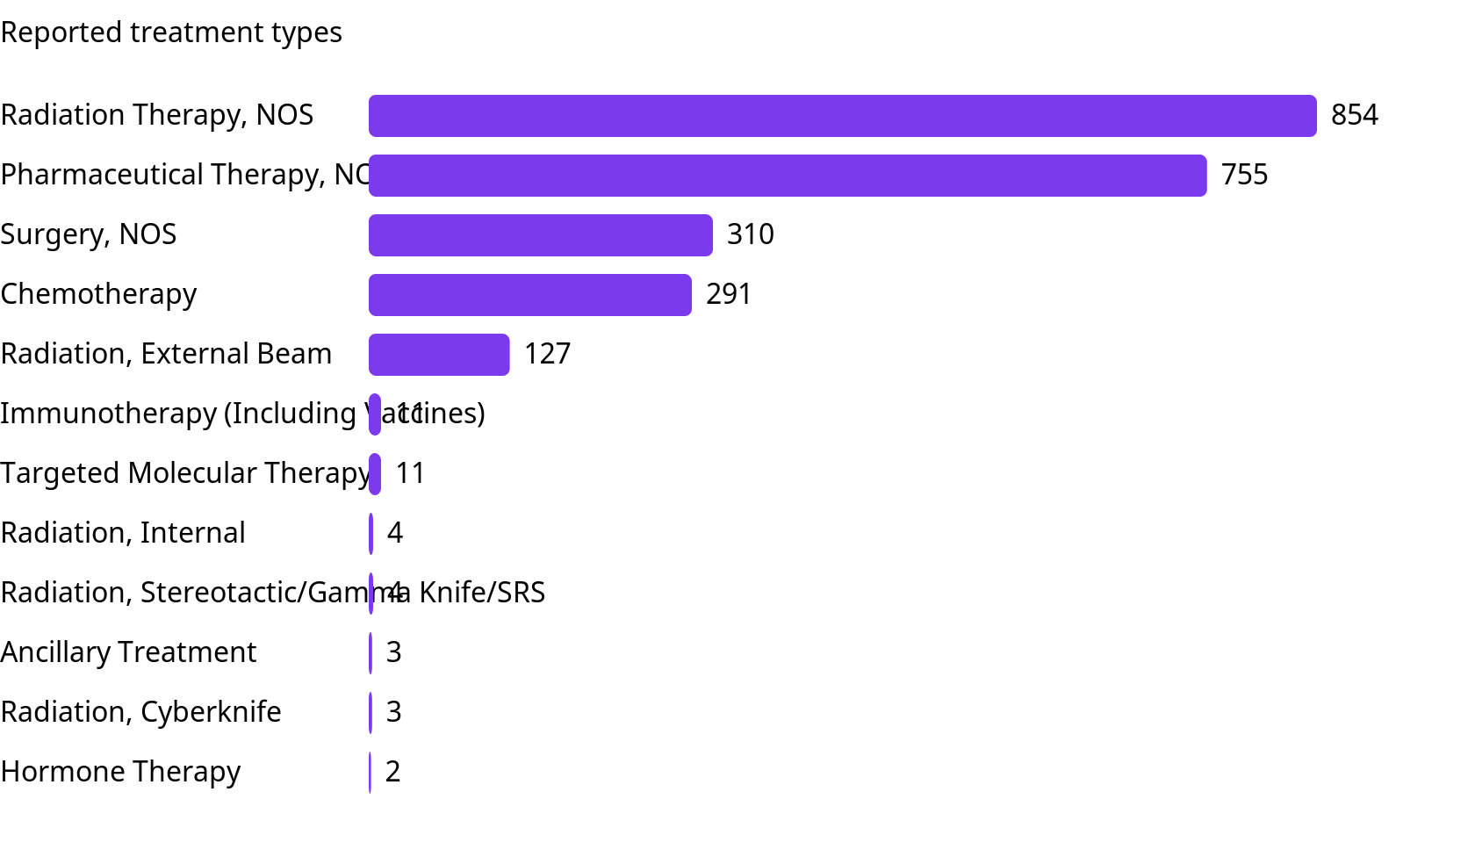
Treatment types

Slide 27
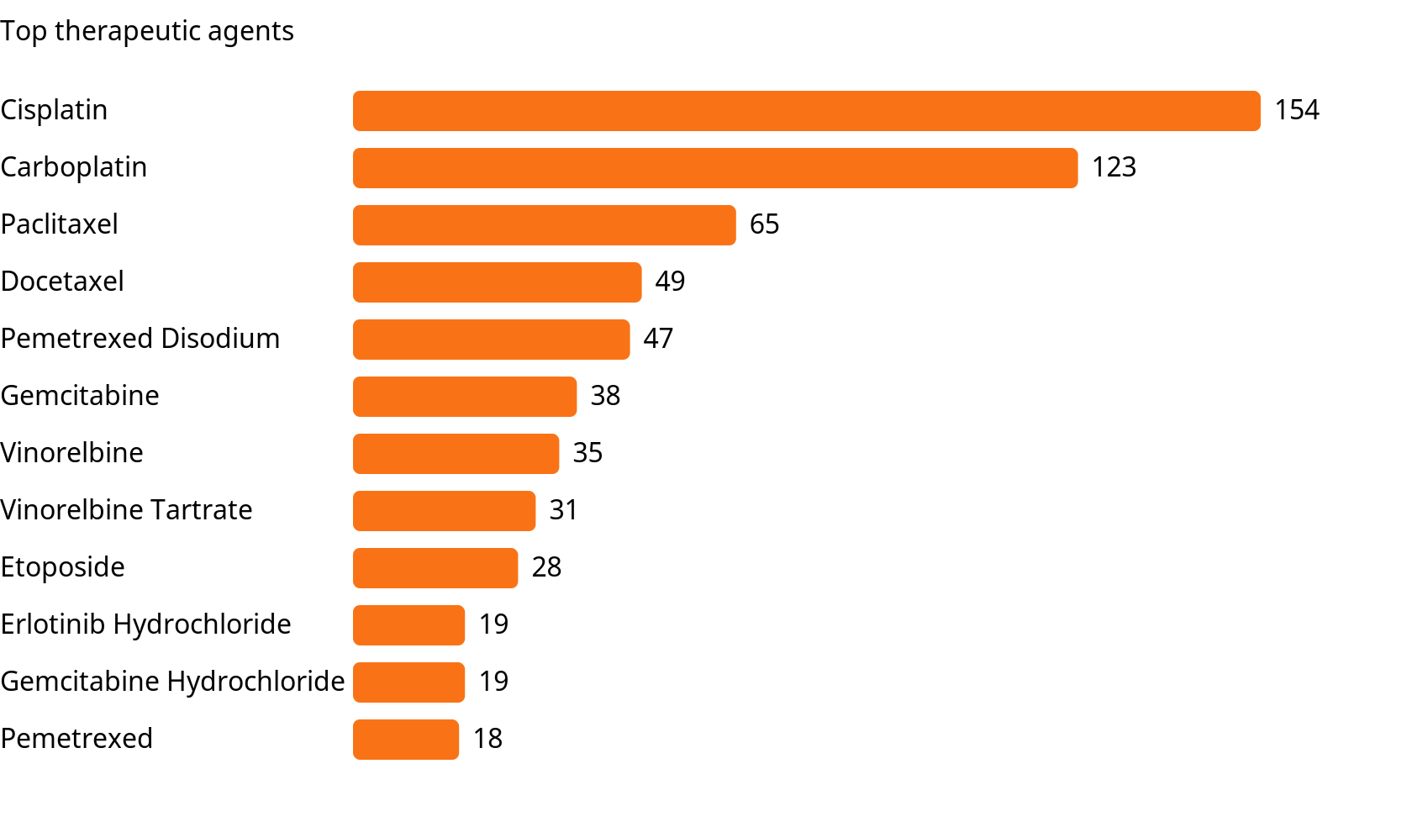
Top therapeutic agents

Slide 28
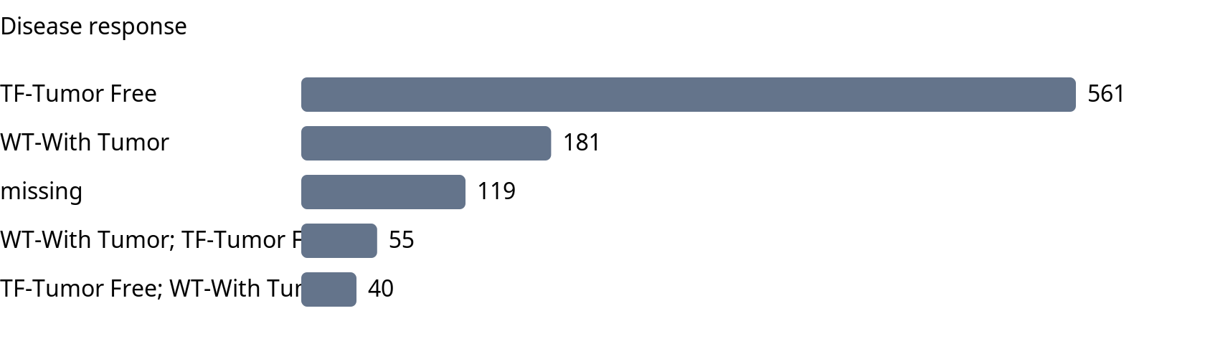
Disease response

Slide 29
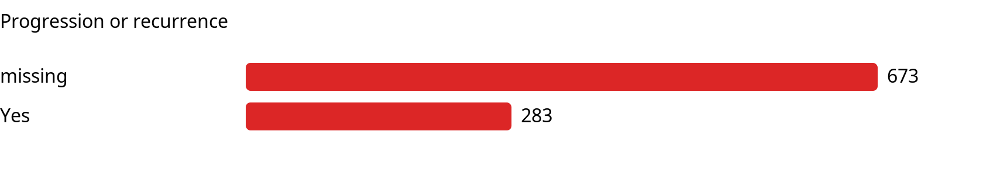
Progression or recurrence

Slide 30
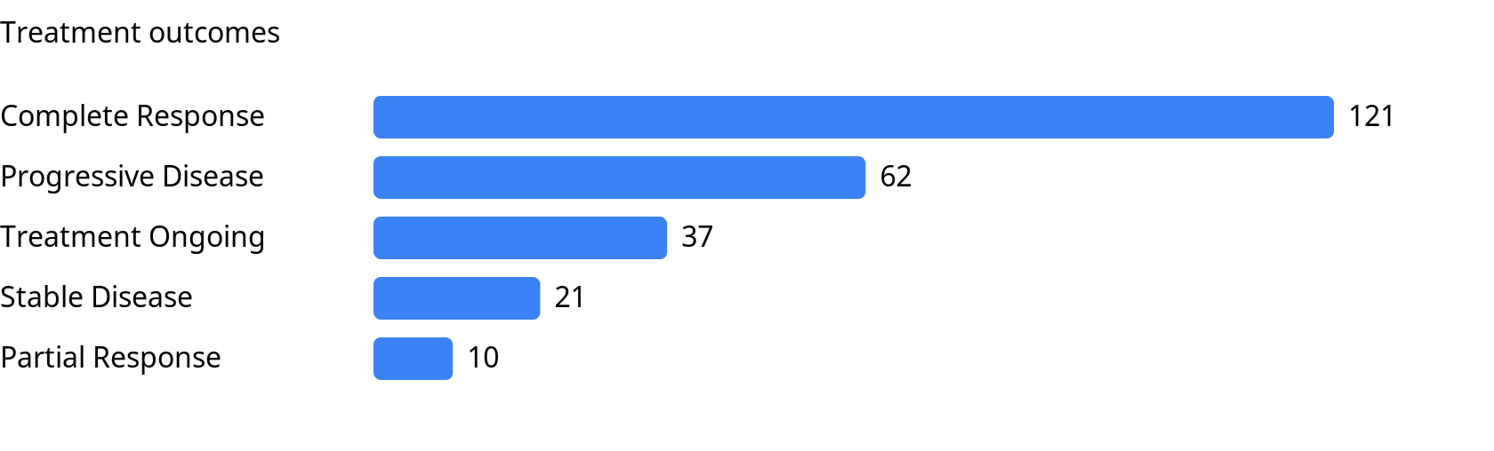
Treatment outcomes

Slide 31
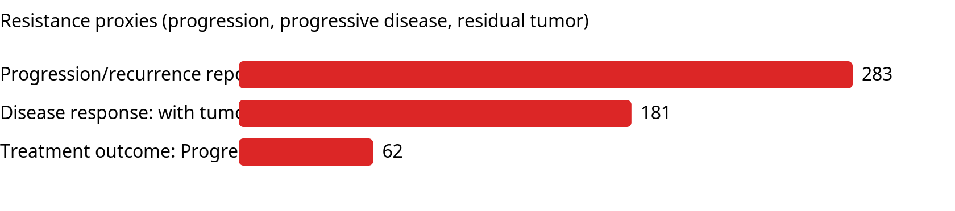
Resistance proxies

Slide 32
Significant Kaplan-Meier curves (p < 0.05)

Slide 33
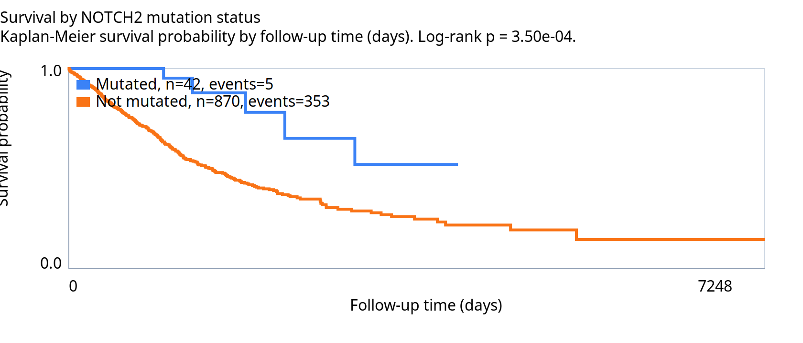
Mutation km NOTCH2

Slide 34
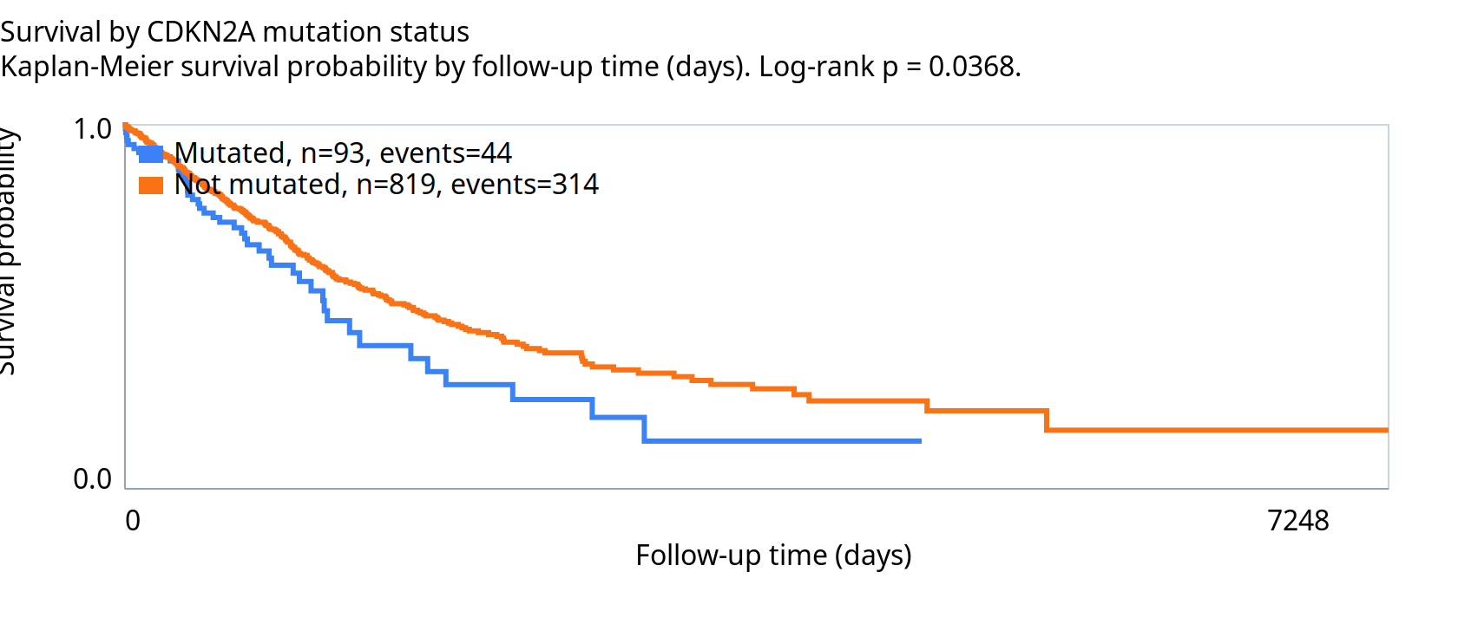
Mutation km CDKN2A

Slide 35
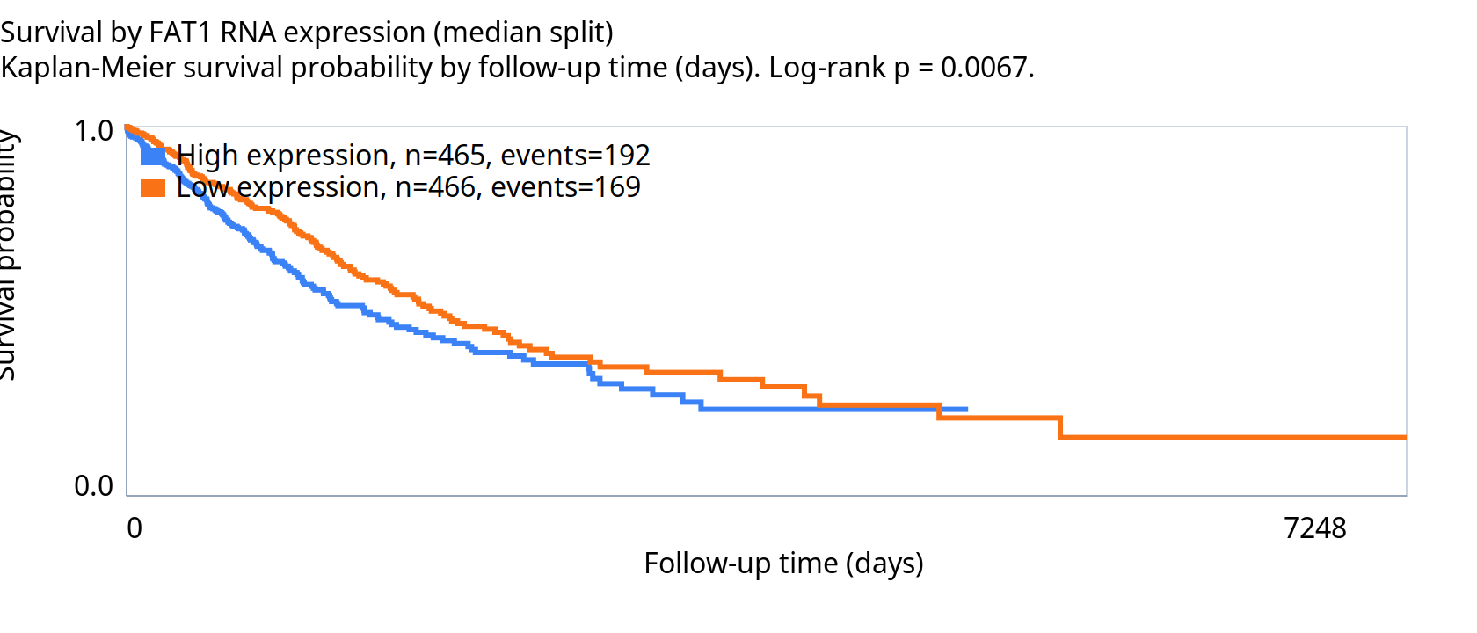
Rna km FAT1

Slide 36
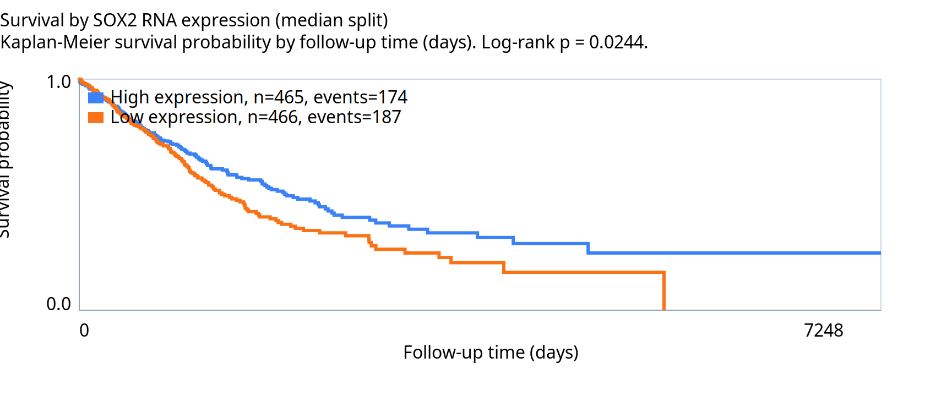
Rna km SOX2

Slide 37
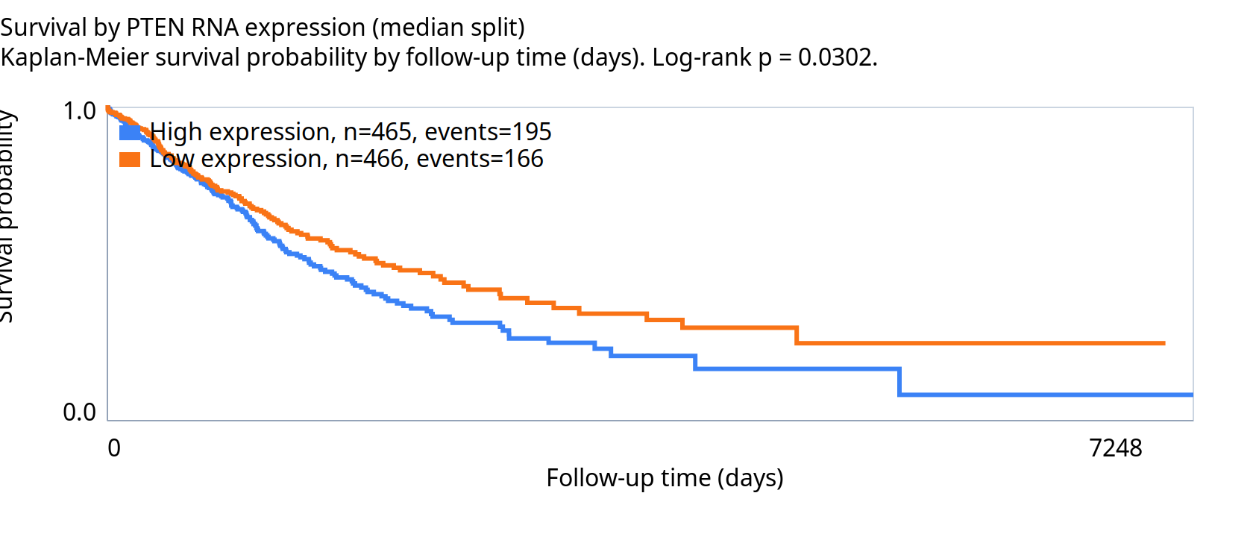
Rna km PTEN

Slide 38
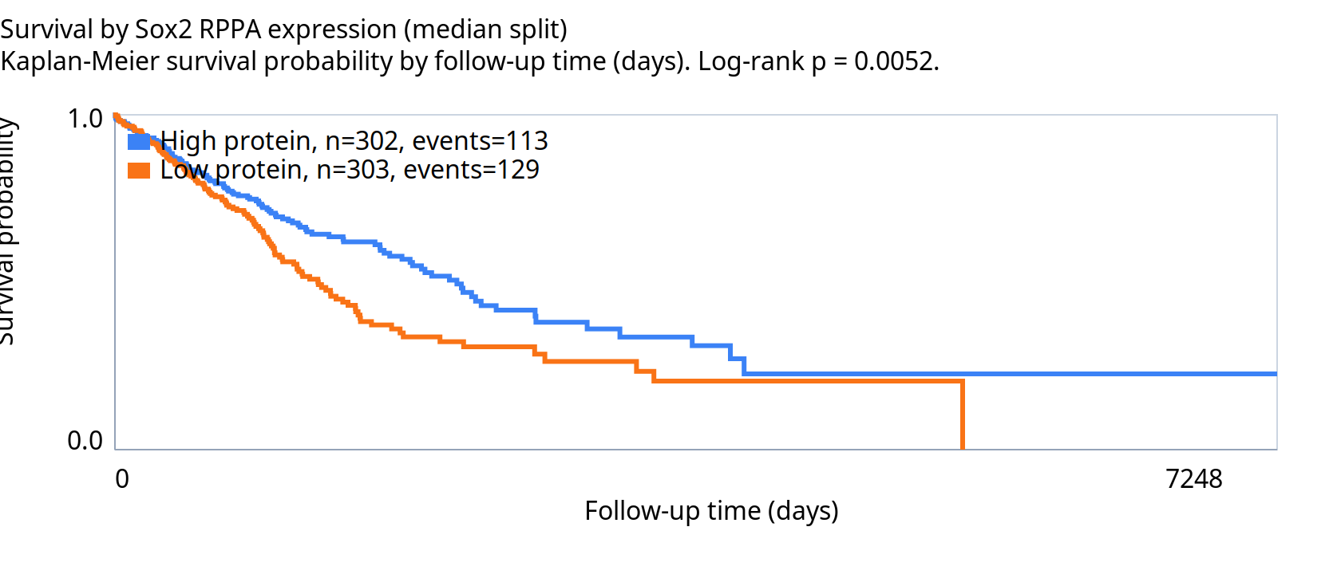
Protein km Sox2

Slide 39
Summary and caveats
Patients/cases: 956
Diagnostic slides: 1053
Mutation-analyzable patients: 932
Expression-analyzable patients: 951
Important mutation rows: 3012
Important RNA expression rows: 32310
Important RPPA protein rows: 12724
Survival analyses are exploratory and unadjusted.
RNA/protein survival uses median splits.
Treatment history is partially available; direct drug-resistance labels are sparse.
Resistance proxies include progression/recurrence and progressive disease outcomes.
Mutation MAF files capture SNVs/indels; fusions and CNAs need separate assays.

