Slide 1
Representative 20 TCGA Lung Patients
20 patients | 10 LUAD + 10 LUSC | 5 smokers + 5 non-smokers per histology
14,892 somatic mutations | Vital status: 12 alive, 8 dead
Clinical, mutation, RNA, RPPA, CNV, miRNA, methylation, and treatment summary

Slide 2
1. Cohort Overview

Slide 3
Histology distribution (LUAD vs LUSC)
Total patients: 20
LUAD: 10 (50.0%)
LUSC: 10 (50.0%)
Balanced 50/50 histology split by design.

Slide 4
Smoking status (selection strata)
Smokers: 10 (50.0%)
Non-smokers: 10 (50.0%)
5 smokers + 5 non-smokers per histology.

Slide 5
Age at diagnosis distribution
Mean age: 62.6 years
Median age: 65.7 years
Range: 33.3 – 81.7 years
Patients with age data: 20/20

Slide 6
2. Clinical Demographics

Slide 7
Vital status
Alive: 12 (60.0%)
Dead: 8 (40.0%)
Death rate: 40.0%
Events (survival_event=1): 8

Slide 8
Sex distribution
male: 15 (75.0%)
female: 5 (25.0%)

Slide 9
AJCC pathologic stage
Most common stage: Stage IB (n=6)
Early stage (I–II): 18
Advanced stage (III–IV): 3

Slide 10
3. Data Availability

Slide 11
Multi-omic data coverage
RPPA: 14/20 patients
miRNA: 17/20 patients
Methylation: 20/20 patients
All 20 have clinical, MAF, RNA, CNV, and H&E slide metadata.

Slide 12
Data modality row counts (median per patient)
Somatic mutations (MAF rows): median 349, total 14,892
Genome-wide RNA rows: 60,660 per sample (121,320 if duplicate samples)
RPPA peptide targets: 487 per patient (when available)
CNV segments: median 3638
miRNA features: median 1881

Slide 13
4. Somatic Mutations

Slide 14
Top driver-gene mutation frequency
TP53 mutated: 16/20 (80.0%)
Genes tracked: 28 important lung drivers
Frequencies from masked somatic MAF (whole-exome SNVs/indels).
Median mutation burden: 349 MAF rows/patient
Max burden: 3,650 (TCGA-18-3409)
Min burden: 46 (TCGA-44-2661)

Slide 15
Driver mutation frequency: LUAD vs LUSC
Grouped bars show histology-specific mutation rates.
KRAS LUAD: 30.0%
CDKN2A LUSC: 50.0%

Slide 16
Somatic mutation burden by patient
Total MAF rows: 14,892
Mean: 745
Median: 349
Higher counts reflect more exome-covered variants called.

Slide 17
Variant classification (cohort-wide)
Total classified variants: 14,892
Missense: 9,393
Silent: 3,702
Nonsense: 801
From whole-exome MAF files (not whole-genome).

Slide 18
5. Copy Number and miRNA

Slide 19
CNV alterations by patient (top 12 by total amp+del)
Total CNV segments: 90,039
Mean amp/patient: 258
Mean del/patient: 65
From ASCAT2 allele-specific segment files.

Slide 20
miRNA features quantified by patient
Patients with miRNA: 17/20
Missing miRNA: 3 patients
Median features: 1881

Slide 21
6. Treatment and Outcomes

Slide 22
Treatment types (patient mentions)
Patients with treatment types: 19/20
Coverage: 95.0%

Slide 23
Disease response
Reported: 17/20
Missing: 3
TF = Tumor Free; WT = With Tumor.

Slide 24
Prior treatment status
No: 13 (65.0%)
No; Yes: 4 (20.0%)
Yes; No: 3 (15.0%)

Slide 25
Progression or recurrence
Progression/recurrence Yes: 6 (30.0%)
Not reported: 14
Used as resistance proxy where direct labels are sparse.

Slide 26
7. Per-Patient Summary

Slide 27
Master patient summary (all 20)
Patient | Hist | Smk | Age | Stage | Vital | Mut rows | Driver genes
05-4410 | LUAD | smo | 62.66 | Stage IB | Alive | 1156 | ALK; BRAF; EGFR; FGFR1;
44-2661 | LUAD | non | 69.3 | Stage IA | Alive | 46 | EGFR
44-3917 | LUAD | smo | 33.34 | Stage IB | Alive | 480 | KEAP1; KRAS; NTRK1; ROS1
55-7815 | LUAD | non | 78.61 | Stage IB | Alive | 158 | KEAP1; KRAS
55-7907 | LUAD | smo | 78.02 | Stage II | Dead | 1263 | ALK; KMT2C; KMT2D; KRAS;
73-A9RS | LUAD | smo | 41.51 | Stage II | Dead | 1048 | BRAF; CDKN2A; KMT2C; NTR
86-7701 | LUAD | non | 66.28 | Stage IV | Alive | 208 | STK11; TP53
86-7954 | LUAD | smo | 68.62 | Stage IB | Alive | 225 | TP53
86-8279 | LUAD | non | 46.63 | Stage II | Alive | 559 | ALK; ERBB2; KMT2C; NF1;
86-8672 | LUAD | non | 59.36 | Stage II | Dead | 329 | CDKN2A; FAT1; KEAP1; TP5
18-3409 | LUSC | smo | 80.62 | Stage IA | Alive | 3650 | ALK; CDKN2A; DDR2; FAT1;
18-5595 | LUSC | non | 50.95 | Stage IB | Dead | 266 | CUL3; KEAP1; PIK3CA
22-4613 | LUSC | smo | 73.16 | Stage IA | Dead | 689 | ALK; CDKN2A; NF1; PIK3CA
37-3789 | LUSC | non | 65.11 | Stage IB | Alive | 308 | KMT2D; TP53
56-5898 | LUSC | smo | 69.65 | Stage IA | Alive | 160 | TP53
56-A5DR | LUSC | non | 81.66 | Stage IA | Alive | 1194 | BRAF; CDKN2A; FAT1; KMT2
60-2698 | LUSC | smo | 62.42 | Stage II | Dead | 2198 | CDKN2A; CUL3; EGFR; KMT2
70-6722 | LUSC | non | 47.44 | Stage II | Alive | 322 | EGFR; KMT2D; PIK3CA; TP5
85-8277 | LUSC | non | 70.62 | Stage II | Dead | 264 | CDKN2A; NOTCH1; TP53
L3-A524 | LUSC | smo | 45.9 | Stage II | Dead | 369 | FAT1; NFE2L2; NTRK3; TP5
Full table: master_patient_summary.csv in visual_report/

Slide 28
8. Detailed Visualizations

Slide 29
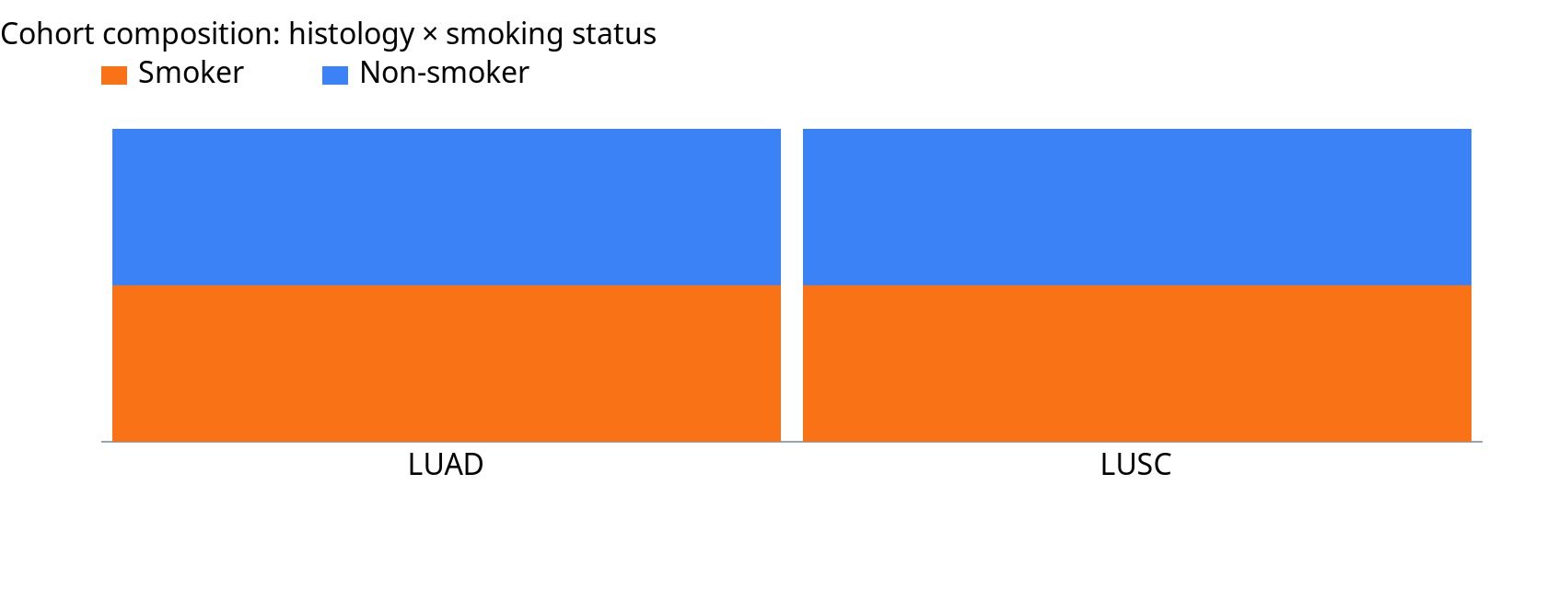
Cohort Composition

Slide 30
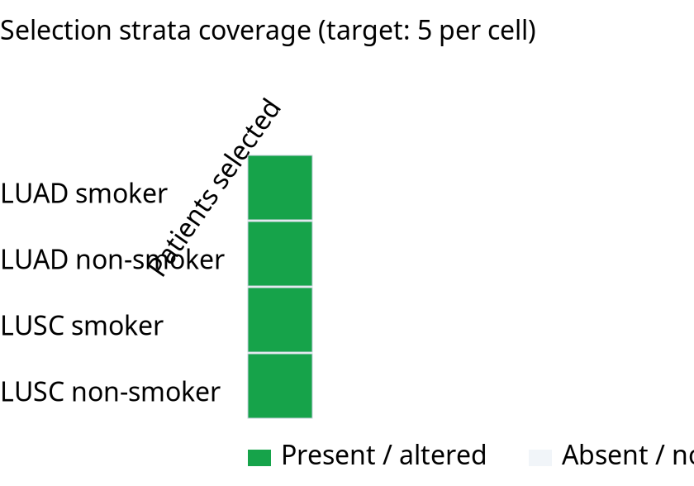
Histology Smoking Matrix

Slide 31
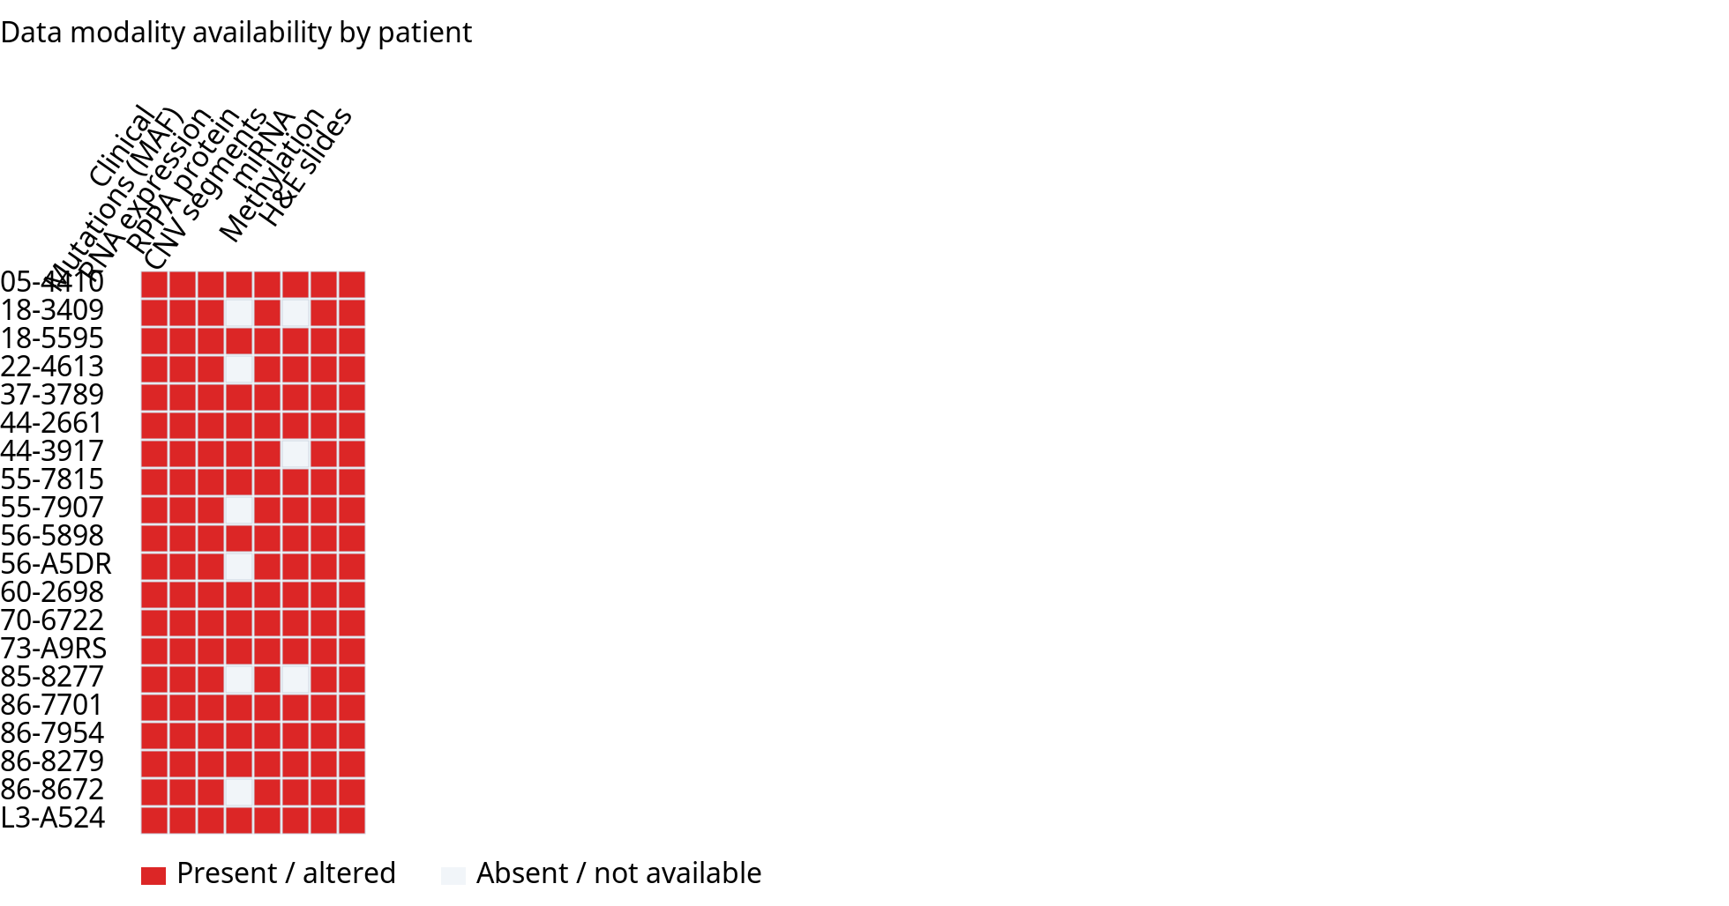
Data Availability Heatmap
Heatmap intensity reflects presence (mutations) or log-scaled expression (RNA).

Slide 32
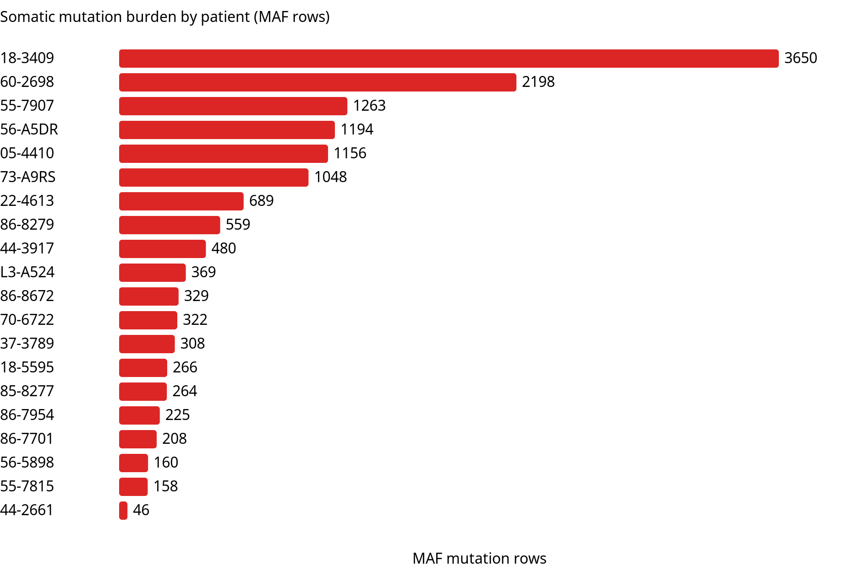
Mutation Burden By Patient

Slide 33
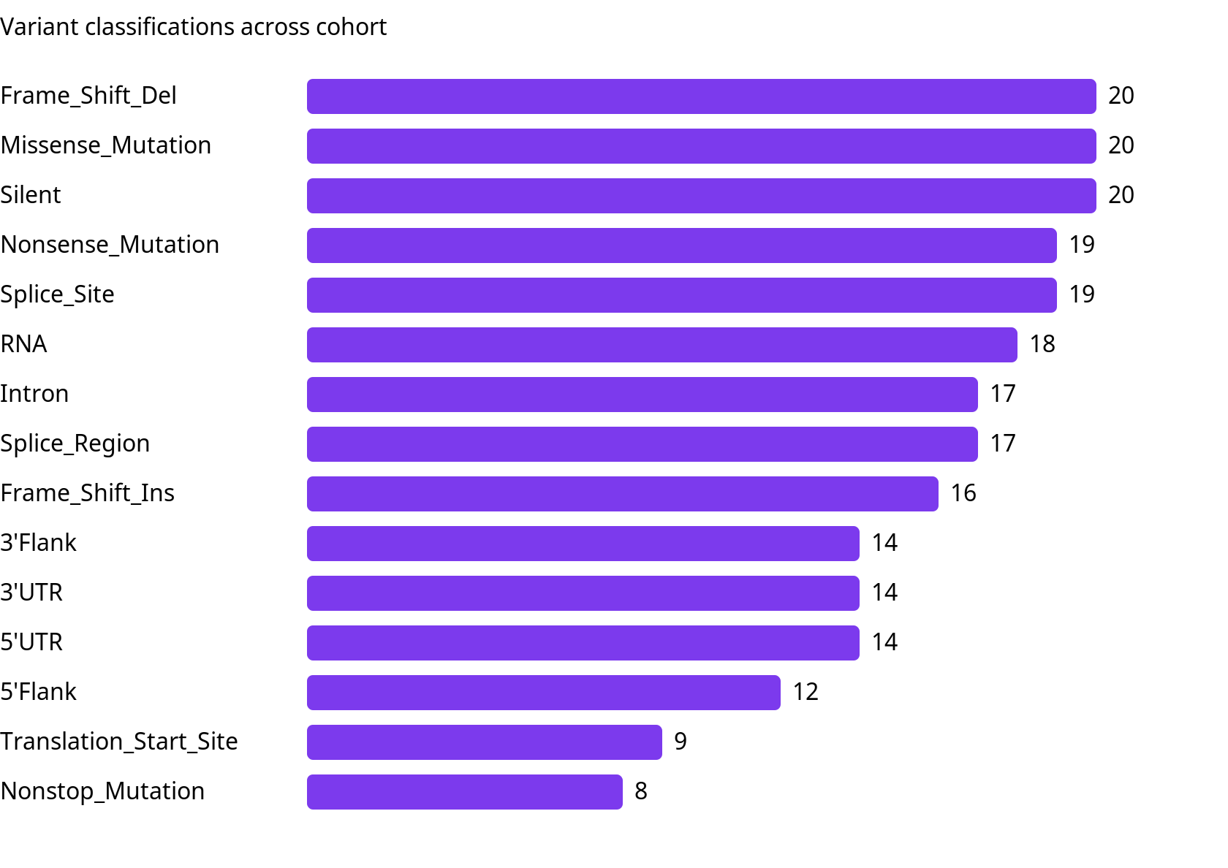
Variant Classification Cohort

Slide 34
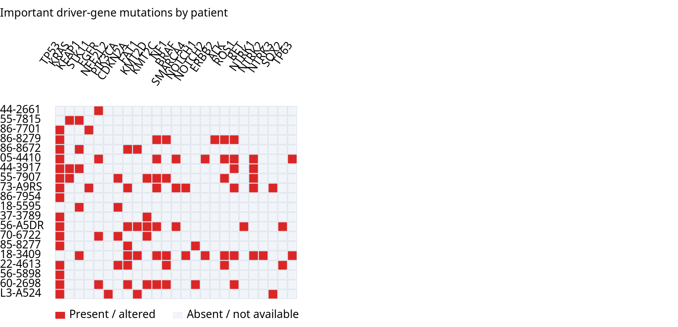
Driver Gene Mutation Matrix

Slide 35
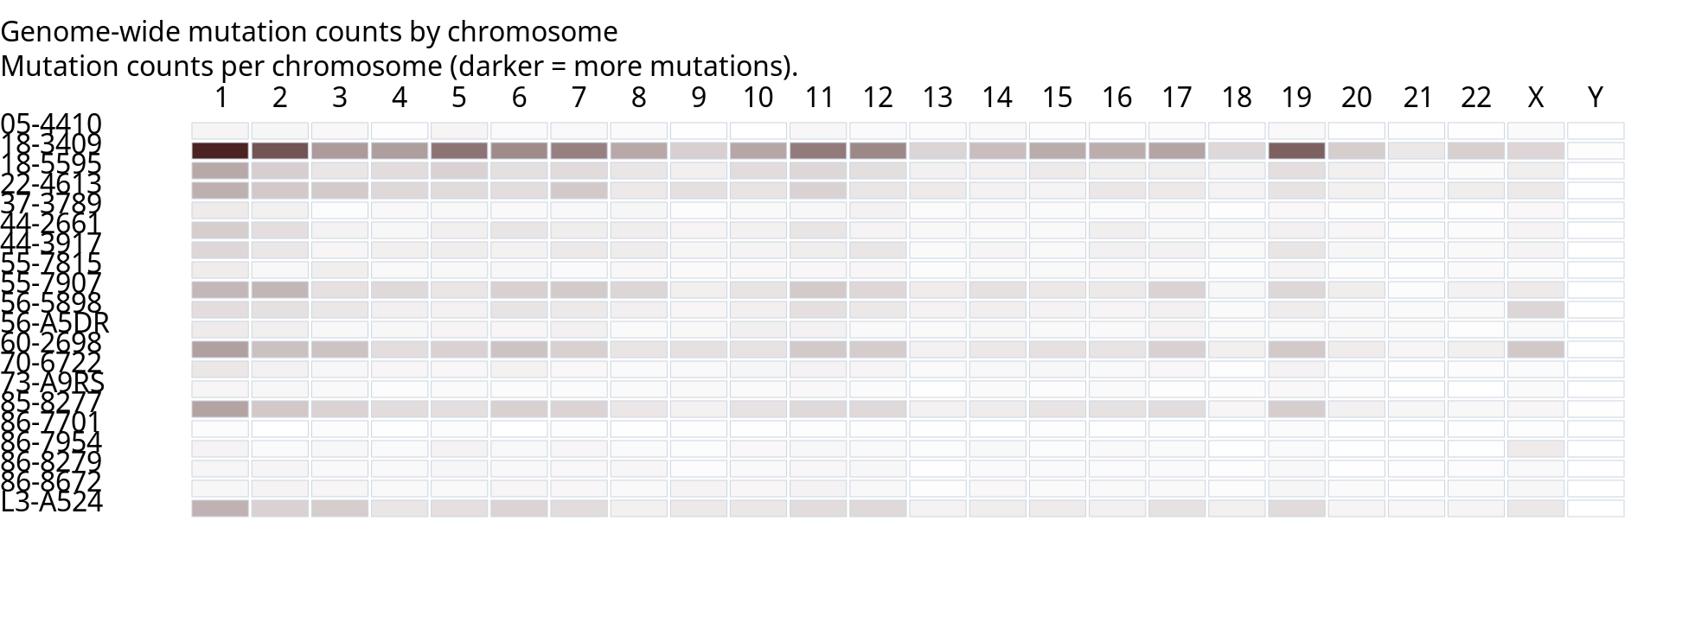
Chromosome Mutation Landscape
Whole-exome mutation counts by chromosome (WXS coverage, not full genome).

Slide 36
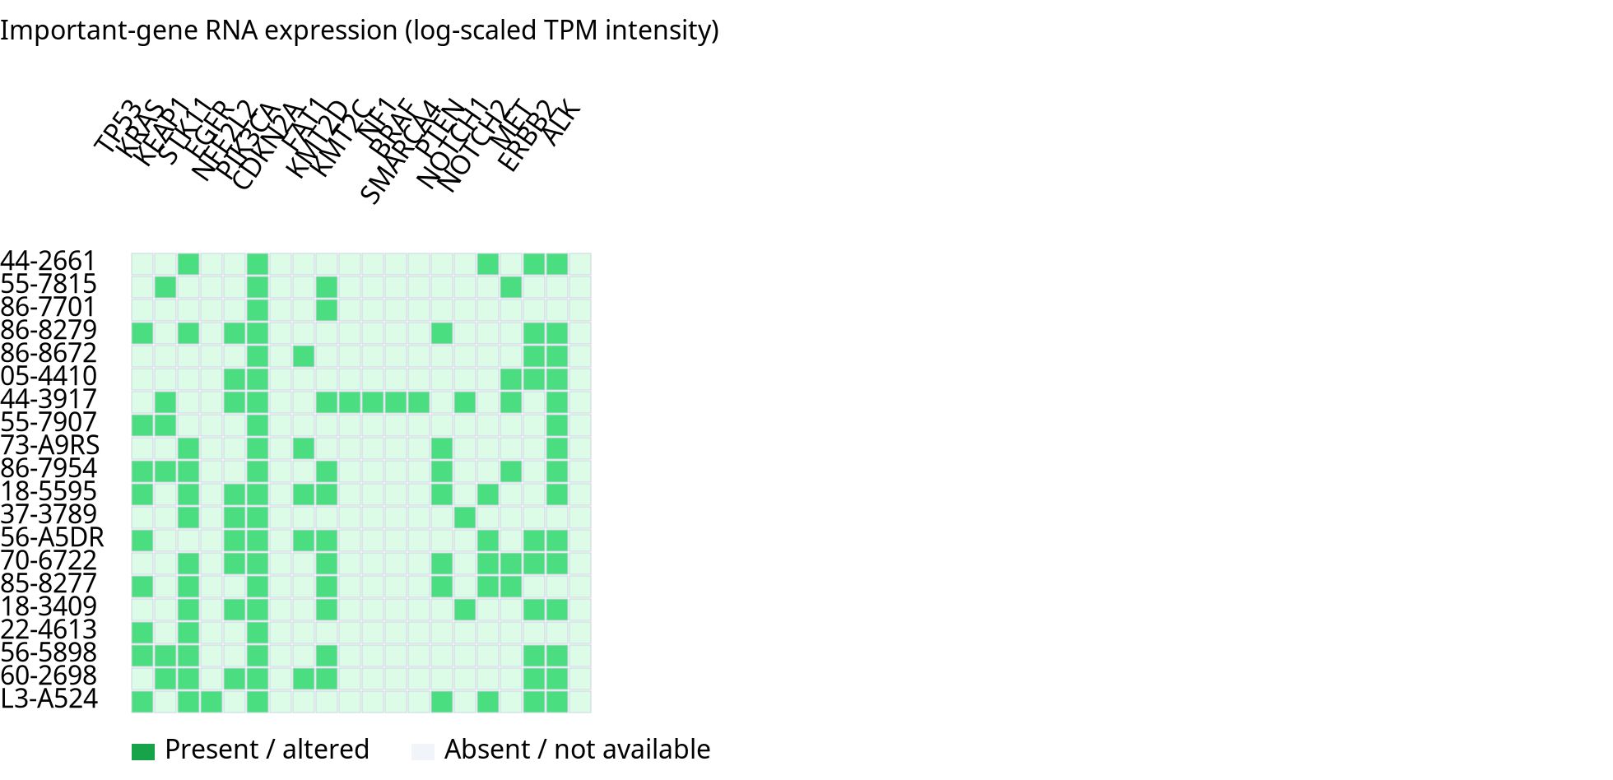
Important Gene Rna Heatmap
Heatmap intensity reflects presence (mutations) or log-scaled expression (RNA).

Slide 37
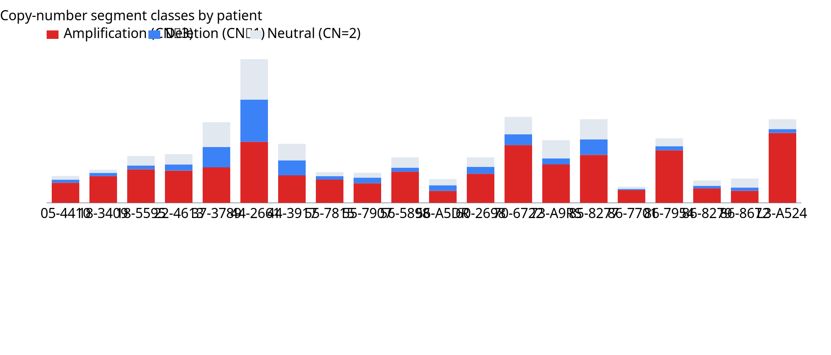
Cnv Alteration Burden

Slide 38
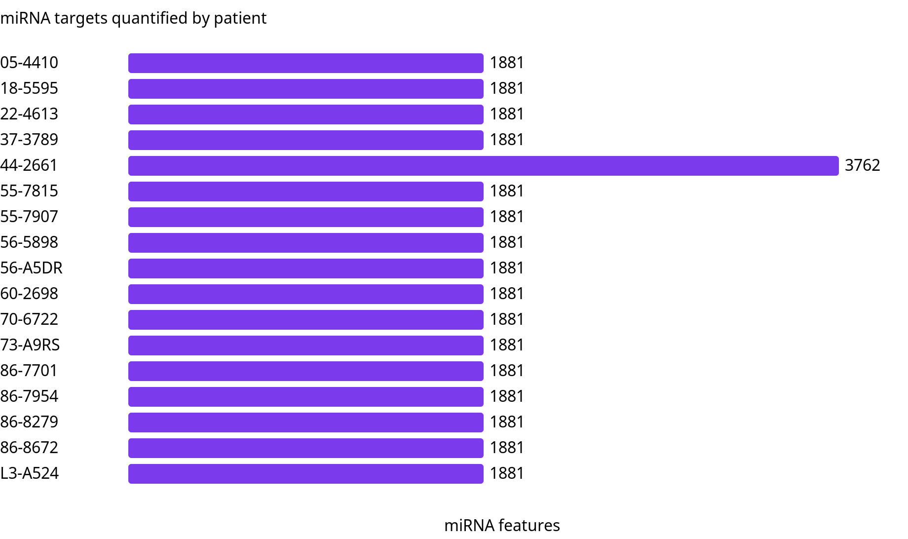
Mirna Coverage

Slide 39
Summary and caveats
Cohort: 20 representative patients (10 LUAD + 10 LUSC; balanced smoking strata).
Total somatic mutations: 14,892 MAF rows (median 349/patient).
Data: RNA all 20; RPPA 14/20; miRNA 17/20; methylation 20/20.
Mutations are whole-exome SNVs/indels; fusions and CNAs require separate assays.
CNV from SNP6/WGS segment files; RNA TPM for 30 curated driver genes.
Treatment/resistance: progression and disease response used as proxies.
Regenerate: python3 data/tcga_lung/visualize_representative_patients.py
PowerPoint: python3 data/tcga_lung/generate_representative_patient_powerpoint.py

