Slide 1
Group Members
Muhammad Aon (BSCS17-29)
Abdul Hakeem (BSCS17-27)
Muhammad Irfan (BSCS17-13)
Muhammad Kashif (BSCS17-24)

Slide 2
Muhammad Aon
BSCS17-29

Slide 3
Project:
Super Store Management System

Slide 4
What is super store?
Super store is a place where access material is kept which will be used when require

Slide 5
Super store management system
Store management is to issue the material in the right quantities, at the right time to the right place.

Slide 6
Problems with the existing system
Lack of Security of data.
Time Consuming.
Data Redundancy
Lack of Concurrency
Less Efficiency
Consumes large Volume of Paper Work.

Slide 7
Why we need this system?
Improves the accuracy of goods.
Increase efficiency and productivity.
Helps save time and money.
Flexibility of arrangement .
Cost effective.
Efficient space utilization.
Error Reduction.

Slide 8
Requirement analysis
Super Store and related Information.
Details of Products to Sell.
Staff and Employee Related Details.
Stock Details.
Product Details.
Customer Details.
Supplier Details.

Slide 9
Abdul Hakeem
BSCS17-27

Slide 10

Home page

Slide 11
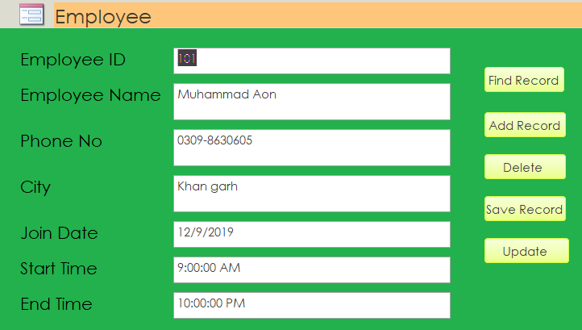
Employee

Slide 12
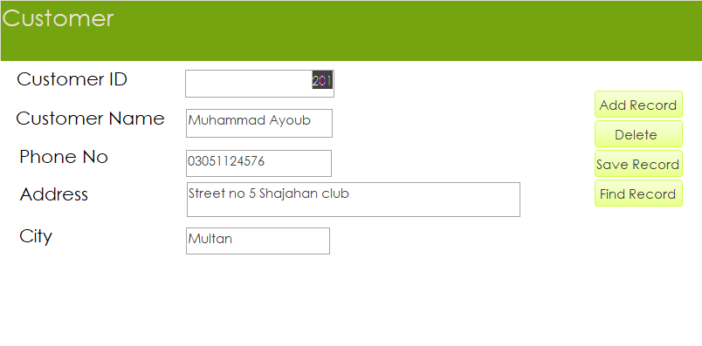
costumer

Slide 13
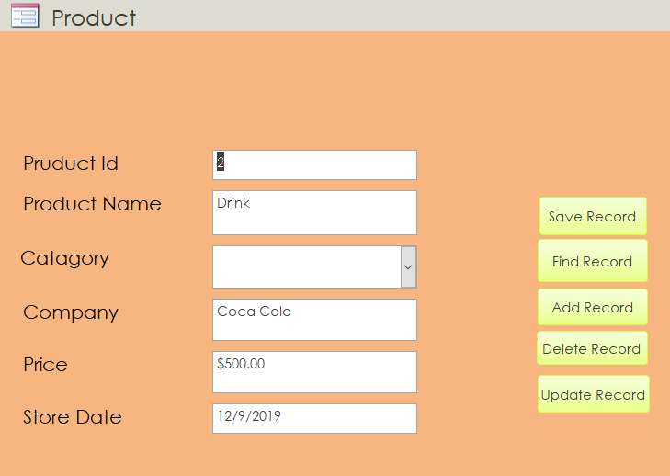
product

Slide 14
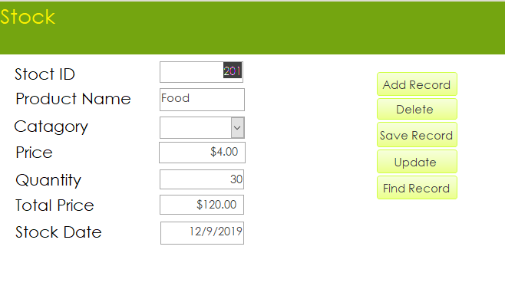
stock

Slide 15
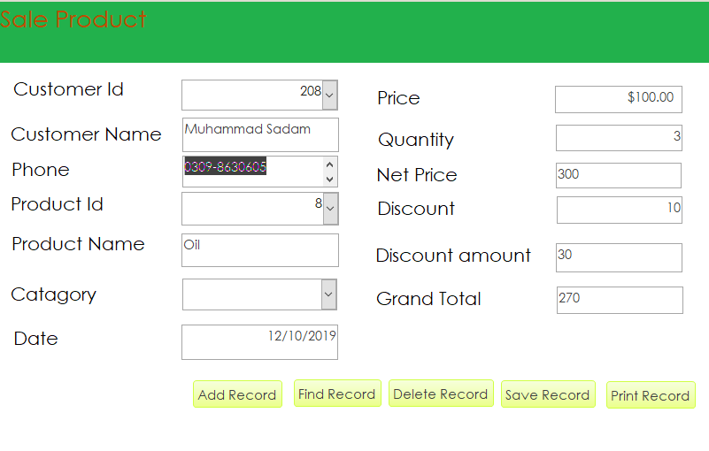
Sale product

Slide 16
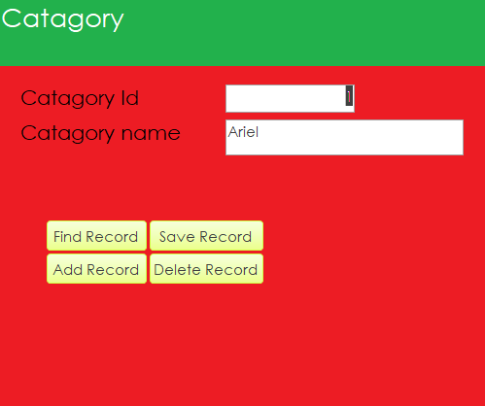
category

Slide 17
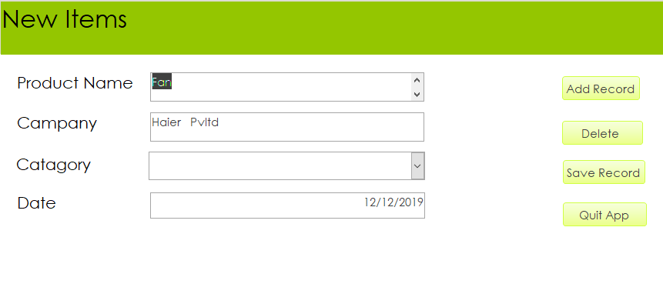
New items

Slide 18
Muhammad Irfan
BSCS17-13

Slide 19
System implement
Computer will be used to maintain the records costumer, sales, purchases
A computerized report in a particular format can be generated
Find the costumer, employee, other details very easily
The details of sales and purchase recorded in system

Slide 20
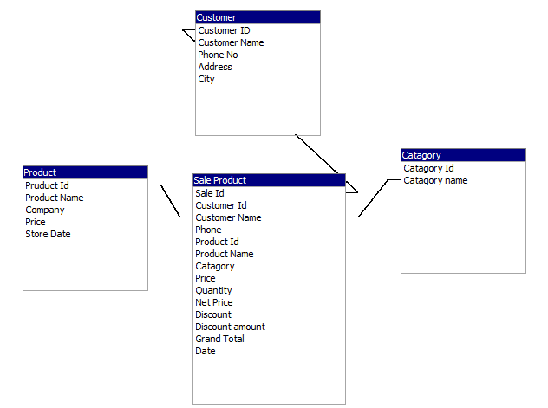
E-r diagram

Slide 21
Data Flow Diagram
Super Store Management System
Costumer
Employee
Product
Category
Stock
Sale Product
New Items

Slide 22
Muhammad Kashif
BSCS17-24

Slide 23
Normalization
List of attributes:-
Costumer: Costumer Name, Costumer Id, Costumer Address, Mobile Number, City
Product: Product Id, Product Name, Product Category, Product Price
Employee: Employee Id, Employee Name, Contact, Joining Date, Starting Time, Ending Time
Category: Category Id, Category Name
Stock: Stock Id, Product Name, Price, Quantity, Total Price, Stock Date

Slide 24
Continue
Sale Product: Costumer Id, Costumer Name, Phone, Product Id, Product Name, Category, Price, Quantity, Net Price
New Items: Product Name, Company, Category, Date

Slide 25
Thank You

