Slide 1
WORK WEEK
An HR Management System
San Jose State University

Slide 2
CS 251A - TEAM COBRA
Abhinaya Koduri
Antonio Ontiveros
Neethu Sundarprasad
Samuel Ordonia
San Jose State University

Slide 3
AGENDA
Introduction to the domain
High level use cases
Employee Management Package
Organizational Structure Package
Identity Information Package
Payroll Package
Conclusion
San Jose State University

Slide 4






WorkWeek Business Services
Personnel
Management
Financial Management
Payroll
Benefits
Network
Organizational Structure
Management
Work/Projects
San Jose State University

Slide 5
Why WorkWeek?
WorkWeek Personnel Management addresses the full spectrum of enterprise human capital needs in one, easy -to-use system.
WorkWeek Recruiting helps you build a great team, from creating your workforce plans all the way through onboarding your new hires.
WorkWeek Payroll revolutionizes the entire payroll process with a unified payroll and HCM system. It gives you the tools you need to flexibly define compensation packages across all areas of your organization around the globe.
WorkWeek Benefit Management allows you to define, manage, and adjust benefit plans to meet your unique requirements—all from a single,unified system.
San Jose State University

Slide 6
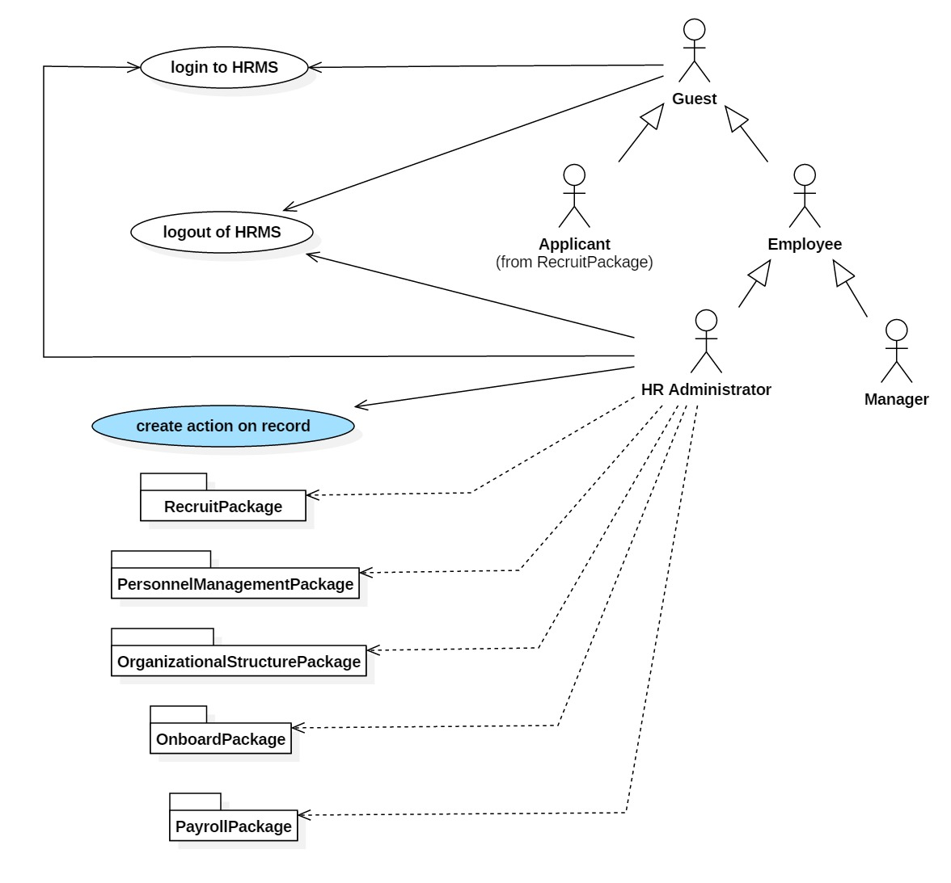
High Level UseCase Diagram
San Jose State University

Slide 7
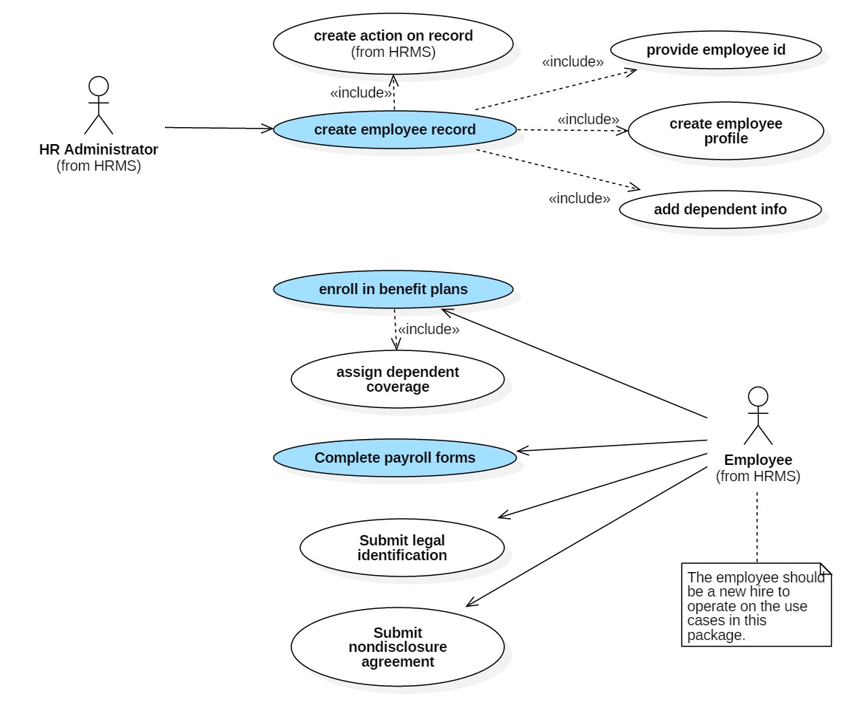
Onboarding UseCase Diagram
San Jose State University

Slide 8
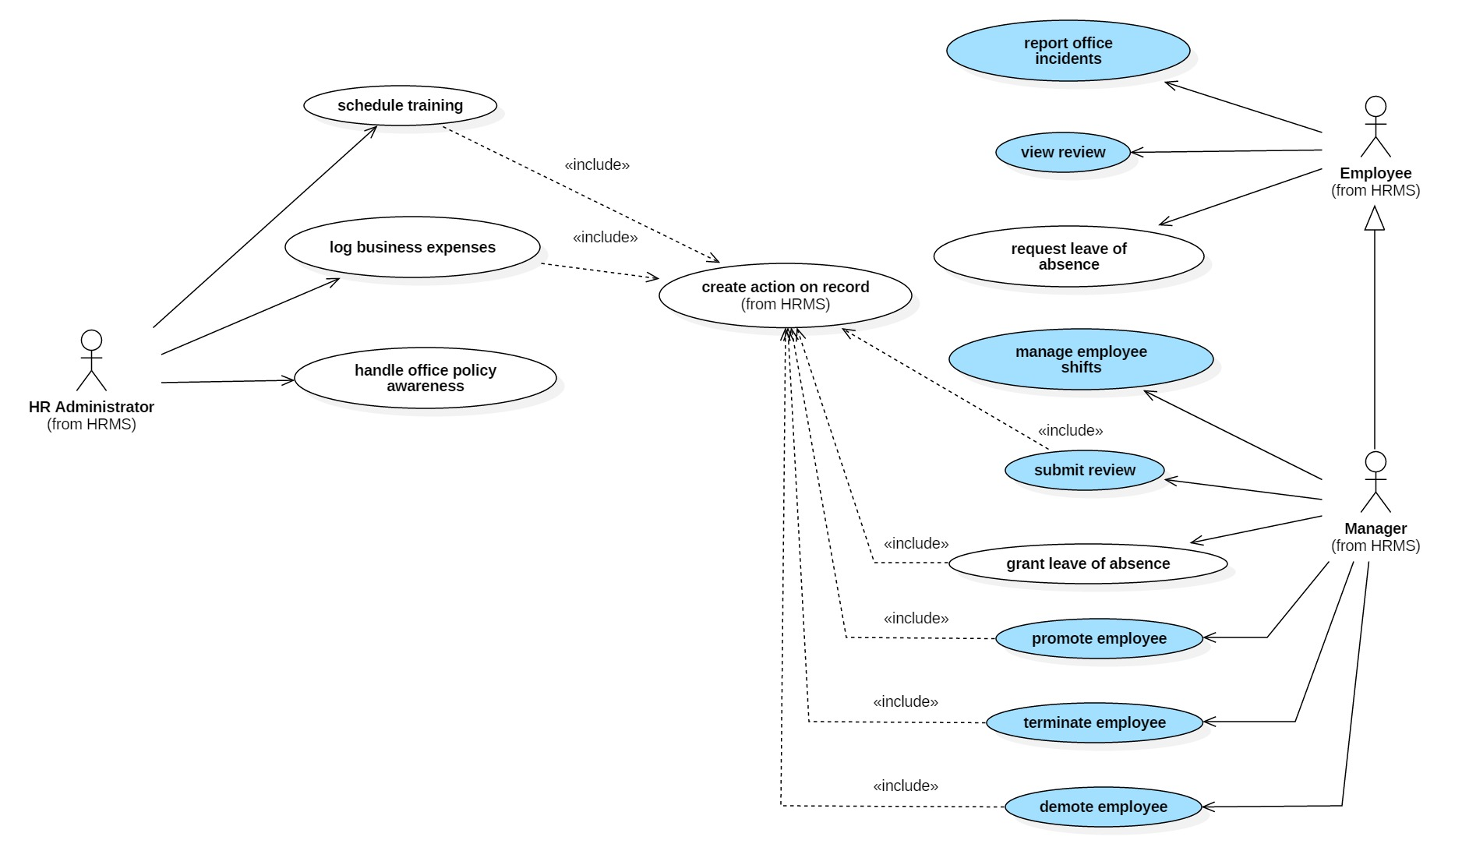
Personnel Management UC Diagram
San Jose State University

Slide 9
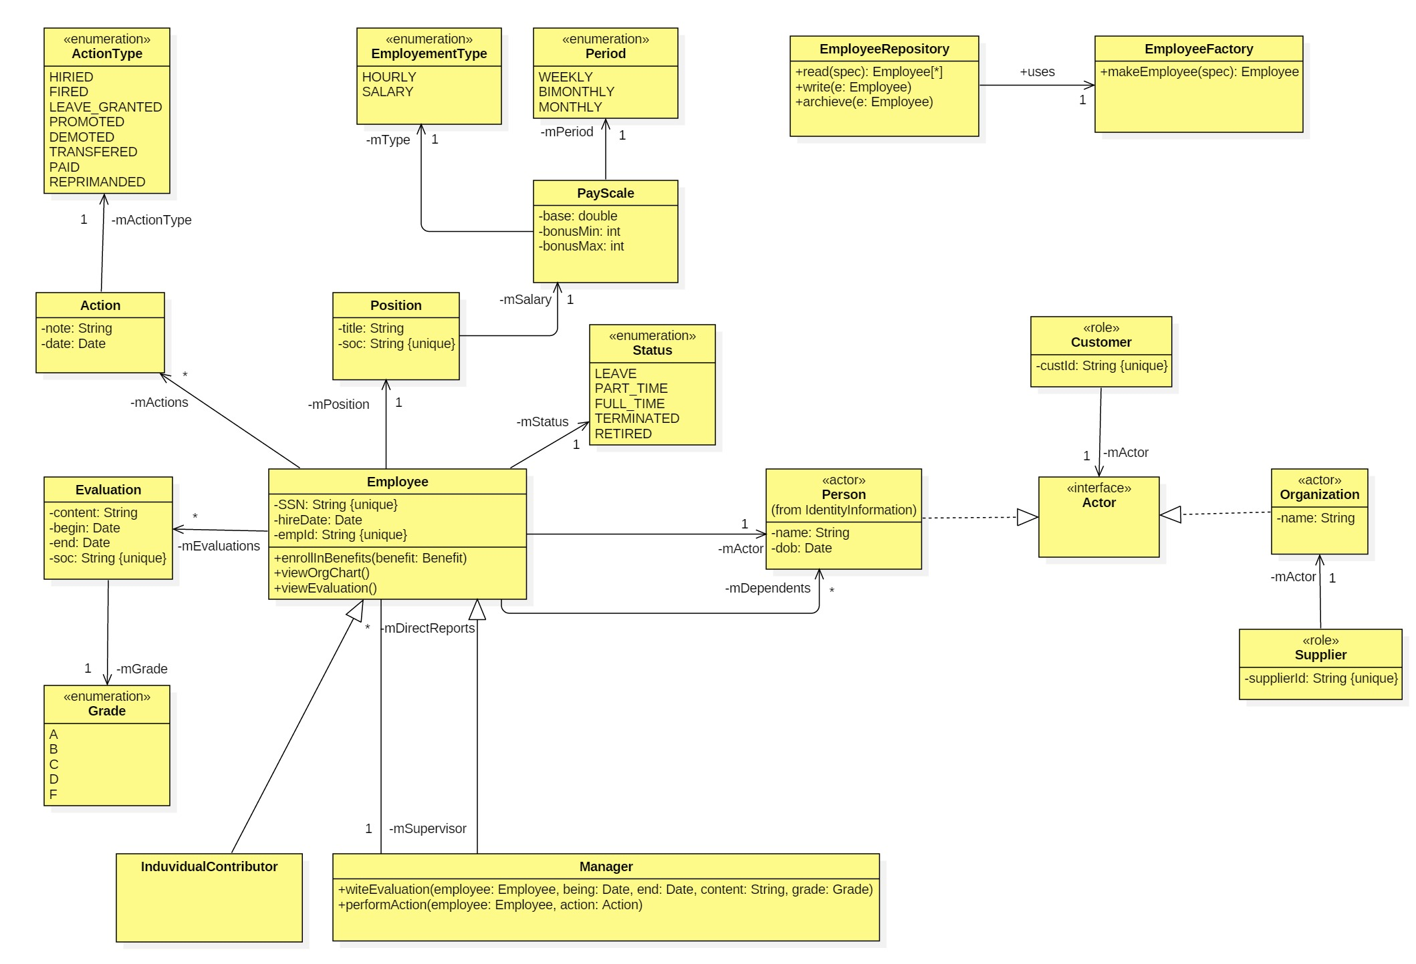
Employee Management Domain Model
San Jose State University

Slide 10
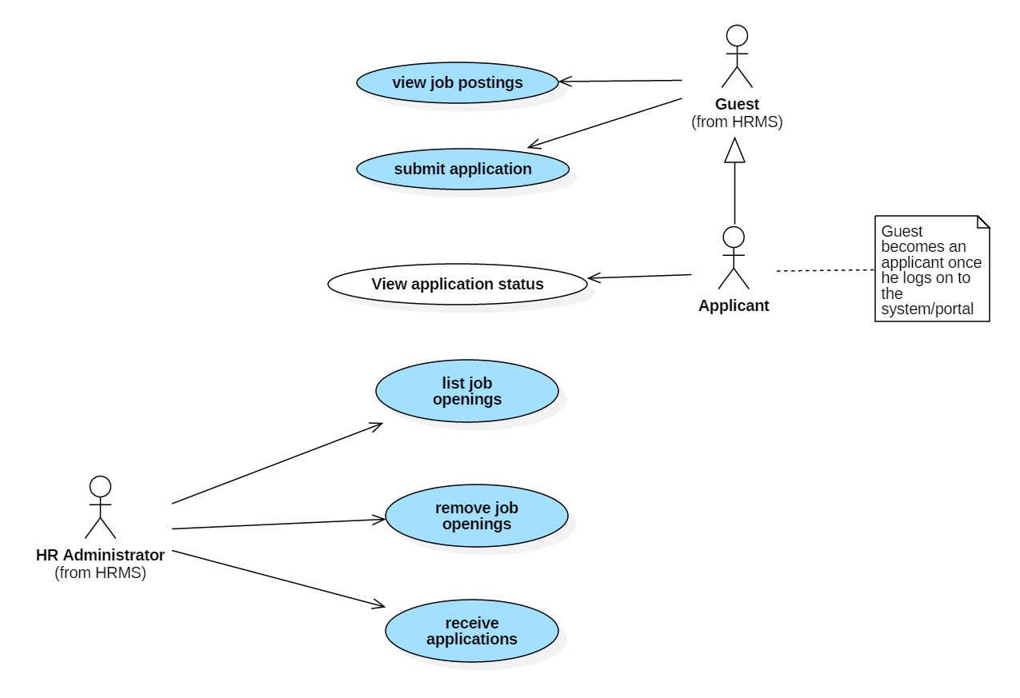
Recruitment UseCase Diagram
San Jose State University

Slide 11
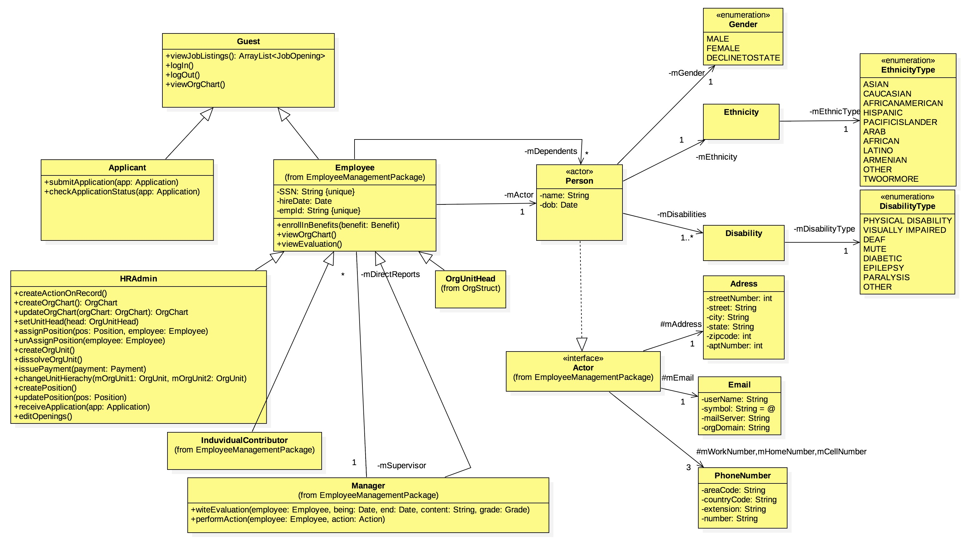
Identity Information Domain Model
San Jose State University

Slide 12
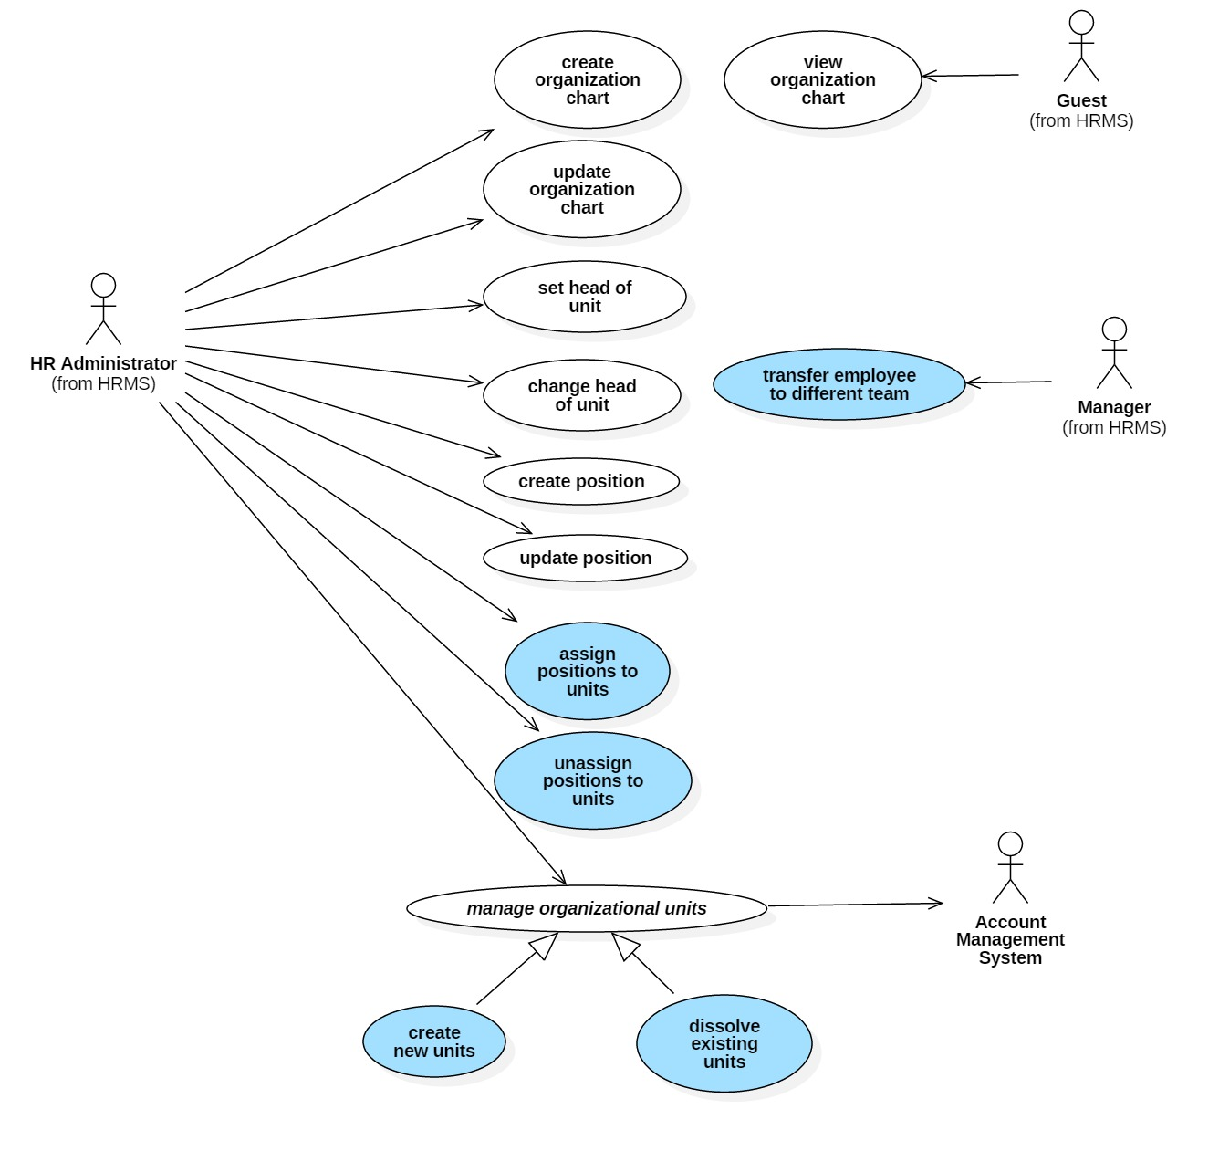
Organizational Structure UseCase Diagram
San Jose State University

Slide 13
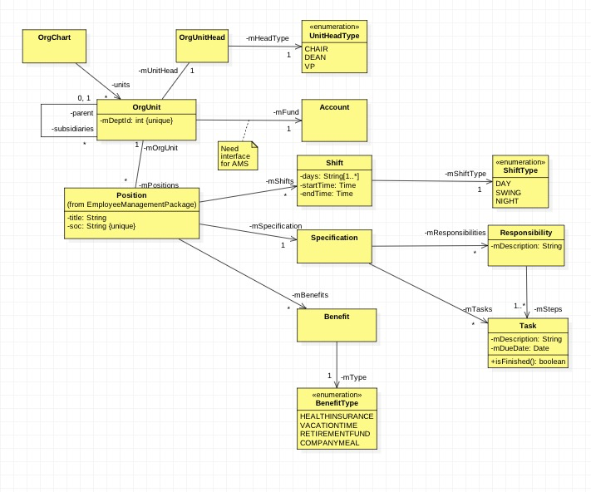
Organizational Structure Domain Model
San Jose State University

Slide 14
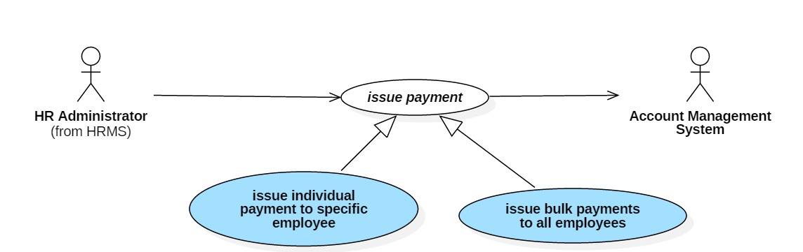
Payroll UseCase Diagram
San Jose State University

Slide 15
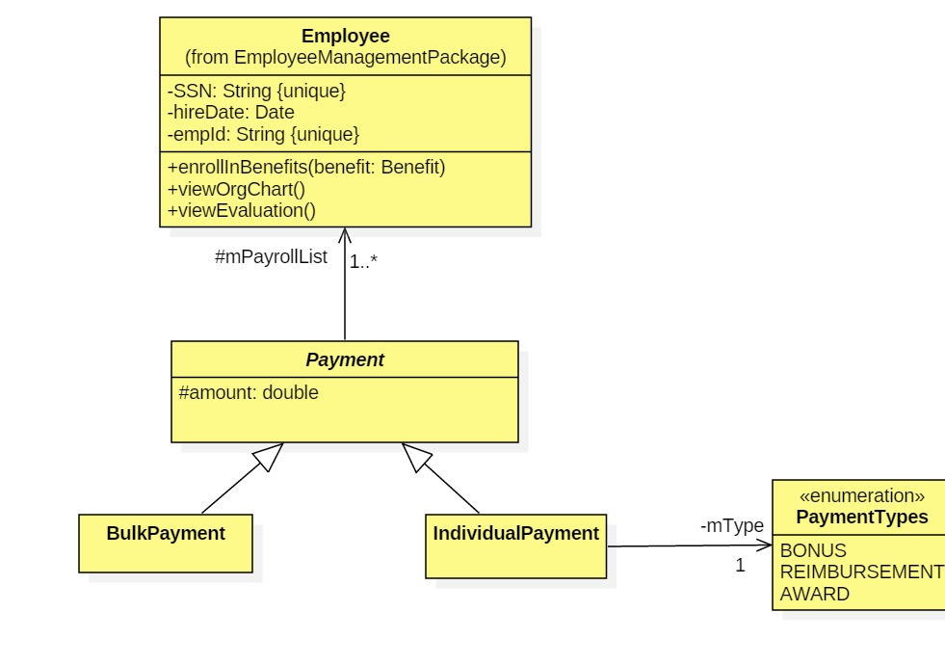
Payroll Domain Model
San Jose State University

Slide 16
REFERENCES
HR Management References:
SAP HCM Modules - Complete HR Solution
Human Resources[AX 2012]
Role of Human Resource Information Systems in an Educational Organization
Features of HR System
HR Management System References:
Work Day
BambooHR
iCMS
San Jose State University

Slide 17

San Jose State University

Slide 18
THANK YOU!
San Jose State University

