Slide 1

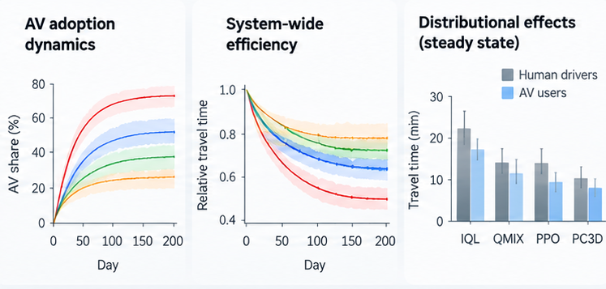
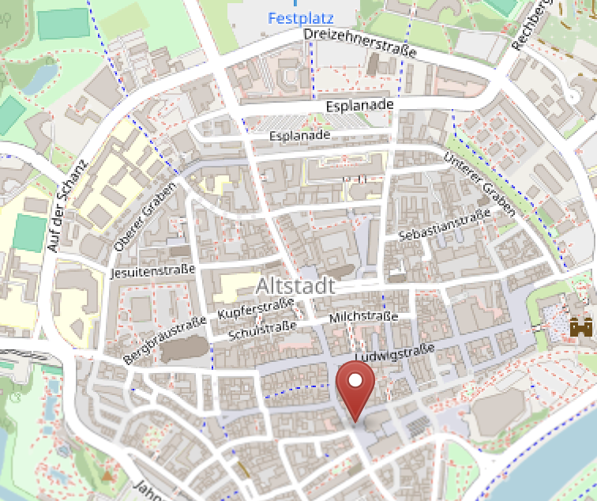
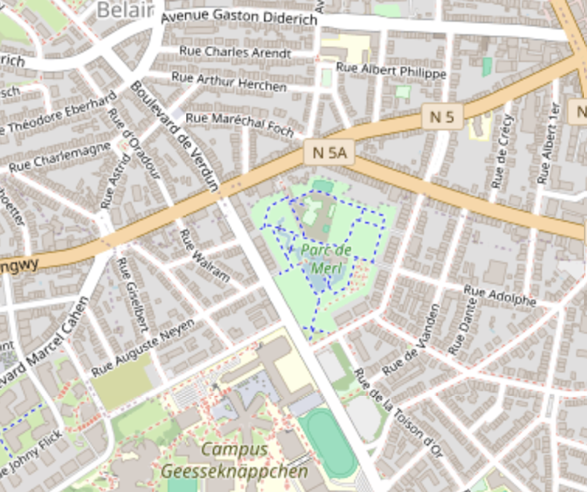
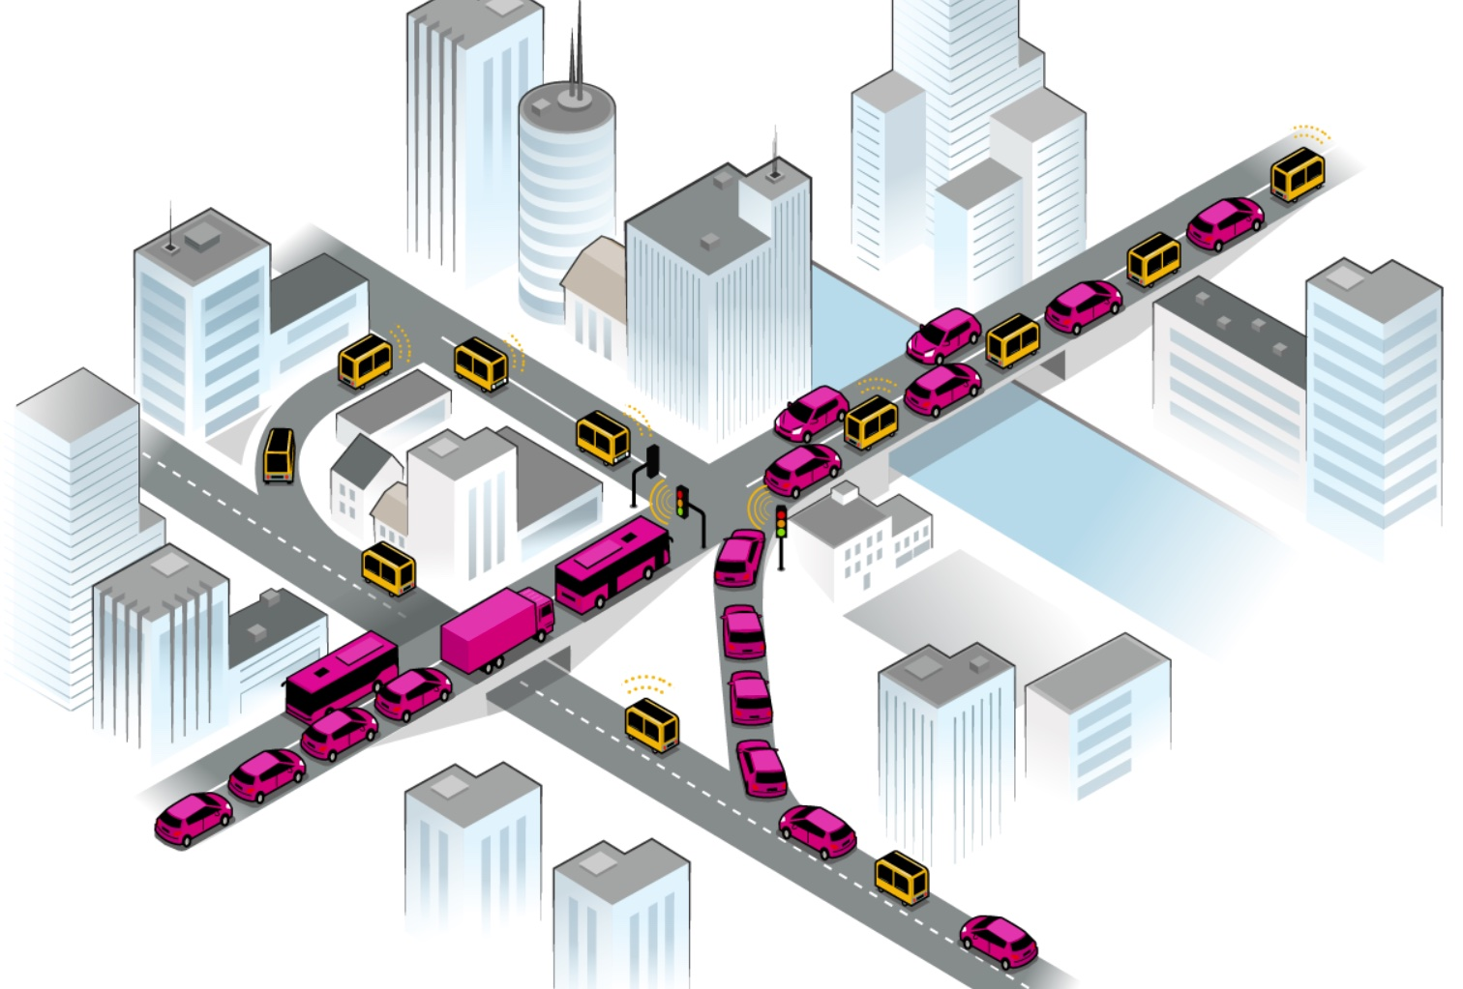

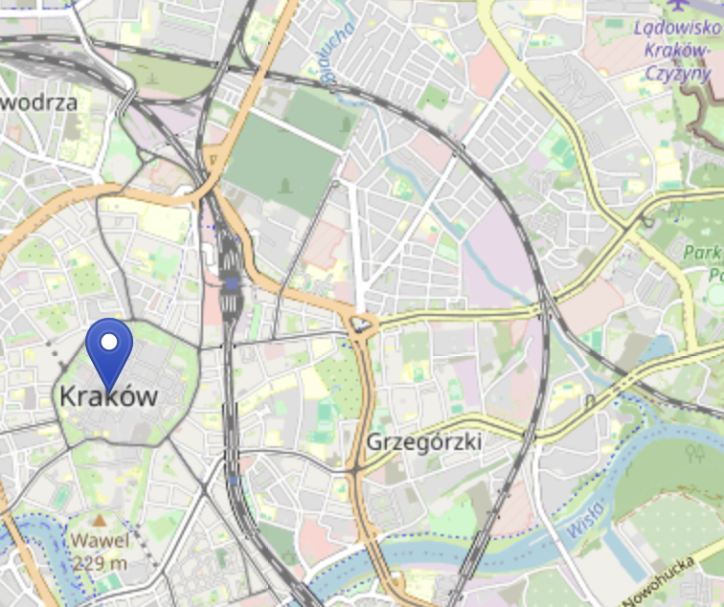
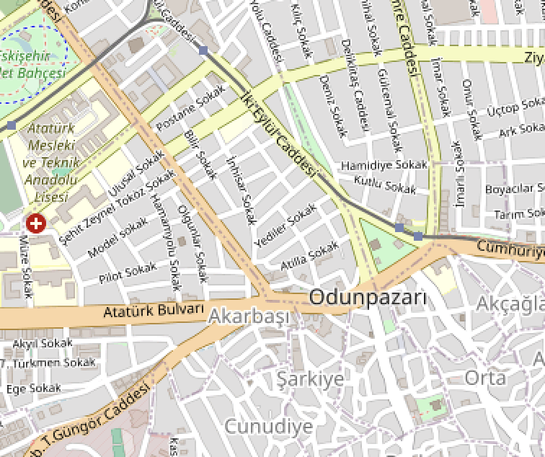
Real-world urban networks
with realistic demand
Mixed traffic with
endogenous adoption
Pretrained AV routing policies
Emergent urban mobility outcomes
Use human routing or delegate to AV?
IPPO
Independent learning
MAPPO
Value decomposition
Ingolstadt
Luxembourg
PPO
Centralized control
PC3D
Variable-roster cooperation
Kraków
Eskişehir

Slide 2
Real-world urban networks
with realistic demand
Mixed traffic with
endogenous adoption
Pretrained AV routing policies
Emergent urban mobility outcomes
Use human routing or delegate to AV?
IPPO
Independent learning
MAPPO
Value decomposition
Ingolstadt
Luxembourg
PPO
Centralized control
PC3D
Variable-roster cooperation
Kraków
Eskişehir

Slide 3


