Slide 1
UMBC PACE Simulator
Oct 16, GSFC

Slide 2
Basic information
PACE Simulator code is developed by Pengwang Zhai @ UMBC
  The code is delivered to OBPG Oct 14, 2020 for testing.
  Second version: May 3 2021 (Pengwang Zhai)
  Further updates in the input scripts will be provided.
What does the simulator compute:
  Radiance and irradiance
    Viewing angles: both upwelling and downwelling
    Wavelength: OCI, HARP2 and SPEXone bands
    Sensor locations: TOA, BOA, TOO, and a customized air sensor height
  Gas absorption: O2, O3, H2O, NO2, CH4
  Inelastic scattering in ocean: Raman, CDOM and Chlorophyll fluorescence

Slide 3
Output file example
Format: hdf5
Dimensions
  /PhiV Dataset {37}
  /ThetaV Dataset {90}
  /WaveLength_PACE Dataset {352} (OCI:239, SPEXone: 109, HARP2: 4)
Stokes vectors
  /Stokes_Vector_AirSensor Dataset {4, 37, 90, 352}
  /Stokes_Vector_BOA Dataset {4, 37, 90, 352}
  /Stokes_Vector_TOA Dataset {4, 37, 90, 352}
  /Stokes_Vector_TOO Dataset {4, 37, 90, 352}
Many other attributes to define aerosol, ocean optical properties

Slide 4
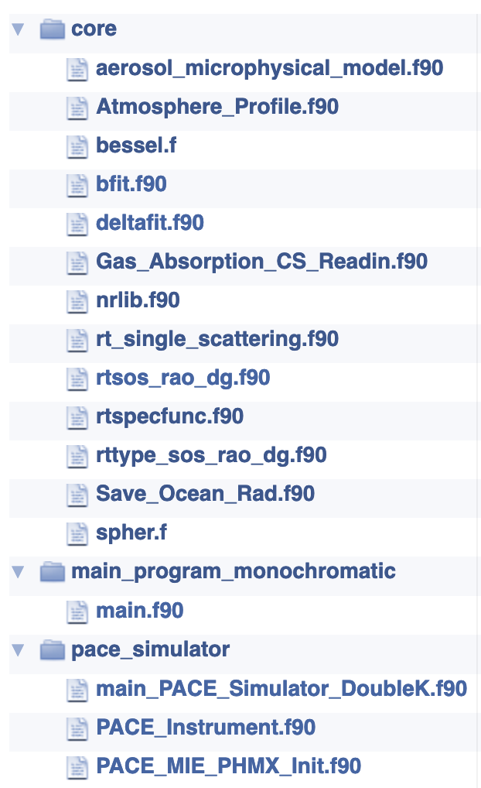
Code structure and resources needed
Basic source code structure
The simulator code is run independently for each case:
each run require its own input file
1 CPU hour per case (depend)
Output data size: 72M
Memory requirement: 16G
A python script is provided to configure the input file:
Solar zenith angle
Aerosol type
Optical depth
Ocean bio-optical model
Inelastic scattering
etc

Slide 5
Input file example
5.000000 #wind speed
30.000000 #THETA0 in degrees
0.100000 #TAU550
3 #Relative Humidity IRH=1,5,
    RH=[0.50,0.70,0.80,0.90,0.95]
16 #IAEROSOL=1,20.
    1-10 is Shettle and Fenn,
    11-20 is Ahmad model
0 #OCEAN_CASE_SELECT,
    case 0 (atmosphere only),
    case 1 [Chla] parameterization,
    case 2 [Chla]+Sediment,
    case 3: seven parameter model
0.010000 #CHLa
1.020000 #PHYTOPLANKTON_INDEX_REFRACTION
3.000000 #PHYTOPLANKTON_SPECTRAL_SLOPE
1.200000 #SEDIMENT_INDEX_REFRACTION
4.000000 #SEDIMENT_SPECTRAL_SLOPE
0.000000 #SEDIMENT_CONCENTRATION
1.000000 #adg440 (1/m), range: 0.0:2.5
0.050000 #bbp660 (1/m), range 0:0.1
0.010000 #Bp660_BackscatterFraction, range 0"0.05
0.015000 #Sdg exponential spectral slope of dg absorption (1/nm) range: 0.01:0.02
0.300000 #Sbp power spectral slope of backscattering coefficient (1/nm) range: 0:0.5
0.010000 #S_Bp power spectral slope of backscattering fraction (1/nm) range: -0.2:0.2

Slide 6
Input file example (continued)
20 #NCOLINPUT
40 #NQUADAINPUT
60 #NQUADOINPUT
1 #CHLA_HOMOGENEITY, 1=.true. 0=.false.
1 #OCEAN_RAMAN_FLAG, 1=.true. 0=.false.
1 #OCEAN_FCHLA_FLAG, 1=.true. 0=.false.
1 #OCEAN_FCDOM_FLAG, 1=.true. 0=.false.
1 #AP_SELECT, 1 Bricaud LUT, 2 Mixure of pico and micron cells in Ciott et al. 2002
0 #monochromatic_flag 1=.true. 0=.false.
0 #HYSPECTRAL_FLAG, 1=.true. 0=.false.
0 #NPQ_FLAG, 1=.true. 0=.false.
1 #OCEAN_PHMX_ONE, 1=.true. 0=.false.
0 #atmos_zero, 1=.true. 0=.false.
0 #SUNGLINT_INPUT, 0 include sun glint 1 no sun glint
0 #GAS_ABS_FLAG, 1=.true. 0=.false.
345.660000 #ozone column amount in Dobson Unit
1.438700 #water vapor column amount in cm
1013.000000 # surface pressure in mb
0 #wv_seg_flag, 0: all; 1: seg1+3only; 2: seg2only; 3 seg1+2+3; 4: seg4only
2.200000 # AirSensor_Height unit km
1 # pseudospherical flag, 0 turn off; 1: turn on
afglus.dat
output_ps_OceanCase0chla00.01mono0atmoszero0sg0gasflag0wv_seg_flag0

