Slide 1
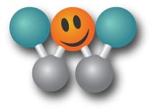
WinMaWeb Presentation
Did you miss out on Apple, Amazon, Google, Facebook…..?
Don’t miss out on this one!!

Slide 2


Have you seen these posters in the MRT stations ????
Ever heard of how the rich get richer
The poor get poorer ????

Slide 3


1. The Fact
80% are struggling
Or don’t have
enough
17%
live
well!
3% have
too much
to handle
If you don’t like your situation, change you are not a tree
Our Mission :
Redistribute the wealth…. back to the people!
We can give you the vehicle but you need to drive it

Slide 4

2. Example
1 company
GROUPON
12.000.000.000 USD
/ 12 months
= 1.000.000.000 a month / 1000 USD = 1.000.000 People
Would you like to be a part of something….
that makes the world a better place to live in !!!
Because of you we have a concept that for sure
will become bigger than Groupon

Slide 5
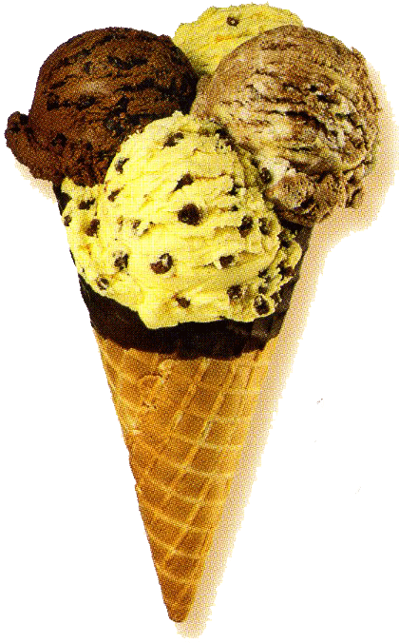
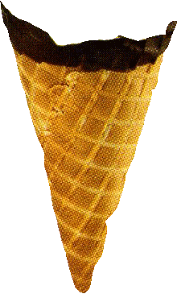

3. Our Concept
Groupon
Facebook
WinMaWeb
Win / Win / Win
6.000.000.000
Social Network
100 Billion Dollars
Win / Win / Win / Win / Win

Slide 6


The 5 W ‘s of WinMaWeb
Everybody Wins :
1. Customer Wins
2. Member Wins
3. Agent Wins
4. Merchant Wins
5. WinMaWeb Wins

Slide 7

Customers
Buy
Deals
50% ++
Merchants
Free
advertising
You
ID#
Back office
Members
Build
Network
20%
20%
20%
Agents
Bring in
Deals
Register in less than 1 minute
Its free
and always will be!

Slide 8



How to build your income
Example : you send 100 emails to your friends
100 emails
You call them
animated
Than duplication happens
100 emails
100 emails
100 emails
100 emails
T1
T2
T3
T4
T5
10 M
100 M
1000 M
10.000 M
100.000 M
If only 0,5 % buy 1 deal in 1 month for 20 USD then you make a 1000 USD
That’s 100 USD per Active Member you bring in, is it worth it !!!

Slide 9

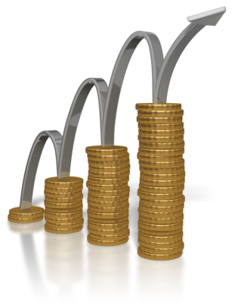
How to build a Passive ( Magic ! ) income
If only 0,5 % buy 1 deal in 1 month for 20 USD then you make a 1000 USD
To withdraw your 1000 USD you must spend 20 % back into WinMaWeb
That’s 200 USD which is 10 x more than our example
What do you think will happen with
your income then???
Inner Economy

Slide 10
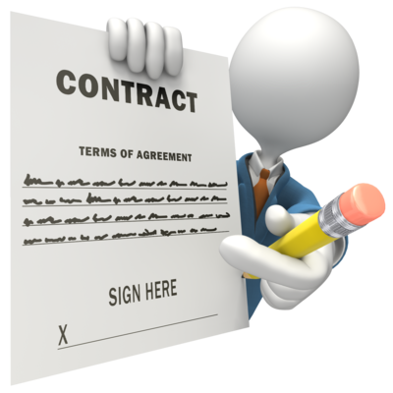

A second way to make money
Become an agent and bring in a deal
You make 20 % of WinMaWeb’s share from
all the people who buy the deal
Example :
200 people buy the deal
Deal price is 100 USD
20% from 50USD ( WinMaWeb’s share )
10 x 200 = 2000 USD ( your Commission ! )

Slide 11



WinMaWeb Success Formula
FUN
SIMPLE
MAGIC
Buying deals at
50% +++ is fun
Everybody who can
send an e-mail and
make a phone call
can do it.
Just like the family
tree, it will grow…
but
much faster & so much
more fun!!!
Its fun to have a
concept where
its impossible to find
a reason not to do it
Its fun to see your
income growing
Its fun to help
your friends

Slide 12


A Chinese proverb translates…
if one man has a dream
it stays a dream
if we all share the same dream
it becomes reality
Lets do it .

