Slide 1
AntiRansomware Tools Thoroughly Tested Part 1
Information Security Inc.

Slide 2
Contents
What is Ransomware?
Rise of Ransomware
Ransomware Testing Environment
Cybereason RansomFree
References

Slide 3
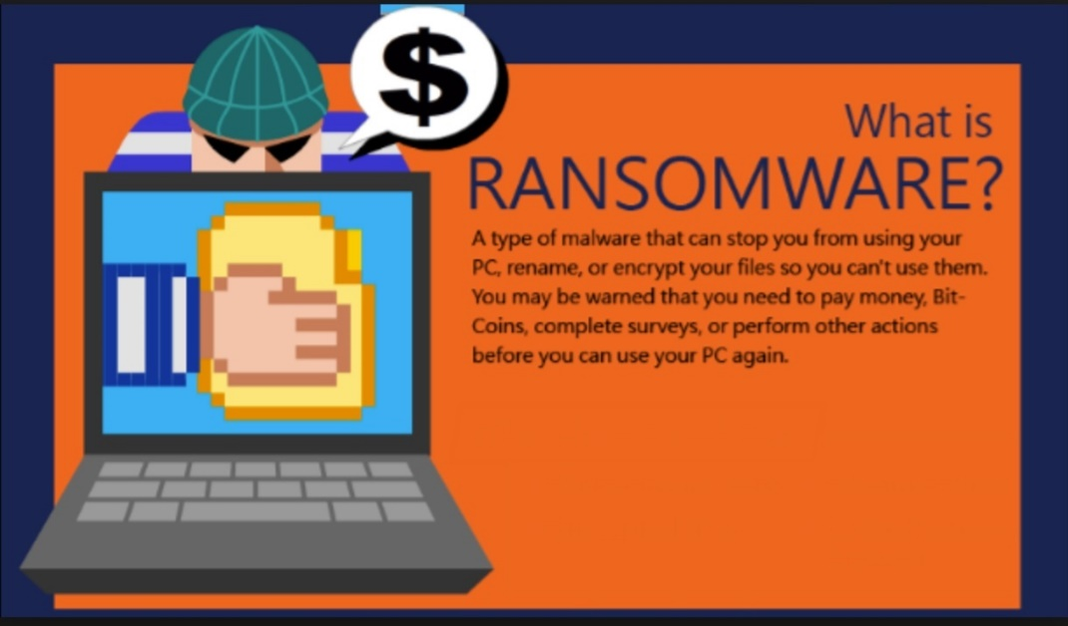
What is Ransomware?
Ransomware is a type of malicious software from cryptovirology that threatens to publish the victim's data or perpetually block access to it unless a ransom is paid
Ransomware is malicious code that is used by cybercriminals to launch data kidnapping and lockscreen attacks
The motive for ransomware attacks is monetary

Slide 4
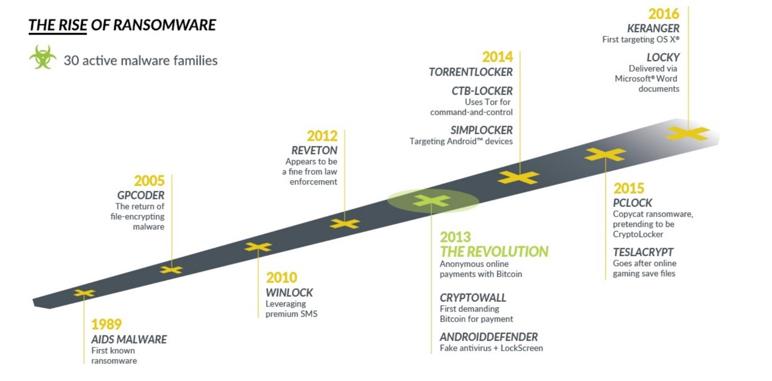
Rise of Ransomware

Slide 5
Ransomware Testing Envinronment
Victim machine: Windows 7 Ultimate SP1 x64
Ransomware: Zepto ransomware (https://www.tripwire.com/state-of-security/latest-security-news/the-newest-online-threat-zepto-ransomware/)

Slide 6

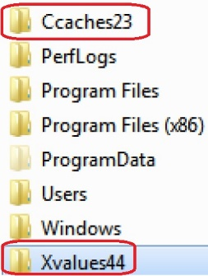
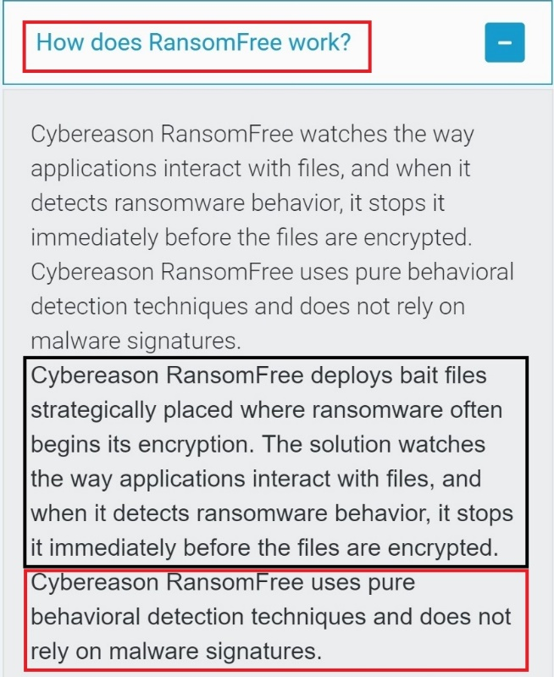
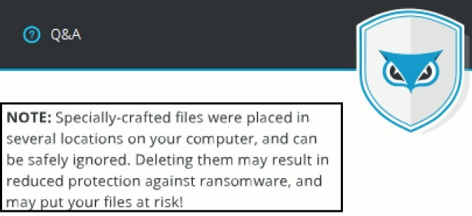
Cybereason RansomFree
Download link: https://ransomfree.cybereason.com/download/
How does RansomFree work?

Slide 7
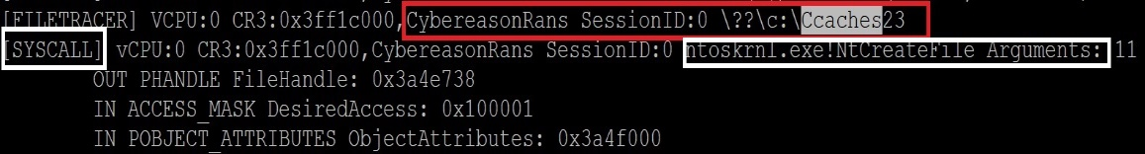
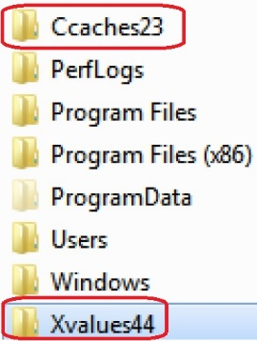
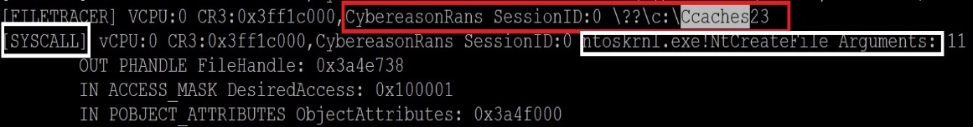
Cybereason RansomFree
How does RansomFree work?
◎ CybereasonRans uses !NtCreateFile function (https://goo.gl/dNd3Hx) to create bait folders and files in mutiple locations
◎ Creating bait folders

Slide 8
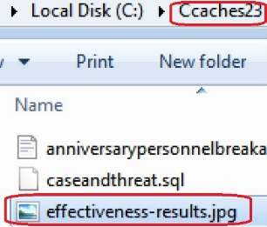
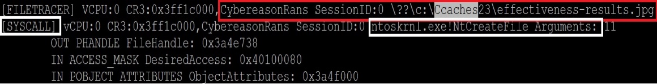
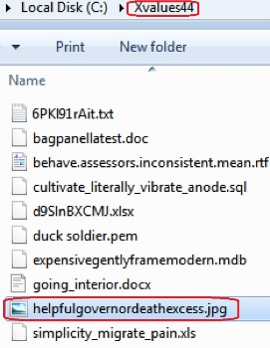
Cybereason RansomFree
How does RansomFree work?
◎ CybereasonRans uses !NtCreateFile function (https://goo.gl/dNd3Hx) to create bait folders and files in multiple locations
◎ Creating bait files inside the folders

Slide 9
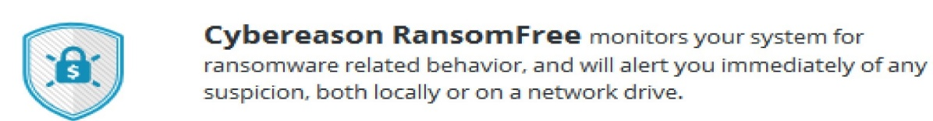
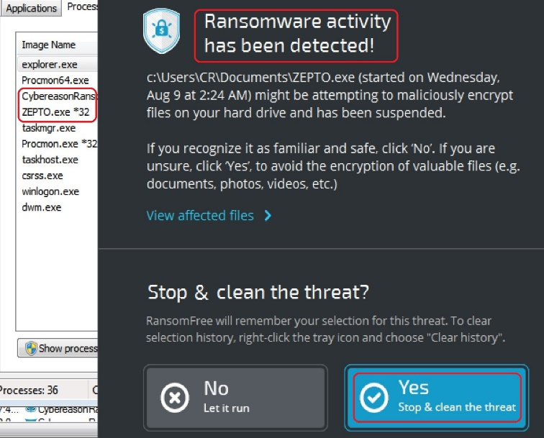
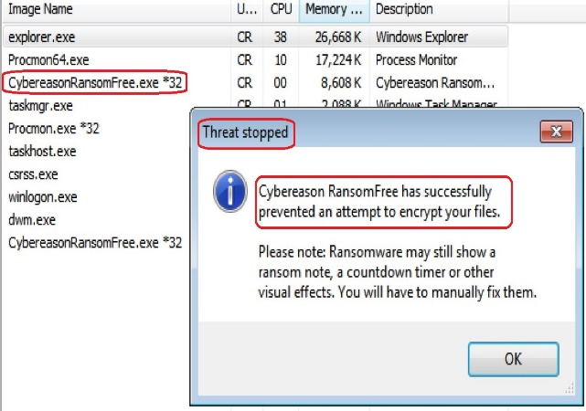
Cybereason RansomFree
How does RansomFree work? When detecting suspecting behavior kill the process
◎

Slide 10
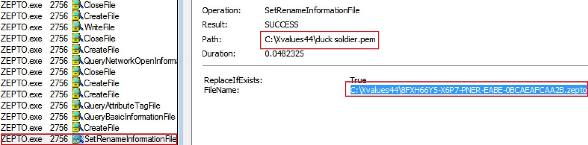
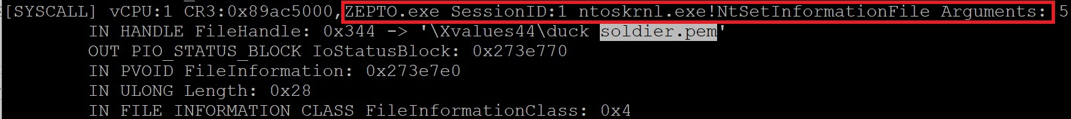
Cybereason RansomFree
How does RansomFree work?
◎ Ransomware is adding .zepto extension to bait files using NtSetInformationFile function (https://goo.gl/3V1UMv)

Slide 11
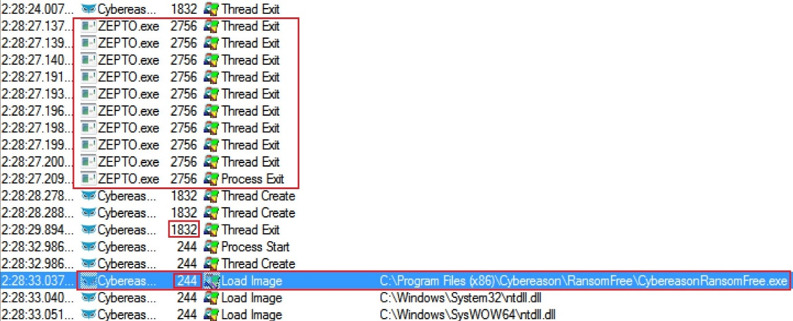
Cybereason RansomFree
How does RansomFree work?
◎ RansomFree kills ransomware’s threads and the parent process and loads a new image of itself starting a new process with ID 244

Slide 12
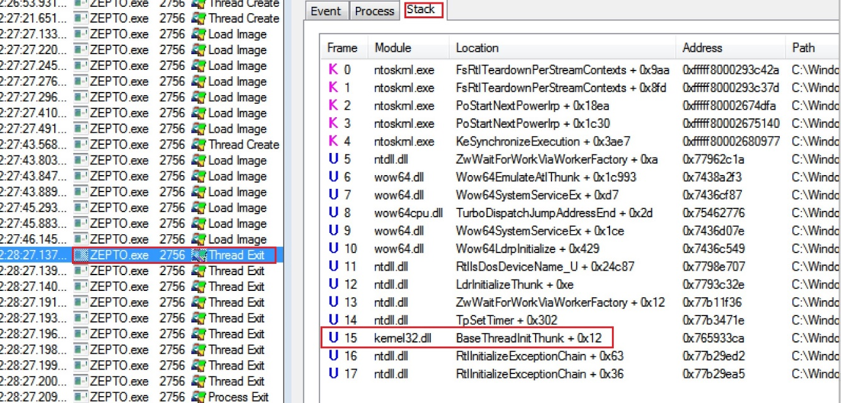
Cybereason RansomFree
How does RansomFree work?
◎ Thread stack before exiting
◎ BaseThreadInitThunk function (https://goo.gl/rm79Bd) calls the thread start address. If the thread returns it will terminate the thread and delete it’s stack

Slide 13
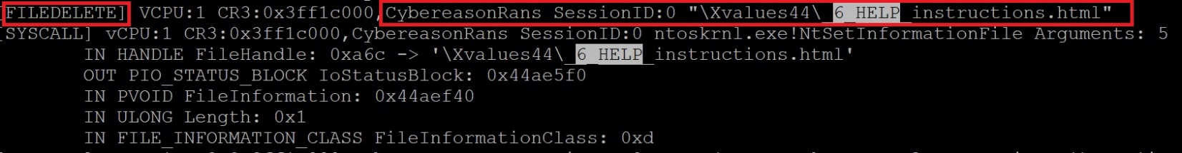
Cybereason RansomFree
How does RansomFree work?
◎ RansomFree deletes files generated by ransomware

Slide 14
References
Wikipedia
https://en.wikipedia.org/wiki/Ransomware
Knowbe
https://www.knowbe4.com/ransomware
Heimdal security
https://heimdalsecurity.com/blog/what-is-ransomware-protection

