Slide 1
AntiRansomware Tools Thoroughly Tested Part 3
Information Security Inc.

Slide 2
Contents
What is Ransomware?
Rise of Ransomware
Ransomware Testing Environment
McAfee Ransomware Interceptor
References

Slide 3
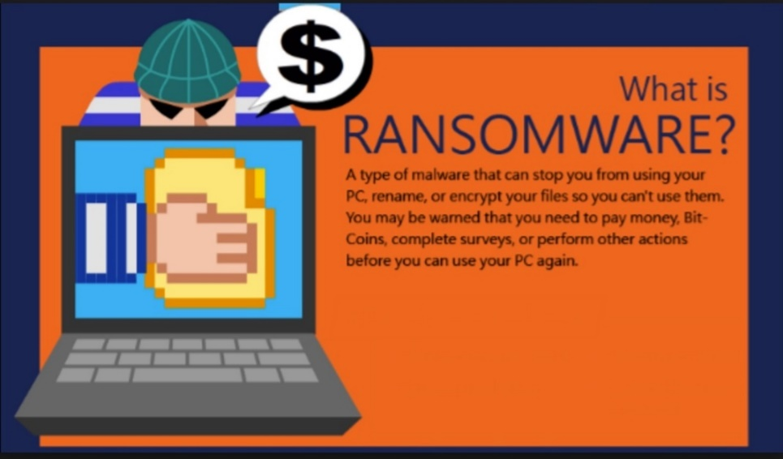
What is Ransomware?
Ransomware is a type of malicious software from cryptovirology that threatens to publish the victim's data or perpetually block access to it unless a ransom is paid
Ransomware is malicious code that is used by cybercriminals to launch data kidnapping and lockscreen attacks
The motive for ransomware attacks is monetary

Slide 4
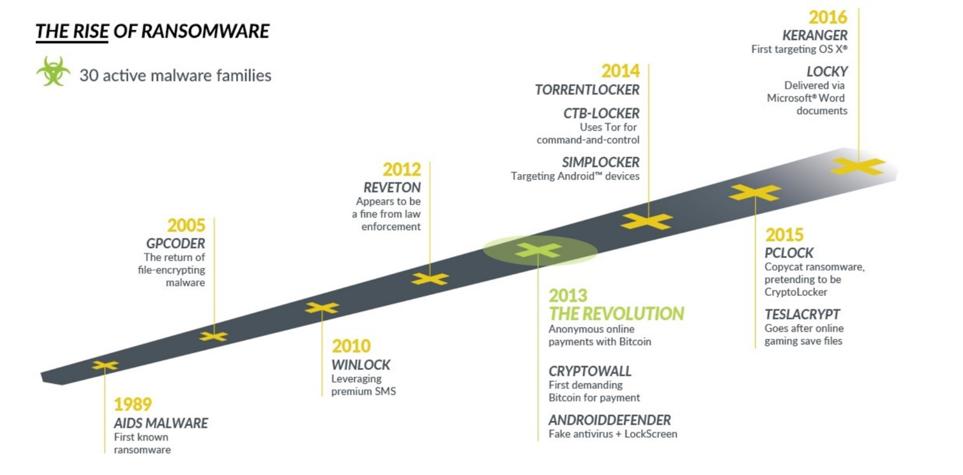
Rise of Ransomware

Slide 5
Ransomware Testing Envinronment
Victim machine: Windows 7 Ultimate SP1 x64
Ransomware: Zepto ransomware (https://www.tripwire.com/state-of-security/latest-security-news/the-newest-online-threat-zepto-ransomware/)

Slide 6
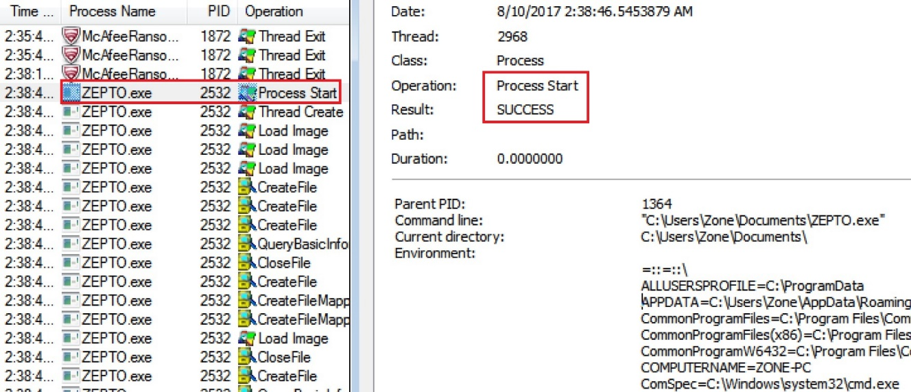
Mc Afee Ransomware Interceptor
Information link: https://www.mcafee.com/jp/downloads/free-tools/interceptor.aspx
How does McAfeeRansomwareInterceptor work?
◎ Ransomware process starts

Slide 7
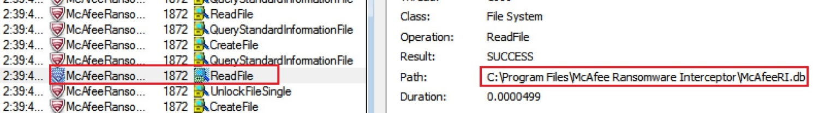
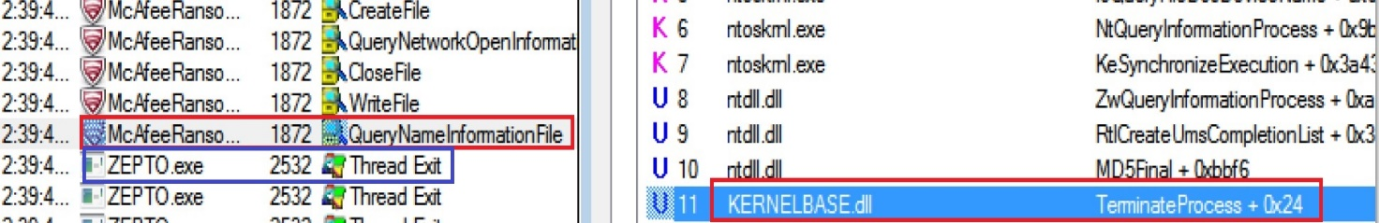
Mc Afee Ransomware Interceptor
Information link: https://www.mcafee.com/jp/downloads/free-tools/interceptor.aspx
How does McAfeeRansomwareInterceptor work?
◎ McAfee RI reads McAfeeRI.db file
◎ McAfee RI writes the log file
◎ McAfee RI Identifies the ransomware threat and terminates the process

Slide 8
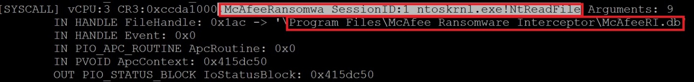
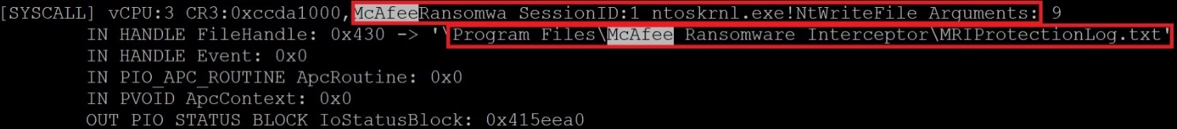
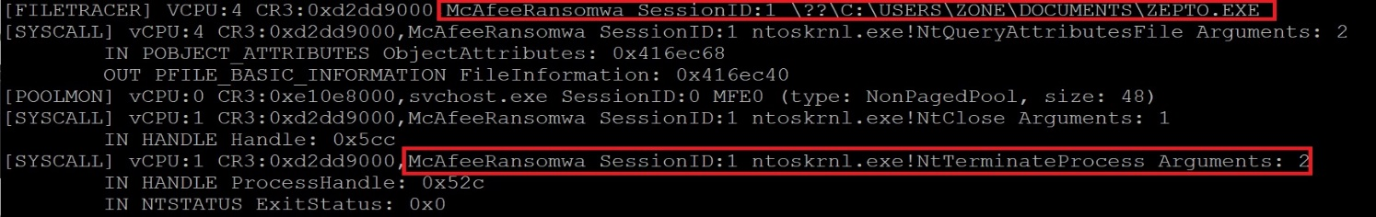
Mc Afee Ransomware Interceptor
Information link: https://www.mcafee.com/jp/downloads/free-tools/interceptor.aspx
How does McAfeeRansomwareInterceptor work?
◎ McAfee RI reads McAfeeRI.db file
◎ McAfee RI writes the log file
◎ McAfee RI Identifies the ransomware threat and terminates the process

Slide 9
References
Wikipedia
https://en.wikipedia.org/wiki/Ransomware
Knowbe
https://www.knowbe4.com/ransomware
Heimdal security
https://heimdalsecurity.com/blog/what-is-ransomware-protection

