Slide 1
AntiRansomware Tools Thoroughly Tested Part 4
Information Security Inc.

Slide 2
Contents
What is Ransomware?
Rise of Ransomware
Ransomware Testing Environment
WebRoot Secure Anywhere
References

Slide 3
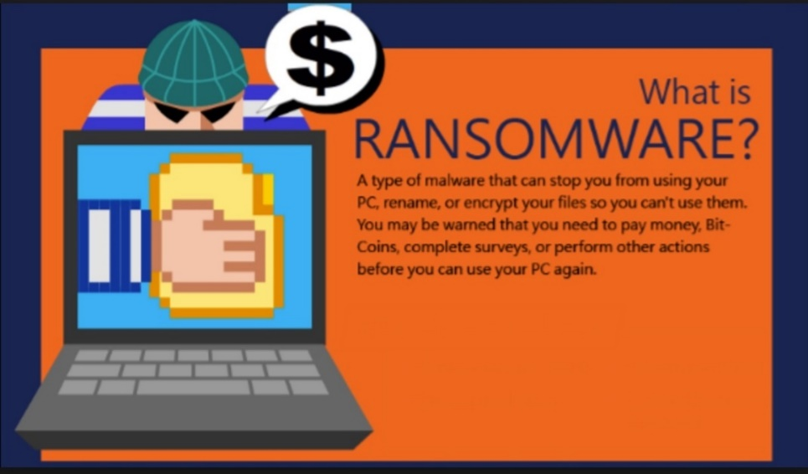
What is Ransomware?
Ransomware is a type of malicious software from cryptovirology that threatens to publish the victim's data or perpetually block access to it unless a ransom is paid
Ransomware is malicious code that is used by cybercriminals to launch data kidnapping and lockscreen attacks
The motive for ransomware attacks is monetary

Slide 4
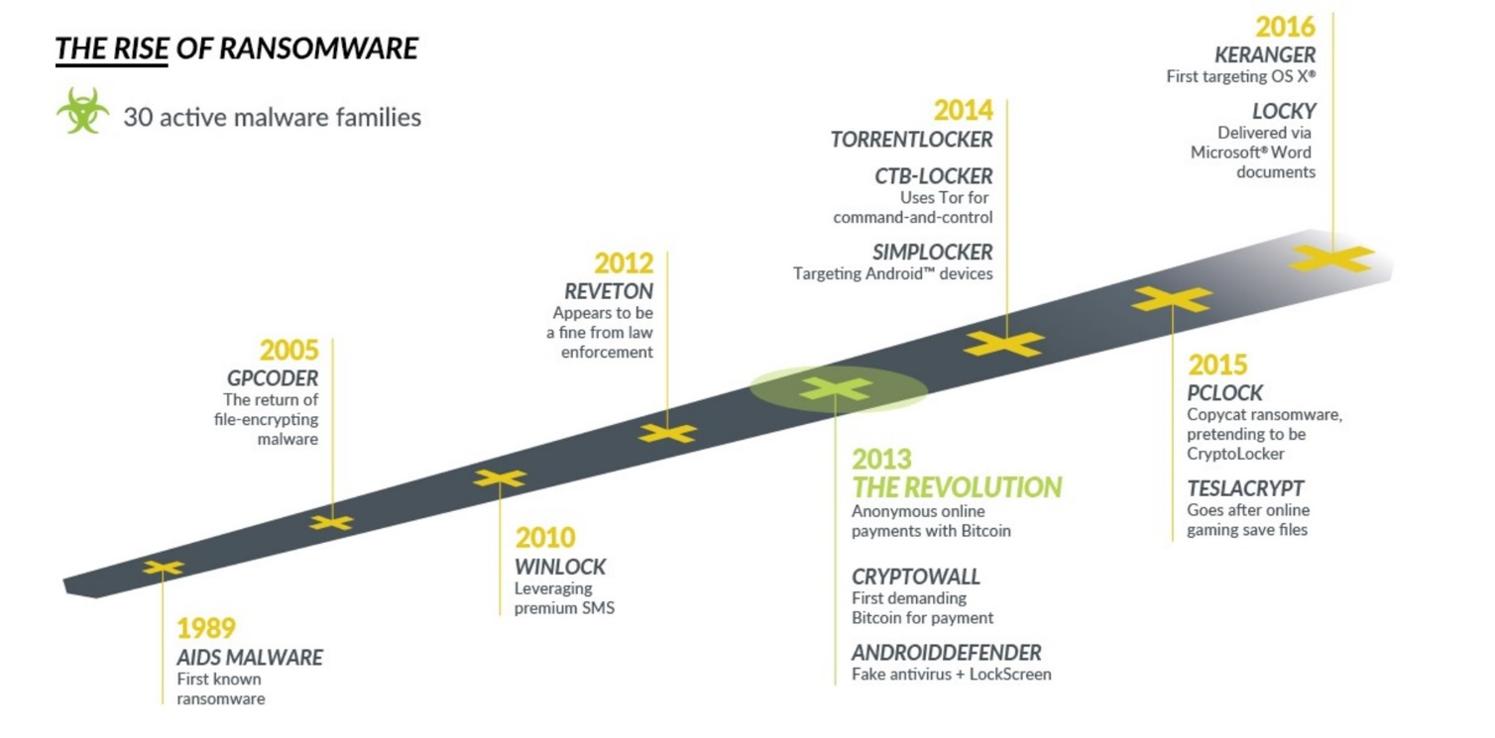
Rise of Ransomware

Slide 5
Ransomware Testing Envinronment
Victim machine: Windows 7 Ultimate SP1 x64
Ransomware: Zepto ransomware (https://www.tripwire.com/state-of-security/latest-security-news/the-newest-online-threat-zepto-ransomware/)

Slide 6
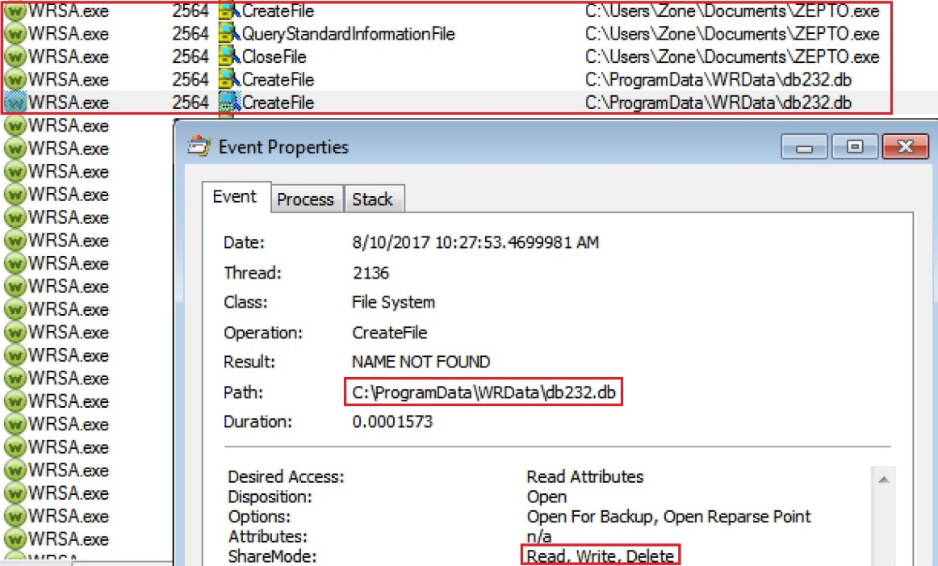
WebRoot Secure anywhere
Information link: https://www.webroot.com/jp/ja/home/products/av
How does WebRoot Security Anywhere work?
◎ WebRoot Security Anywhere identifies the ransomware file (from database) and blocks it in real time before creating a process

Slide 7
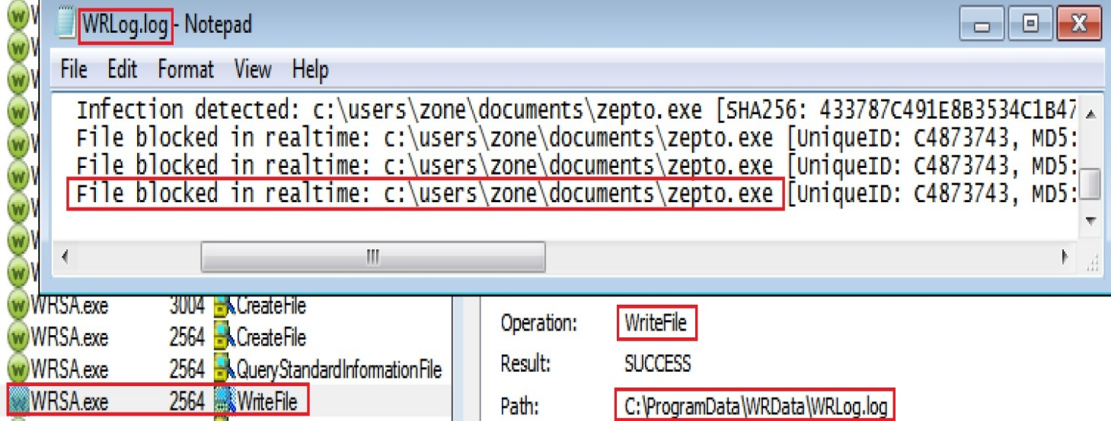
WebRoot Secure anywhere
Information link: https://www.webroot.com/jp/ja/home/products/av
How does WebRoot Security Anywhere work?
◎After blocking the ransomware WebRoot Security Anywhere writes the result to the log file

Slide 8
References
Wikipedia
https://en.wikipedia.org/wiki/Ransomware
Knowbe
https://www.knowbe4.com/ransomware
Heimdal security
https://heimdalsecurity.com/blog/what-is-ransomware-protection

