Slide 1
AntiRansomware Tools Thoroughly Tested Part 5
Information Security Inc.

Slide 2
Contents
What is Ransomware?
Rise of Ransomware
Ransomware Testing Environment
Malwarebytes Anti-Ransomware
References

Slide 3
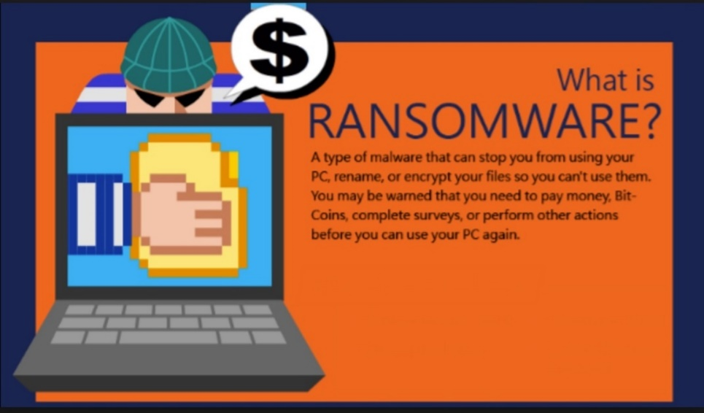
What is Ransomware?
Ransomware is a type of malicious software from cryptovirology that threatens to publish the victim's data or perpetually block access to it unless a ransom is paid
Ransomware is malicious code that is used by cybercriminals to launch data kidnapping and lockscreen attacks
The motive for ransomware attacks is monetary

Slide 4
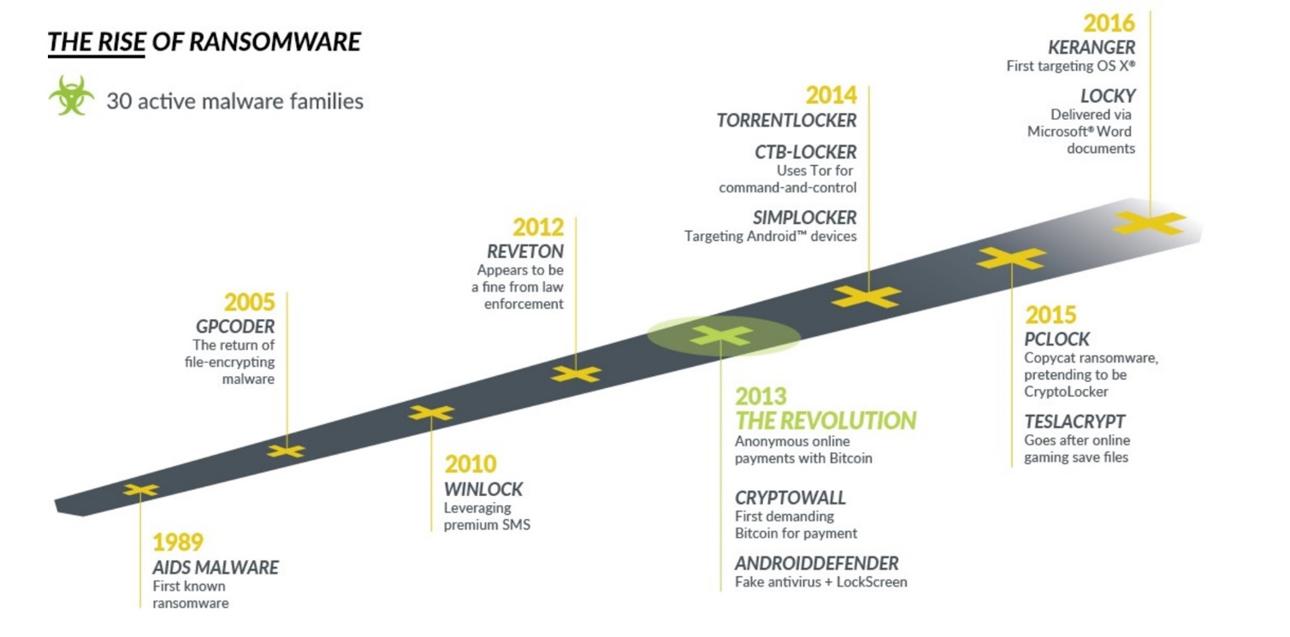
Rise of Ransomware

Slide 5
Ransomware Testing Envinronment
Victim machine: Windows 10 x64
Ransomware: Satana Ransomware (https://www.kaspersky.com/blog/satana-ransomware/12558/)

Slide 6
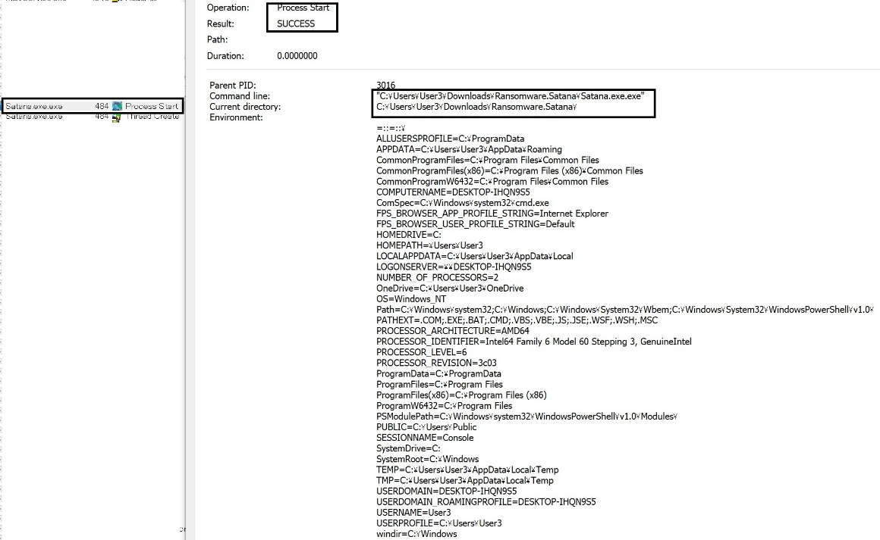
Malwarebytes Anti-Ransomware
Information link: https://malwarebytes.app.box.com/s/6vqfgzs9ci86fbga4nt95yq5uytppg1b
How does Malwarebytes Anti-Ransomware work?
◎ Ransomware process starts

Slide 7
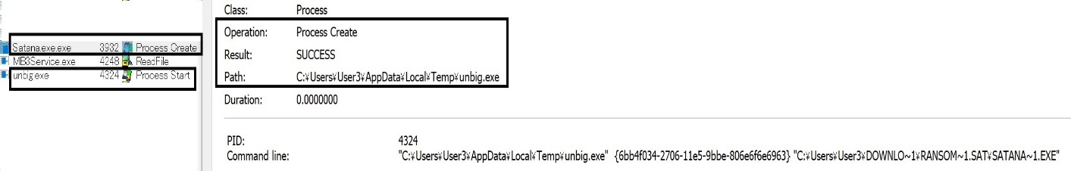
Malwarebytes Anti-Ransomware
Information link: https://malwarebytes.app.box.com/s/6vqfgzs9ci86fbga4nt95yq5uytppg1b
How does Malwarebytes Anti-Ransomware work?
◎ Ransomware main process spawns a child process (unbig.exe)

Slide 8
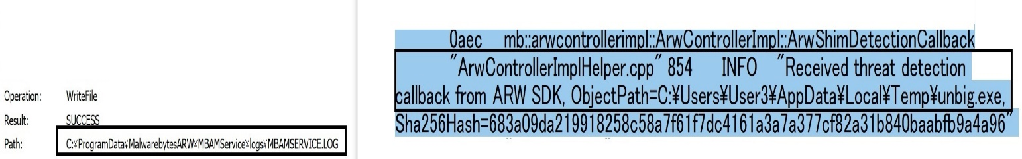
Malwarebytes Anti-Ransomware
Information link: https://malwarebytes.app.box.com/s/6vqfgzs9ci86fbga4nt95yq5uytppg1b
How does Malwarebytes Anti-Ransomware work?
◎ Ransomware process is identified and killed by Malwarebytes Anti-Ransomware

Slide 9
References
Wikipedia
https://en.wikipedia.org/wiki/Ransomware
Knowbe
https://www.knowbe4.com/ransomware
Heimdal security
https://heimdalsecurity.com/blog/what-is-ransomware-protection

