Slide 1
AntiRansomware Tools Tested Part 6
Information Security Inc.

Slide 2
Contents
What is Ransomware?
Rise of Ransomware
Ransomware Testing Environment
Bitdefender Anti-Ransomware
References

Slide 3
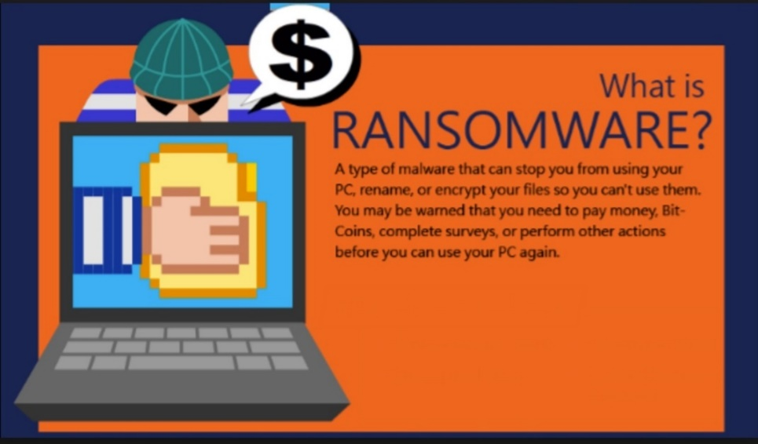
What is Ransomware?
Ransomware is a type of malicious software from cryptovirology that threatens to publish the victim's data or perpetually block access to it unless a ransom is paid
Ransomware is malicious code that is used by cybercriminals to launch data kidnapping and lockscreen attacks
The motive for ransomware attacks is monetary

Slide 4
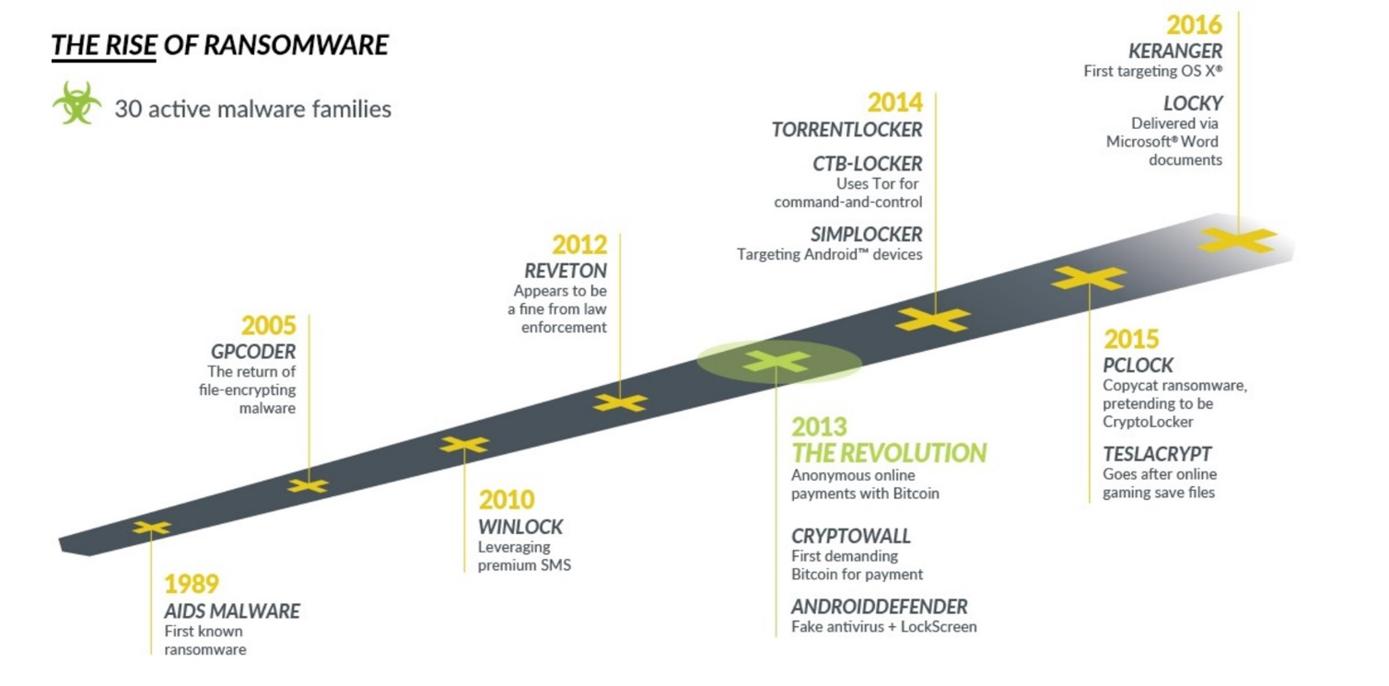
Rise of Ransomware

Slide 5
Ransomware Testing Envinronment
Victim machine: Windows 10 x64
Ransomware: CTB-Locker
(https://www.bleepingcomputer.com/virus-removal/ctb-locker-ransomware-information)

Slide 6
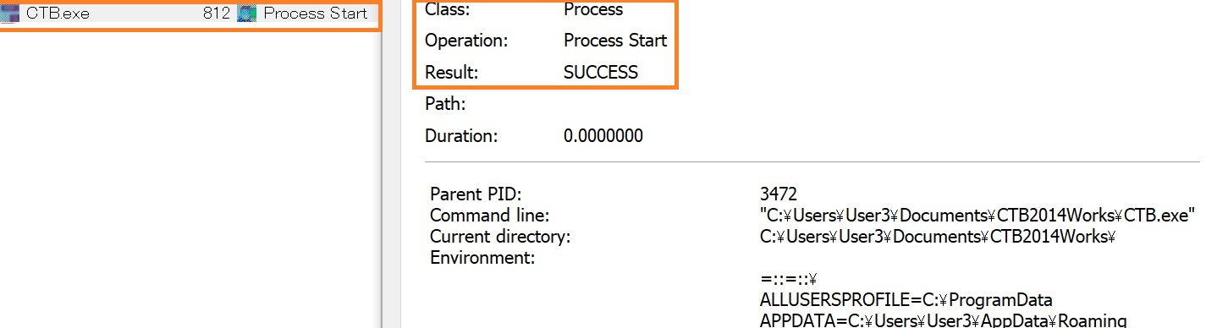
Bitdefender Anti-Ransomware
Information link: https://www.bitdefender.com/solutions/anti-ransomware-tool.html
How does Bitdefender Anti-Ransomware work?
◎ Ransomware process starts

Slide 7
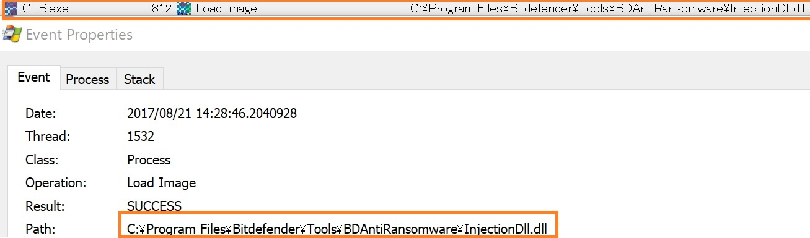
Malwarebytes Anti-Ransomware
Information link: https://www.bitdefender.com/solutions/anti-ransomware-tool.html
How does Bitdefender Anti-Ransomware work?
◎ Bitdefender Anti-Ransomware injects <InjectionDll.dll> DLL into the ransomware’s process address space

Slide 8
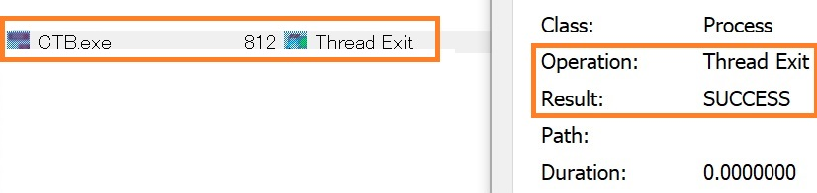
Malwarebytes Anti-Ransomware
Information link: https://www.bitdefender.com/solutions/anti-ransomware-tool.htmls
How does Bitdefender Anti-Ransomware work?
◎ Ransomware process is identified and killed by Bitdefender Anti-Ransomware

Slide 9
References
Wikipedia
https://en.wikipedia.org/wiki/Ransomware
Knowbe
https://www.knowbe4.com/ransomware
Heimdal security
https://heimdalsecurity.com/blog/what-is-ransomware-protection

