Slide 1
TRex
Information Security Inc.

Slide 2
Contents
About Trex
Current Challenges
Implications
Trex Stateful Features
Trex Stateless Features
Topology and the Testing Environment
Installing TRex
Using TRex
References

Slide 3

About TRex
TRex is a traffic generator for Stateful and Stateless use cases
TRex -> realistic traffic generator

Slide 4
Current Challenges
Cost : Commercial State-full traffic generators are expensive
Scale : Bandwidth does not scale up well with features complexity
Standardization : Lack of standardization of traffic patterns and methodologies
Flexibility : Commercial tools do not allow agility when flexibility and changes are needed

Slide 5

Implications
High capital expenditure (capex) spent by different teams
Testing in low scale and extrapolation became a common practice, it is not accurate, and hides real life bottlenecks and quality issues
TRex addresses these problems through an innovative and extendable software implementation and by leveraging standard and open SW and x86/UCS HW.

Slide 6
TRex Stateful Features
Fueled by DPDK
Generates and analyzes L4-7 traffic and able to provide in one tool capabilities provided by commercial L7 tools.
Stateful traffic generator based on pre-processing and smart replay of real traffic templates.
Generates and amplifies both client and server side traffic.
Customized functionality can be added.
Scale to 200Gb/sec for one UCS
Low cost

Slide 7
TRex Stateless Features
Large scale - Supports about 10-30 million packets per second (mpps) per core, scalable with the number of cores
Profile can support multiple streams, scalable to 10K parallel streams
Interactive support - Fast Console, GUI
Statistics per interface
PCAP file import/export

Slide 8
Topology
TRex testing topology -> TRex running in stateful mode
-> TRex emulates/creates a internal router
Router IP: 192.168.10.188
------------
| TRex |
| Client | IF1 IP: 192.168.10.105
| Side | ---------------
------------ | IF1 |
| DUT |
------------ | IF2 |
| TRex | ---------------
| Server | Cisco 2960
| Side | IF2 IP: 192.168.86.11
------------
Router IP: 192.168.86.188

Slide 9
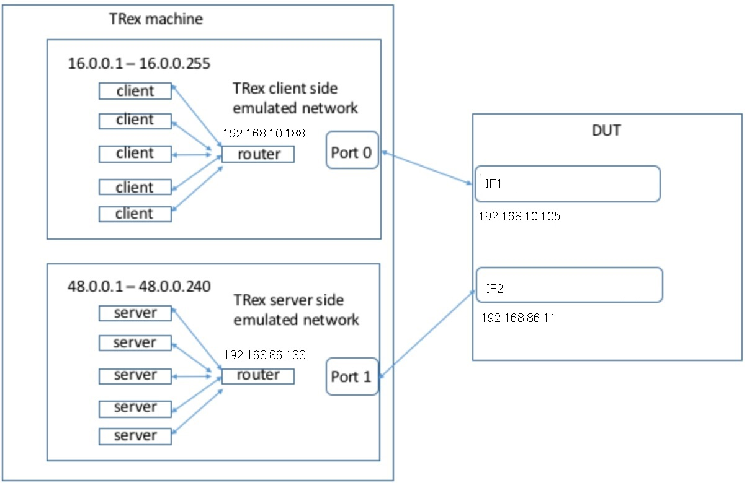
Topology

Slide 10
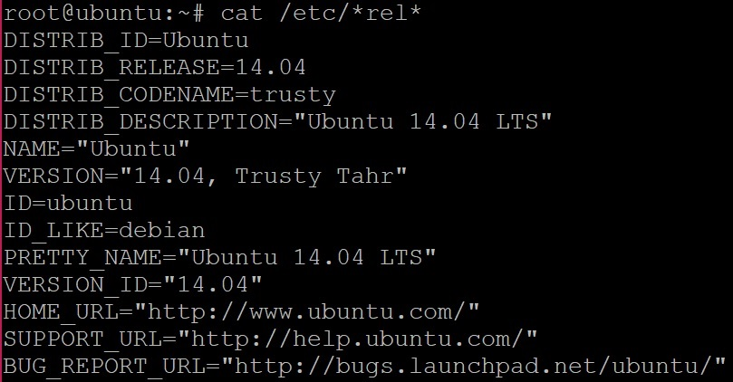
Testing Environment
Ubuntu 14.04 LTS

Slide 11
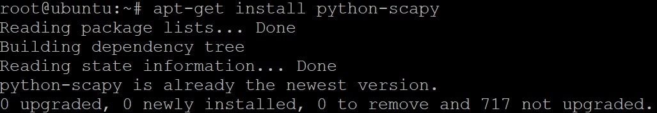
Installing TRex
Installing dependencies -> scapy

Slide 12
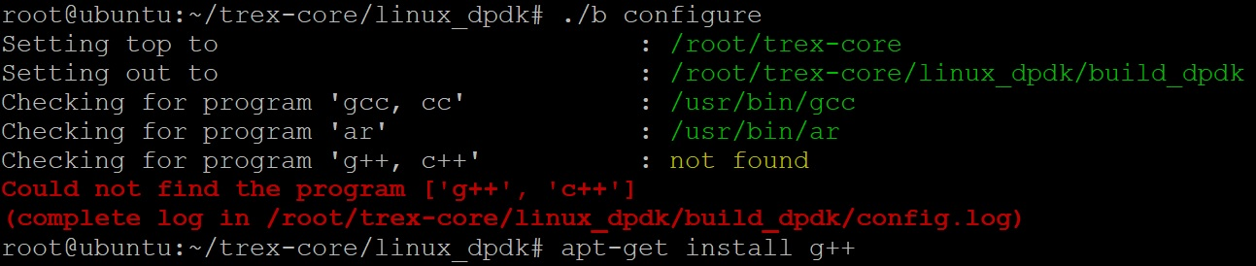
Installing TRex
Installing dependencies -> g++

Slide 13
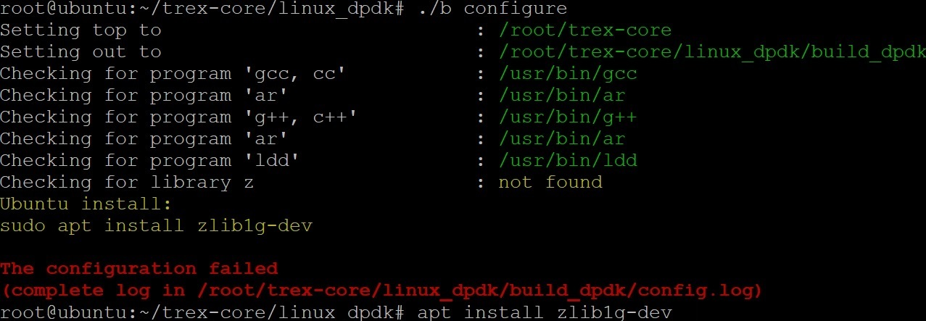
Installing TRex
Installing dependencies -> zlib1g-dev

Slide 14
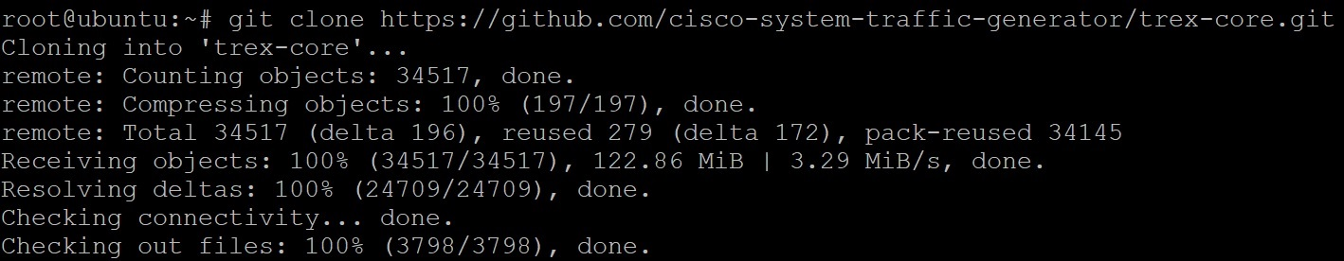
Installing TRex
Cloning GitHub repository

Slide 15
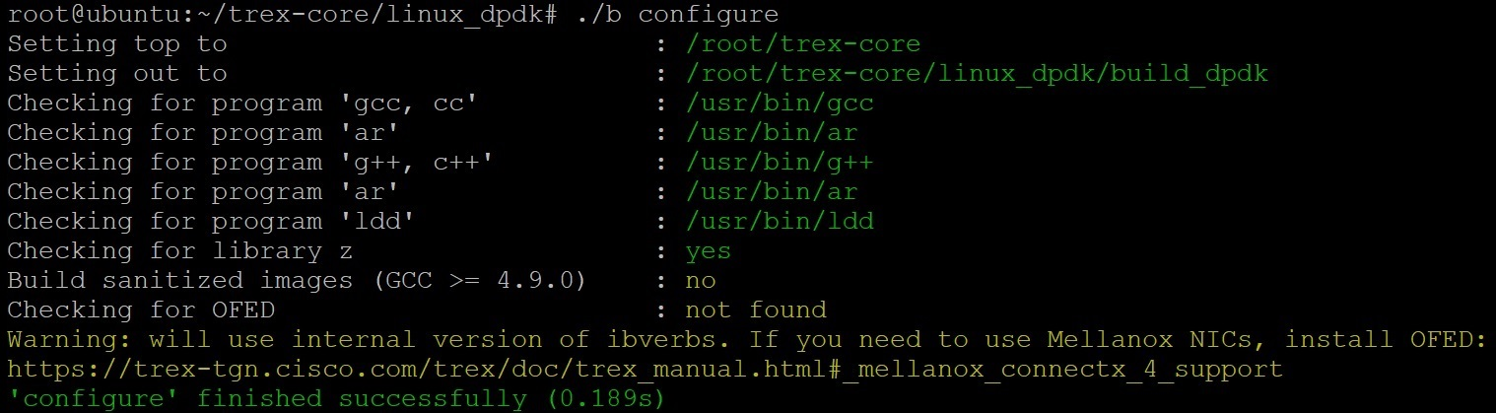
Installing TRex
Configuring TRex -> ./b configure

Slide 16
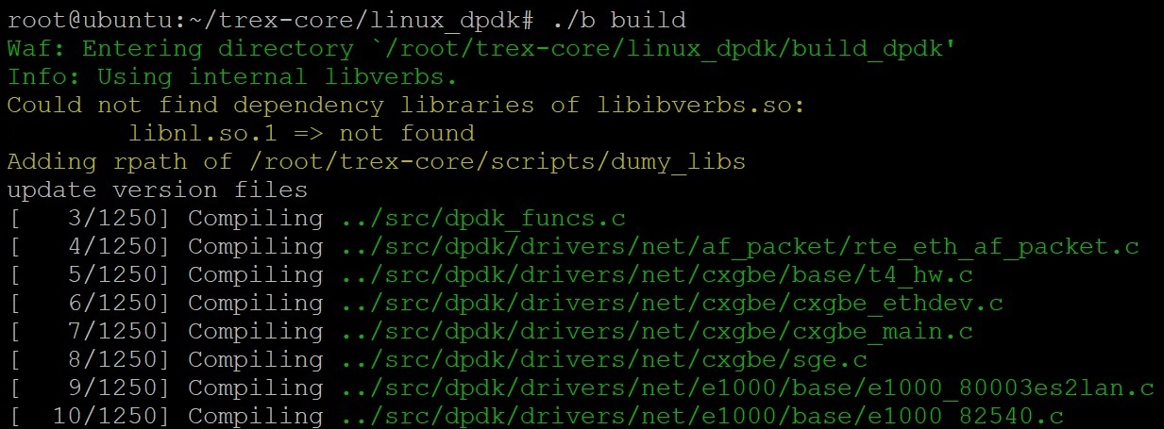
Installing TRex
Building Trex -> ./b build

Slide 17
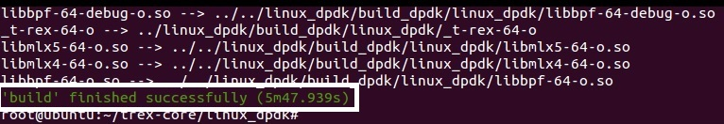
Installing TRex
Building Trex -> ./b build

Slide 18
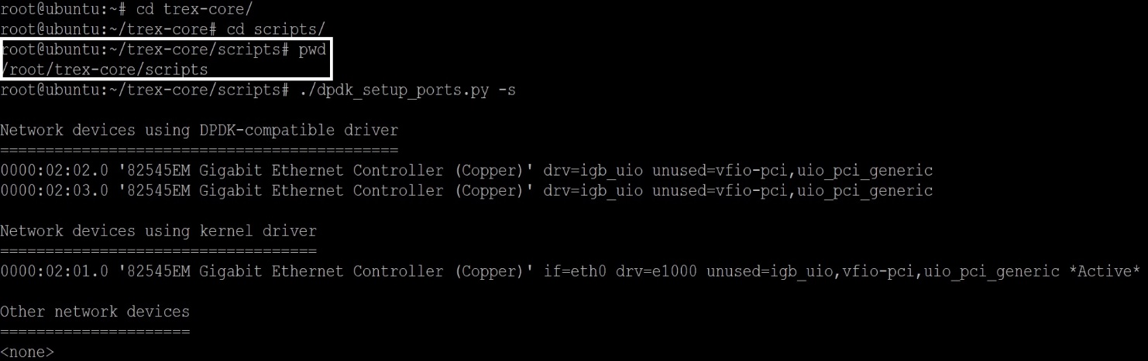
Using TRex
Identify the ports

Slide 19
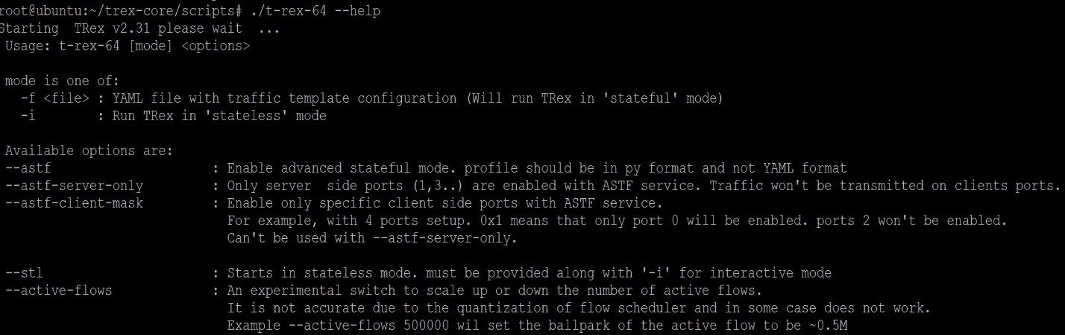
Using TRex
TRex help menu

Slide 20
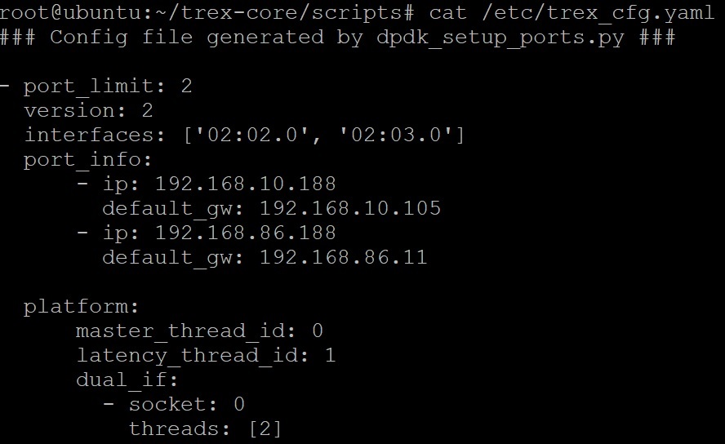
Using TRex
Default config file -> /etc/trex_cfg.yaml

Slide 21
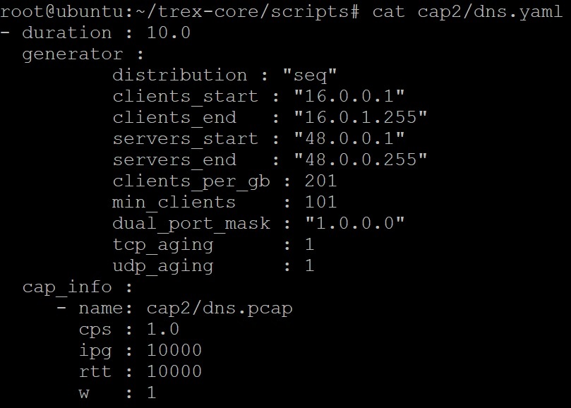
Using TRex
Traffic config file -> in this example 255 clients talking to 240 servers

Slide 22
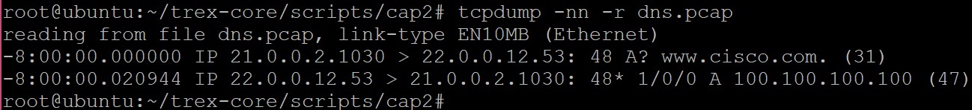
Using TRex
Pcap file contents -> dns.pca, query for www.cisco.ip

Slide 23
Using TRex
DUT config -> static routes

Slide 24
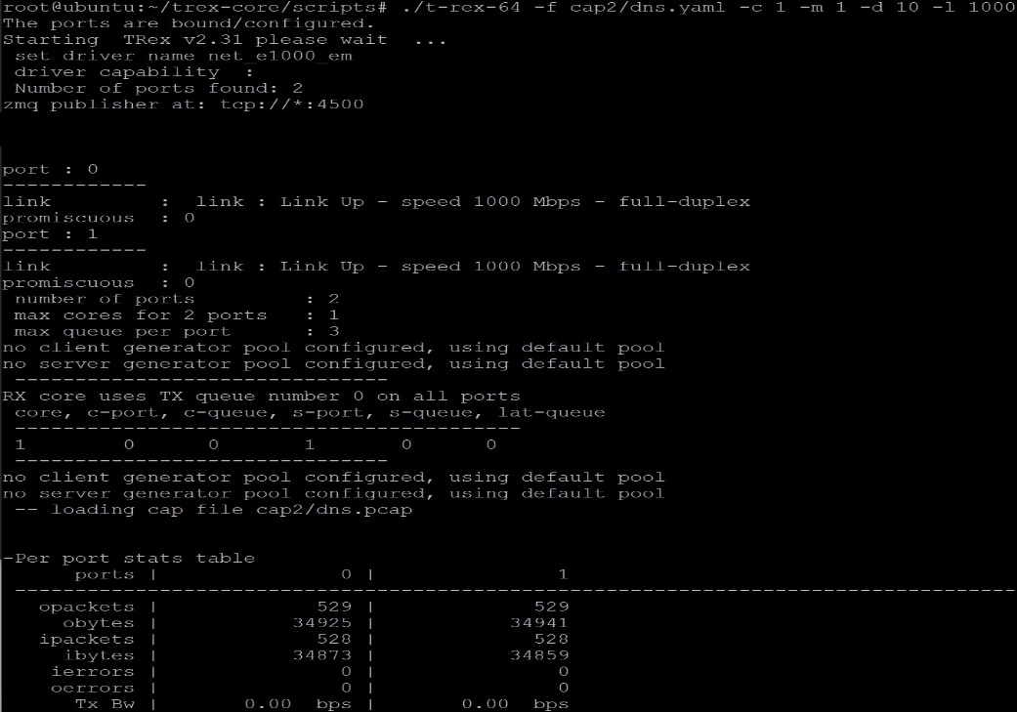
Using TRex
Running TRex

Slide 25
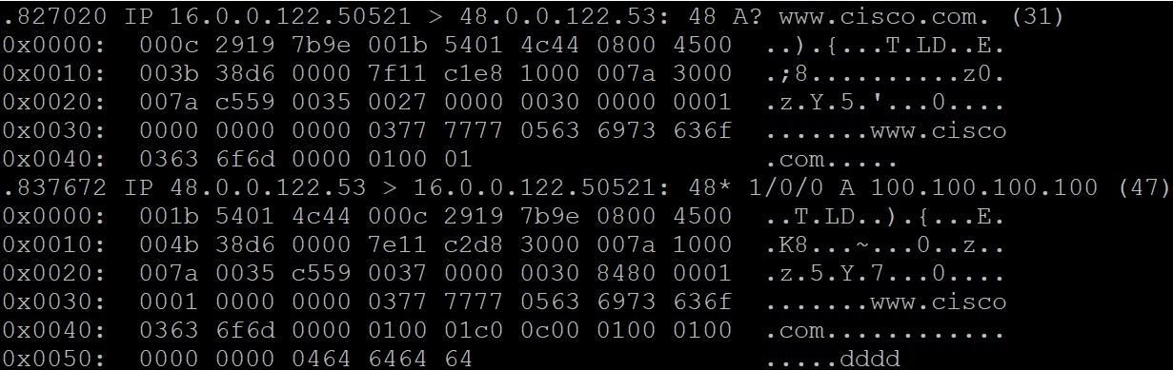
Using TRex
Tcpdump showing TRex DNS query (taken on another machine)

Slide 26
References
TRex
https://trex-tgn.cisco.com/trex/
Ubuntu 14.04 LTS
http://old-releases.ubuntu.com/releases/14.04.1/ubuntu-14.04-desktop-amd64.iso
TRex Manual
https://trex-tgn.cisco.com/trex/doc/trex_manual.html

