Slide 1
TRex Simulator
Information Security Inc.

Slide 2
Contents
About TRex Simulator
Testing Environment
Building TRex Simulator
Using TRex Simulator
References

Slide 3

About TRex Simulator
The TRex simulator is a linux application (no DPDK needed) that can run on any Linux (it can also run on TRex machine itself)
Can create output pcap file from input of traffic YAML

Slide 4
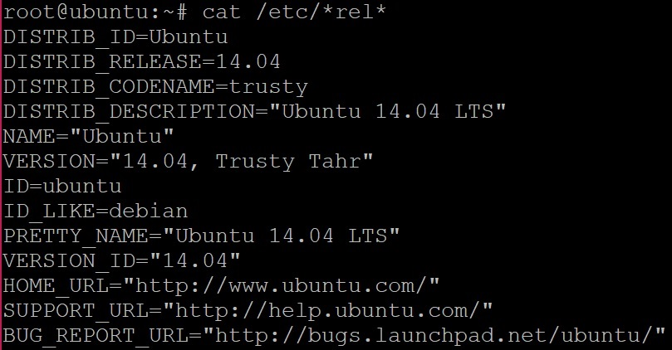
Testing Environment
Ubuntu 14.04 LTS

Slide 5
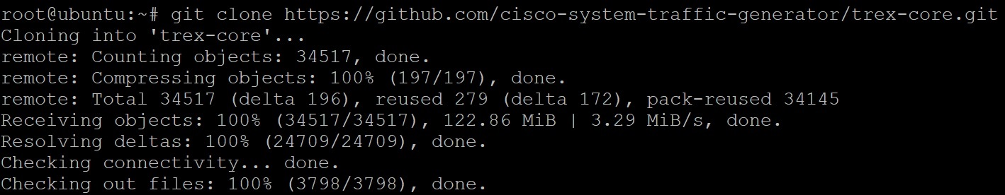
Building TRex Simulator
Cloning GitHub repository

Slide 6
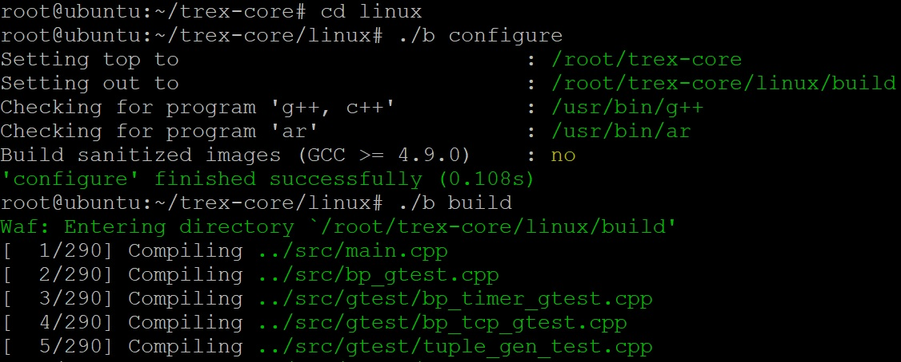
Building TRex Simulator
./b configure -> ./b build

Slide 7
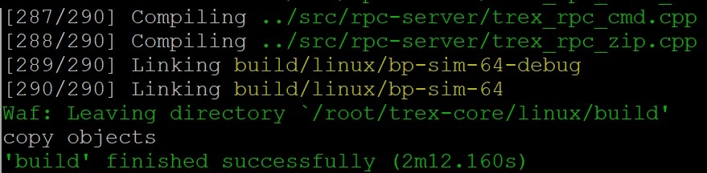
Building TRex Simulator
./b configure -> ./b build

Slide 8
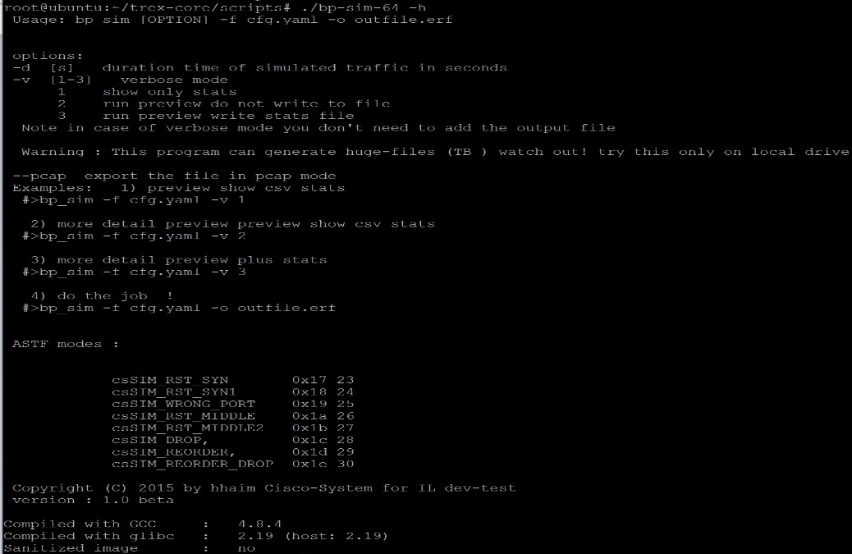
Using TRex Simulator
TRex Simulator help menu

Slide 9
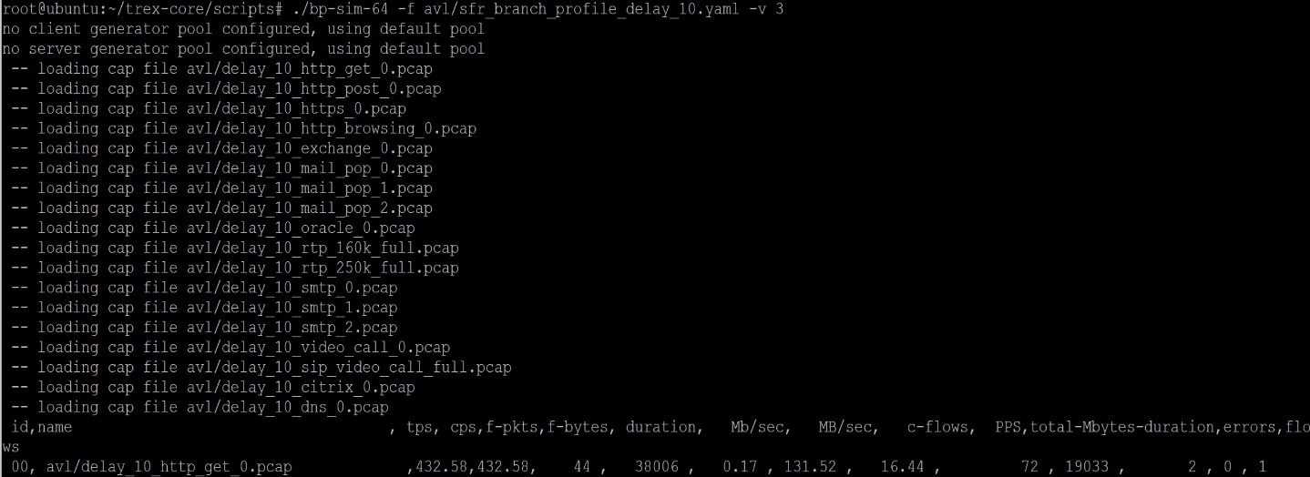
Using TRex Simulator
Preview plus stats

Slide 10
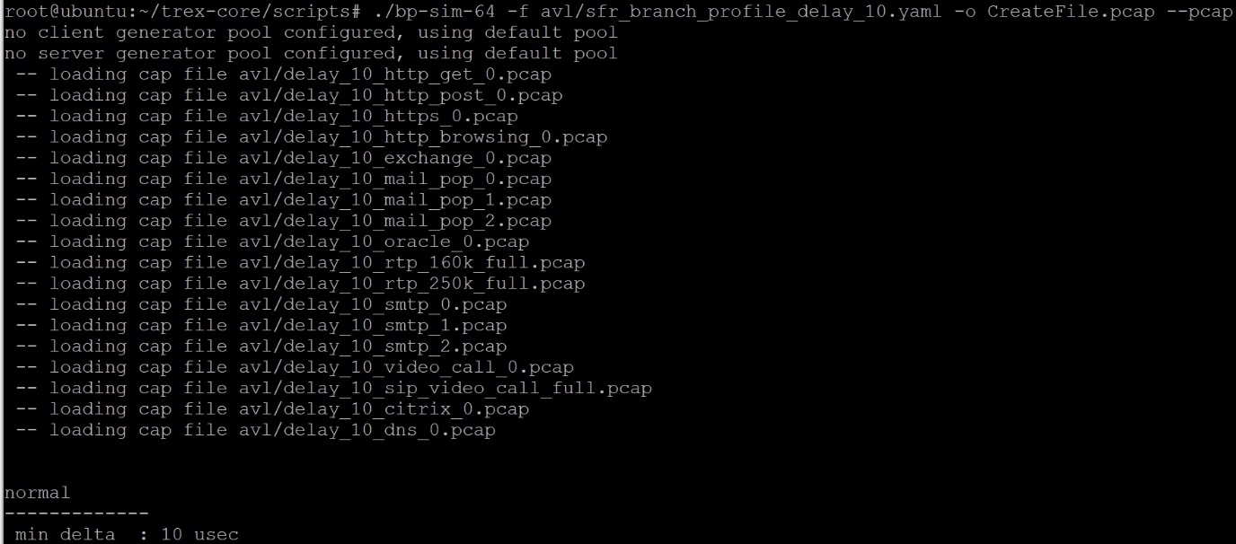
Using TRex Simulator
Create a pcap file

Slide 11
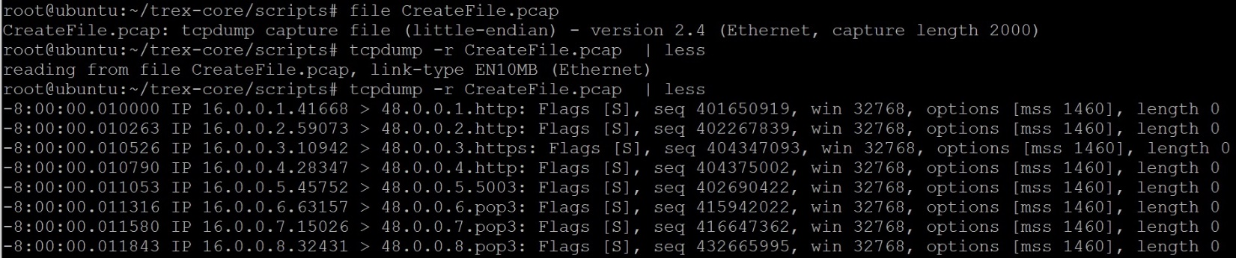
Using TRex Simulator
Verify the created pcap file

Slide 12
References
TRex Simulator
https://trex-tgn.cisco.com/trex/doc/trex_manual.html#_simulator
Ubuntu 14.04 LTS
http://old-releases.ubuntu.com/releases/14.04.1/ubuntu-14.04-desktop-amd64.iso
TRex Manual
https://trex-tgn.cisco.com/trex/doc/trex_manual.html

