Slide 1
TRex Stateless GUI
Information Security Inc.

Slide 2
Contents
About TRex Stateless GUI
Testing Environment
Building TRex Stateless GUI
Using TRex Stateless GUI
References

Slide 3

About TRex Stateless GUI
TRex Stateless GUI application provides a graphical user interface for Trex
TRex Stateless GUI application is a JavaFX based application

Slide 4
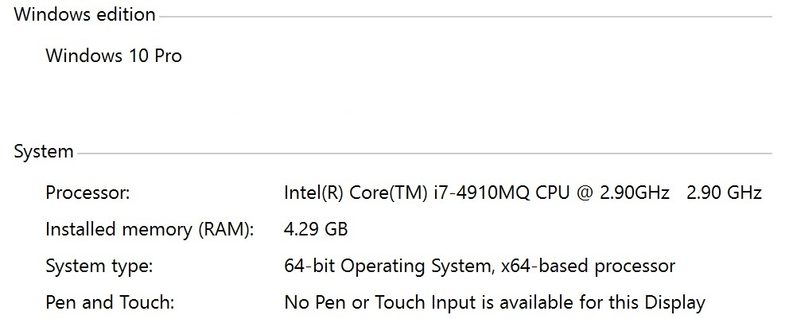
Testing Environment
Windows 10 Pro x64

Slide 5
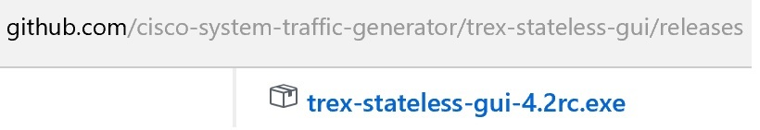
Installing TRex Stateless GUI
Downloading latest release

Slide 6
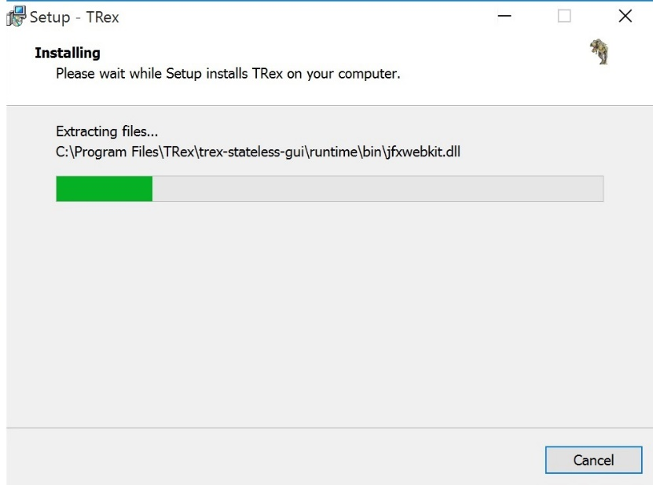
Installing TRex Stateless GUI
Installing latest release

Slide 7
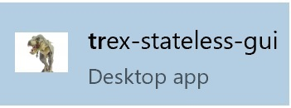
Using TRex Stateless GUI
Launching TRex stateless GUI

Slide 8
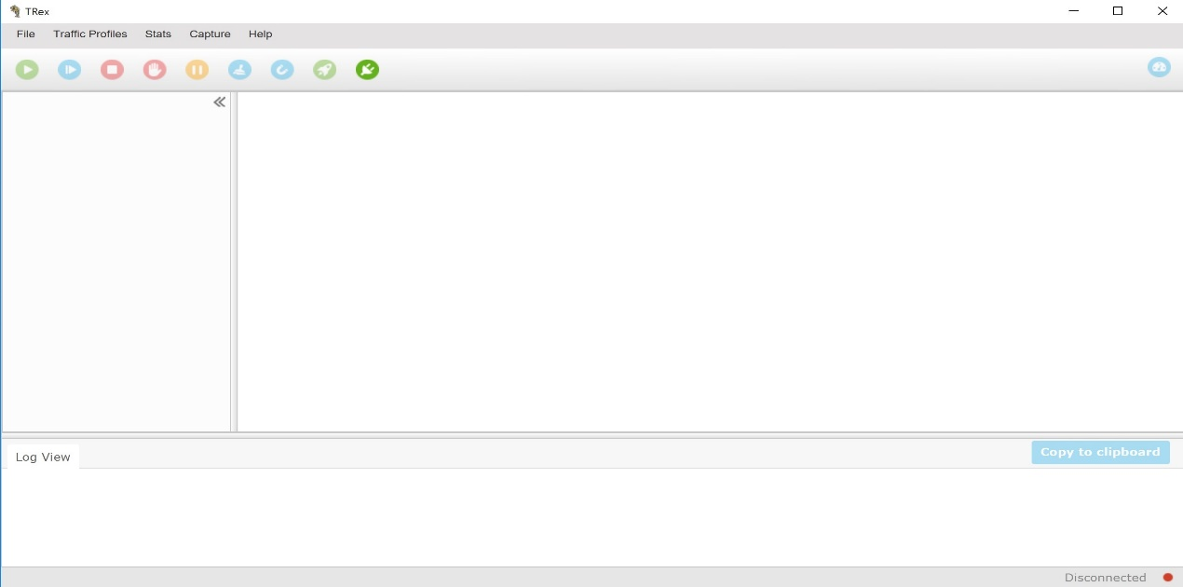
Using TRex Stateless GUI
Launching TRex stateless GUI

Slide 9
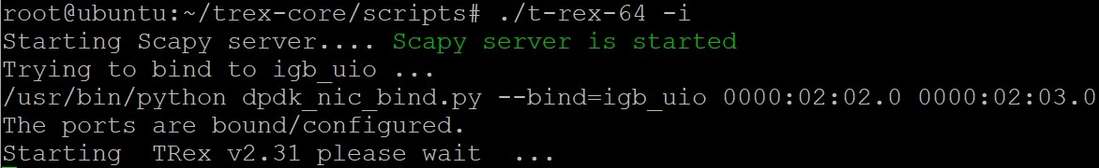
Using TRex Stateless GUI
Starting TRex server

Slide 10
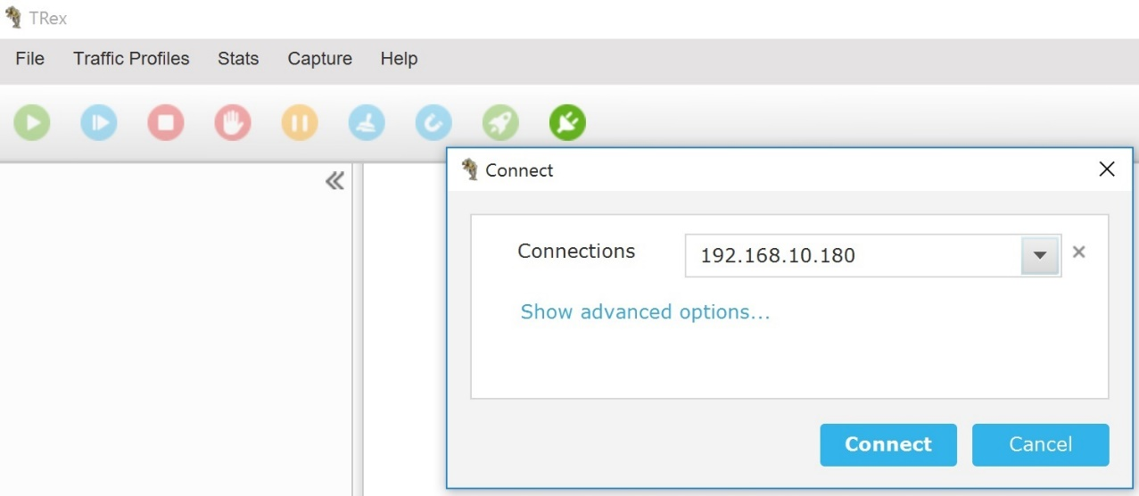
Using TRex Stateless GUI
Connecting to TRex server

Slide 11
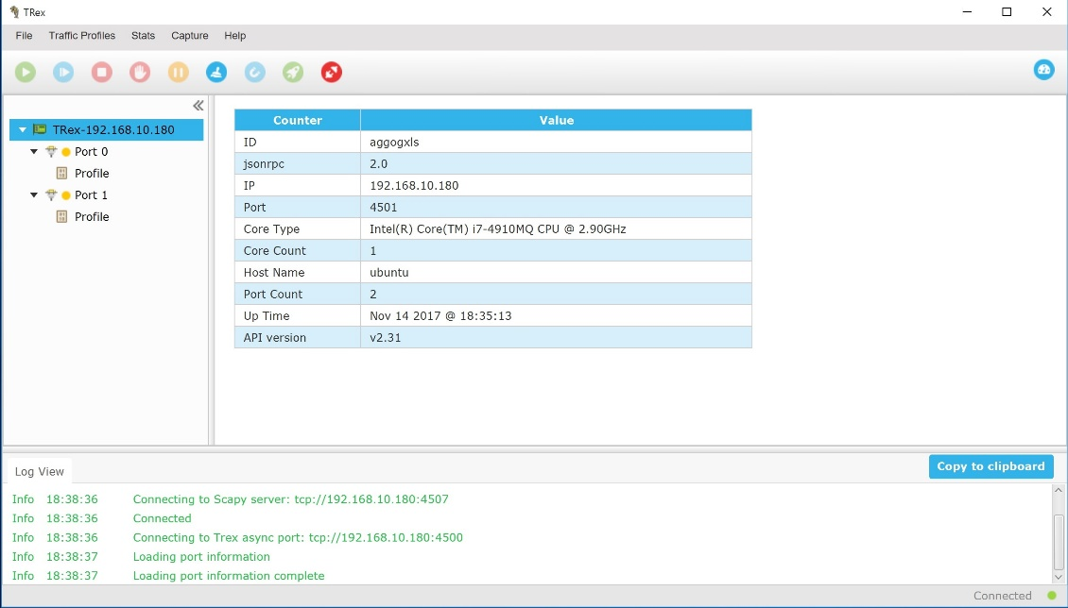
Using TRex Stateless GUI
Connecting to TRex server

Slide 12
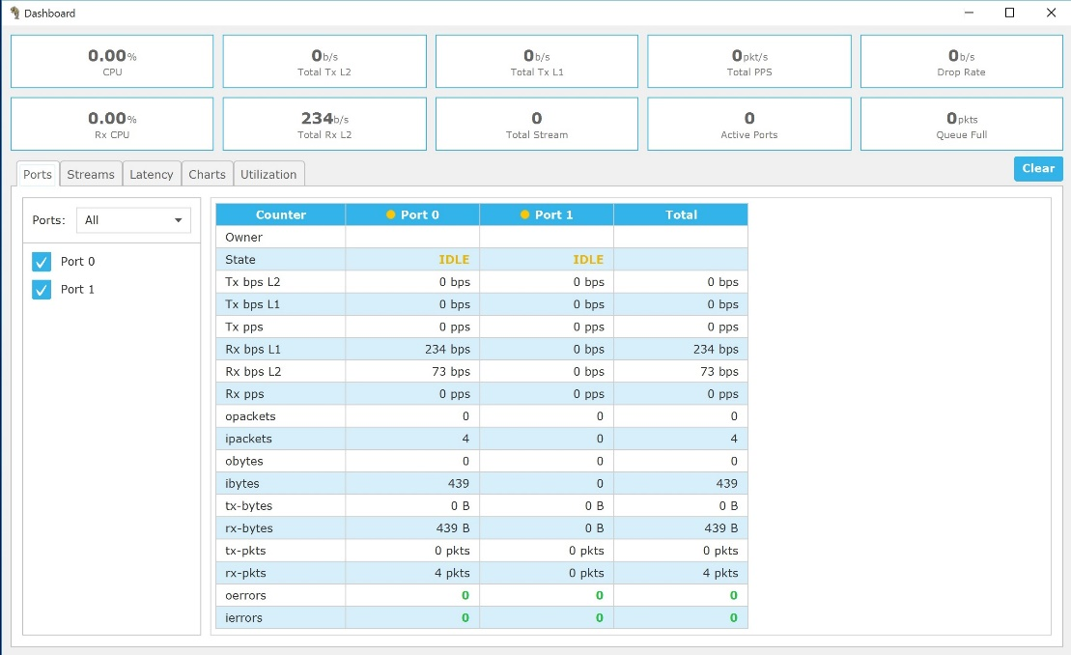
Using TRex Stateless GUI
Dashboard

Slide 13
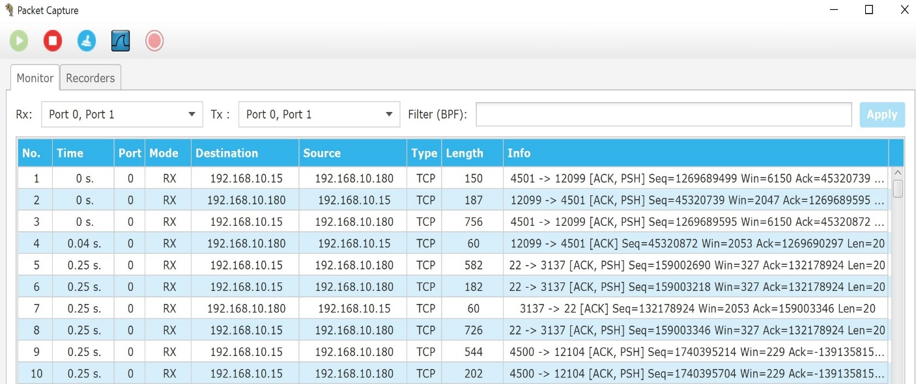
Using TRex Stateless GUI
Packet Capture using TRex GUI

Slide 14
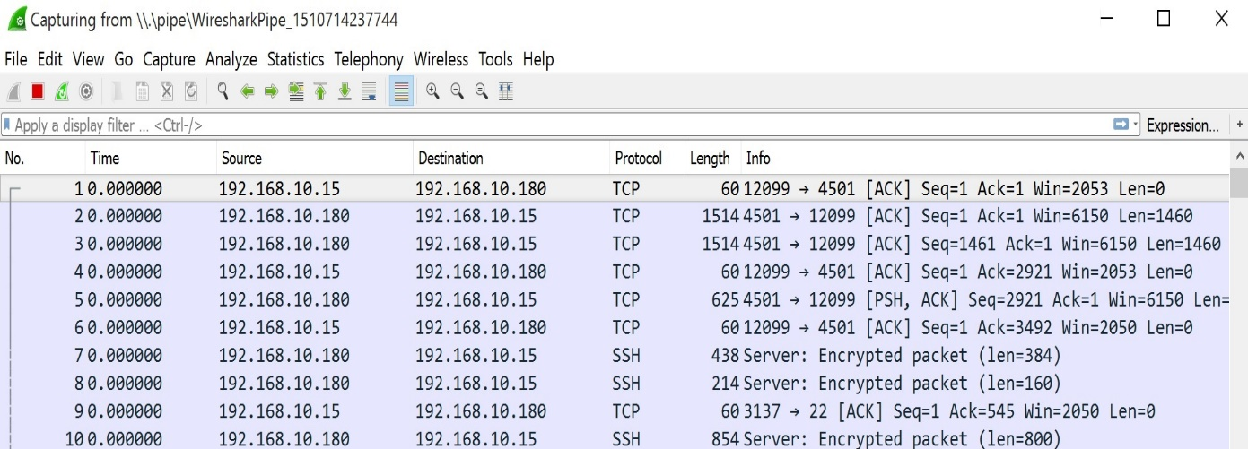
Using TRex Stateless GUI
Packet Capture using Wireshark

Slide 15
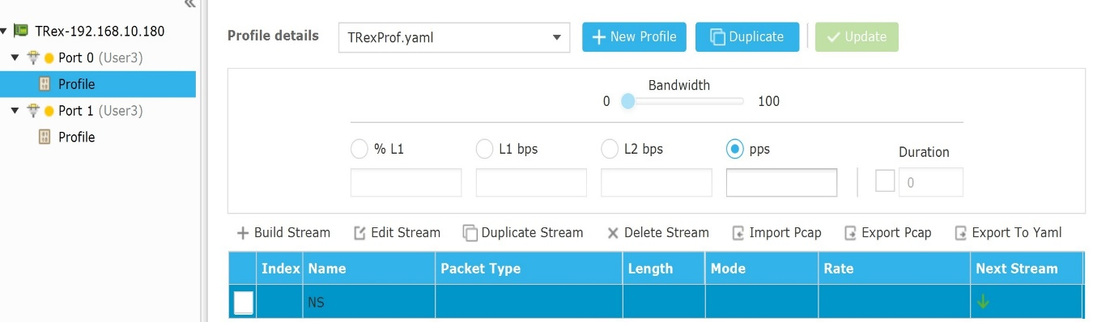
Using TRex Stateless GUI
Packet Editor -> New profile -> New Stream

Slide 16
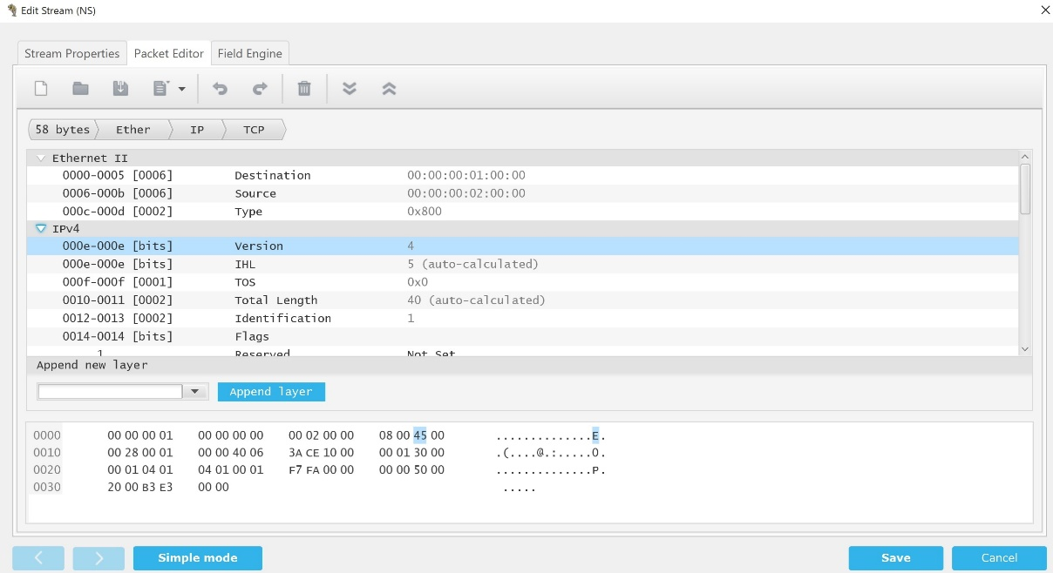
Using TRex Stateless GUI
Edit Stream -> Packet Editor (Advanced Mode is enabled)

Slide 17
References
TRex Stateless GUI
https://github.com/cisco-system-traffic-generator/trex-stateless-gui
Ubuntu 14.04 LTS
http://old-releases.ubuntu.com/releases/14.04.1/ubuntu-14.04-desktop-amd64.iso
TRex Manual
https://trex-tgn.cisco.com/trex/doc/trex_manual.html

